Slide 1
Google Play Store
Data Analysis
Insights & Dashboard using Excel, Power Query & Pivot Tables
Presented by: Suman Saha — Data Analyst

Slide 2
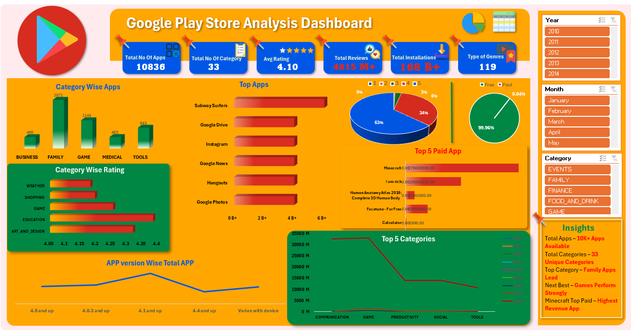















Pivot Table Analysis
Key Insights
Strategic Recommendations
Dashboard
Data Cleaning Process
Dataset Overview
Problem Statement
Top 5 Categories by Installs
Focus on Quality Categories
01
Overall Scale
Data Source: Kaggle — Google Play Store Dataset
10,000+ apps across 33 diverse categories
Prioritize development in high-rating categories like Education to
build premium apps that users value and rate highly
Data Quality
10,836
Category Leader
Removed null values in critical fields: Rating, Reviews, and Installs to ensure accuracy
Our Challenge
Key Questions
Family apps dominate the marketplace
Enhance Paid App Visibility
Total Apps
Implement targeted marketing campaigns and better promotional
strategies to increase discoverability of paid apps
Analyze Google Play Store data to unlock actionable insights that drive better app development and business decisions.
Average Rating
How are apps distributed across categories?
Google Play Store
Data Analysis
02
Year-wise App Distribution
Top Apps by Installs
4.1 stars across all apps
Comprehensive app ecosystem
Type Correction
What drives higher ratings and engagement?
Free Apps
Maintain Update Cadence
33
99.96% of total apps are free to download
Fixed data types across numbers, dates, and text fields
Encourage developers to release frequent updates, as this practice
strongly correlates with maintaining high user ratings
03
How do free and paid apps compare in performance?
Categories
Insights & Dashboard using Excel, Power Query & Pivot Tables
Best Rated
Feature Engineering
Education category achieves highest ratings
Diverse app segments
Presented by: Suman Saha — Data Analyst
Support New Developers
Which categories show the strongest user engagement?
Added Year, Month, and Revenue Estimate columns for deeper insights
Top Performer
Provide resources and visibility boosts for developers entering
underrepresented categories to foster ecosystem diversity
2012-16
Free vs Paid App Comparison
Subway Surfers leads in installs
Category-wise Average Rating
04
User Engagement
Data-Driven Optimization
Time Period
Standardization
4.8 billion+ total reviews recorded
Leverage these insights to guide marketing investments, app
improvement priorities, and strategic business decisions
Multi-year analysis
Unified category names and city labels for consistent
reporting
Top Paid App
Minecraft dominates paid app category

Slide 3
Pivot Table Analysis
Key Insights
Strategic Recommendations
Dashboard
Data Cleaning Process
Dataset Overview
Top 5 Categories by Installs
Problem Statement
Focus on Quality Categories
01
Overall Scale
Data Source: Kaggle — Google Play Store Dataset
10,000+ apps across 33 diverse categories
Prioritize development in high-rating categories like Education to
build premium apps that users value and rate highly
Google Play Store
Data Analysis
Data Quality
10,836
Category Leader
Removed null values in critical fields: Rating, Reviews, and Installs to ensure accuracy
Our Challenge
Key Questions
Family apps dominate the marketplace
Enhance Paid App Visibility
Total Apps
Implement targeted marketing campaigns and better promotional
strategies to increase discoverability of paid apps
Average Rating
Analyze Google Play Store data to unlock actionable insights that drive better app development and business decisions.
How are apps distributed across categories?
02
Year-wise App Distribution
Top Apps by Installs
4.1 stars across all apps
Comprehensive app ecosystem
Type Correction
What drives higher ratings and engagement?
Free Apps
Maintain Update Cadence
33
99.96% of total apps are free to download
Fixed data types across numbers, dates, and text fields
Encourage developers to release frequent updates, as this practice
strongly correlates with maintaining high user ratings
03
How do free and paid apps compare in performance?
Categories
Insights & Dashboard using Excel, Power Query & Pivot Tables
Best Rated
Feature Engineering
Education category achieves highest ratings
Diverse app segments
Which categories show the strongest user engagement?
Presented by: Suman Saha — Data Analyst
Support New Developers
Added Year, Month, and Revenue Estimate columns for deeper insights
Top Performer
Provide resources and visibility boosts for developers entering
underrepresented categories to foster ecosystem diversity
2012-16
Free vs Paid App Comparison
Subway Surfers leads in installs
Category-wise Average Rating
04
User Engagement
Data-Driven Optimization
Time Period
Standardization
4.8 billion+ total reviews recorded
Leverage these insights to guide marketing investments, app
improvement priorities, and strategic business decisions
Multi-year analysis
Unified category names and city labels for consistent
reporting
Top Paid App
Minecraft dominates paid app category

Slide 4

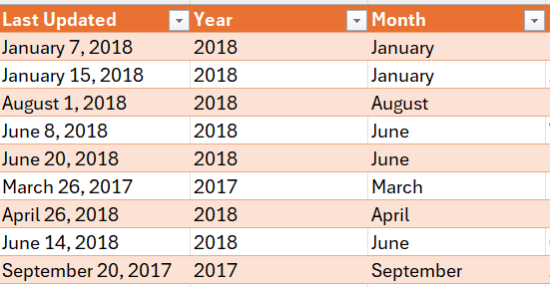
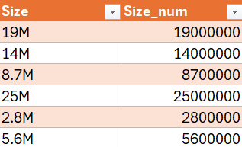
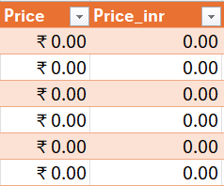
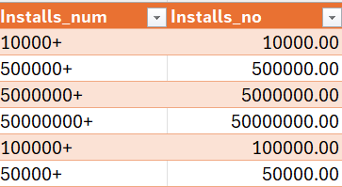
Pivot Table Analysis
Key Insights
Strategic Recommendations
Dashboard
Data Cleaning Process
Dataset Overview
Top 5 Categories by Installs
Problem Statement
Focus on Quality Categories
01
Overall Scale
Data Source: Kaggle — Google Play Store Dataset
10,000+ apps across 33 diverse categories
Prioritize development in high-rating categories like Education to
build premium apps that users value and rate highly
Google Play Store
Data Analysis
Data Quality
10,836
Category Leader
Removed null values in critical fields: Rating, Reviews, and Installs to ensure accuracy
Our Challenge
Key Questions
Family apps dominate the marketplace
Enhance Paid App Visibility
Total Apps
Implement targeted marketing campaigns and better promotional
strategies to increase discoverability of paid apps
Average Rating
Analyze Google Play Store data to unlock actionable insights that drive better app development and business decisions.
How are apps distributed across categories?
02
Year-wise App Distribution
Top Apps by Installs
4.1 stars across all apps
Comprehensive app ecosystem
Type Correction
What drives higher ratings and engagement?
Maintain Update Cadence
Free Apps
33
99.96% of total apps are free to download
Fixed data types across numbers, dates, and text fields
Encourage developers to release frequent updates, as this practice
strongly correlates with maintaining high user ratings
03
How do free and paid apps compare in performance?
Best Rated
Categories
Feature Engineering
Education category achieves highest ratings
Diverse app segments
Support New Developers
Which categories show the strongest user engagement?
Added Year, Month, and Revenue Estimate columns for deeper insights
Top Performer
Provide resources and visibility boosts for developers entering
underrepresented categories to foster ecosystem diversity
2012-16
Free vs Paid App Comparison
Subway Surfers leads in installs
Category-wise Average Rating
04
User Engagement
Time Period
Data-Driven Optimization
4.8 billion+ total reviews recorded
Standardization
Leverage these insights to guide marketing investments, app
improvement priorities, and strategic business decisions
Multi-year analysis
Unified category names and city labels for consistent
reporting
Top Paid App
Minecraft dominates paid app category

Slide 5






Pivot Table Analysis
Key Insights
Strategic Recommendations
Dashboard
Data Cleaning Process
KPI Cards
Dataset Overview
Total Apps, Total Category, Average Rating,
Total Reviews and Total Installs
Top 5 Categories by Installs
Problem Statement
Focus on Quality Categories
Overall Scale
01
Data Source: Kaggle — Google Play Store Dataset
10,000+ apps across 33 diverse categories
Prioritize development in high-rating categories like Education to
build premium apps that users value and rate highly
Data Quality
10,836
Category Leader
Total No Of Apps
Total No Of Category
Removed null values in critical fields: Rating, Reviews, and Installs to ensure accuracy
Our Challenge
Key Questions
Family apps dominate the marketplace
10836
33
Enhance Paid App Visibility
Total Apps
Implement targeted marketing campaigns and better promotional
strategies to increase discoverability of paid apps
Average Rating
Analyze Google Play Store data to unlock actionable insights that drive better app development and business decisions.
How are apps distributed across categories?
Year-wise App Distribution
02
Top Apps by Installs
4.1 stars across all apps
Comprehensive app ecosystem
Avg Rating
Total Reviews
4.10
4815 M+
Type Correction
What drives higher ratings and engagement?
Maintain Update Cadence
Free Apps
33
99.96% of total apps are free to download
Encourage developers to release frequent updates, as this practice
strongly correlates with maintaining high user ratings
Fixed data types across numbers, dates, and text fields
03
How do free and paid apps compare in performance?
Total Installations
Categories
168 B+
Best Rated
Education category achieves highest ratings
Feature Engineering
Diverse app segments
Support New Developers
Which categories show the strongest user engagement?
Top Performer
Added Year, Month, and Revenue Estimate columns for deeper insights
Provide resources and visibility boosts for developers entering
underrepresented categories to foster ecosystem diversity
2012-16
Free vs Paid App Comparison
Subway Surfers leads in installs
Category-wise Average Rating
04
User Engagement
Time Period
Data-Driven Optimization
4.8 billion+ total reviews recorded
Standardization
Leverage these insights to guide marketing investments, app
improvement priorities, and strategic business decisions
Multi-year analysis
Top Paid App
Unified category names and city labels for consistent
reporting
Minecraft dominates paid app category

Slide 6


Key Insights
Pivot Table Analysis
Strategic Recommendations
Dashboard
Data Cleaning Process
KPI Cards
Dataset Overview
Total Apps, Total Category, Average Rating,
Total Reviews and Total Installs
Problem Statement
Free App Economy
Focus on Quality Categories
Top 5 Categories by Installs
Overall Scale
01
Free apps dominate the marketplace,
expanding reach and monetizing
via ads and in‑app purchases.
Data Source: Kaggle — Google Play Store Dataset
10,000+ apps across 33 diverse categories
Prioritize development in high-rating categories like Education to
build premium apps that users value and rate highly
Data Quality
10,836
Category Leader
Total No Of Apps
Total No Of Category
Removed null values in critical fields: Rating, Reviews, and Installs to ensure accuracy
Our Challenge
Key Questions
Family apps dominate the marketplace
10836
33
Enhance Paid App Visibility
Total Apps
Implement targeted marketing campaigns and better promotional
strategies to increase discoverability of paid apps
Average Rating
Analyze Google Play Store data to unlock actionable insights that drive better app development and business decisions.
How are apps distributed across categories?
02
Year-wise App Distribution
Paid Apps
Top Apps by Installs
4.1 stars across all apps
Comprehensive app ecosystem
Avg Rating
Total Reviews
4.10
4815 M+
Limited installs but higher
revenue per user
Type Correction
What drives higher ratings and engagement?
Maintain Update Cadence
Free Apps
33
99.96% of total apps are free to download
Encourage developers to release frequent updates, as this practice
strongly correlates with maintaining high user ratings
Fixed data types across numbers, dates, and text fields
03
How do free and paid apps compare in performance?
Total Installations
Categories
168 B+
Best Rated
Update Impact
Education category achieves highest ratings
Feature Engineering
Diverse app segments
Support New Developers
Which categories show the strongest user engagement?
Frequent updates correlate with
sustained high ratings
Top Performer
Added Year, Month, and Revenue Estimate columns for deeper insights
Provide resources and visibility boosts for developers entering
underrepresented categories to foster ecosystem diversity
2012-16
Subway Surfers leads in installs
Free vs Paid App Comparison
Category-wise Average Rating
04
User Engagement
Time Period
Data-Driven Optimization
4.8 billion+ total reviews recorded
Standardization
Leverage these insights to guide marketing investments, app
improvement priorities, and strategic business decisions
Multi-year analysis
Top Paid App
Unified category names and city labels for consistent
reporting
Minecraft dominates paid app category

Slide 7
Pivot Table Analysis
Dashboard
Key Insights
Strategic Recommendations
Data Cleaning Process
Data Interpretation
Dataset Overview
KPI Cards
Free App Economy
Total Apps, Total Category, Average Rating,
Total Reviews and Total Installs
Problem Statement
Focus on Quality Categories
Top 5 Categories by Installs
Overall Scale
Category Dominance
01
Data Source: Kaggle — Google Play Store Dataset
Free apps dominate the marketplace,
expanding reach and monetizing
via ads and in‑app purchases.
Prioritize development in high-rating categories like Education to
build premium apps that users value and rate highly
10,000+ apps across 33 diverse categories
Data Quality
Family and Game categories lead in both app count and total installs, representing the largest market opportunities
10,836
Category Leader
Total No Of Apps
Total No Of Category
Removed null values in critical fields: Rating, Reviews, and Installs to ensure accuracy
Our Challenge
Key Questions
Family apps dominate the marketplace
10836
33
Enhance Paid App Visibility
Total Apps
Implement targeted marketing campaigns and better promotional
strategies to increase discoverability of paid apps
Analyze Google Play Store data to unlock actionable insights that drive better app development and business decisions.
Average Rating
How are apps distributed across categories?
Paid Apps
02
Year-wise App Distribution
Top Apps by Installs
4.1 stars across all apps
Comprehensive app ecosystem
Quality Leaders
Avg Rating
Total Reviews
Limited installs but higher
revenue per user
4.10
4815 M+
Type Correction
What drives higher ratings and engagement?
Education and Art & Design categories consistently receive the highest user ratings, indicating strong user satisfaction
Free Apps
Maintain Update Cadence
33
99.96% of total apps are free to download
Encourage developers to release frequent updates, as this practice
strongly correlates with maintaining high user ratings
Fixed data types across numbers, dates, and text fields
03
How do free and paid apps compare in performance?
Total Installations
Categories
168 B+
Best Rated
Update Impact
Feature Engineering
Education category achieves highest ratings
Diverse app segments
Frequent updates correlate with
sustained high ratings
Support New Developers
Which categories show the strongest user engagement?
Added Year, Month, and Revenue Estimate columns for deeper insights
Provide resources and visibility boosts for developers entering
underrepresented categories to foster ecosystem diversity
Top Performer
Free App Economy
2012-16
Free vs Paid App Comparison
Subway Surfers leads in installs
Category-wise Average Rating
Free apps comprise nearly the entire
marketplace, maximizing user reach
and creating monetization through ads
and in-app purchases
04
User Engagement
Data-Driven Optimization
Time Period
Standardization
4.8 billion+ total reviews recorded
Leverage these insights to guide marketing investments, app
improvement priorities, and strategic business decisions
Multi-year analysis
Unified category names and city labels for consistent
reporting
Top Paid App
Minecraft dominates paid app category

Slide 8






Pivot Table Analysis
Key Insights
Strategic Recommendations
Dashboard
Data Interpretation
Data Cleaning Process
KPI Cards
Dataset Overview
Total Apps, Total Category, Average Rating,
Total Reviews and Total Installs
Problem Statement
Free App Economy
Focus on Quality Categories
Top 5 Categories by Installs
01
Overall Scale
Category Dominance
Free apps dominate the marketplace,
expanding reach and monetizing
via ads and in‑app purchases.
Data Source: Kaggle — Google Play Store Dataset
Prioritize development in high-rating categories like Education to
build premium apps that users value and rate highly
10,000+ apps across 33 diverse categories
Data Quality
Family and Game categories lead in both app count and total installs, representing the largest market opportunities
10,836
Category Leader
Total No Of Apps
Total No Of Category
Removed null values in critical fields: Rating, Reviews, and Installs to ensure accuracy
Our Challenge
Key Questions
Family apps dominate the marketplace
Enhance Paid App Visibility
10836
33
Total Apps
Implement targeted marketing campaigns and better promotional
strategies to increase discoverability of paid apps
Analyze Google Play Store data to unlock actionable insights that drive better app development and business decisions.
Average Rating
How are apps distributed across categories?
Paid Apps
02
Year-wise App Distribution
Top Apps by Installs
4.1 stars across all apps
Comprehensive app ecosystem
Quality Leaders
Avg Rating
Total Reviews
Limited installs but higher
revenue per user
4.10
4815 M+
Type Correction
What drives higher ratings and engagement?
Education and Art & Design categories consistently receive the highest user ratings, indicating strong user satisfaction
Free Apps
Maintain Update Cadence
33
99.96% of total apps are free to download
Encourage developers to release frequent updates, as this practice
strongly correlates with maintaining high user ratings
Fixed data types across numbers, dates, and text fields
03
How do free and paid apps compare in performance?
Total Installations
Categories
168 B+
Best Rated
Update Impact
Feature Engineering
Education category achieves highest ratings
Diverse app segments
Frequent updates correlate with
sustained high ratings
Support New Developers
Which categories show the strongest user engagement?
Added Year, Month, and Revenue Estimate columns for deeper insights
Provide resources and visibility boosts for developers entering
underrepresented categories to foster ecosystem diversity
Top Performer
Free App Economy
2012-16
Free vs Paid App Comparison
Subway Surfers leads in installs
Category-wise Average Rating
Free apps comprise nearly the entire
marketplace, maximizing user reach
and creating monetization through ads
and in-app purchases
04
User Engagement
Data-Driven Optimization
Time Period
Standardization
4.8 billion+ total reviews recorded
Leverage these insights to guide marketing investments, app
improvement priorities, and strategic business decisions
Multi-year analysis
Unified category names and city labels for consistent
reporting
Top Paid App
Minecraft dominates paid app category

Slide 9
Pivot Table Analysis
Key Insights
Strategic Recommendations
Thank You
Dashboard
Data Interpretation
Data Cleaning Process
KPI Cards
Dataset Overview
Total Apps, Total Category, Average Rating,
Total Reviews and Total Installs
Problem Statement
Free App Economy
Focus on Quality Categories
Top 5 Categories by Installs
Overall Scale
Category Dominance
01
Data Source: Kaggle — Google Play Store Dataset
Free apps dominate the marketplace,
expanding reach and monetizing
via ads and in‑app purchases.
10,000+ apps across 33 diverse categories
Prioritize development in high-rating categories like Education to
build premium apps that users value and rate highly
Data Quality
Family and Game categories lead in both app count and total installs, representing the largest market opportunities
10,836
Category Leader
Total No Of Apps
Total No Of Category
Removed null values in critical fields: Rating, Reviews, and Installs to ensure accuracy
Our Challenge
Key Questions
Family apps dominate the marketplace
Enhance Paid App Visibility
10836
33
Total Apps
Implement targeted marketing campaigns and better promotional
strategies to increase discoverability of paid apps
Analyze Google Play Store data to unlock actionable insights that drive better app development and business decisions.
Average Rating
How are apps distributed across categories?
Paid Apps
02
Year-wise App Distribution
Top Apps by Installs
4.1 stars across all apps
Comprehensive app ecosystem
Quality Leaders
Total Reviews
Avg Rating
Limited installs but higher
revenue per user
4.10
4815 M+
Type Correction
What drives higher ratings and engagement?
Education and Art & Design categories consistently receive the highest user ratings, indicating strong user satisfaction
Free Apps
Maintain Update Cadence
33
99.96% of total apps are free to download
Fixed data types across numbers, dates, and text fields
Encourage developers to release frequent updates, as this practice
strongly correlates with maintaining high user ratings
Total Installations
03
How do free and paid apps compare in performance?
168 B+
Categories
Best Rated
Update Impact
Feature Engineering
Education category achieves highest ratings
Diverse app segments
Frequent updates correlate with
sustained high ratings
Support New Developers
Which categories show the strongest user engagement?
Added Year, Month, and Revenue Estimate columns for deeper insights
Top Performer
Free App Economy
Provide resources and visibility boosts for developers entering
underrepresented categories to foster ecosystem diversity
2012-16
Free vs Paid App Comparison
Subway Surfers leads in installs
Contact
Category-wise Average Rating
Free apps comprise nearly the entire
marketplace, maximizing user reach
and creating monetization through ads
and in-app purchases
04
Suman Saha - Data Analyst
User Engagement
Data-Driven Optimization
Time Period
Standardization
4.8 billion+ total reviews recorded
Leverage these insights to guide marketing investments, app
improvement priorities, and strategic business decisions
Multi-year analysis
Unified category names and city labels for consistent
reporting
Top Paid App
Minecraft dominates paid app category

Slide 10
Pivot Table Analysis
Key Insights
Strategic Recommendations
Dashboard
Thank You
Data Cleaning Process
Data Interpretation
Dataset Overview
KPI Cards
Total Apps, Total Category, Average Rating,
Total Reviews and Total Installs
Problem Statement
Free App Economy
Focus on Quality Categories
Top 5 Categories by Installs
Overall Scale
Category Dominance
01
Data Source: Kaggle — Google Play Store Dataset
Free apps dominate the marketplace,
expanding reach and monetizing
via ads and in‑app purchases.
10,000+ apps across 33 diverse categories
Prioritize development in high-rating categories like Education to
build premium apps that users value and rate highly
Data Quality
Family and Game categories lead in both app count and total installs, representing the largest market opportunities
10,836
Category Leader
Total No Of Apps
Total No Of Category
Removed null values in critical fields: Rating, Reviews, and Installs to ensure accuracy
Our Challenge
Key Questions
Family apps dominate the marketplace
Enhance Paid App Visibility
10836
33
Total Apps
Implement targeted marketing campaigns and better promotional
strategies to increase discoverability of paid apps
Analyze Google Play Store data to unlock actionable insights that drive better app development and business decisions.
Average Rating
How are apps distributed across categories?
Paid Apps
02
Year-wise App Distribution
Top Apps by Installs
4.1 stars across all apps
Comprehensive app ecosystem
Quality Leaders
Total Reviews
Avg Rating
Limited installs but higher
revenue per user
4.10
4815 M+
Type Correction
What drives higher ratings and engagement?
Education and Art & Design categories consistently receive the highest user ratings, indicating strong user satisfaction
Free Apps
Maintain Update Cadence
33
99.96% of total apps are free to download
Fixed data types across numbers, dates, and text fields
Encourage developers to release frequent updates, as this practice
strongly correlates with maintaining high user ratings
03
How do free and paid apps compare in performance?
Total Installations
Categories
168 B+
Best Rated
Update Impact
Feature Engineering
Education category achieves highest ratings
Diverse app segments
Frequent updates correlate with
sustained high ratings
Support New Developers
Which categories show the strongest user engagement?
Added Year, Month, and Revenue Estimate columns for deeper insights
Top Performer
Free App Economy
Provide resources and visibility boosts for developers entering
underrepresented categories to foster ecosystem diversity
2012-16
Free vs Paid App Comparison
Subway Surfers leads in installs
Contact
Category-wise Average Rating
Free apps comprise nearly the entire
marketplace, maximizing user reach
and creating monetization through ads
and in-app purchases
04
Suman Saha - Data Analyst
User Engagement
Data-Driven Optimization
Time Period
Standardization
4.8 billion+ total reviews recorded
Leverage these insights to guide marketing investments, app
improvement priorities, and strategic business decisions
Multi-year analysis
Unified category names and city labels for consistent
reporting
Top Paid App
Minecraft dominates paid app category

Slide 11
Pivot Table Analysis
Key Insights
Strategic Recommendations
Thank You
Dashboard
Data Cleaning Process
Dataset Overview
Problem Statement
Top 5 Categories by Installs
Focus on Quality Categories
01
Overall Scale
Data Source: Kaggle — Google Play Store Dataset
10,000+ apps across 33 diverse categories
Prioritize development in high-rating categories like Education to
build premium apps that users value and rate highly
Data Quality
10,836
Category Leader
Removed null values in critical fields: Rating, Reviews, and Installs to ensure accuracy
Our Challenge
Key Questions
Family apps dominate the marketplace
Enhance Paid App Visibility
Total Apps
Implement targeted marketing campaigns and better promotional
strategies to increase discoverability of paid apps
Analyze Google Play Store data to unlock actionable insights that drive better app development and business decisions.
Average Rating
How are apps distributed across categories?
02
Year-wise App Distribution
Top Apps by Installs
4.1 stars across all apps
Comprehensive app ecosystem
Type Correction
What drives higher ratings and engagement?
Free Apps
Maintain Update Cadence
33
99.96% of total apps are free to download
Fixed data types across numbers, dates, and text fields
Encourage developers to release frequent updates, as this practice
strongly correlates with maintaining high user ratings
03
How do free and paid apps compare in performance?
Categories
Best Rated
Data Interpretation
Education category achieves highest ratings
Feature Engineering
Diverse app segments
Support New Developers
Which categories show the strongest user engagement?
Added Year, Month, and Revenue Estimate columns for deeper insights
Category Dominance
Quality Leaders
Top Performer
Provide resources and visibility boosts for developers entering
underrepresented categories to foster ecosystem diversity
2012-16
Free vs Paid App Comparison
Subway Surfers leads in installs
Family and Game categories lead in both app count and total installs, representing the largest market opportunities
Education and Art & Design categories consistently receive the highest user ratings, indicating strong user satisfaction
Contact
Category-wise Average Rating
04
Suman Saha - Data Analyst
User Engagement
Data-Driven Optimization
Time Period
Standardization
4.8 billion+ total reviews recorded
Free App Economy
Leverage these insights to guide marketing investments, app
improvement priorities, and strategic business decisions
Multi-year analysis
Unified category names and city labels for consistent
reporting
Top Paid App
Free apps comprise nearly the entire marketplace, maximizing user reach and creating monetization through ads and in-app purchases
Minecraft dominates paid app category

