Slide 1


Deep Learning-based Yoga Posture Correction with
Dynamically Varying Poses
By
Sumurth Dixit
Vikash Kumar Patel
Bharat Kumar Sharma
Under the supervision of
Dr. Sushil Kumar

Slide 2
Abstract
COVID-19 has had such an enormous influence on everyone's lives, Yoga has grown more and more popular every day.
This can be explained by Yoga's potentially wide range of physical, mental, and spiritual advantages.
Without a teacher's guidance, many people have taken up this trend and practiced Yoga.
Practicing Yoga improperly or without the correct direction can harm one's health.
There is currently only a handful of pieces of research on this complex topic.

Slide 3
Abstract
Yoga positions in the existing datasets, and their demand that the user is under the camera's range of view are the problems.
We suggest in this study a deep learning model-based posture correction for Yoga that will provide users and clients with the right instruction.
Earlier models only had a small number of positions and had poor accuracy for comparable postures.
The main goal of the proposed work is to include additional positions and strive to provide higher accuracy for similar stances.

Slide 4
Introduction
Improper posture execution might result in harm or diminished benefits.
It's crucial to make sure people are doing Yoga poses correctly. Yoga teachers typically use both verbal instructions and physical corrections to improve posture.
Using these techniques, especially in group situations, can be difficult.
They could also be ineffective in correcting positions that alter dynamically while the instructor is changing the pose.
In order to successfully correct Yoga postures and manage dynamically changing positions, an automated system is required.

Slide 5
Introduction
Convolutional neural networks (CNNs) have made tremendous strides in the field of image recognition.
These methods have been used for a variety of purposes, including correcting posture.
In this article, we provide a deep learning-based method for correcting Yoga posture using dynamically changing postures.
The suggested method analyzes photographs of a person executing Yoga poses using a CNN and then offers suggestions to rectify the stance.
The widely recognized convolutional pose machine (CPM) adopted a method that advanced joint recognition over a sequence of network stages.

Slide 6
Related Work
Earlier, computer vision, the concept of describing articulated objects in a general and human pose in particular as a graph of components has been promoted.
The Pictorial Structures (PSs), first developed by Fishler Elschlager were streamlined and made usable by employing the distance transformation approach of Felzenszwalb and Huttenlocher.
There are therefore many different PS-based models with the immediate application that were afterward created.
Pooling and local reaction normalization layers are introduced after an array of convolutional layers, and layers for dropout are used to regularize the layers that are completely interconnected.
Pictorial structural models have been a common component of traditional pose estimation techniques that maximize a partial configuration based on local image evidence for a component and a priority for the relevant components.
Poselets are used in an alternative strategy. There have been early examples of posture comparisons utilizing ConvNets for pose estimation.

Slide 7
Proposed Methodology
The deep learning papers uses the following methodologies.
Data Collection: Assembling video evidence of individuals engaging in numerous acts. A uniform method should be used to identify each video with the appropriate stance.
Model Selection: Pick the most relevant deep learning models, and afterward evaluate the output produced by each model to the output produced by our suggested model. In order to process the data, all the models employ CNN.
Feature Extraction: The model receives input in the form of movies, from which frames are taken at certain intervals and supplied to the technique to create joint vectors. The axis and joints' angles are calculated.
Feedback Generation: The discrepancies are computed on a regular basis in real-time for each angle, along with figures for the angle and marks indicating that the joint is also being performed appropriately and which practice is being performed incorrectly for each specific exercise.
The major elements of the suggested Yoga posture Correction System are:
Key points detection using OpenCV
Higher probability prediction and comparison.

Slide 8
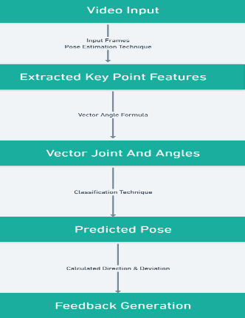
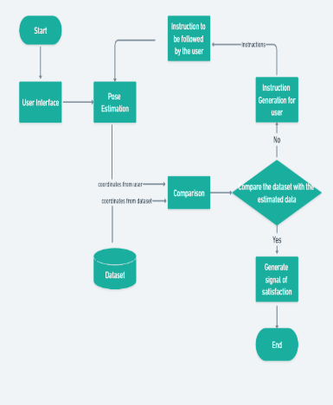
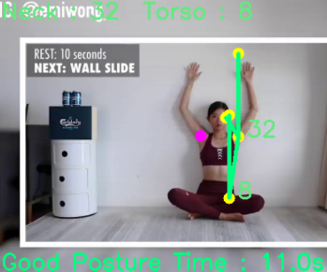
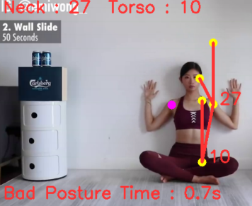
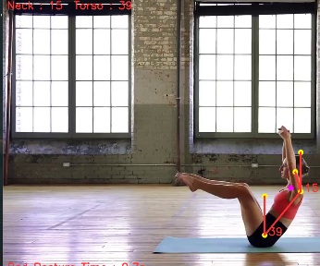
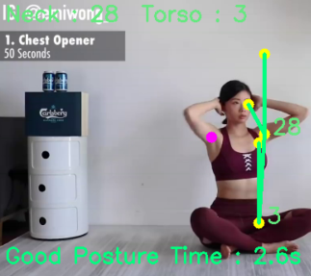
Overview of proposed model(left), Output pictures of the model(centre), Working steps of model(right).

Slide 9

Result Analysis
Model Accuracy and Model Loss: The model's accuracy on the training dataset was 98.5782% after 60 iterations
It’s accuracy on the validation dataset was 94.2101%. The model's accuracy was predicted using the formula given in Eq. (1).
$Model Accuracy= \frac{Total Number of green lines}{Total number of green plus red lines}$ (1)
Precision: It is employed to assess the model's effectiveness. Given that all the samples were accurately identified as positive, it is calculated as the ratio of those samples.
Our model's accuracy is 0.92813. It is given by Eq. (2).
$Model Precision= \frac{TP}{TP+FP }$ (2)
Recall: It is used to assess the model's effectiveness. Given that all samples are expected to be positive, it is calculated as the proportion of samples that were correctly identified as positive.
Our model has a 0.90926 recall rate. In mathematics, it is represented by Eq. (3).
$Model Recall= \frac{TP}{TP+FN }$ (3)
TP = True Positive, FP = False Positive, FN = False Negative

Slide 10
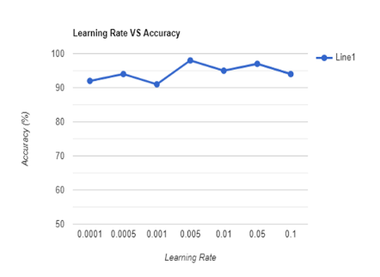
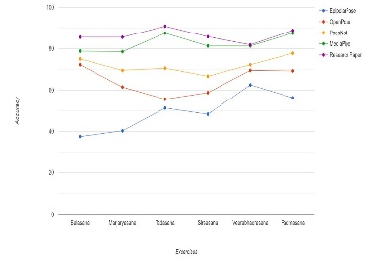
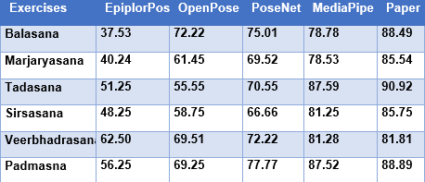
Result Analysis
Impact of Learning Rate on Model Performance: It is defined as the magnitude of the model's correction in response to the mistake shown each time the model's weights are adjusted.
Although a very fast learning rate can considerably shorten the learning period, accuracy suffers.
(Top Left) The learning rate vs. accuracy of our model which signifies that stable and quick learning happens at 97% accuracy between 0.001 and 0.005 learning rate
(Table) The accuracy of the mentioned 6 Yoga when run on different algorithms and compared to our algorithm
(Top Right) The comparison of the accuracy of the models in estimating 6 Yoga poses based on table.

Slide 11
Conclusion
Using a typical RGB camera, we propose a Yoga tracking system in this paper.
In order to accurately represent Yoga practitioners, human pose estimate is necessary (HPE).
In a standard RGB image, HPE proposes to replicate all skeletal connected components of a given individual. It has significant applications in motion graphics, software system, and human detection and recognition.
For HPE to achieve high accuracy, representations must be both locally geometrically accurate and globally semantically distinguishing.
The estimation of the correctness of the multiple Yoga exercises carried out by people varies depending on wide ranging multi-scale information.
Unobstructed pose is employed to observe the individual's attention to recognize the essential characteristics.
Videos that have been previously recorded are an opportunity for people to access the model. In order for the model to achieve the intended outcome, the research has taken the monitoring angles from the users' exercises and utilized them as a feature.
Angles between the joints and the ground are taken into account. Any changes to the joint angles have an impact on the result.
The end-to-end deep learning-based system does away with the requirement for manually creating the features, making it possible to add new asanas by just keeping the model.

Slide 12
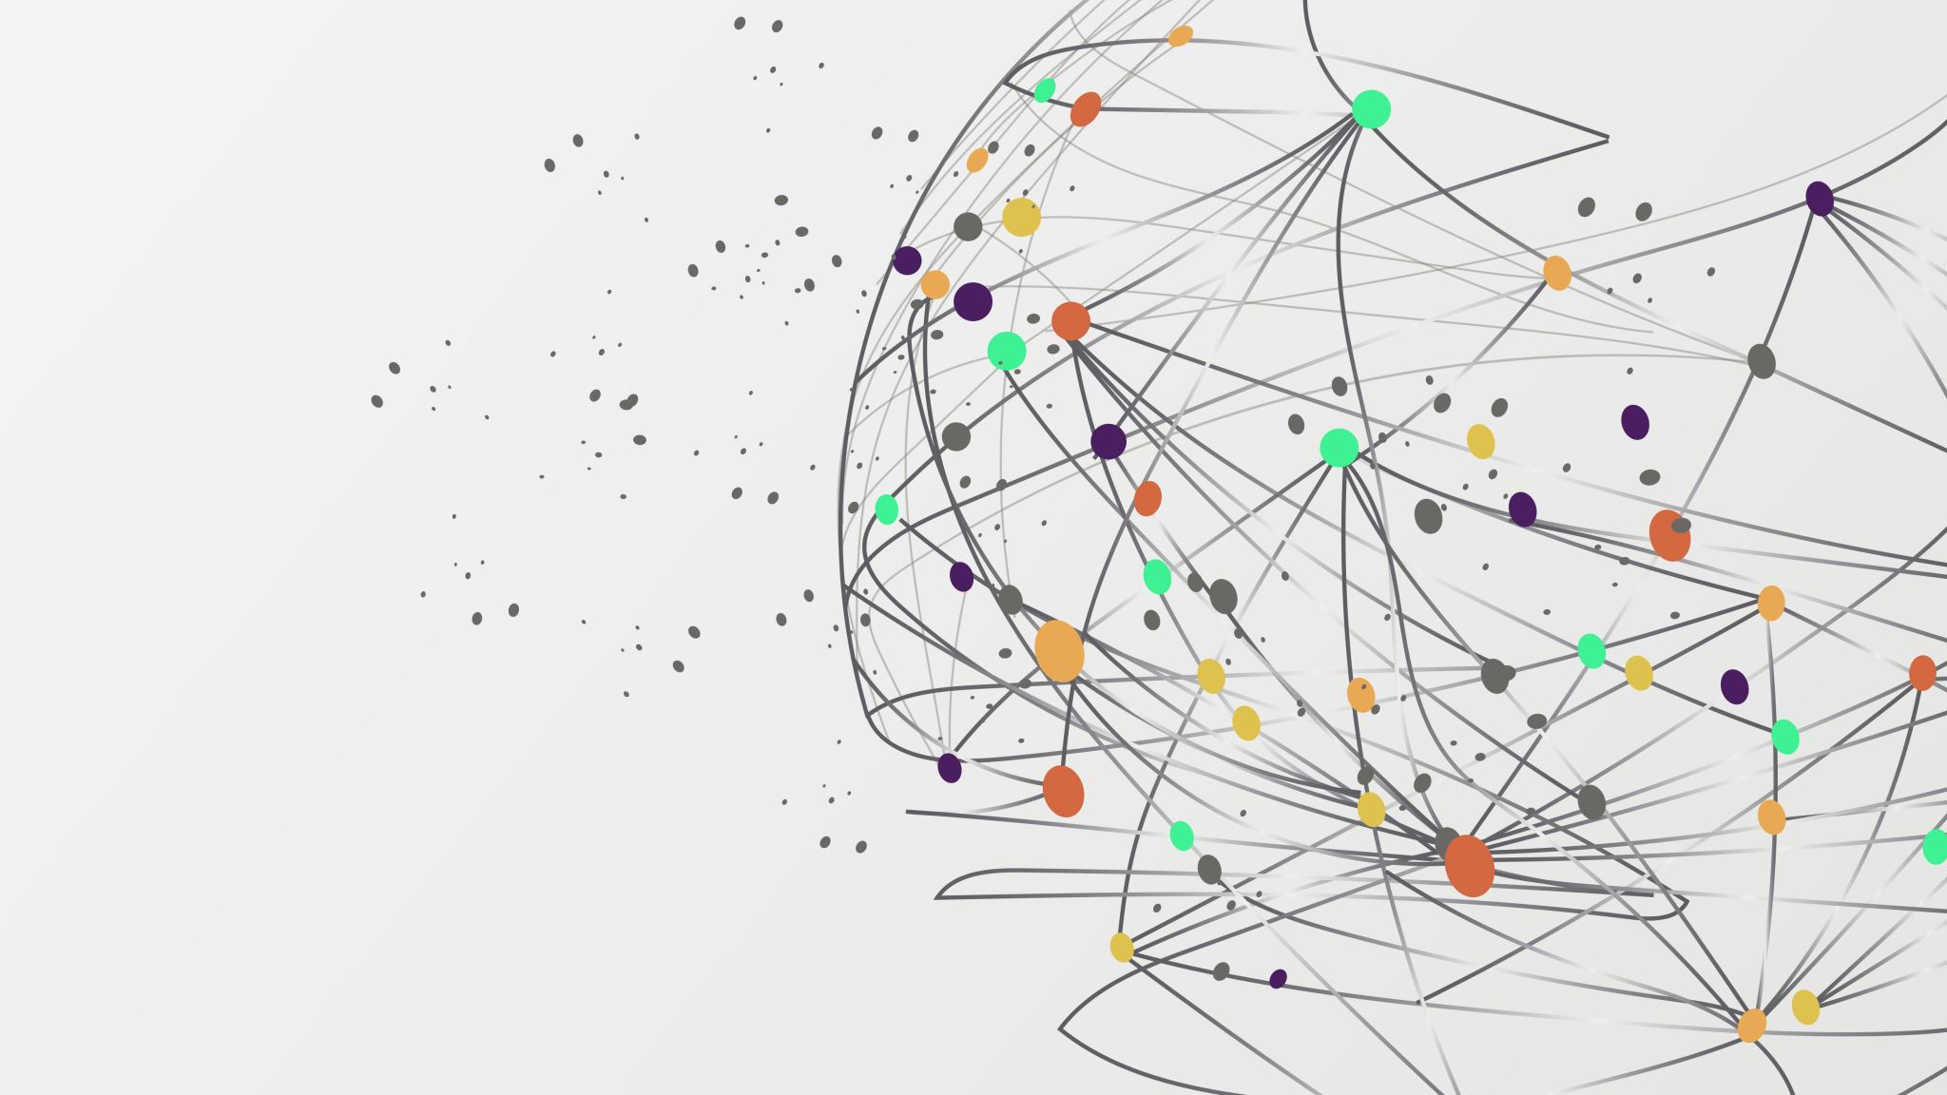
Thank You

