Slide 2
Query level satisfaction
Task satisfaction
Sequence
Action sequece + auxilily feature(traditionally used) = new model

Slide 3
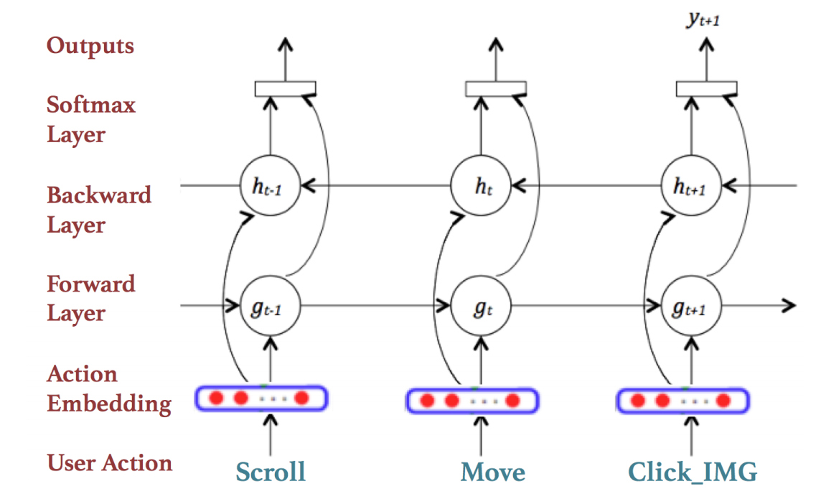
Query level satisfaction
used feature (mouse click, dwell time)
Sequence information (click->move->pause->click-> …)
Predict satisfaction using sequence of user action
Using bi-lstm model

Slide 4
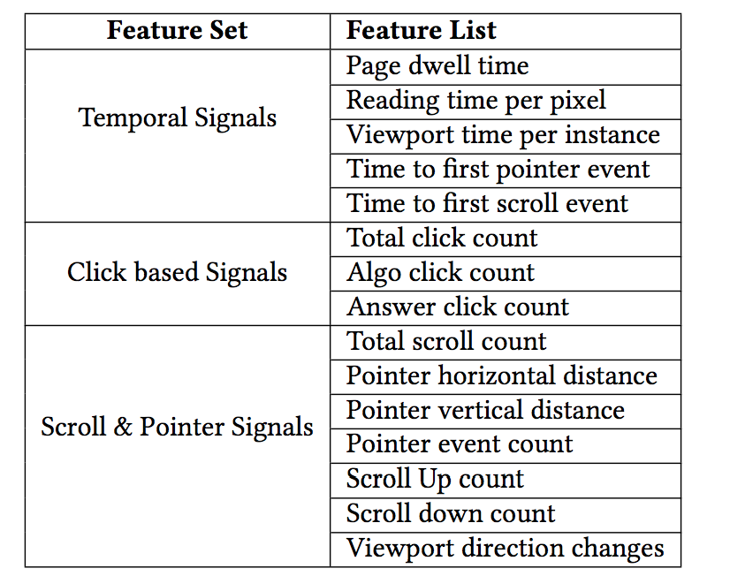
Unifed Multi-View Interaction Model
traditionally used static features and implicit signals

Slide 5
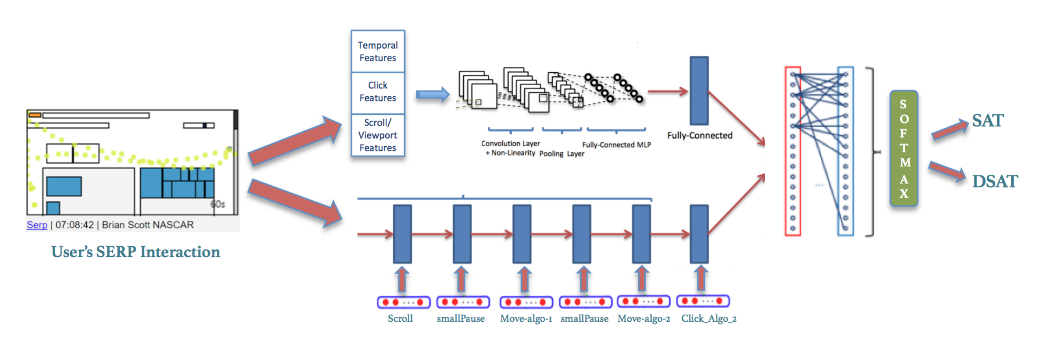
Unifed Multi-View Interaction Model

