Slide 1
MINOR PROJECT B.tech (CSE-CT&IS) May 2020
ENCRYPTO
Submitted By -
Payal Verma -170101155
Deepika Bansal - 170101079
Kumari Suprriya - 170101233

Slide 2

Introduction
Our approach proposes a method that involves encrypting the file using any standard encryption technique and using Diffie Hellman for user authentication. In this way the files can be saved in a public domain securely without the threat of being used by any unauthorised person.
Diffie Hellman Key Exchange
Advanced Encryption Standard
Key generation using Putty key generator

Slide 3
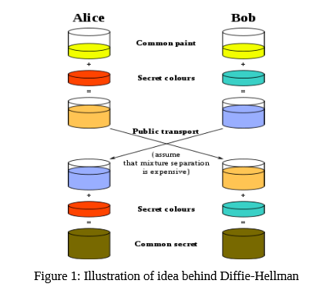
Diffie Hellman Key Exchange
Diffie–Hellman key exchange (DH) is a method of securely exchanging cryptographic keys over a public channel and was one of the first public-key protocols named after Whitfield Diffie and Martin Hellman.
Diffie–Hellman key exchange establishes a shared secret between two parties that can be used for secret communication for exchanging data over a public network

Slide 4
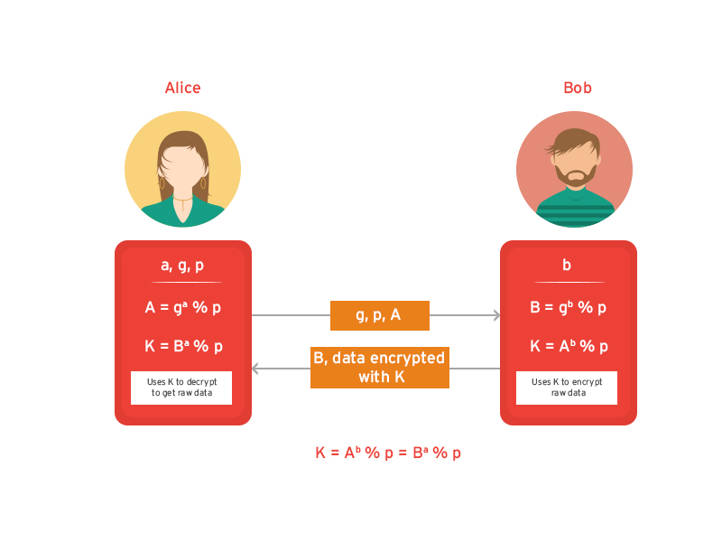
Advantages of the Diffie Hellman Algorithm
The sender and receiver don’t need any prior knowledge of each other.
Once the keys are exchanged, the communication of data can be done through an insecure channel.
The sharing of the secret key is safe.

Slide 5
Advanced Encryption Standard
The more popular and widely adopted symmetric encryption algorithm nowadays is the Advanced Encryption Standard (AES). It is found to be at least six time faster than triple DES. A replacement for DES was needed as its key size was too small.
Why we chose AES?
AES is more secure (it is less susceptible to cryptanalysis than 3DES).
supports larger key sizes than 3DES's 112 or 168 bits
faster in both hardware and software.
AES's 128-bit block size makes it less open to attacks via the birthday problem than 3DES with its 64-bit block size.
required by the latest U.S. and international standards.

Slide 6
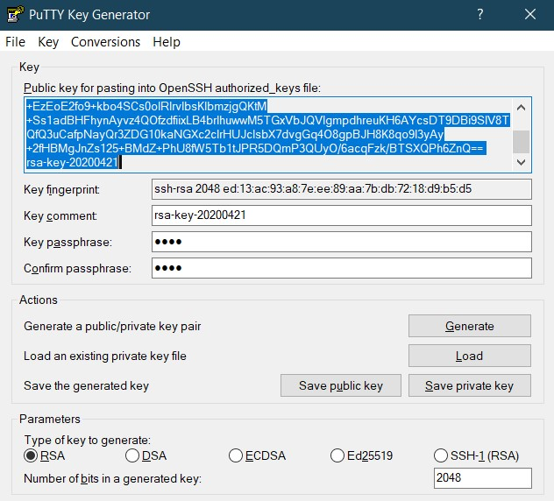
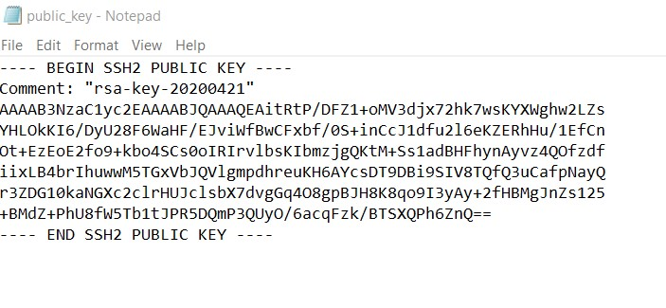
Putty key generation

Slide 7
Implementation
Software interfaces used for implementation of the project :
Python tkinter - Tkinter is Python's de-facto standard GUI (Graphical User Interface) package.
Python flask - Flask is a BSD licensed microframework for Python based on Werkzeug and Jinja 2.
Python crypto - Another python’s extensively maintained library is PyCrypto. It is an actively developed library that provides cryptographic recipes and primitives.
The application is built using python inscribed in HTML, initially, be accessible through the any IDE , here we used Visual Studio.

Slide 8
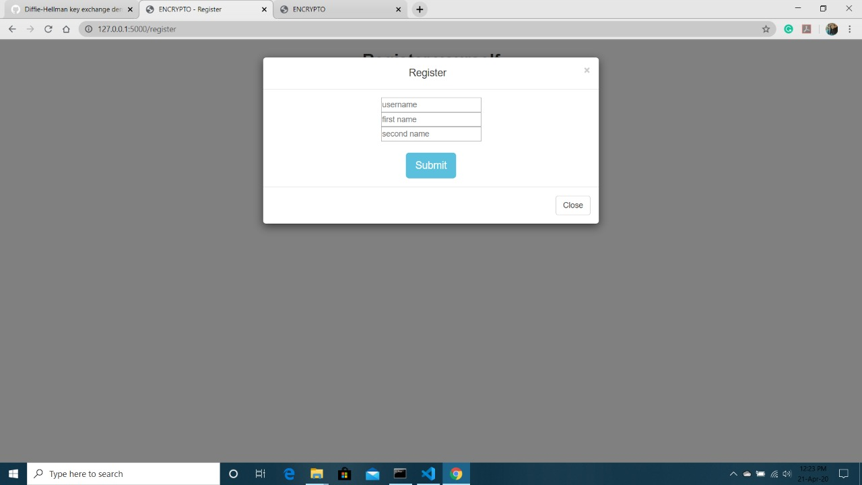
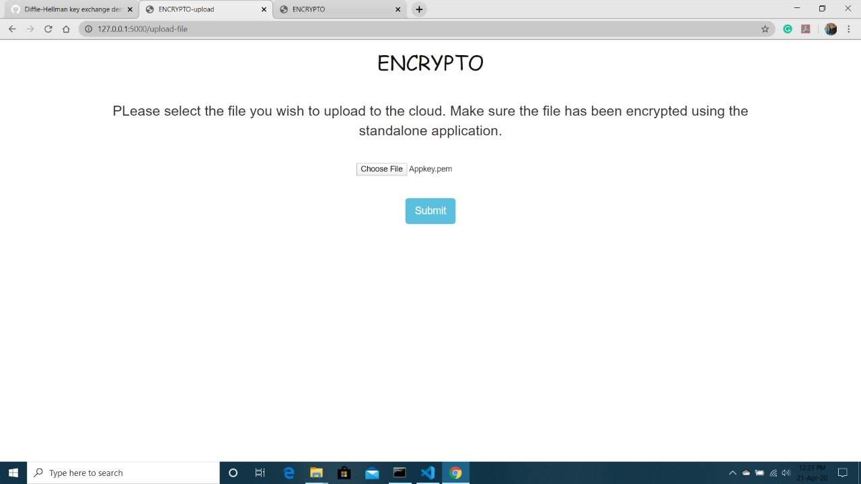
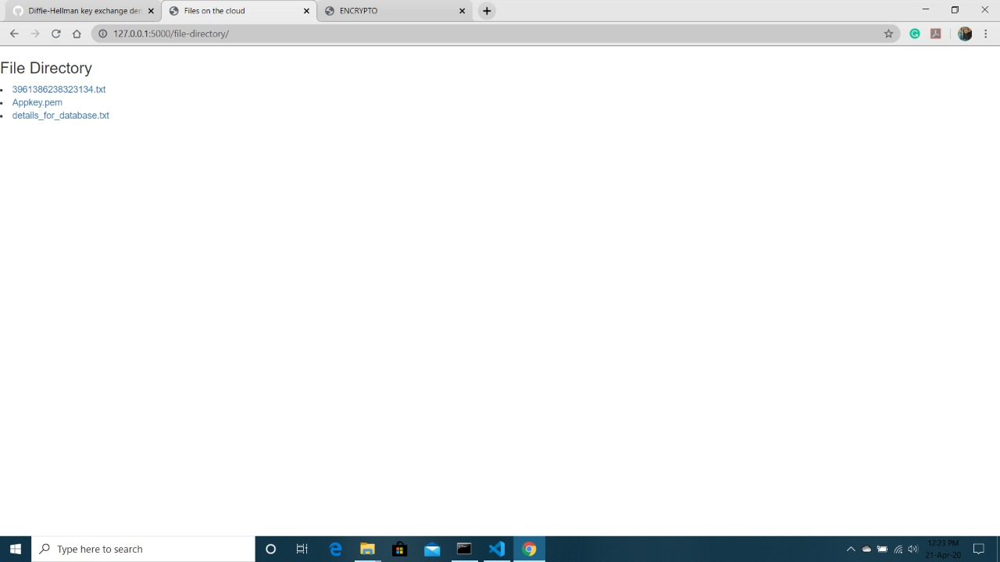


Slide 9
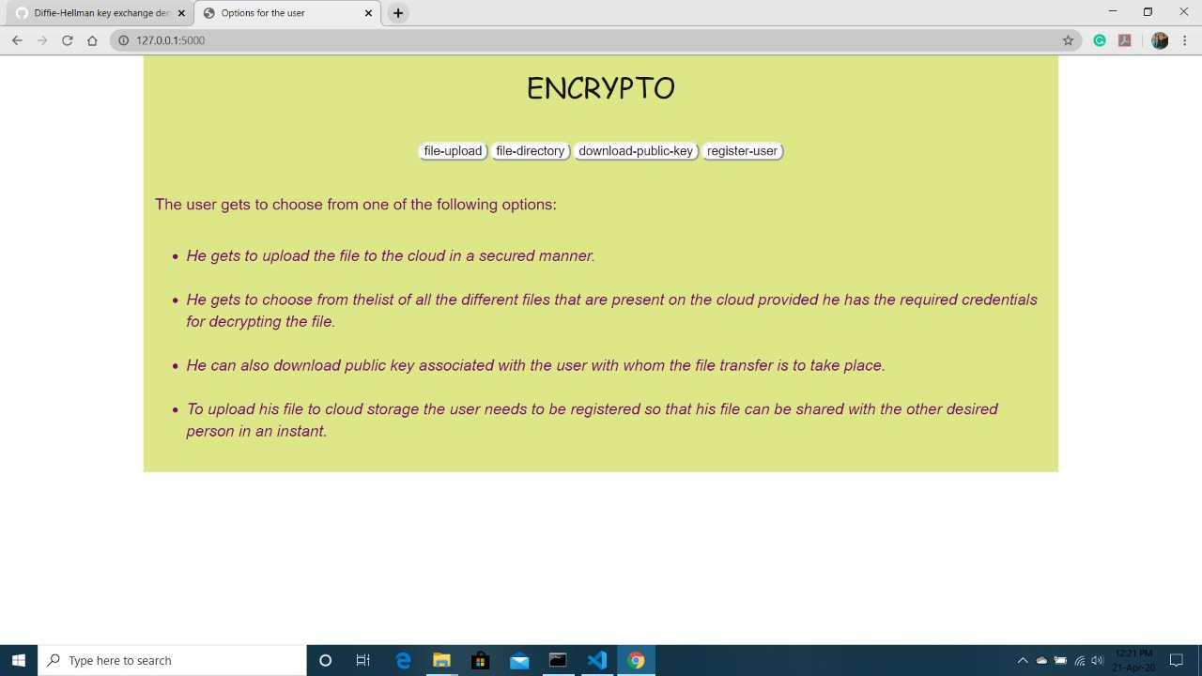
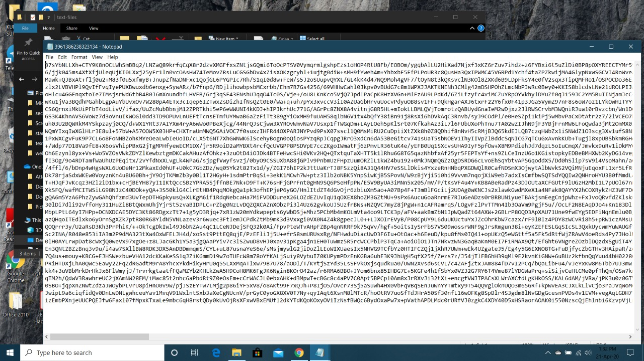

Slide 10
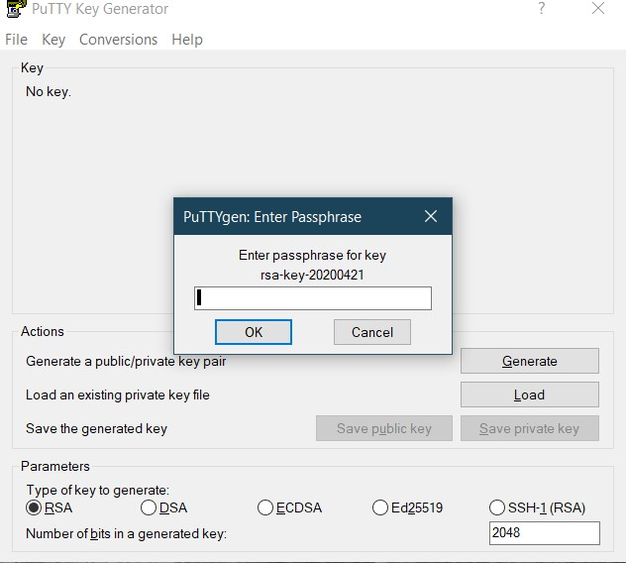

Slide 11
Project Scope
provided capabilities to solve many problems that were earlier deemed impossible to be computed by a machine.
removed the pressure from those responsible for manufacturing better machines
Cloud Computing provided platform for better utilization of the resource spread across the world.
proposes a mechanism for secure file storage cloud using encryption and Diffie Hellman.

Slide 12
ENCRYPTO on Cloud computing platform(Amazon EC2 Instance)
long term commitment. You’re paying by the hour
Play space. You can create additional instances of your application for load testing (client and/or server), testing new architectures, rewrites, versions, etc. Scaling. You can easily scale vertically (upgrade to a larger 2 or 4 cpu instance) or horizontally (add instances)
excellent bandwidth.
Less worry about hardware failure. Failures do occur, although it should occur less often than a dedicated server, and recovery is much easier.
No CPU throttling or other usage limitations.
Dedicated IP address. It’s yours and yours alone, as long as you keep your instance running.

Slide 13
Conclusion
The proposed project aims to address the problem of secure file storage on the cloud. This method is a basic implementation of the proposed methodology that can be improvised and customised according to the needs. It proposes to use encryption and Diffie Hellman to provide double layer of security to the files that are stored on the cloud . removed the pressure from those responsible for manufacturing better machines to keep up with the increasing complexity of the problems that the machines are intended to solve. Cloud Computing provided platform for better utilization of the resource spread across the world.

Slide 14
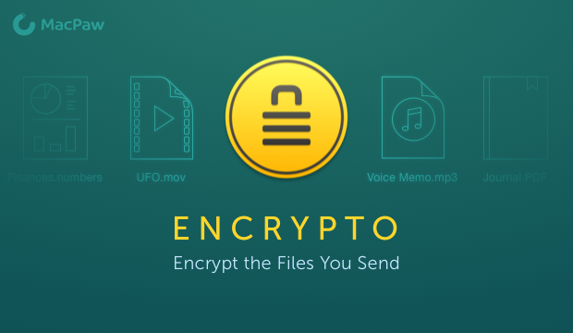
Thank you

