Slide 1

Introduction to Serverless Architecture
Simplify your development and operations
[Suresh and 12/06/2024]

Slide 2
Introduction to Serverless Architecture
• Don’t think Serverless means no servers
• Definition: Building and running applications without managing servers called as Serverless.
• Cloud providers handle the infrastructure.
Example :- - AWS Lambda, Azure Functions, Google Cloud Functions.
• Developers can Focus on writing code
Developers doesn’t need to care about
1 ) Writing code for a server
2) Creating a server
3) Maintaining a server
4) Deploying the server

Slide 3
Server-Based Architecture Vs Serverless Architecture
Aspect | Traditional Architecture | Serverless Architecture
Infrastructure Management | Managed by the organization | Managed by the cloud provider
Scalability | Manual scaling, often over-provisioned | Automatic, event-driven scaling
Cost | Fixed costs, potential underutilization | Pay-as-you-go, cost-efficient
Deployment | Time-consuming setup, requires DevOps | Fast deployment, focuses on code

Slide 4
Benefits of Serverless Architecture
• Simplified Operations
The cloud provider is responsible for OS and middleware updates and security patches.
• Cost Efficiency
Costs are based on actual usage. You pay for the compute time your code consumes and the resources it uses, with no charges for idle time.
• Automatic Scalability
Serverless architectures automatically scale up or down based on demand. There is no need to manually add or remove servers.
• Faster Development
Developers can deploy code quickly without worrying about underlying infrastructure.

Slide 5
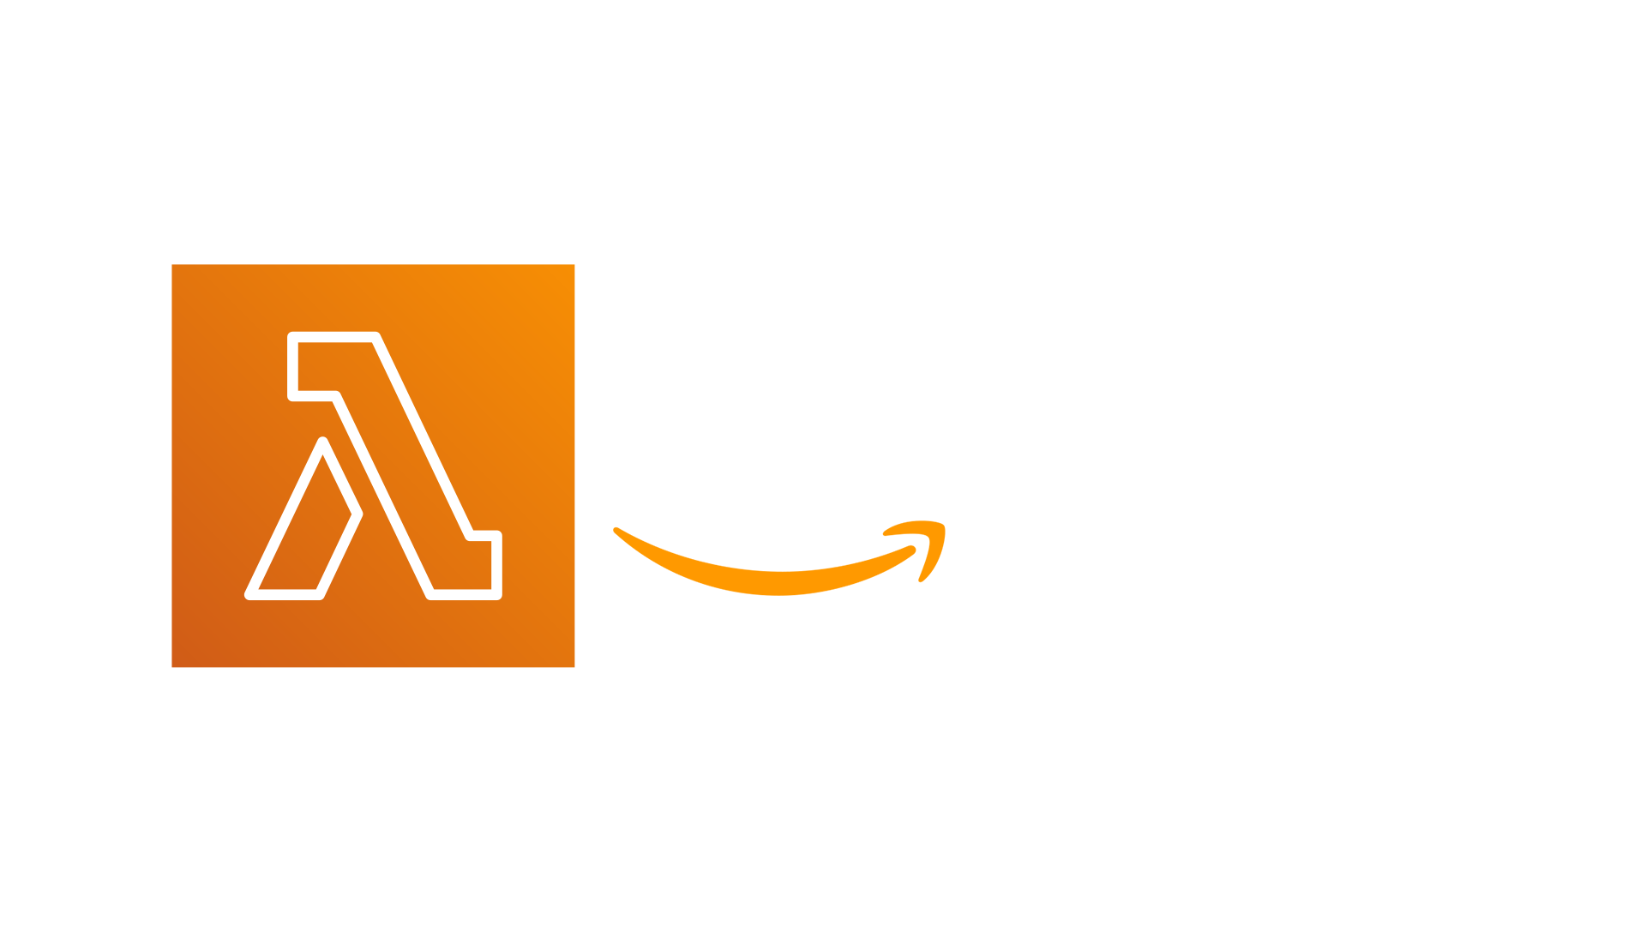
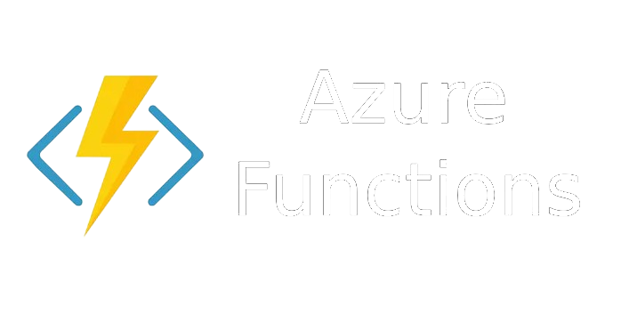

Cost Comparision
AWS Lambda
Pricing Model: Pay-per-request and duration.
Free Tier: 1 million requests and 400,000 GB-seconds of compute time per month.
Request Pricing: $0.20 per 1 million requests beyond the free tier.
Duration Pricing: $0.00001667 per GB-second beyond the free tier​
Azure Functions
Pricing Model: Pay-per-request and duration.
Free Tier: 1 million requests and 400,000 GB-seconds of execution time per month.
Request Pricing: $0.20 per 1 million executions beyond the free tier.
Duration Pricing: $0.000016 per GB-second beyond the free tier
Google Cloud Functions
Pricing Model: Pay-per-request and duration.
Free Tier: 2 million invocations, 400,000 GB-seconds of compute time, and 200,000 GHz-seconds of CPU time per month.
Request Pricing: $0.40 per 1 million invocations beyond the free tier.
Duration Pricing: $0.0000025 per GB-second beyond the free tier​

Slide 6
Conclusion
• Serverless architecture simplifies development.
• Focus on business logic, not infrastructure.
• Automatic scaling and cost efficiency.

