Slide 1
Agenda of the today seminar
1) What is Testing?
2) Why do we need Testing?
3) What are the types of Testing?

Slide 2
What is SDLC? (Software Development lifecycle)
Planning
Defining
Designing
Building
Testing
Deployment
Maintenance
SDLC Cycle represents the process of developing software that represents all the methods required to make a software product transit through its life cycle stages.

Slide 3
Planning
- Whether this solves a real-time problem for a users
Defining
Requirement gathering -
Designing
- UI/UX
Building
Programming -
Testing
- Automation, Manual
(UAT-Limited Users) -
End-user(All Users)
Deployment
Maintenance
- Enhancement

Slide 4
What is Testing and what do we do?
The purpose of software testing is to identify the errors, faults, or missing requirements in contrast to actual requirements
We ensures the product should meets the Quality standard as per the requirement from the product owner(Client)
It was Performed by Test engineer either manually or Automated
Verification: It refers to the set of tasks that ensure that the software correctly implements a specific function. It means “Are we building the product right?”.
Validation: It refers to a different set of tasks that ensure that the software that has been built is traceable to customer requirements. It means “Are we building the right product?”.

Slide 5
Types of Software Testing
Testing types
Manual
Automation
Manual Testing :- Testing which is performed by human effort
Scenario :- if a tester has 10 user credentials need to segregate the users which has admin access
Tester will enter the user credentials manually one by one in the particular website to check the scenario (This is one kind of scenario)

Slide 6
Manual testing Types
Black box testing – it is also known as functional testing , in blackbox testing Tester doesn’t require knowledge of internal coding of the software Only GUI (Graphical User Interface) is required for testing
White box testing – it is also known as structural testing, in this white box testing internal working structure (Coding of software) and database knowledge is necessarily required for this type of testing.
Grey(Gray) box testing – it is also know as translucent testing in this case tester should have some minimal amount Coding knowledge is required to perform testing
Scenario:- if Tester want to check a Specific user login (Credentials) should have admin access if Single credentials it can be done through manual what if we have 500 credentials and above (This is one kind of scenario)

Slide 7
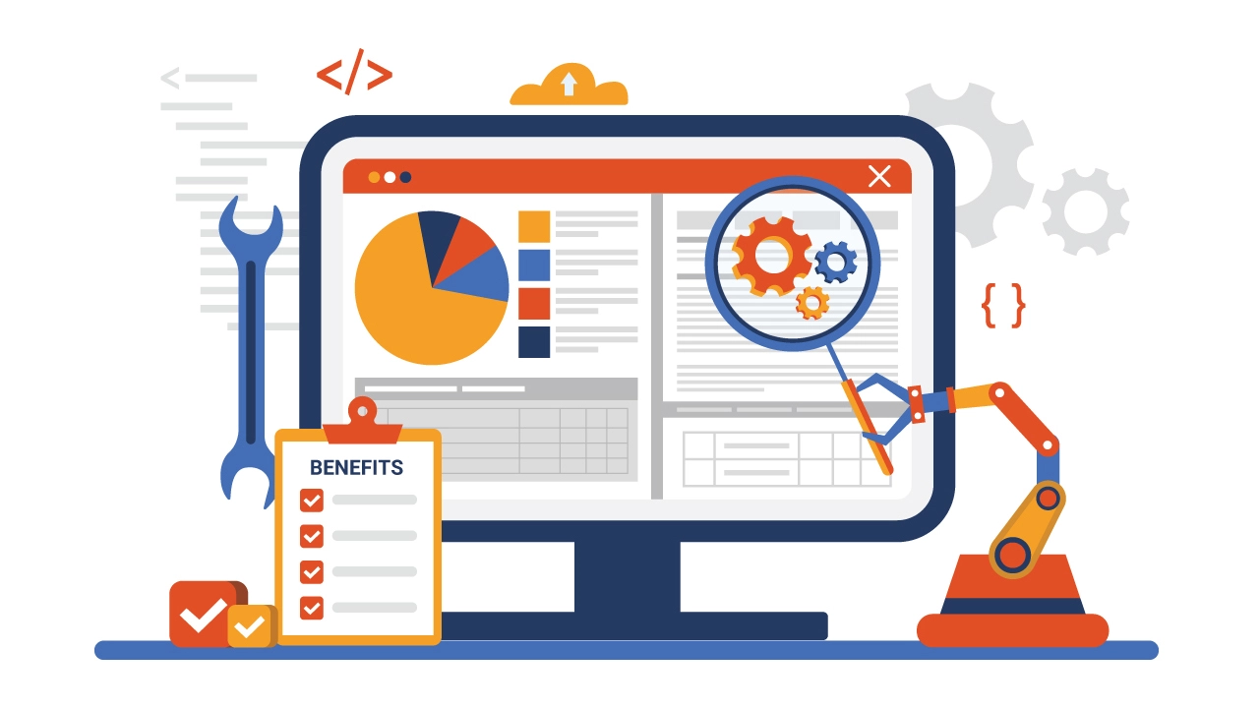
Automation testing
The name itself having Automation to automate without any human interaction
Where Tester used to write scripts using different programming language like java, python and web interaction tools like selenium to check weather the entire flow of a software functionality should works fine as per the given requirement

Slide 8
Black box – Functional testing
Black box Testing
Functional testing
Non Functional testing
Functional Testing mainly Focuses on verifying if the software or system works as intended, meeting functional requirements like input/output, error handling, and user interface.
Scenario: Involves testing features and functionalities such as arithmetic operations in a calculator app or tasks in an e-commerce website like adding items to the cart.
Goal: Ensures that the software behaves correctly based on requirements and design documentation.
Types: Includes unit testing, integration testing, system testing

Slide 9
Black box – Non-Functional testing
Black box Testing
Functional testing
Non Functional testing
Non-Functional Testing validates non-functional aspects like performance, security, usability, reliability, and compatibility of the software.
Execution: Tests how well the software performs under different conditions, ensuring it meets quality standards and operates effectively.
Examples: Checking a website's ability to handle concurrent users without crashing or its security against cyber threats like hackers.
Importance: Ensures the software is stable, maintainable, secure, and high-performing

Slide 10
Types of Functional testing
Functional testing
Unit testing
Integration testing
System testing
Smoke Testing
Sanity Testing
Regression Testing
Re-Testing

Slide 11
Functional testing
Unit testing - Is a Software testing method which is performed by developers for a smallest Component of an application once after the development is completed
Integration testing - Integration testing is when performing tests on multiple different modules and components together. The purpose of this testing is to examine how those various modules interact with each other. First every module is tested separately to make sure it works smoothly and afterward the integration test is executed
System testing - System testing is the process of running tests on the entire software as a user point of view. This test is to check if the product is meeting the requirements and needs while finding bugs and defects that must be corrected in order to do so. System testing is also referred to as an end-to-end test
Smoke testing - Smoke testing, also known as build verification testing, it is the first test conducted on a new build of a software application. The purpose of smoke testing is to check whether the core functionality of the software work correctly, ensuring that the build is stable enough for further, more detailed testing. It helps in identifying major issues early in the development process.

Slide 12
Functional testing
Sanity testing - verifies specific functionalities or areas of the software have been fixed or implemented correctly after making changes or enhancements. Validating particular components or functionalities affected by recent changes. It aims to ensure that the recent modifications haven't introduced any unexpected side effects.
Regression testing - It verifies Recent code changes or updates doesn't affected the existing functionality. it is nothing but testing the existing feature with the new added feature it shouldn't affect the existing functionality due to new code changes
Re-testing - is the process of executing test cases that failed in a previous testing cycle after defects have been fixed or changes have been made to the software. The purpose of re-testing is to verify that the reported defects have been successfully resolved and that the affected functionalities now work as intended.

Slide 13
Non functional testing
Non-Functional testing
Performance testing
Usability testing
Compatibility testing
Performance testing - evaluates the speed and efficiency of a software application under various load conditions to identify bottlenecks and optimize performance
Usability testing - focuses on ensuring that a software application is user-friendly by evaluating the interface, navigation, and overall user experience to meet user needs
Compatibility testing - ensures that a software application functions seamlessly across different platforms, devices, browsers, and environments to expand user reach

Slide 14
Performance testing
Load - Load testing evaluates how a system performs under normal and peak load conditions by simulating real-life user loads to identify bottlenecks and ensure optimal performance (maximum users as per requirements)
Stress - Stress testing assesses a system's stability and robustness under extreme load conditions beyond its breaking point to understand how it behaves and recovers from crashes
Stability - Focuses on ensuring the system remains stable under varying conditions without unexpected failures or crashes, contributing to a reliable user experience
Scalability - Evaluates how well a system can handle increased workload or user demands by assessing its ability to scale up or down effectively without compromising performance

Slide 15
Need for Software Testing
Software bugs can cause potential monetary and human loss. There are many examples in history that clearly depicts that without the testing phase in software development lot of damage was incurred. Below are some examples:
1985: Canada’s Therac-25 radiation therapy malfunctioned due to a software bug and resulted in lethal radiation doses to patients leaving 3 injured and 3 people dead.
1994: China Airlines Airbus A300 crashed due to a software bug killing 264 people.
1996: A software bug caused U.S. bank accounts of 823 customers to be credited with 920 million US dollars.
1999: A software bug caused the failure of a $1.2 billion military satellite launch.
2015: A software bug in fighter plan F-35 resulted in making it unable to detect targets correctly.
2015: Bloomberg terminal in London crashed due to a software bug affecting 300,000 traders on the financial market and forcing the government to postpone the 3bn pound debt sale.
Starbucks was forced to close more than 60% of its outlet in the U.S. and Canada due to a software failure in its POS system.
Nissan cars were forced to recall 1 million (10 lakhs) cars from the market due to a software failure in the car’s airbag sensory detectors.

Slide 16
