Slide 1
BCSE306
Artificial Intelligence
Dr. Durgesh Kumar
Assistant Professor (Senior)
School of Computer Science and Engineering (SCOPE),
VIT Vellore,

Slide 2
Lecture Outline
Agent and Environment
  Agent, Environment, Sensor, Preceptor, Actuators
Good Behaviour Concept of Rationality
  Performance Measures
  Rationality
  Omniscience, learning, and autonomy
The Nature of Environment
  Specifying the task Environment (P.E.A.S)?
  Properties of Task Environment
    Fully observable vs partially observable
    Single agent vs Multiagent , Deterministic vs Non-Determinstic

Slide 3
Lecture Outline (Contd.)
The structure of Agents
  Agent = architecture + Program
  Agent Programs
  Simple Reflex Agents
  Model-based reflex agents
  Goal-based agents
  Utility based agent
  Learning based agents

Slide 4
What is an Agent?
Artificial intelligence is defined as the study of rational agents.
A rational agent could be anything that makes decisions, as a person, firm, machine, or software.
An AI system is composed of an agent and its environment. The agents act in their environment. The environment may contain other agents.
An agent is anything that can be viewed as :
- perceiving its environment through sensors and
- acting upon that environment through actuators

Slide 5
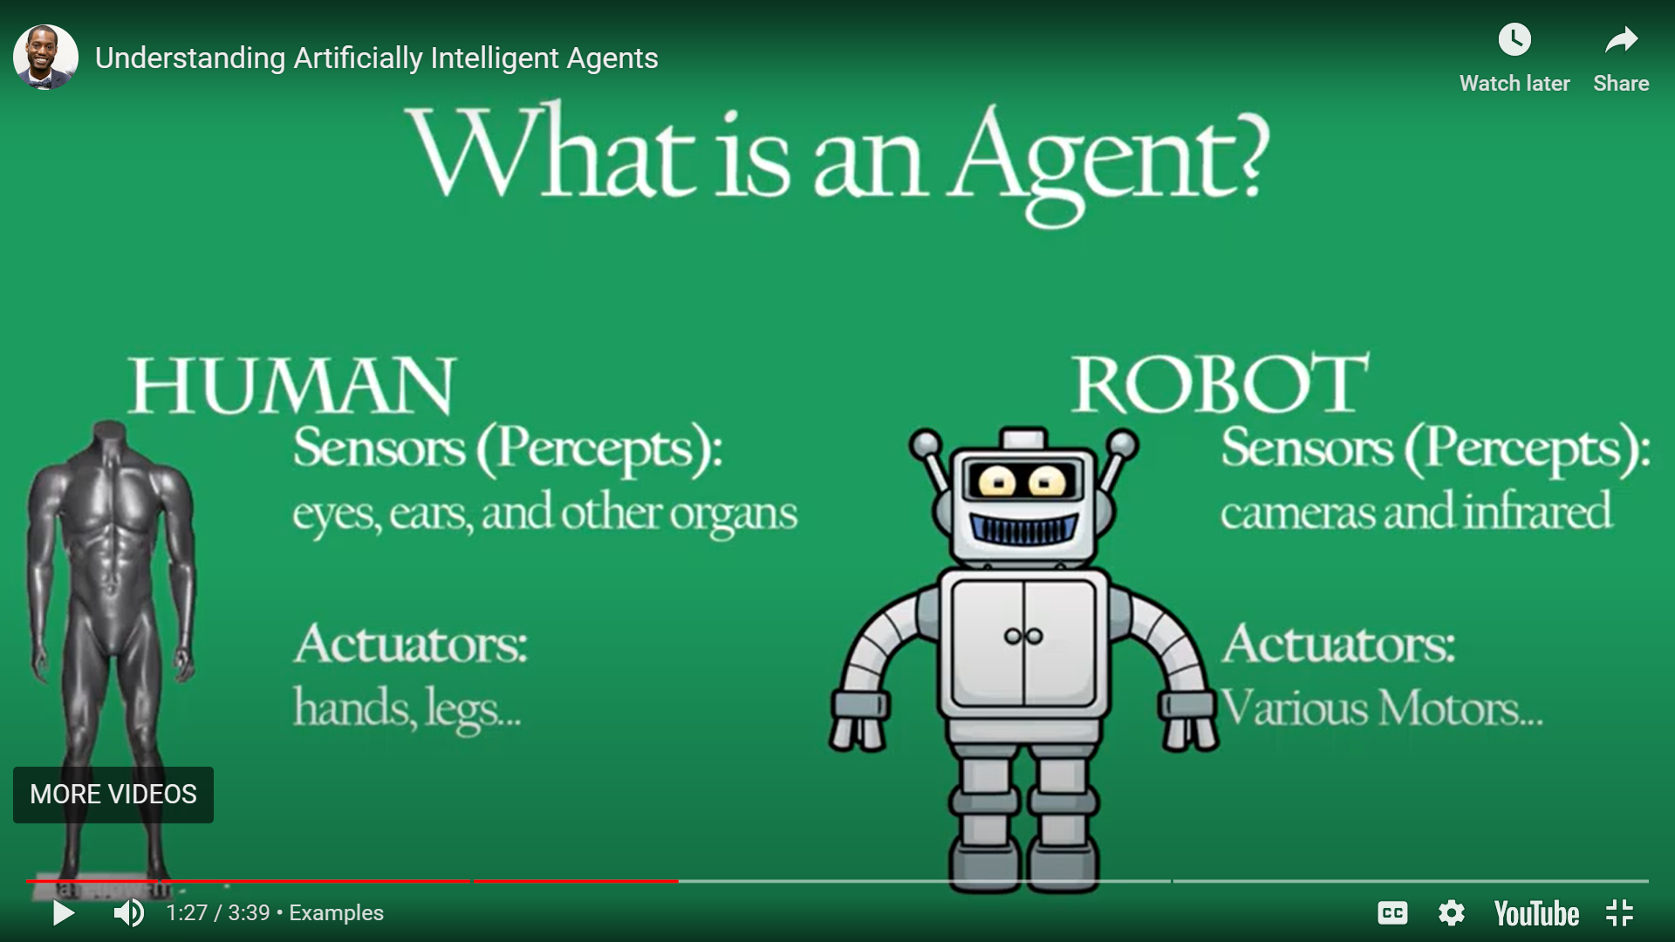
Agent vs Human

Slide 6
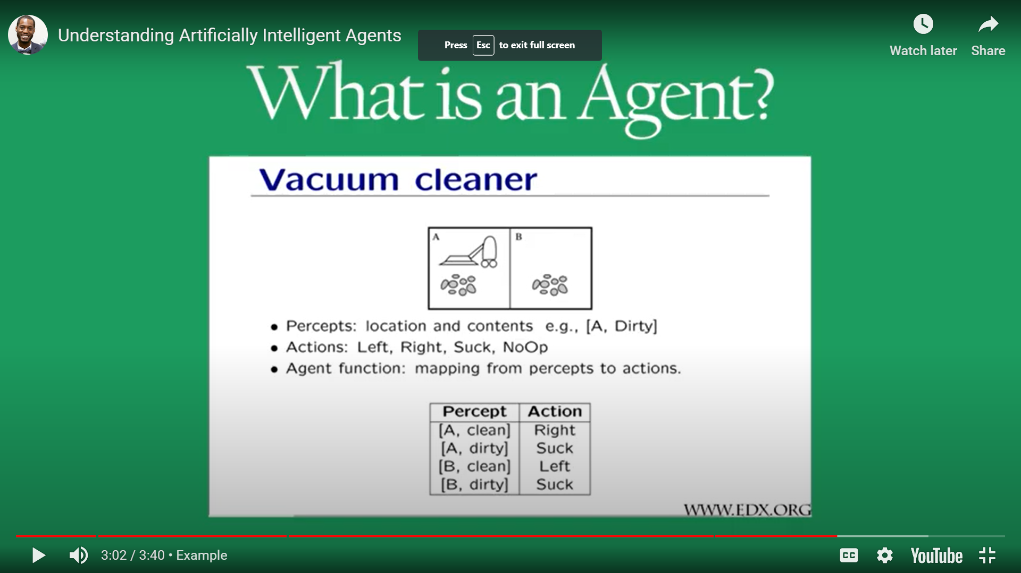
simple agent function for the vacuum-cleaner world

Slide 7
PEAS in Artificial Intelligence
PEAS stands for a Performance measure, Environment, Actuator, Sensor.
Rational Agent: The rational agent considers all possibilities and chooses to perform a highly efficient action.
For example, it chooses the shortest path with low cost for high efficiency.

Slide 8

PEAS description
1. Performance Measure: Performance measure is the unit to define the success of an agent. Performance varies with agents based on their different precepts. e.g. Precision, Recall,
F-1 measure, Accuracy for ML models
What can be a performance measure for a cleaning agent?
Ans: The performance of cleaning robots can be accessed in different terms as follows:

Slide 9
PEAS description
1. Performance Measures:What can be a performance measure for a cleaning agent?
Ans: The performance of cleaning robots can be accessed in different terms as follows:
- Cleaning Efficiency: cleaning coverage, cleaning timing
- Navigation and Obstacle Avoidance: Collision avoidance, Mapping and path planning
- Battery Life and Charging
- Noise level

Slide 10
PEAS description
1. Performance Measures:What can be a performance measure for a self driving cars?
Ans: The performance of self driving cars can be accessed in different terms as follows:
- Safety: collision rate, reaction time, Failure modes and safety protocols
- Autonomous Driving Capability: Object detection and recognition, Lane-keeping and lane-changing performance, Traffic signal and sign recognition
- Navigation and Route Planning and Charging
- Noise level Human Machine interface: user experience, communication with pedestrians and other road users

Slide 11
PEAS description
1. Performance Measure: Performance measure is the unit to define the success of an agent. Performance varies with agents based on their different precepts. e.g. Precision, Recall,
F-1 measure, Accuracy for ML models
Environment: Environment is the surrounding of an agent at every instant. It keeps changing with time if the agent is set in motion. There are 5 major types of environments:
  a) Fully Observable & Partially Observable
  b) Episodic & Sequential
  c) Static & Dynamic
  d) Discrete & Continuous
  e) Deterministic & Stochastic

Slide 12
PEAS description (Contd.)
Actuator: An actuator is a part of the agent that delivers the output of action to the environment.
Sensor: Sensors are the receptive parts of an agent that takes in the input for the agent.

Slide 13
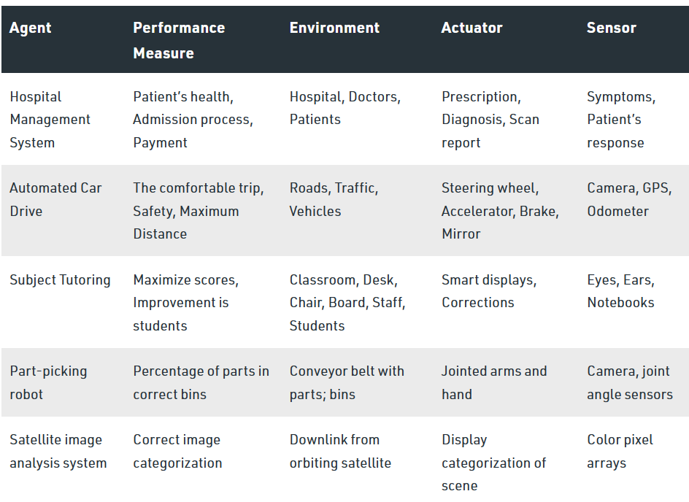
Specifying task environment using P.E.A.S

Slide 14
Specifying task environment using P.E.A.S
Agent | Performance Measure | Environment | Actuators | Sensors
Taxi Driver

Slide 15
Specifying task environment using P.E.A.S
Agent | Performance Measure | Environment | Actuators | Sensors
Taxi Driver | Safe, fast, legal, Navigation or routing, maximize profits(time, fuel), impact on other road users | Roads, other traffic, police, pedestrians, customers, weather | Steering, Accelerator, brake, Signal, horn, display, speech | Cameras, speedometer, GPS, engine sensors, accelerometer, microphones, touchscreen

Slide 16
Types of Environments in AI
An environment in artificial intelligence is the surrounding of the agent.
The agent takes input from the environment through sensors and delivers the output to the environment through actuators.
There are several types of environments:
        Fully Observable vs Partially Observable
        Deterministic vs Non-Deterministic (Stochastic)
        Competitive vs Collaborative
        Single-agent vs Multi-agent
        Static vs Dynamic
        Discrete vs Continuous
        Episodic vs Sequential
        Known vs Unknown
Notes:
12

Slide 17
1.Fully Observable vs Partially Observable
When an agent sensor is capable to sense or access the complete state of an agent at each point in time, it is said to be a fully observable environment else it is partially observable.
A task environment is fully observable if the sensors detects all the aspects that are relevant to the choice of action (performance measure).
Examples:
  Chess – the board is fully observable, and so are the opponent’s moves.
  Driving – the environment is partially observable because what’s around the corner is not known.

Slide 18
1.Fully Observable vs Partially Observable
A task environment can be partially observable because of noisy, inaccurate sensors, or incomplete knowledge about all possible states
Maintaining a fully observable environment is easy as there is no need to keep track of the history of the surrounding (internal states).

Slide 19
2.Deterministic vs Non-Deterministic (Stochastic)
Deterministic: If the next state of the environment is completely determined by current state and actions executed by agents.
The stochastic environment is random in nature which is not unique and cannot be completely determined by current state of environment and the agent’s action.
Examples:
  Chess – there would be only a few possible moves for a coin at the current state and these moves can be determined.
  Self-Driving Cars- the actions of a self-driving car are not unique, it varies time to time.

Slide 20
3. Competitive vs Collaborative
An agent is said to be in a competitive environment when it competes against another agent to optimize the output.
  The game of chess is competitive as the agents compete with each other to win the game which is the output.
An agent is said to be in a collaborative environment when multiple agents cooperate to produce the desired output.
  multiple self-driving cars are found on the roads, they cooperate with each other to avoid collisions and reach their destination which is the output desired.

Slide 21
4.Single-agent vs Multi-agent
An environment consisting of only one agent is said to be a single-agent environment.
  A person left alone in a maze is an example of the single-agent system.
An environment involving more than one agent is a multi-agent environment.
  The game of football is multi-agent as it involves 11 players in each team.

Slide 22
5.Dynamic vs Static
An environment that keeps constantly changing itself when the agent is up with some action is said to be dynamic.
  A roller coaster ride is dynamic as it is set in motion and the environment keeps changing every instant.
An idle environment with no change in its state is called a static environment.
  An empty house is static as there’s no change in the surroundings when an agent enters.

Slide 23
6. Discrete vs Continuous
If an environment consists of a finite number of actions that can be deliberated in the environment to obtain the output, it is said to be a discrete environment.
The game of chess is discrete as it has only a finite number of moves. The number of moves might vary with every game, but still, it’s finite.
The environment in which the actions are performed cannot be numbered i.e. is not discrete, is said to be continuous.
Self-driving cars are an example of continuous environments as their actions are driving, parking, etc. which cannot be numbered.

Slide 24
7.Episodic vs Sequential
In an Episodic task environment, each of the agent’s actions is divided into atomic incidents or episodes. There is no dependency between current and previous incidents. In each incident, an agent receives input from the environment and then performs the corresponding action.
  Example: Consider an example of Pick and Place robot, which is used to detect defective parts from the conveyor belts. Here, every time robot(agent) will make the decision on the current part i.e. there is no dependency between current and previous decisions.
In a Sequential environment, the previous decisions can affect all future decisions. The next action of the agent depends on what action he has taken previously and what action he is supposed to take in the future
  Checkers- Where the previous move can affect all the following moves.

Slide 25
8. Known vs Unknown
In a known environment, the output for all probable actions is given.
Obviously, in case of unknown environment, for an agent to make a decision, it has to gain knowledge about how the environment works.

Slide 26
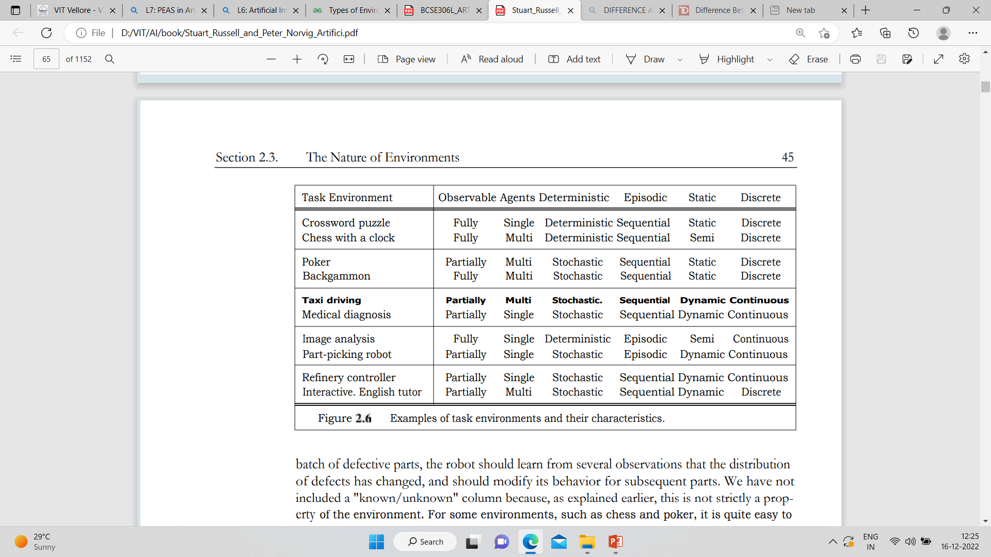

Properties of task Environment

Slide 27


