Slide 1
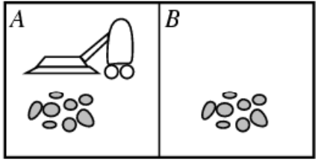
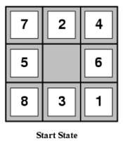
BCSE306
Artificial Intelligence
Module 2: Problem Solving based on Search
Dr. Durgesh Kumar
Assistant Professor (Senior)
School of Computer Science and Engineering (SCOPE),
VIT Vellore,

Slide 2
Lecture Outline
The Problem solving based on Search
  Introduction
    Problem solving agent vs Planning Agent
    Informed search vs Uniformed Search
    Problem solving agent
  4 phase of Problem-solving process
  Search problem and its solution
    2 cell vacuum cleaner
    Sokoban puzzle ( 8 tile puzzle)

Slide 3
Agent Types
Problem-solving agent
- use atomic representation of states of environment
- states are visible as whole
- no internal structure visible to agent
Module 2: Problem based on Searching
Module 3: Local Search and Adversial Search
Planning agent
- use factored or structured representation of states of environment
Module 6 : Planning

Slide 4
Search Algorithm
Informed (Heuristic) Search
- Agent can estimate how far it is from Goal states.
- Greedy Best First Search
- A* Search
Uninformed Search
- Agent can not estimate how far it is from Goal states.
- Breadth First Search (BFS)
- Depth First Search (DFS)
- Uniform cost search (Dijkstra’s algo)
- Depth-limited and iterative deepening DFS

Slide 5
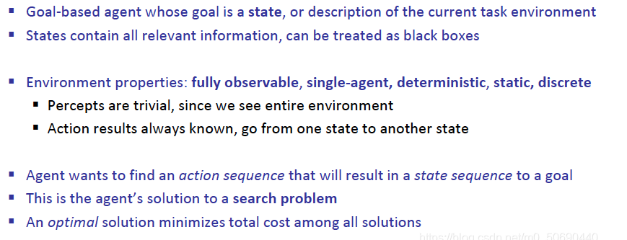
Problem Solving Agent

Slide 6
Problem Solving Agent
Searching problem could be implemented by a problem-solving agent, which is subset of Goal-based agent.
The goal is here will be set of states.
The Agent will reach to a goal state through a sequence of actions.
To do so, the agent is going to search across many combination of state space.

Slide 7
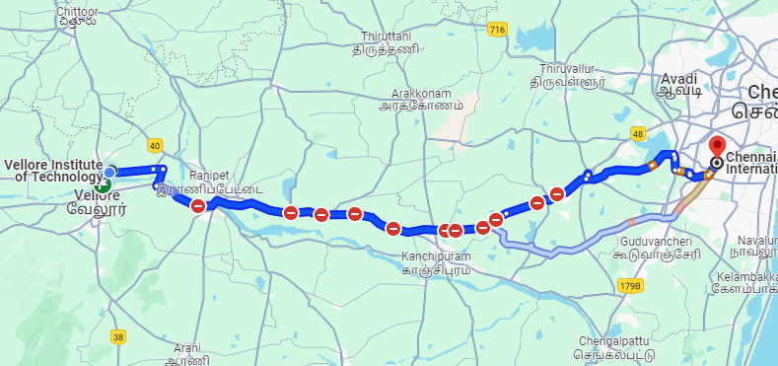
Problem Solving Agent Example
Shortest path between VIT Vellore Campus to Chennai Airport.

Slide 8
4-phase Problem Solving process
Goal formulation
Problem Formulation
Search
Execution

Slide 9
4-phase Problem Solving process
Goal formulation: The agent adopts the goal to reach Chennai Airport from VIT Vellore
Problem Formulation: The agent devises a description of states and actions necessary to reach goal- An abstract model of relevant part of the world.
Search – Before taking any action in real world, agent simulates sequences of actions in its model, searching until reaching goal state. Such a sequence of action is called solution.

Slide 10
4-phase Problem Solving process
Search – Before taking any action in real world, agent simulates sequences of actions in its model, searching until reaching goal state. Such a sequence of action is called solution.
Execution: The agent can now execute the actions in the solution, one at a time.

Slide 11
Based on Execution
Open Loop System
- fully observable, deterministic, known environment.
- if the model is correct and once the agent has found a solution
- it can ignore its percepts while executing the actions.
Closed Loop System
- partially observable, non-deterministic environment.
- there is chance that model is incorrect, or environment is non-deterministic
- the agent would be using closed loop approach that monitor the percepts.

Slide 12
Search Problem and its solutions
State space (S): Set of descriptions of the agent and environment.
Initial state:
Goal states:
Action state: Finite set if available actions in a state
Transition model: (Deterministic) mapping from <state, action> to a new state.
  - Ex: Result(s, a1) = s2
Action costs: Numerical cost for a <state, action, new_state> transition
- Ex: Cost(s1, a1, a2) = 4

Slide 13
Example Search Problems
Standardized Problems
  2 Cell vacuum cleaner: (Grid World)
  Sokoban puzzle (Sliding puzzle)
  - 8 puzzle, 15 puzzle
Real-world problems
  Route finding problems
    - Touring problem, TSP
  VLSI layout
  Robot navigation
  Automatic assembly sequencing
  Protein design

Slide 14
Example - 2 Cell vacuum cleaner
States
– Agent location and dirt location
– How many possible states?
– What if there are n possible locations?
• Actions
– Left, right, suck
• Transition model
Action cost/ Path cost

Slide 15
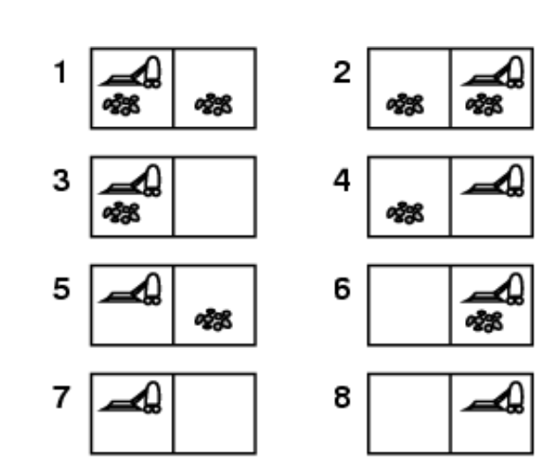
Example - 2 Cell vacuum cleaner

Slide 16
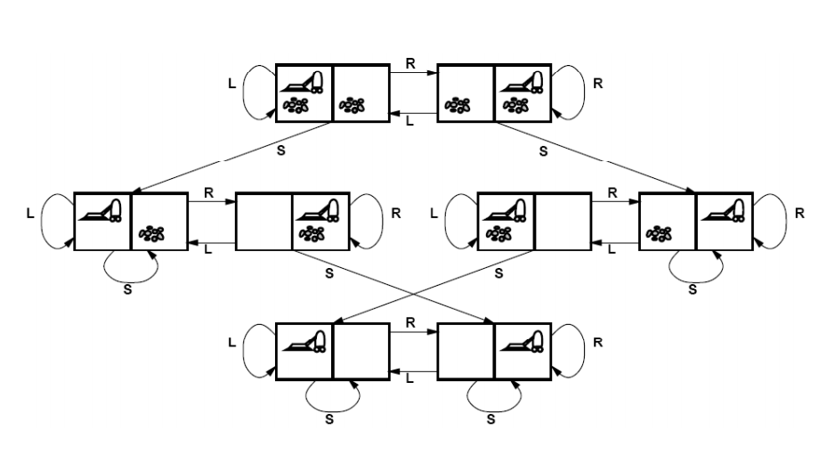
Example - 2 Cell vacuum cleaner

Slide 17
Example - 2 Cell vacuum cleaner

Slide 18
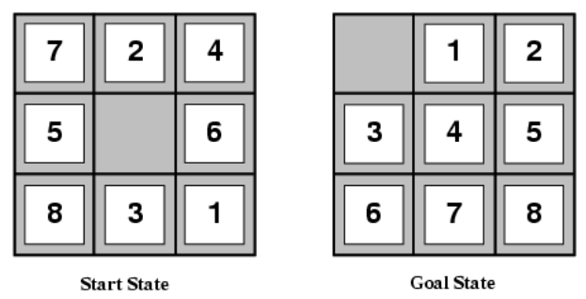
Example - Sokoban puzzle
This is a 8-tiles sokaban puzzle.
Agent goal is to push a number of boxes, scattered about grid, to designated storage locations.
There can be at most one box per cell.
A tile that slides
  Image agent is at blank space ( for simplicity)

Slide 19
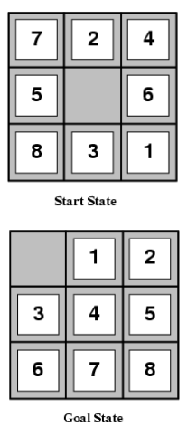
Example - Sokoban puzzle (8 tiles)
States
  - Locations of tiles
    8 puzzle ?
      How many number of states?
Start state
Goal States
Actions:
  - Move blank tile UP, DOWN, LEFT, RIGHT
Transition Model
Action Cost/ path cost
  -1 per move

Slide 20

Example - Sokoban puzzle (8 tiles)
1
States
  - Locations of tiles
  8 puzzle ? How many number of states?
    = 181,440 states
  9! is total possible number of configurations.
  However, 9!/2 is the solvable configurations.
  For example, this configuration is not solvable.
    Ref: 1)Link1

Slide 21
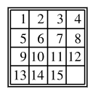
Example - Sokoban puzzle (8 tiles)
States
  - Locations of tiles
  8 puzzle ? How many number of states?
    = 181,440 states
  15 puzzle
  Finding a solution to N-puzzle is easy
  But finding Optimal solution of N-puzzle is NP-Hard.

Slide 22


