Slide 1
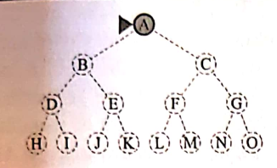
BCSE306
Artificial Intelligence
Module 2: Problem Solving based on Search
Dr. Durgesh Kumar
Assistant Professor (Senior)
School of Computer Science and Engineering (SCOPE),
VIT Vellore,

Slide 2
Lecture Outline
The Problem solving based on Search
  Search Algorithm and Search Tree
    Search tree, node, parent, successor, predecessor, fringe
    Search data structures
    Different types of Queue – Priority queue, FIFO, LIFO
    Measuring Problem solving performance
  Uninformed search
    Breadth First Search (BFS)
    Depth First Search (DFS)
    Uniform cost Search (Dijkstra)

Slide 3
Search Algorithm and Search Tree

Slide 4
Search Data structures
node.STATE : the state which the node corresponds
node.PARENT : the node that generated this node during search process.
node.ACTION : the action that was applied to parent’s state to generate this node.
node.PATH_COST : the total cost of the path from initial state to this node, also denoted by g(node)

Slide 5
Search Data structures - Queue
Three kinds of queues used in search algorithm:
Priority queue: pops the node with minimum coset according to some evaluation function 𝑓. Used in best-first search.
FIFO queue: QUEUE pops the node which was inserted first, used in breadth-first search.
LIFO queue : STACK pops the most recently added node, used in depth-first search.

Slide 6
Search Data structures - Queue
Three kinds of queues used in search algorithm:
Priority queue: pops the node with minimum coset according to some evaluation function 𝑓. Used in best-first search.
FIFO queue: QUEUE pops the node which was inserted first, used in breadth-first search.
LIFO queue : STACK pops the most recently added node, used in depth-first search.

Slide 7
Measuring problem-solving performance
Three kinds of queues used in search algorithm:
Completness: Is the algorithm guaranteed to find a solution when there is one, and to correctly report failure when there is not ?
Cost Optimality: Does it find the a solution with lowest cost of all solutions ?
Time Complexity : How long it takes to find a solution?
Space Complexity : How much memory is needed to perform search?

Slide 8
Measuring problem-solving performance
Time and space complexity are measured in terms of
 b: maximum branching factor of the search tree
 d: depth of the least-cost solution
 m: maximum depth of the state space (may be ∞)

Slide 9
Breadth First Search (BFS)
Initialize a FIFO queue with start state.
Visit every node level by level and keep Checking for the Goal state.

Slide 10
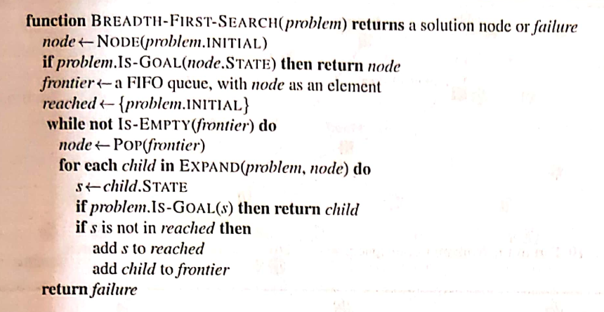
BFS - Algorithm

Slide 11
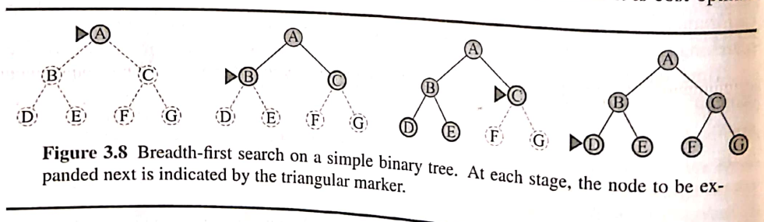
BFS – Example 1

Slide 12
BFS – Example 2

Slide 13
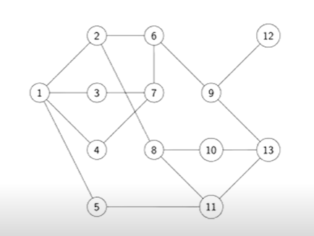
BFS – Example 3

Slide 14
BFS – properties
Complete? Yes (if b is finite)
Time? O(b^d)
  [ 1+ b + b^2 + …+ b^d] = O(b^d)
Space? O(b^d) (keeps every node in memory)
Optimal? Yes (if cost = 1 per step)
.- where b is the branching factor for each node and
- d is the maximum depth at which goal state is found
BFS always finds a solution with minimum number of actions

Slide 15
BFS – Drawback
When b=10, and d=10, BFS would take 3 hrs and 10 TB of memory.
With d=14, search would take 3.5 years even with infinite memory.
Exponential complexity search problems can not be solved by uninformed search for any but smallest instance.

Slide 16
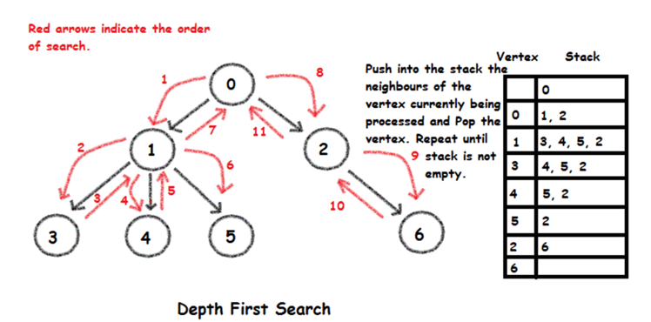
Depth First Search (DFS)
Depth-First Search (DFS) always expands the deepest node in the frontier first.

Slide 17
Properties of DFS
Depth-First Search (DFS) search is not cost-optimal; it returns the first solution it finds, even if it is not cheapest.
For finite state spaces that are trees, it is efficient and complete.
For acyclic state space, it may end up expanding the same state many times via different paths, but will (eventually) systematically explore the entire space.

Slide 18
Properties of DFS -2
In the cyclic state spaces, it can get stuck in an infinite loop; therefore, some implementations of depth-first search check each new node for cycles.
In infinite state spaces, DFS search is not systematic, it may stuck going down in infinite path, even if there are no cycles.
Therefore, DFS search is incomplete.

Slide 19
Advantage of DFS -2
For problems, where a tree like search is feasible, vanilla DFS has much smaller needs for memory.
As vanilla DFS don’t keep a reached table at all.
For the finite tree-shaped state-space, space complexity of DFS search = O(b m)
    Where b is branching factor
    m is maximum depth of the tree.

Slide 20
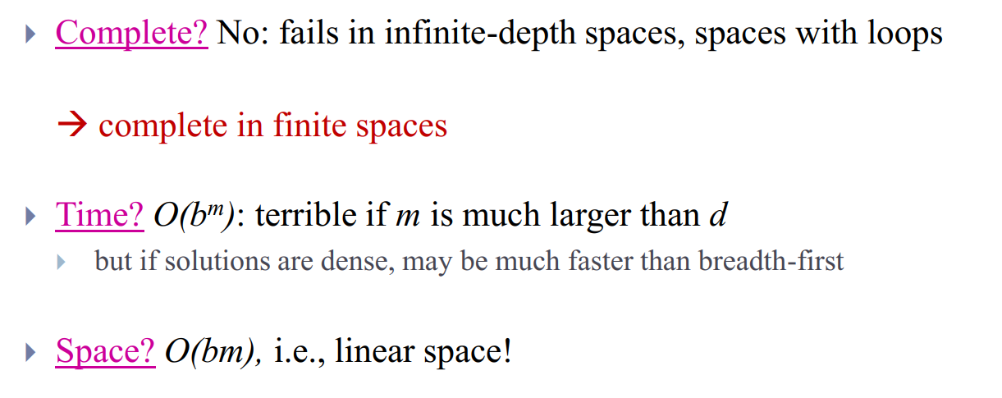
Analysis of DFS -2

Slide 21
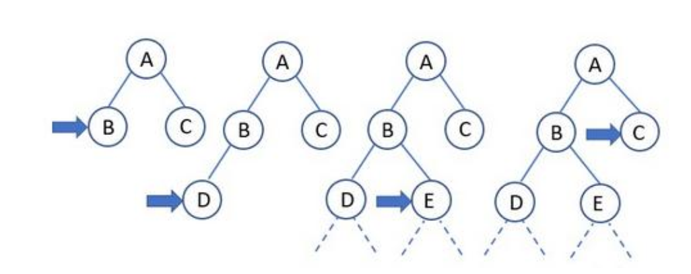
Depth limited DFS
depth-first search with depth limit l,
i.e., it is assumed that nodes at depth l have no successors

Slide 22
Iterative Deepening DFS
DFS which tries to find best value of l depth-first search with depth limit l, for l = 1, 1, 2, .. and so on
i.e., it is assumed that nodes at depth l have no successors

Slide 23
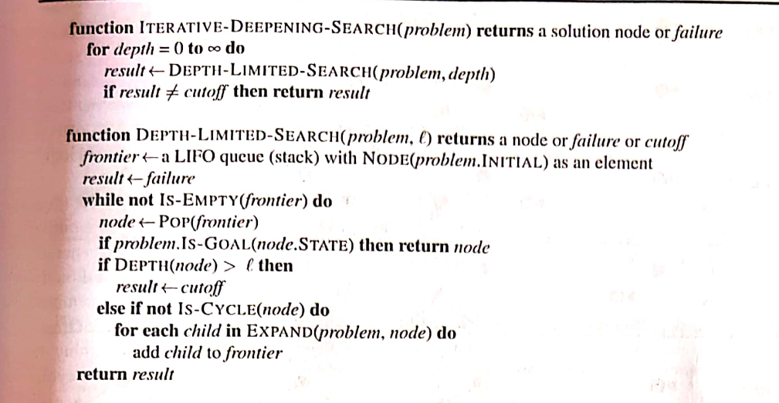
Iterative Deepening DFS

Slide 24
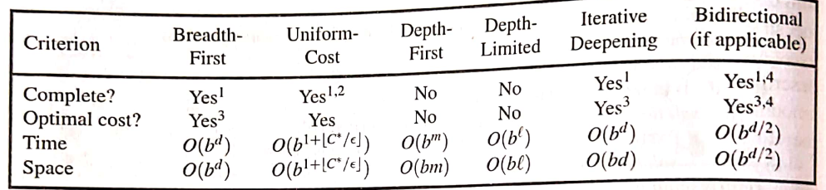
Comparison of different algorithm

Slide 25


