Slide 1

Web Development Module Overview

Slide 2
Learning Outcomes

Slide 3
Learning Outcomes
On the successful completion of this module, you will be able to:
Explain the concepts of the Internet and web technology used in creating a web page.
Build interactive client-side web pages using standard web technology such as HTML, CSS and Javascript.
Build responsive web pages for optimal viewing on all devices using responsive CSS frameworks.
Build a website and publish it to the server.

Slide 4

OOPS!!
This is a 60 hours 4 credit points module

Slide 5
Assessment Components

Slide 6
Assessment Components
Assessment Method | Task | Subtask/Description | Week | Weightage
Test | Test 1 | Non-proctored, MCQs on Intro to Internet & WWW, HTML, structure questions on relative path. | 4 | 15%
Practical | Practical Test 1 | Programming questions on HTML, CSS | 7 | 30%
Test | Test 2 | Proctored, MCQs, programming questions on Javascript | 14 | 25%
Assignment | Assignment 1 | Build a website | 16 | 30%
Always refer to your Lesson Plan & Blackboard for details!

Slide 7
Lecturers and Tutors

Slide 8
Who will guide me along?
Module Group (DIT) | Tutors/Supervisors | Contact Details
1 | Mr Tommy Low | Email: tommy_low@nyp.edu.sg DID: 6550-1796
2, 4 | Mr Lee Ching Yuh | Email: lee_ching_yuh@nyp.edu.sg DID: 6550-1620
3, 5 | Ms Veronica Ang | Email:
Module Group (DSF) | Tutors/Supervisors | Contact Details
1, 3 | Mr Tommy Low | Email: tommy_low@nyp.edu.sg DID: 6550-1796
2 | Mr Lim Yishun | Email:
4 | Mr Fong Chee Wah | Email:

Slide 9
Who will guide me along?
Module Group (DBFT) | Tutors/Supervisors | Contact Details
1, 4 | Ms Teo Bee Wah | Email: teo_bee_wah@nyp.edu.sg DID: 6550-1721
2, 3 | Mr Caine Chew | Email:
Module Group (DCS) | Tutors/Supervisors | Contact Details
2, 3 | Ms Teo Bee Wah | Email: teo_bee_wah@nyp.edu.sg DID: 6550-1721
1 | Ms Wang Meifen | Email: wang_meifen@nyp.edu.sg DID: 6550-1644

Slide 10
Who will guide me along?
Module Group (CIP) | Tutors/Supervisors | Contact Details
1, 2, 6 | Mr Jason Chung | Email: jason_chung@nyp.edu.sg DID: 6550-1712
3 | Mr Fong Chee Wah | Email:
4 | Mr Caine Chew | Email:
5 | Ms Wang Meifen | Email: wang_meifen@nyp.edu.sg DID: 6550-1644
7 | Mr Lim Yishun | Email:

Slide 11
Online Learning
http://www.w3schools.com (good reference for HTML,CSS,JavaScript)
http://www.codecademy.com (good reference for HTML,CSS,JavaScript)
http://www.Lynda.com (good for learning everything)

Slide 12
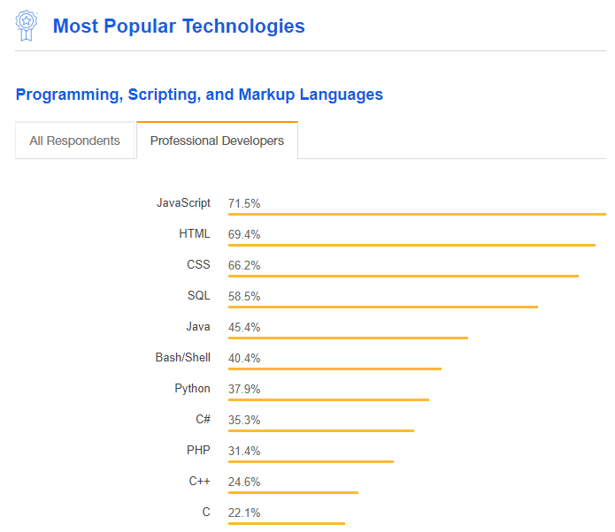
Why Learn?
Learning HTML , CSS and JavaScript is the foundation of developing Web Applications.
They are the 3 most popular techs in recent years.
21st century skills: Problem Solving, ways of thinking, communication, collaboration..
Source: https://insights.stackoverflow.com/survey/2018#most-popular-technologies

Slide 13
How to Maximize your Potential in the Learning Journey
For those who already Know How
Be the most helpful tutors for your peers!!
Learn as you share
Learn independently / in advance
For those who know some
Be an active learner, learn and share, soon be a great tutor to your peers!!
For those who just about to start
Be a happy attentive learner, try it, do it, explore it!
Don’t understand?? Ask ☺

