Slide 1
Introduction to the Web Development Environment
Web Development

Slide 2
Overview
What is Internet? How it works?
What is World Wide Web? How it works?
What is a website?
Introduction to Web Applications

Slide 3
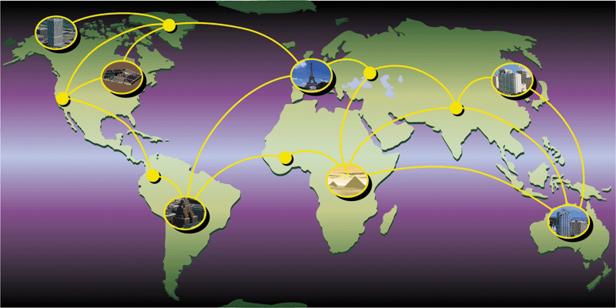
The Internet
The Internet is a worldwide collection of networks that links millions of businesses, government agencies, educational institutions, and individuals.
An information highway

Slide 4
How the Internet is managed?
Who controls the Internet?
No single person - it is a public, cooperative, and independent network.
World Wide Web Consortium (W3C)
Oversees research, sets standards and guidelines
Mission is to contribute to the growth of the Web
As of 28 February 2017, the World Wide Web Consortium (W3C) has 446 Members

Slide 5
How does the internet work?
https://www.youtube.com/watch?v=7_LPdttKXPc
What are the terms mentioned in the video?

Slide 6
How Does Internet Work ?
How to communicate ?
Transmission Control Protocol/Internet Protocol
Protocol (Language )
How to identify the target ?
TCP/IP
IP Address
192.168.100.1
Domain Name
nyp.gov.sg

Slide 7

Domain Name Service
Domain Name Server
66.94.234.63
yahoo.com
a network service that maps domain names to IP addresses

Slide 8

Domain Name
.com for Commercial organisations
www.microsoft.com
.edu for Educational institutions; universities, etc
www.stanford.edu
.net for Network resources organisations
www.cobweb.net
.org for Other non-profit making organisations
www.w3c.org
.edu.sg (sg is the country code for Singapore)
www.nyp.edu.sg
Reference: http://www.sgnic.sg/ for DNS Information

Slide 9
How does Internet work?
The role of
TCP/IP
Underlying protocol (language) to enable the communication between the nodes in the Internet
IP address (e.g. 139.130.4.5)
To uniquely identify each of the node
Domain Name (e.g. nyp.edu.sg)
human-readable web address
DNS
Domain Name Service – a service to translate domain name to IP address and vice versa
Domain Name Server/System – a server which provide the Domain Name Service

Slide 10
Internet Intranet Extranet
Internet
The World
Supplier, Customers,
Collaborators
Extranet
Intranet
Within the Organisation

Slide 11
Types of Internet Services
FTP
WEB SERVICES
EMAIL
WWW
TELNET
MESSENGER

Slide 12
World Wide Web – (WWW)
We are using it everyday
https://www.youtube.com/watch?v=J8hzJxb0rpc
From Web 1.0 to Web 2.0 and going to Web 3.0
https://www.youtube.com/watch?v=fWj4NNdJHE0
https://www.youtube.com/watch?v=-NvcIN6EB-o
https://www.geeksforgeeks.org/web-1-0-web-2-0-and-web-3-0-with-their-difference/

Slide 13
URL – Uniform Resource Locator
To locate a resource available in the Web
http://www.nyp.edu.sg/admissions/full-time-diploma/am-i-eligible.html
protocol
path
the resource
(identify the targeted web resource)
domain name
(identify the web server)

Slide 14

Web Client vs Web Server
By default, web server listen at port 80
e.g. Chrome, Firefox, Safari
HTTP Request
Port
Server
Client
HTTP Response
Get URL
Send request to web server
Receive response
Interpret and display
Listen for the request
Find the resource required
Send Response

Slide 15
Web Browser
Locate
Retrieve
Interpret
HTML
CSS
JavaScript
Display/render
Text
Image
Audio
Video

Slide 16
What is a website?
How to access a website?
URL
What’s the underlying technologies?
HTTP/HTTPS
Web Server vs Web Client
It enables
Sharing of content
Communication and collaboration
It consists of a group of interlinked and well-structured web pages

Slide 17
Web Hosting
To make your website accessible via the World Wide Web, you have to host it to a server connected to the Internet.
You will need (will be given if you are getting a hosting service)
A domain name (to uniquely identify your website)
To upload your website
https://www.youtube.com/watch?v=opMQ1y3SnsU
https://www.youtube.com/watch?v=-s3XKYZ4nHs
Notes:
http://www.webhostingsecretrevealed.net/web-hosting-beginner-guide/

Slide 18
What are the common components inside a web page?
Title
Navigation
Hyperlinks
Web content
Words
Images
Video
Hyperlinks
interactive content
Presented in different Layout and Design

Slide 19
Static Web Site vs Dynamic Web Site
Static web site
Consists of static web pages which when requested by the web client, they are sent by the web server with no processing required.
To change the content of a web page, the creator need to change it manually and update it accordingly to the web site.

Slide 20
Static Web Site vs Dynamic Web Site
Dynamic web site
Consists of dynamic web pages, of which the content is generated dynamically when requested by the web client.
Web server contains necessary processing power, logics and data to automatically generate the content of web pages.

Slide 21
Web Applications
More than a basic content-based web site
Not limited to richness in content but functionalities
Users interact with the application to accomplish certain tasks
Similar to desktop application but it is accessed using web browser, through web page
Involve both frontend and backend processing

Slide 22
Web Applications
To the end users, same way to access to a website or a web application
To people who are doing business, it is important to focus at what are the functionalities available to help in achieving the business objectives
To the developers, additional skills are required to develop web applications
Different server-side programming languages
Different web application frameworks

Slide 23
What you will be taught and tested in this module?
HTML
CSS
JavaScript
JSON
HTML DOM
Able to create a interactive static website

Slide 24
What may be introduced and be applied in this module?
Able to create a responsive and dynamic website with some simple functionalities
Bootstrap (frontend framework)
Advanced HTML5 APIs
Drag and Drop
Geolocation

