Slide 1
HTML(Part II)
Web Development

Slide 2
Overview
Table
Form
Video
audio
iframe

Slide 3
Tables
Tables is useful in present large amounts of data in rows and columns
Tables can include numeric data, textual content, images and multimedia
A table consists of one or several rows
Each row has one or more columns

Slide 4
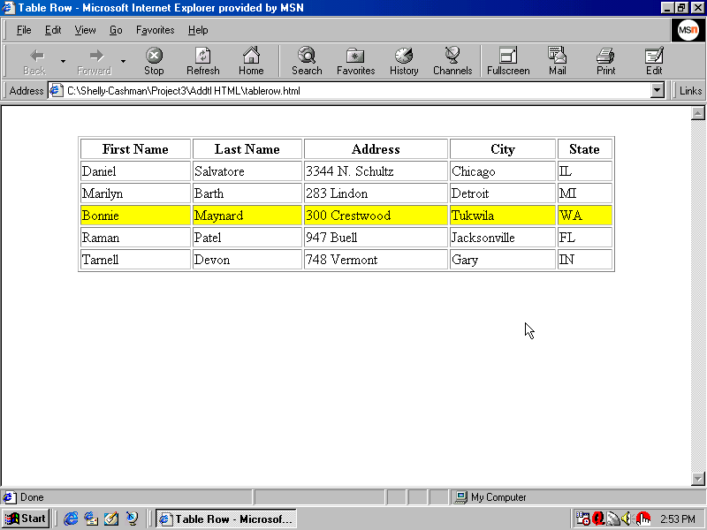
Table Elements
row
Notes:
This is a row.

Slide 5
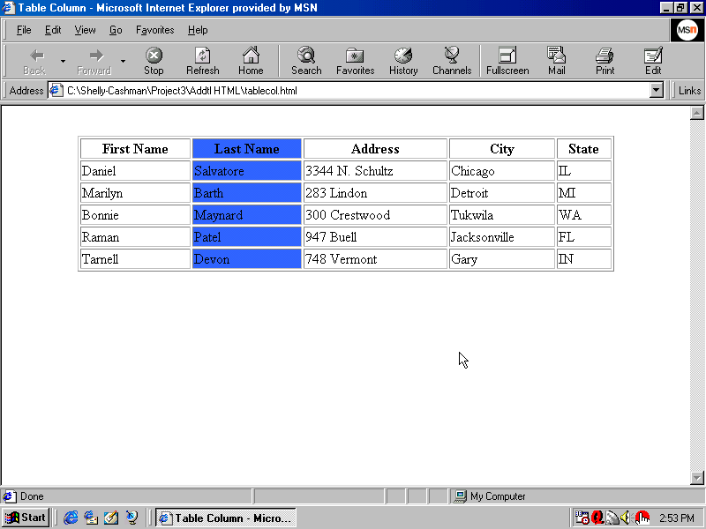
Table Elements
column
Notes:
This is a column

Slide 6
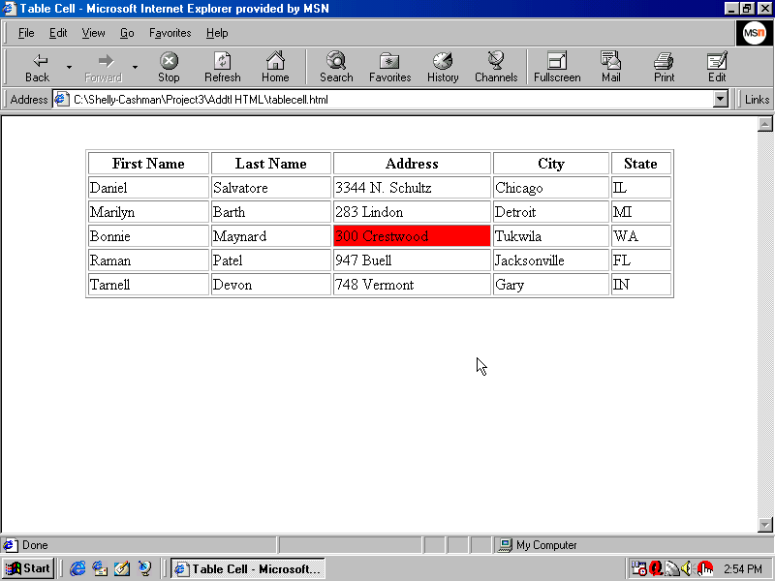
Table Elements
cell
Caption is the label of table
Notes:
This is a cell.

Slide 7
Tags for Creating Tables
Tag | Description
<table>…</table> | Defines a table
<th>…</th> | Defines a table header
<tr>…</tr> | Defines a table row
<td>…</td> | Defines a table cell
<caption>…</caption> | Defines a table caption
Notes:
The <caption> tag must be inserted immediately after the <table> tag.

Slide 8
<table> Attributes
In HTML5, <table> only has one attribute which is border.
Attribute | Possible Values | Default
border | 0 or 1 | 0
Some old web pages use table to control the layout of a web page. For such usage, the border attribute should be set to 1.
Using table to do layout is strongly discouraged as it is difficult to maintain.

Slide 9
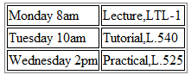
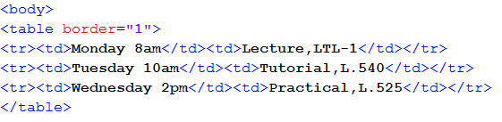
Table - Example
The several core tags for creating table: <table></table>: begin / end the table <tr></tr>: create a table row <td></td>: create tabular data (cell)
<table>
<tr>
<td></td>
<td></td>
</tr>
<tr>
<td></td>
<td></td>
</tr>
<tr>
<td></td>
</tr>
</table>

Slide 10
Hands On Activity
Create the following table
AdmNo | Name | PEM | Mentor
141000A | Mary Lim | BT1401 | Mr Tan
142000B | Luke Sun | BT1401

Slide 11
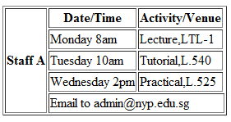
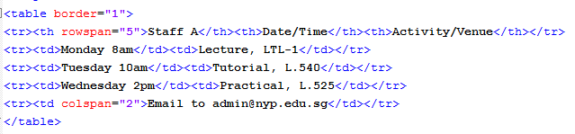
Creating Tables

Slide 12
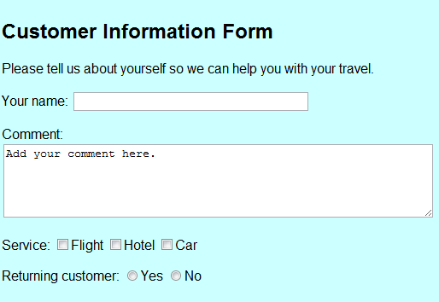
Forms
Forms are the most common way of accepting user input
Examples : membership registration, sign up for newsletter and currency converter

Slide 13
Forms
How does an HTML form work?
A user visiting your web page fills out the form and clicks submit
The browser sends the submitted form data to the web server
The web server processes the form data
A response page is sent back to the browser.

Slide 14
Forms
A form is simply an area that contains various form elements, such as text box, check box, radio button, list box, etc.
A form is defined using the <form> tag with attributes
<form …>
form elements
</form>

Slide 15
Form elements
The <form> tag can contain one or more of the following form elements:
<input> <option>
<textarea> <optgroup>
<button> <fieldset> <label> <datalist>
<select> <output>
Note : we will only cover some of the commonly used form elements in this module

Slide 16
Form elements
Id and Name Attributes
Form elements take both the name attribute and the id attribute. They are used for different purposes
The name attribute is used to hold the value of the field. It is passed to the server as a variable.
The id attribute is used by CSS and JavaScript to identify a specific element (we will come to this later part of the module)

Slide 17
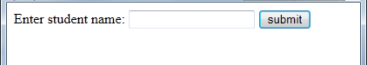
A simple example
<form>
<label for="sname">Enter student name:</label>
<input type="text" id="sname" name="studname" />
<input type="submit" value="submit" />
</form>

Slide 18
<label> tag
<label for="sname">Enter student name:</label>
Defines a label for an <input> element
The for attribute of the <label> tag should be equal to the id attribute of the related element to bind them together
Another alternative:
<label>Enter student name:
<input type="text">
</label>

Slide 19
Input Type : Text
<input type="text" id="sname" name="studname" />
defines a single-line text field (default width is 20 characters)
You can specify the size of the width using the size attribute e.g <input type="text" id="sname" name="studname" size= "30" />

Slide 20
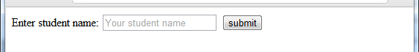
Placeholder attribute
<input type="text" id="sname" name="studname" placeholder="Your student name" />
Specifies a short hint that describes the expected value of an <input> element

Slide 21
Autofocus attribute
<input type="text" id="sname" name="studname" autofocus />
Specifies that an <input> element should automatically get focus when the page loads
The autofocus attribute can be set in the following ways:
<input autofocus />
<input autofocus =" autofocus " />
<input autofocus ="" />

Slide 22
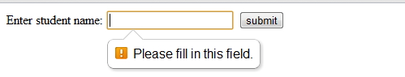
Required attribute
<input type="text" id="sname" name="studname" required />
Specifies that an input field must be filled out before submitting the form
The required attribute can be set in the following ways: <input required /> <input required ="required" /> <input required ="" />
The required attribute works with other input types such as text, search, url, tel, email, password, number, checkbox, radio, etc.

Slide 23
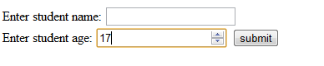
Input Type : Number
<label for="sage">Enter student age:</label>
<input type="number" id="sage" name="sage" />
Define a field for entering a number
Use with the following attributes to specify restrictions:
max : specifies the maximum value allowed
min : specifies the minimum value allowed
step : specifies the legal number intervals
value : Specifies the default value

Slide 24
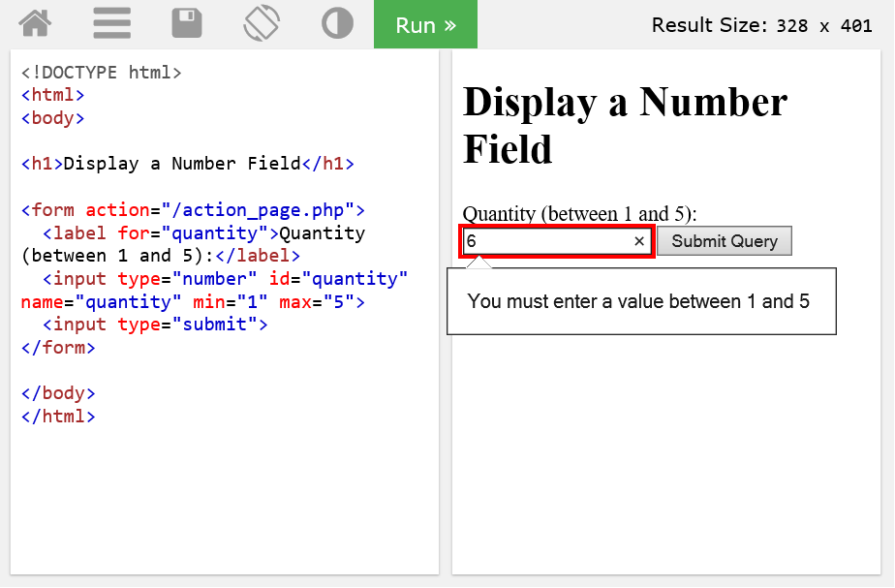
Input Type : Number
https://www.w3schools.com/tags/tryit.asp?filename=tryhtml5_input_type_number

Slide 25
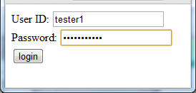
Input Type : Password
<input type="password" id="pw" name="pw" />
Defines a password field
Characters are masked

Slide 26
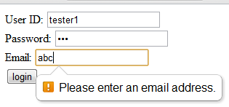
Input Type : email
<input type="email" id="email" name="email" />
Define a field for an e-mail address
It will be automatically validated when submitted

Slide 27
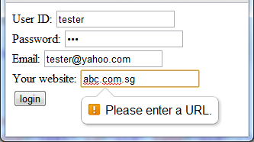
Input Type : url
<input type= "url" id=“url" name=“url" />
Define a field for entering a URL
It will be automatically validated when submitted

Slide 28
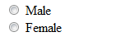
Input Type : radio
<input type="radio" name="gender" value="male" /> Male<br /> <input type="radio" name="gender" value="female" /> Female
Radio Buttons are used when you want the user to select one of a limited number of choices
Only one radio button in the group can be checked at any given time
Each radio button in the group should have a unique value - the value to be sent to the server if that radio button is selected
The name attributes should be the same to indicate they are of the same group (in this e.g., name="gender")

Slide 29
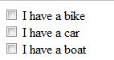
Input Type : checkbox
<input type="checkbox" name="vehicle" value="Bike" /> I have a bike<br>
<input type="checkbox" name="vehicle" value="Car" /> I have a car<br >
<input type="checkbox" name="vehicle" value="Boat" /> I have a boat<br>
Checkboxes are used when you want the user to select one or more of a limited number of choices
Each checkbox in the group should have a unique value
Every checkbox within the same group have the same name attributes

Slide 30
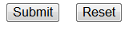
Input Type : submit and reset
<form> ... <input type="submit" value="Submit" />&nbsp;&nbsp;
<input type="reset" value="Reset" /> ... </form>
The input type: reset defines a reset button which resets all form values to default values
The input type: submit defines a submit button which sends the form to the server for processing

Slide 31
Input Type : button
<input type= " button" value= "Click" />
The input type: button defines a clickable button which can invoke a Javascript

Slide 32
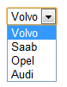
Select list
<select>
<option value="volvo">Volvo</option>
<option value="saab">Saab</option>
<option value="opel">Opel</option>
<option value="audi">Audi</option>
</select> https://www.w3schools.com/tags/tryit.asp?filename=tryhtml_select
The <select> tag is use to create a drop-down list
It is used in conjunction with the <option> tags

Slide 33
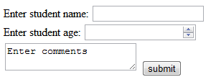
Textarea field
<textarea>Enter comments</textarea>
Defines a multi-line text input control
Commonly used attributes are:
cols : specifies the visible width of a text area
rows : specifies the visible number of lines in a text area
maxlength : specifies the maximum number of characters allowed in the text area
Try it yourself : https://www.w3schools.com/tags/tryit.asp?filename=tryhtml_textarea

Slide 34
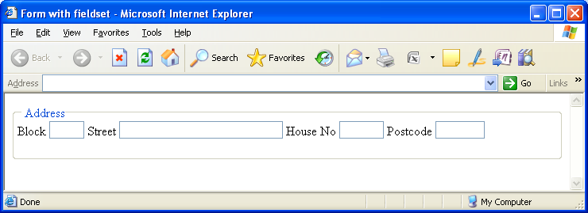
<fieldset> and <legend>
group related elements using <fieldset> and <legend>

Slide 35
<fieldset> and <legend>
group related elements using <fieldset> and <legend>
<form>
<fieldset>
<legend>Address</legend>
<label for="blk">Block</label>
<input type="text" id="blk" name="blk" size="3"/>
<label for="street">Street</label>
<input type="text" id="street" name="street" size="30"/>
<label for="houseno">House No</label>
<input type="text" id="houseno" name="houseno" size="5"/>
<label for="postcode">Postcode</label>
<input type="text" id="postcode" name="postcode" size="6"/>
</fieldset>
</form>

Slide 36
Sending the form data
So far, we have not learned how to actually send the data for processing at the web server
The <form> tag has two main attributes: action and method
Example: <form action="processform.aspx" method= "get" >
Username:
<input type="text" name="user"/>
<input type="submit" value="Submit"/>
</form>

Slide 37
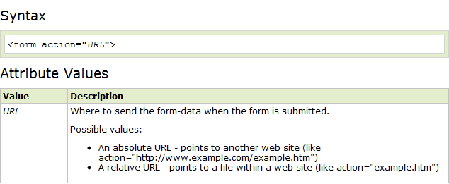
action attribute
The action attribute specifies where to send the form-data when a form is submitted
https://www.w3schools.com/tags/tryit.asp?filename=tryhtml_form_action

Slide 38
action attribute
To send the form data through email
For example:
<form name=“input” method=“post” action=“mailto:chin_kia_su@yahoo.com.sg”>

Slide 39
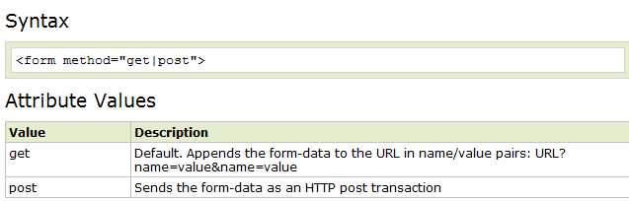
method attribute
The method attribute specifies the HTTP method to use when the form is submitted
Source: https://www.w3schools.com/tags/att_form_method.asp
Notes:
Appends form-data into the URL in name/value pairs
The length of a URL is limited (about 3000 characters)
Never use GET to send sensitive data! (will be visible in the URL)
Useful for form submissions where a user wants to bookmark the result
GET is better for non-secure data, like query strings in Google
Notes on POST:
Appends form-data inside the body of the HTTP request (data is not shown in URL)
Has no size limitations
Form submissions with POST cannot be bookmarked

Slide 40
method attribute
if method="get", the data are sent to the web server as name-value pairs at the end of the URL indicated in the action attribute
URL consists of the destination and a query string, for example:
processform.aspx?user=ChinKiaSu
As the length of URL is limited (URLs over 2,000 characters will not work in the most popular web browsers ), there is a limit in the length and numbers of data
As query string is visible, may not be suitable for sending sensitive data too

Slide 41
method attribute
If method="post", the data are sent as name-value pairs to the web server in the request body (not visible in URL), usually be sent as a separate data stream.
For the same example, if method="post" is used, the following content is sent to the Web server:
user=ChinKiaSu
If there are more than one piece of data, the & sign is used to separate them, for example:
user=ChinKiaSu&password=kiasiking
Notes:
HTTP Request Payload

Slide 42
Adding Video
<video src="../multimedia/BigBuck.ogg" autoplay></video>
<video src="../multimedia/BigBuck.ogg" width="320" height="180" poster="poster320.jpg" controls></video>

Slide 43
Video: additional attributes
muted
Specifies that the audio output of the video should be muted
loop
Value is loop. Specifies that the video will start over again, every time it is finished
preload
Value can be auto, metadata, none. Specify when should be video be loaded.
poster
Specifies an image to be shown while the video is downloading, or until the user hits the play button

Slide 44
Fall back to support older browser
<video width="320" height="240" controls="controls">
<source src="movie.mp4" type="video/mp4" />
<source src="movie.ogg" type="video/ogg" />
<h1><a href ="movie.mp4">Download the video</a></h1>
Your browser does not support the video tag.
</video>
show
Notes:
However browsers that support HTML5 video/audio ignore the fall back section even if they can’t play the media. For example, if Firefox finds a video of H.264 (.mp4), it shows an X icon but won’t show the fall back content.

Slide 45
Adding Audio
<audio autoplay src="../multimedia/onlytime.mp3" />
<audio controls>
<source src='../multimedia/BigBuck.ogg' />
<source src='../multimedia/BigBuck.mp3' />
<h1>Your browser cannot play</h1>
</audio>
show

Slide 46
Audio: additional attributes
autoplay
Specifies that the audio will start playing as soon as it is ready
muted
Specifies that the audio should be muted
loop
Value is loop. Specifies that the audio will start over again, every time it is finished
preload
Value can be auto, metadata, none. Specify when should be audio be loaded.

Slide 47
Using iframe
<iframe> allows you to embed another document within the current HTML document
Possible usage:
Advertisement from external party
Source from another document, within website or other website
Social media buttons
show

