Slide 1

BATTERY STATUS MONITORING SYSTEM
A presentation on
Submitted by
ARITRA DALUI (11600620007)
ARCHISMAN MANGAL (11600620005)
BANANI MANNA (11600620010)
MEGHA BOSE (11600621037)
SAYAN BHUL (11600620032)
SUSHANTO DEY (11600620029)
SWAPNODEEP BANERJEE (11600620030)
Under the guidance of
MR. SUDEEP SAMANTA
Asst. Prof. of Electrical Engineering Department
DEPARTMENT OF ELECTRICAL ENGINEERING
MCKV Institute of Engineering
243, G. T. Road (North), Liluah, Howrah- 711 204
Year: 2023

Slide 2
ACKNOWLEDGEMENT
We would like to express my special thanks of gratitude to our mentor Asst. Prof. Mr. SUDEEP SAMANTA as well as our H.O.D Prof. (Dr.) TAMAL ROY who gave us the golden opportunity to do this wonderful project on the topic of "BATTERY STATUS MONITORING SYSTEM”, which also helped us in doing a lot of Research and we came to know about so many new things and make something useful out of it.
We are really thankful to them. Secondly, We would also like to thank our friends who helped us a lot in finalizing this project within the limited time frame.

Slide 3
ABSTRACT
The rapid proliferation of battery-powered devices across various industries has highlighted the critical importance of effective battery management. This project focuses on the design, development, and implementation of a Battery Status Monitoring System (BSMS) aimed at enhancing the performance and reliability of battery-powered applications.
The primary objectives of the project include the creation of a robust hardware and software architecture capable of monitoring multiple battery parameters, such as voltage, current, temperature, and state of charge. Through a user-friendly interface, user can access comprehensive insights into the battery status, enabling timely maintenance and optimization strategies.
The successful implementation of the Battery Status Monitoring System offers a proactive approach to battery management, promoting sustainability, cost-effectiveness, and enhanced reliability in a wide range of applications. This project contributes to the advancement of battery technology and supports the growing demand for efficient and intelligent battery monitoring solutions.

Slide 4
TABLE OF CONTENT
Sl. No | Topics | Slide No.
1 | Introduction | 5
2 | Objectives | 6
3 | Theoretical Aspects
i) | Battery Management System (BMS) | 7
ii) | State of Charge (SOC) & State of Health (SOH) | 8
iii) | Kalman Filter | 9
4 | Components Used | 10
5 | Schematic Diagram | 11
6 | Electrical Circuits | 12
7 | Observations
i) | Discharging | 13
ii) | Recharging | 14
8 | Benefits | 15
9 | Conclusion | 16

Slide 5
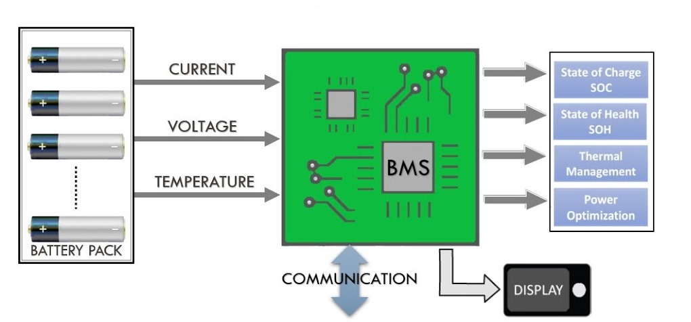
INTRODUCTION
The Battery Status Monitoring System (BSMS) is a critical component in the management of energy storage systems, with a primary focus on accurately monitoring State of Charge (SOC) and State of Health (SOH), Thermal Management and Power Optimization of batteries.
The filtered results are used to continuously update and refine the estimates of SOC and SOH. Additionally, the system incorporates wireless communication technology for seamless data transmission, allowing remote monitoring and control.
Fig 1: Battery Status Monitoring

Slide 6
Hardware Development
Efficiency Optimization
OBJECTIVES
Microcontroller Implementation
Testing
and
Validation
Fault
Detection
Predictive Maintenance

Slide 7
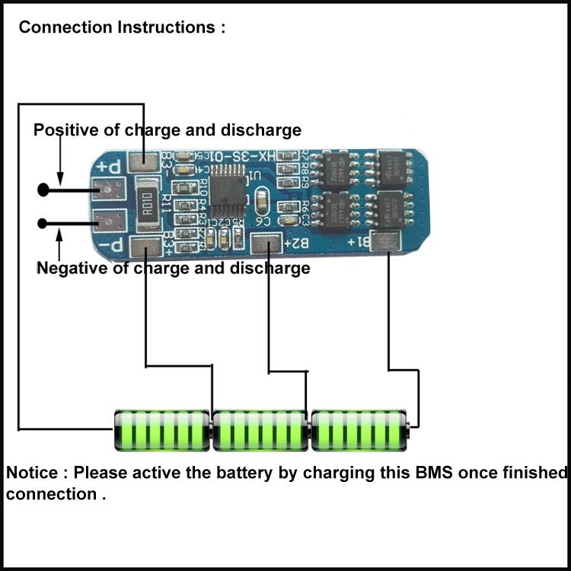
THEORETICAL ASPECTS
Battery Management System BMS :
Battery management system (BMS) is technology dedicated to the oversight of a battery pack, which is an assembly of battery cells, electrically organized in a row x column matrix configuration to enable delivery of targeted range of voltage and current for a duration of time against expected load scenario.
Fig 2: BMS

Slide 8
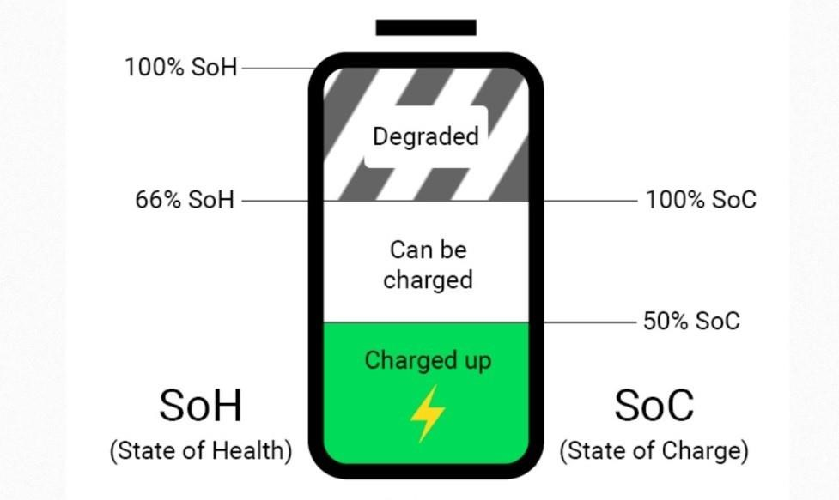

THEORETICAL ASPECTS
State Of Charge (SOC) :
The state of charge (SOC) of a battery is a measure of the amount of energy available in the battery at a specific point in time
State Of Health (SOH) :
The state-of-health (SOH) of a battery describes the difference between a battery being studied and a fresh battery and considers cell aging.
Fig 3: SOC & SOH

Slide 9
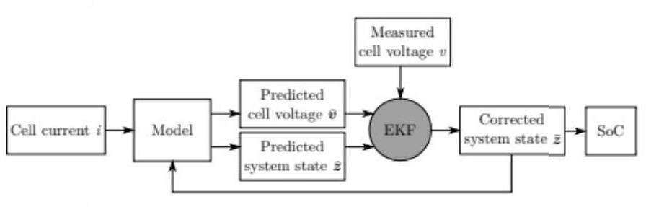
THEORETICAL ASPECTS
Kalman filter :
The Kalman filter is a recursive estimator. This means that only the estimated state from the previous time step and the current measurement are needed to compute the estimate for the current state.
Fig 4: Kalman Filter

Slide 10
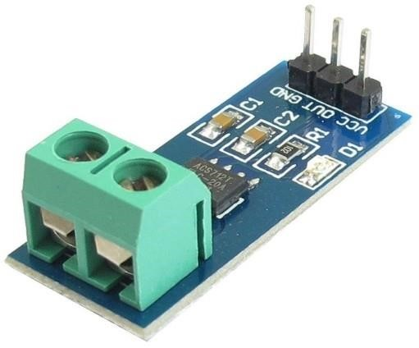
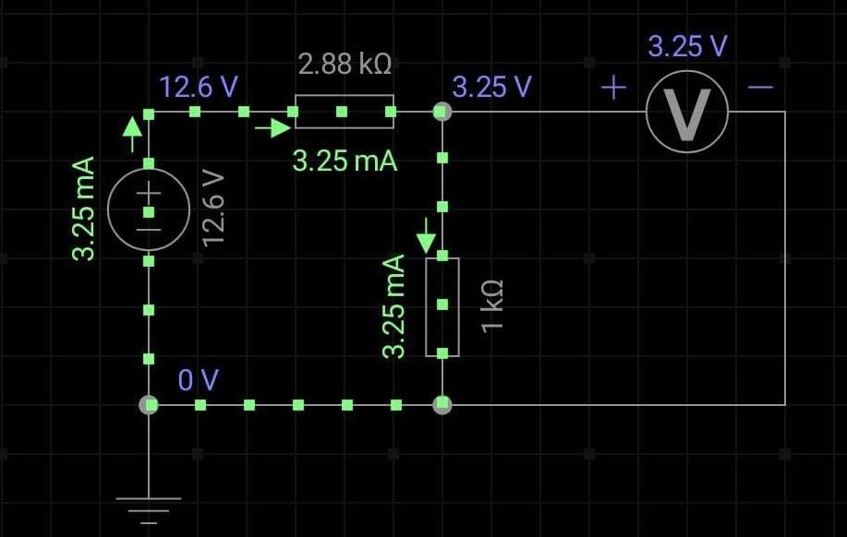

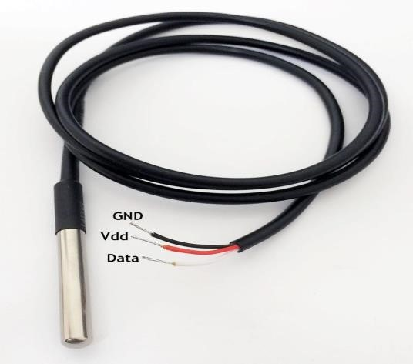


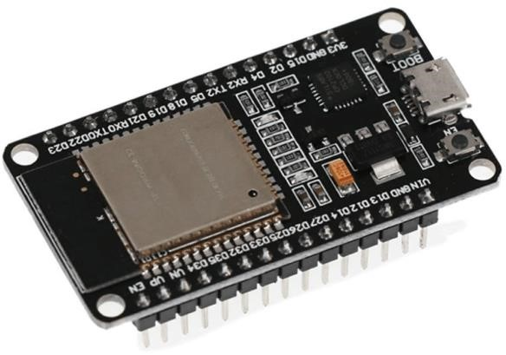
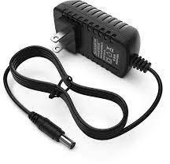
COMPONENTS USED
Fig 10: 20W COB LED
Fig 5: Current Sensor
ACS 712
Fig 8: Voltage divider circuit as voltage sensor
Fig 6: Temperature sensor
Fig 11: 18650 Li-Ion Battery
Fig 7: ESP32 DEVKIT V1
Fig 12: 12V 2A power adaptor
Fig 9: 3S BMS module

Slide 11
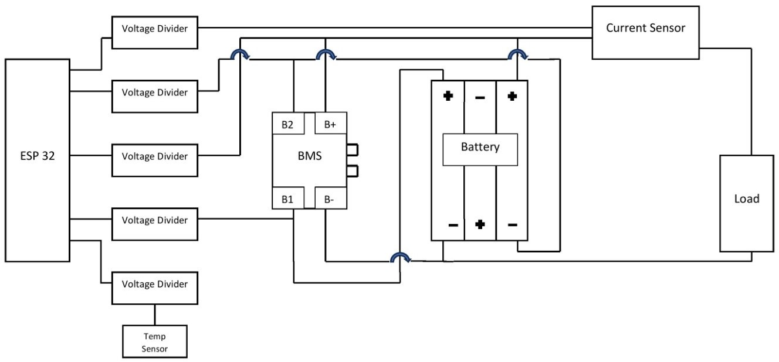
SCHEMATIC diagram
B1
B2
Fig 13: Schematic representation

Slide 12
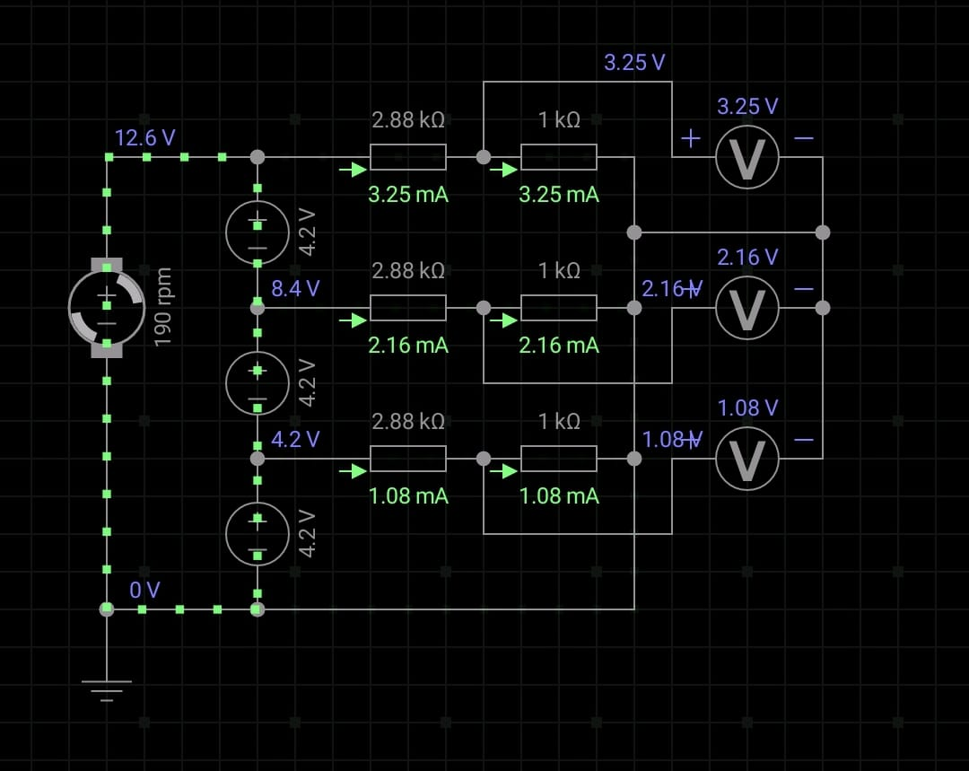
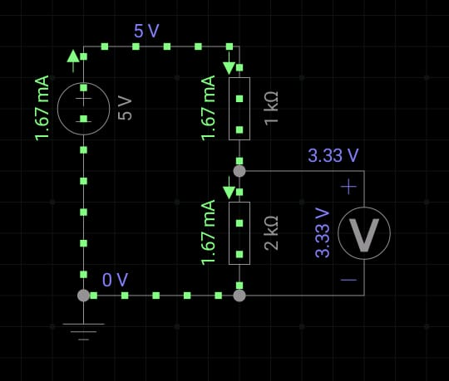
Electrical Circuits
Fig 14: Voltage divider as voltage sensor
Fig 15: Voltage divider as Logic level shifter

Slide 13
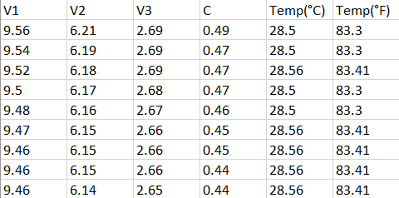
Observation
DISCHARGING
Fig 16: Raw data

Slide 14
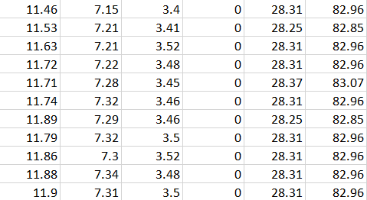
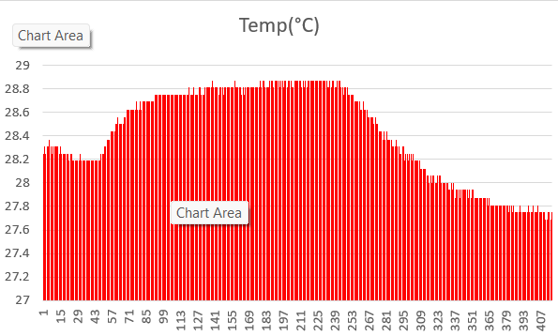
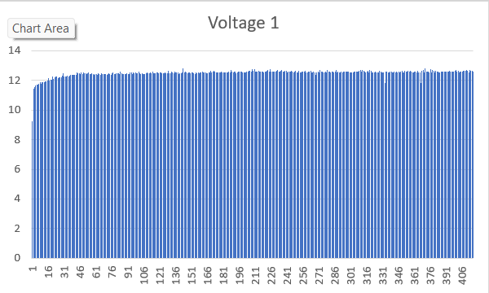
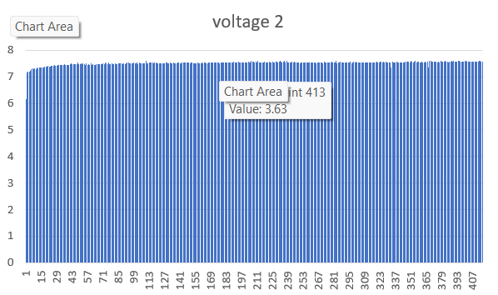
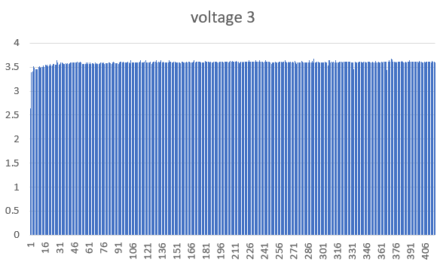
Observation
RECHARGING

Slide 15
benefits
Enables proactive maintenance
Minimizes the risk of unexpected failures
Extends overall battery lifespan
Enhances reliability of systems relying on these power sources
Facilitates optimized energy management
Ensures efficient utilization and reduces unnecessary power consumption
Remote monitoring enhances safety by identifying potential issues promptly
Crucial role in electric vehicles and renewable energy systems
Maximizes energy efficiency
Promotes sustainability
Advances the transition towards a more resilient and intelligent energy infrastructure

Slide 16
FUTURE ASPECTS
By measuring different parameters of battery like voltage, current, temperature we are going to determine SOC, SOH, Thermal management and power optimization thus we can do predictive maintenance of a battery. Without any man power

Slide 17
Conclusion
The battery status monitoring system is a crucial advancement in efficient power management. By continuously tracking and analyzing battery health, it enhances lifespan, prevents failures, and optimizes energy usage in various applications. Real-time data empowers informed decisions, contributing to a sustainable energy infrastructure. As technology evolves, these monitoring systems play a pivotal role in meeting the demand for reliable and intelligent energy solutions.

Slide 18
THANK YOU

