Slide 1

BATTERY STATUS MONITORING SYSTEM
A presentation on
Submitted by
ARITRA DALUI (11600620007)
ARCHISMAN MANGAL (11600620005)
BANANI MANNA (11600620010)
MEGHA BOSE (11600621037)
SAYAN BHUL (11600620032)
SUSHANTO DEY (11600620029)
SWAPNODEEP BANERJEE (11600620030)
Under the guidance of
MR. SUDEEP SAMANTA
Asst. Prof. of Electrical Engineering Department
DEPARTMENT OF ELECTRICAL ENGINEERING
MCKV Institute of Engineering
243, G. T. Road (North), Liluah, Howrah- 711 204
Year: 2023

Slide 2
ACKNOWLEDGEMENT
We would like to express my special thanks of gratitude to our mentor Asst. Prof. Mr. SUDEEP SAMANTA as well as our H.O.D Prof. (Dr.) TAMAL ROY who gave us the golden opportunity to do this wonderful project on the topic of "BATTERY STATUS MONITORING SYSTEM”, which also helped us in doing a lot of Research and we came to know about so many new things and make something useful out of it.
We are really thankful to them. Secondly, We would also like to thank our friends who helped us a lot in finalizing this project within the limited time frame.

Slide 3
ABSTRACT
The rapid proliferation of battery-powered devices across various industries has highlighted the critical importance of effective battery management. This project focuses on the design, development, and implementation of a Battery Status Monitoring System (BSMS) aimed at enhancing the performance and reliability of battery-powered applications.
The primary objectives of the project include the creation of a robust hardware and software architecture capable of monitoring multiple battery parameters, such as voltage, current, temperature, and state of charge. Through a user-friendly interface, user can access comprehensive insights into the battery status, enabling timely maintenance and optimization strategies.
The successful implementation of the Battery Status Monitoring System offers a proactive approach to battery management, promoting sustainability, cost-effectiveness, and enhanced reliability in a wide range of applications. This project contributes to the advancement of battery technology and supports the growing demand for efficient and intelligent battery monitoring solutions.

Slide 4
TABLE OF CONTENT

Slide 5
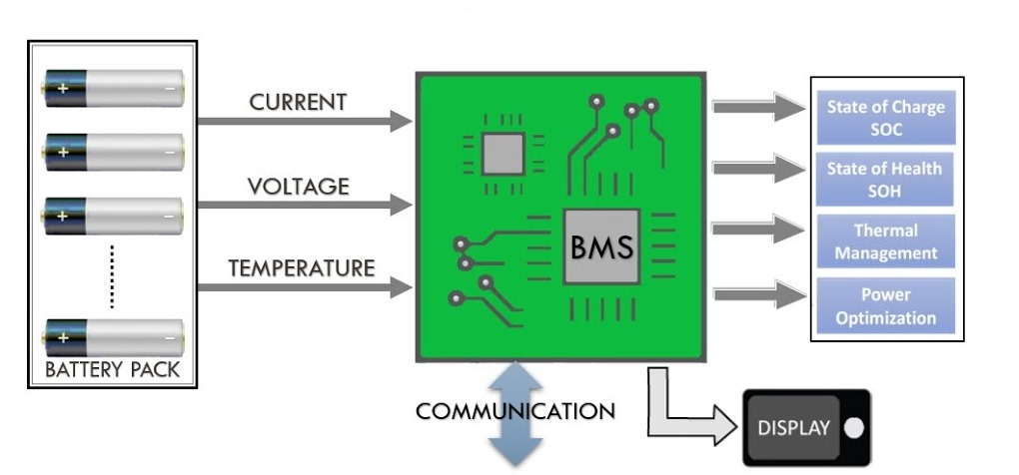
INTRODUCTION
Battery status monitoring involves tracking and analyzing the performance and health of a device's battery. It is a crucial aspect of modern electronic devices, ranging from smartphones and laptops to electric vehicles and renewable energy systems. The goal of battery status monitoring is to provide users and system administrators with real-time information about the battery's charge level, voltage, temperature, and overall health.
Fig 1:

Slide 6
OBJECTIVE
Energy Efficiency Optimization
Hardware Development
Testing
and
Validation
Microcontroller Implementation
Fault Detection
and
Notification
Project Evaluation

Slide 7
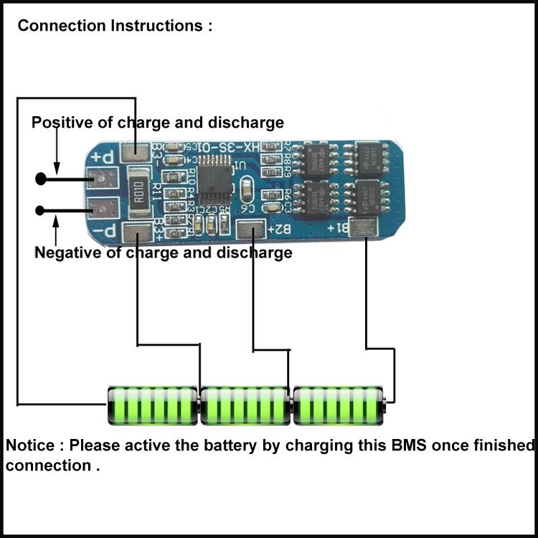
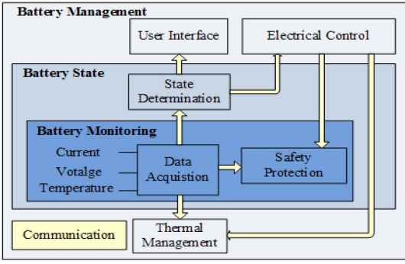
THEORETICAL ASPECTS
Battery Management System BMS :
Battery management system (BMS) is technology dedicated to the oversight of a battery pack, which is an assembly of battery cells, electrically organized in a row x column matrix configuration to enable delivery of targeted range of voltage and current for a duration of time against expected load scenario.
Fig 2:

