Slide 1
ProcScope
A C++17 Linux System Monitor & Device Explorer
Module-9 Capstone — individual project defense
Presented by Rudra Prakash Nayak
reads /proc · /sys/class · /dev
0 external libraries
background sampler thread
github.com/rudraprakashnayak/procpulse

Slide 2
ProcScope at a glance
Four collectors, one sampler thread, three ways to present — C++17 standard library and POSIX only
4
3
0
2
collectors
run modes
external dependencies
test layers
cpu · memory · processes · devices
interactive menu · --once · --live
C++17 standard library + POSIX APIs
fixture unit tests + integration script
Built in six documented stages
git tags stage-1 … stage-6 + v1.0 — intro, PRD, design, implementation, tests, final report
every commit maps to one capstone stage; the README carries the reference-project banner
procfs · sysfs · devfs — the kernel's own reporting interface, read straight from C++

Slide 3
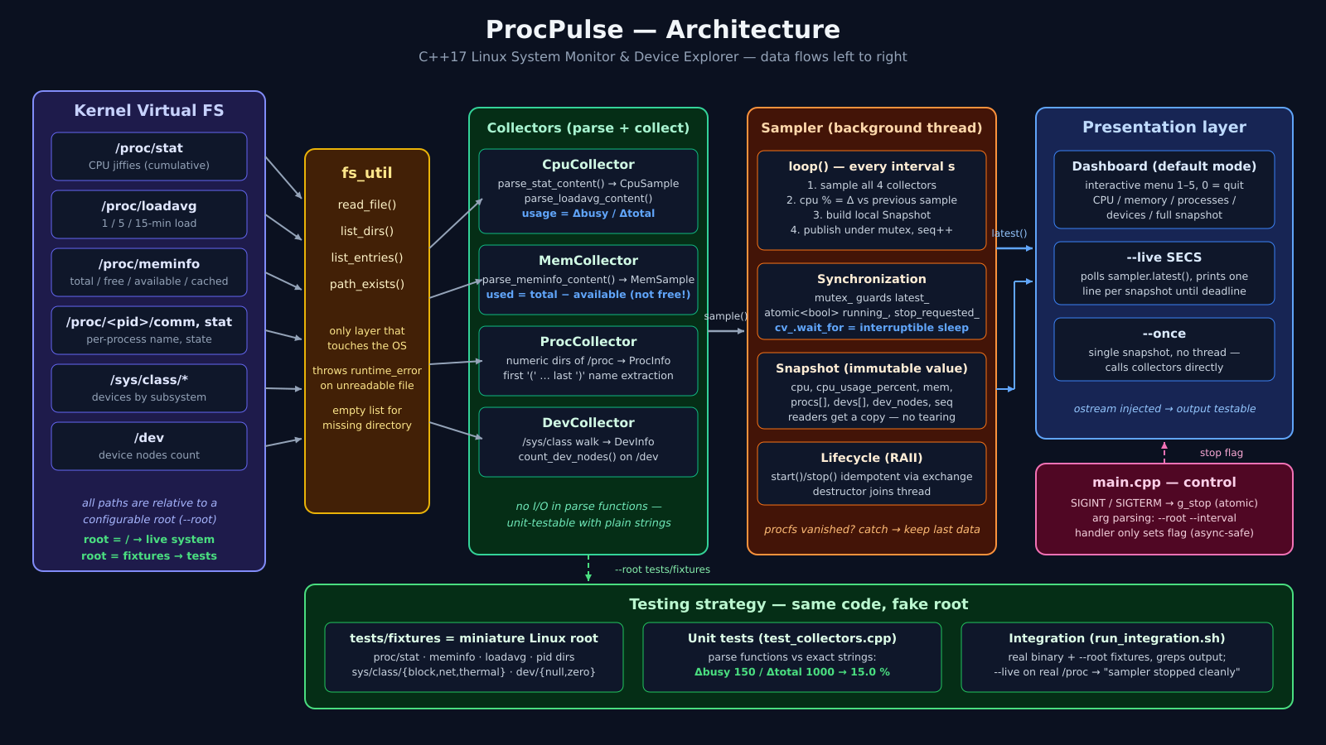
Architecture — one pipeline, left to right
kernel virtual filesystems → fs_util → collectors → sampler thread (mutex + condition variable) → dashboard / --live / --once

Slide 4
Where the data comes from
Everything ProcScope knows, the kernel already publishes — the job is parsing it correctly
/proc
/sys/class
/dev
stat — CPU jiffies since boot
loadavg — 1 / 5 / 15 minute load
meminfo — memory counters in kB
<pid>/comm + <pid>/stat —
process name and state
numeric directories = live PIDs
subsystem → device directory tree
block/sda · net/eth0 ·
thermal/thermal_zone0 …
the kernel's canonical view of
devices, always mounted
device nodes exposed to userspace
counted, not parsed — a quick
signal of system exposure
all paths prefixed with --root,
so tests run against fixtures
One fs_util layer owns ifstream / opendir / readdir / stat — collectors never touch the OS directly.

Slide 5
CPU usage is a delta, never a reading
usage between two fixture samples, 250 ms apart
Why two samples?
/proc/stat counters are cumulative since boot — one sample only gives a ratio since boot, which is meaningless.
Two samples define a window: usage = Δbusy / Δtotal over that window.
busy() = user + nice + system + irq + softirq; idle and iowait stay out.
If Δtotal == 0 (idle box, or fixtures) return 0.0 — no division by zero.
The sampler keeps previous_cpu_ privately, so only its own thread touches it — no lock needed.
15.0 %
Δbusy / Δtotal = 150 / 1000
fixtures: cpu 100 0 50 800 → cpu 200 0 100 900; busy() excludes idle and iowait because the CPU is not working there

Slide 6
Two parsing traps I had to solve
Memory: used ≠ total − free
MemFree counts only completely untouched pages.
Linux deliberately fills spare RAM with disk cache and buffers — reclaimable, not used.
MemAvailable is the kernel's estimate of what a new app could actually allocate.
used = total − available
fixture check: 1000 − 400 = 600 → 60.0 % exactly
Processes: the name field lies
/proc/<pid>/stat: pid (comm) state …
comm sits in parentheses and may itself contain spaces or parentheses — e.g. (kworker/0:1).
Naive splitting on spaces misparses every field after it.
name = first '(' … last ')'
state = first non-space char after ')'; pid = atoi of the prefix
Both traps are covered by unit tests that feed exact fixture strings into the pure parse functions — no kernel required.

Slide 7
The sampler thread — one tick, four beats
Sampler::loop() runs on its own std::thread; the main thread only ever reads published snapshots
1
2
3
4
Sample
Delta
Publish
Sleep
all four collectors read /proc, /sys/class and /dev once
cpu % = usage_between(previous, now); first tick reports 0
lock mutex_, seq = latest + 1, latest_ = snap (immutable)
cv_.wait_for(interval) with stop predicate — wakes instantly on stop()
Why this is safe
mutex_ guards latest_ only; readers copy the Snapshot out under the lock — no torn reads.
running_ and stop_requested_ are std::atomic<bool>; start()/stop() use exchange() so double calls are no-ops.
~Sampler() calls stop(): notify + join — an unjoined std::thread would std::terminate.
If procfs disappears mid-tick, the catch keeps the previous snapshot instead of crashing.
SIGINT / SIGTERM set g_stop (atomic) — the handler does nothing else, because signal handlers must stay async-signal-safe.

Slide 8
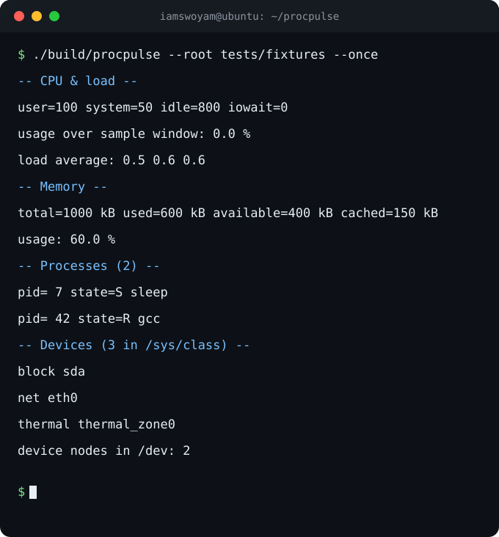
Three ways to run it
./build/procpulse
interactive menu — choices 1–5 print CPU, memory, processes, devices or a full snapshot; 0 quits
--once
one snapshot and exit — no thread started; ideal for scripts and for the fixture demo
--live SECS --interval S
sampler thread publishes every S seconds; main prints one [seq n] line per snapshot until the deadline
Ctrl-C anywhere
SIGINT sets the atomic g_stop; loops observe it and the sampler joins cleanly
[seq 1] cpu=0.0% mem=9.3% procs=84 devs=253
[seq 2] cpu=0.8% mem=9.1% procs=28 devs=253
sampler stopped cleanly

Slide 9
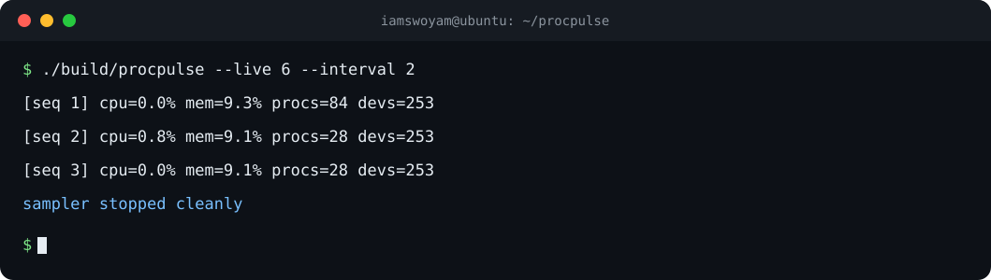
Testing: same code, fake root
tests/fixtures = a miniature Linux root
proc/stat, stat2, loadavg, meminfo, pid 7 & 42, sys/class/{block,net,thermal}, dev/{null,zero} — collectors run unchanged against it via --root
Unit tests — pure parse functions
test_collectors.cpp feeds exact strings: Δ 150/1000 → 15.0 % CPU; 1000 − 400 → 60.0 % memory; comm/stat edge cases. No kernel, no mocks
Integration — the real binary
run_integration.sh runs build/procpulse --root tests/fixtures --once and greps exact lines: load average 0.5 0.6 0.6, Processes (2), device nodes 2
Live check on real procfs
--live 3 against the running system must print 'sampler stopped cleanly' — proves the thread starts and shuts down on real data
make test = unit + integration in one command; green on Ubuntu (WSL) g++ 15.2 with -Wall -Wextra -O2 -pthread

Slide 10
What broke, and what I learned
MinGW had no threads
the win32-thread model lacks std::thread / mutex — compile errors, not runtime bugs. Linux is the target: builds and tests moved to WSL Ubuntu g++ 15.2, no platform shims
The loadavg grep failed
the dashboard prints 0.5 0.6 0.6 (stream defaults) but my test grepped the fixture's 0.52 0.58 0.59 — fixed the expectation to the program's real formatting
Processes vanish mid-scan
reading /proc/<pid>/stat races process exit; per-PID try/catch skips gone processes, comm read first as name fallback — even ps has this race
Shutdown could hang or terminate
a sleeping loop ignores stop for a whole interval; an unjoined thread calls std::terminate — cv_.wait_for with predicate plus destructor-joins fixed both
Every issue above is written up in docs/DEVLOG.md with symptom, cause and fix.
The devlog is part of the deliverable — debugging is engineering, not embarrassment.

Slide 11
Thank you — questions?
github.com/rudraprakashnayak/procpulse
six documented stages — tags stage-1 … stage-6 and v1.0
intro → PRD → design → implementation → tests → final report
ProcScope — a C++17 Linux System Monitor & Device Explorer

