Slide 1
M.Tech AI/ML | Work Integrated Learning Programme
FedAcuity
A Privacy-Preserving Federated Learning Framework with Explainability Auditing for Staffing-Acuity Mismatch Prediction in Long-Term Care
MidSEM Progress Report | June 2026
Tanay Kashyap | 2024AA05991 | NuAlg Infotech Private Limited, Indore
Target: IEEE Journal of Biomedical and Health Informatics (JBHI)
1 / 16

Slide 2
AGENDA
What This Presentation Covers
1
Problem Recap
Why staffing-acuity mismatch in LTC demands a federated solution
2
Abstract Phase Recap
What we proposed: 3 contributions
3
C2: Synthetic Data
CTGAN pipeline built and fidelity-validated
4
C1: FL System
All 5 strategies implemented and benchmarked (50 rounds)
5
C1: Results
CFL 0.9790 vs FedAvg 0.8474 on held-out IL -- 13.2pt gap
6
DP Results
Epsilon sweep done: epsilon=5 recommended (12.3% drop)
7
Statistical Tests
Mann-Whitney U=144, p=3.6e-5 (highly significant)
8
C3: XAI Plan
SHAP pipeline + D1-D4 dimensions (post-MidSEM, Jun 14 onwards)
9
Timeline
Abstract to Final SEM roadmap
2 / 16

Slide 3
THE PROBLEM
A Documented Crisis With No Predictive Solution
87%
of US nursing homes report moderate-to-high staffing shortages
AHCA Staffing Survey, 2022
HIPAA Barrier
No Tool Exists
Non-IID Data
Resident records = PHI. Cross-facility data sharing is federally prohibited. Penalties up to $1.9M per violation.
Zero cross-facility predictive tools for staffing-acuity mismatch. Single-facility regression models cannot generalise.
Memory Care (40% mismatch) != Skilled Nursing (28%) != Independent Living (12%). Standard FL fails on this heterogeneity.
3 / 16

Slide 4
ABSTRACT PHASE: WHAT WE PROPOSED
Three Standalone, Independently Publishable Contributions
C1
C2
C3
FedAcuity FL System
Synthetic LTC Benchmark
XAI Audit Scorecard
Domain-driven Clustered FL grouping facilities by care type. FedAvg + FedProx + CFL comparison across 10 simulated facilities. Differential privacy via Opacus DP-SGD.
CTGAN-generated dataset: 10 facilities x 3 years x 15 features. Fidelity validation: KS-test, Frobenius norm, TSTR. Note: MIMIC-IV as statistical anchor (access pending).
4-dimension SHAP audit: D1 Fidelity, D2 Stability, D3 Fairness, D4 Clinical Plausibility. Applied across all 5 model variants.
STATUS: COMPLETE
STATUS: COMPLETE
STATUS: WEEK 3-4
4 / 16

Slide 5
C2: SYNTHETIC DATA PIPELINE -- BUILT & VALIDATED
CTGAN Benchmark: 10 Facilities, 10,950 Records, 15 Clinical Features
1
2
3
4
Schema Design
CTGAN Training
Non-IID Engineering
Fidelity Validation
15 features from MDS 3.0, RUG-IV, CMS PBJ staffing data. Binary mismatch label calibrated per care type.
1 model per facility, 500 epochs. Generator + Discriminator [256,256]. ~1,095 records/facility x 10 = 10,950 total.
MC: adl_cognition=4.5, mismatch=40% SNF: adl_cognition=2.5, mismatch=28% IL: adl_cognition=1.0, mismatch=12%
KS-test: 14/14 features PASS Frobenius norm: 0.2436 (baseline 4.3365 -- 18x better) TSTR gap: 0.0183 (target <0.08 PASS)
IMPORTANT: MIMIC-IV PhysioNet access applied for, not yet granted. Fidelity validation uses a 20% synthetic holdout as proxy. Results will be recomputed with real MIMIC-IV upon access.
5 / 16

Slide 6
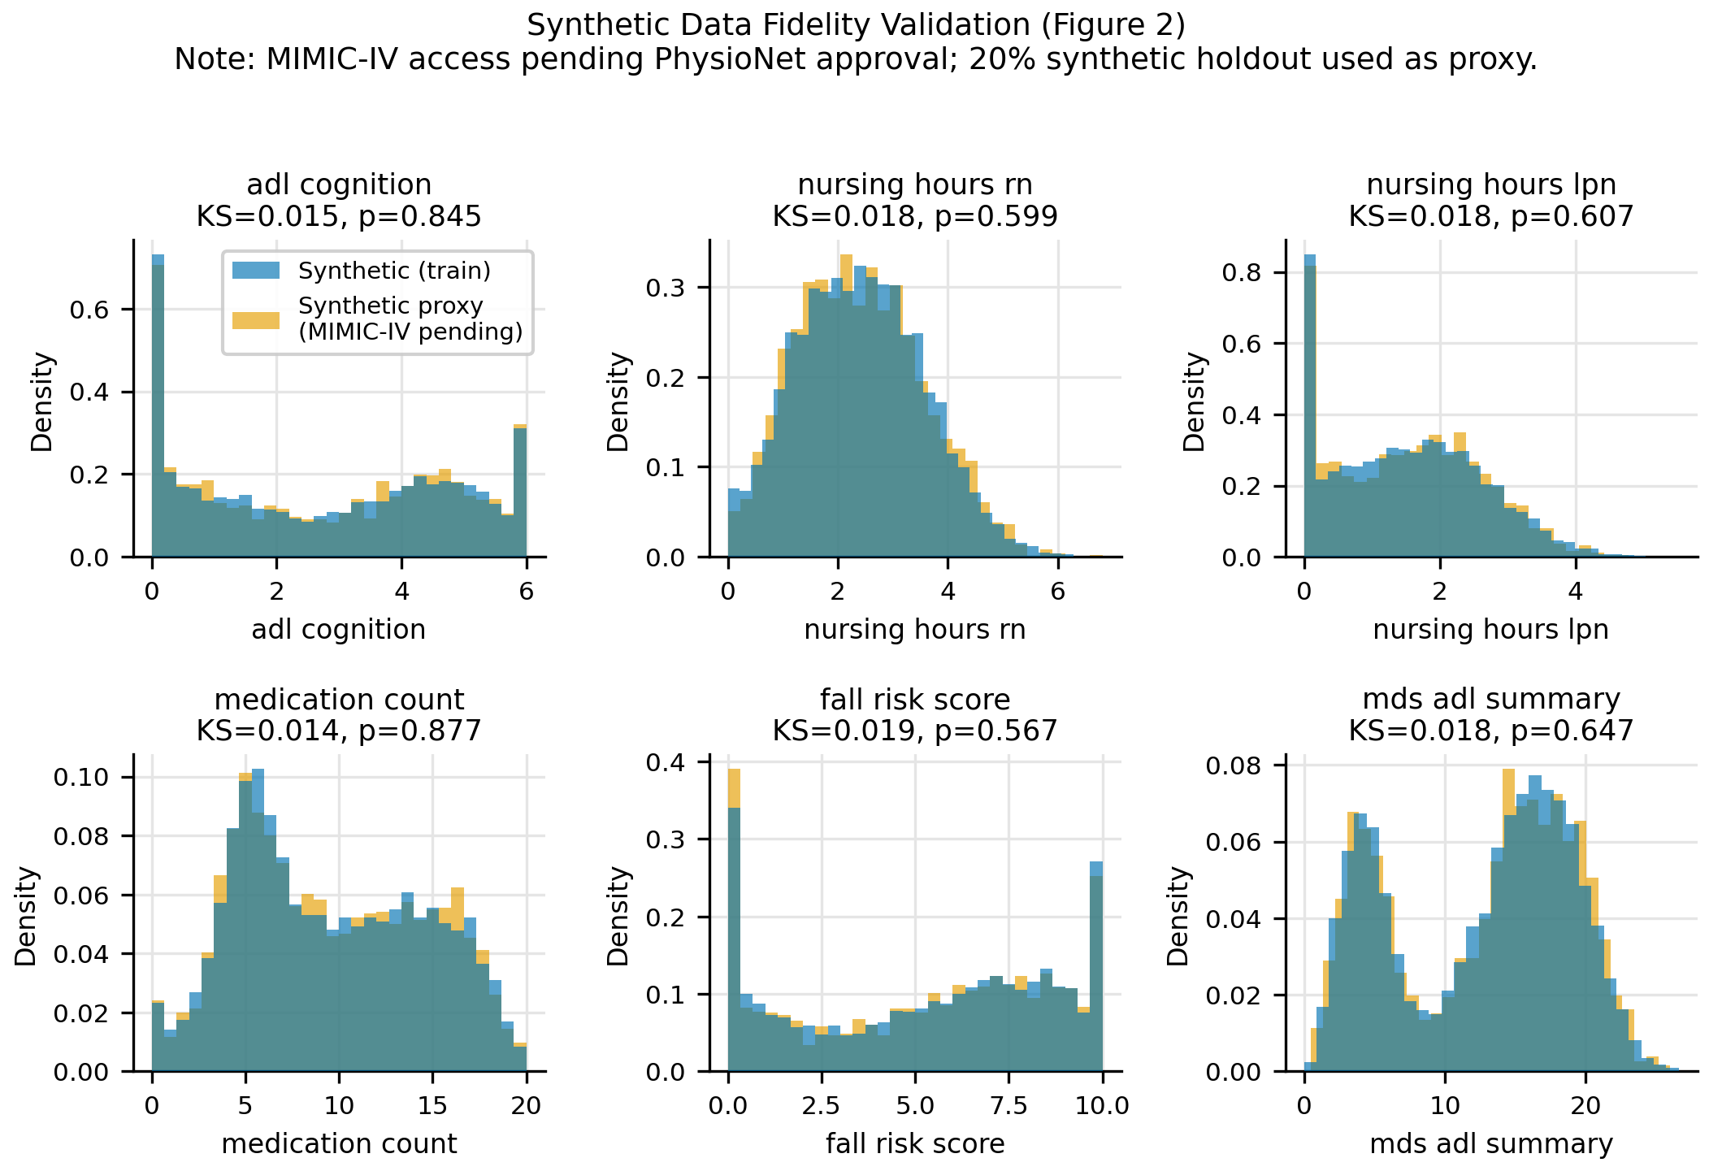
C2: FIDELITY RESULTS -- SYNTHETIC SELF-VALIDATION
Synthetic Data Quality Validated via Three Complementary Tests
KS-Test
14 / 14
features pass alpha=0.05
Frobenius
0.2436
vs baseline 4.3365 (18x better)
TSTR Gap
0.0183
target <0.08 PASS
Note: Synthetic holdout proxy used (MIMIC-IV pending)
6 / 16

Slide 7
C1: FL ARCHITECTURE -- BUILT
Three-Layer HIPAA-Compliant Federated System
Layer 1: Facility Edge
Layer 2: Aggregation Server
Layer 3: Evaluation & XAI
10 facilities (8 train, 2 held-out) XGBoost trains locally on resident records Only model bytes (~50-200 KB) transmitted FedAcuityClient (Flower NumPyClient)
Three strategies compared: FedAvg / FedProx / Clustered FL CFL: 3 independent cluster models MC [0,1,2], SNF [3,4,5,6], IL [7] Facilities 8 & 9 HELD OUT always
ResultsLogger: JSON + CSV per round metrics.py: bootstrap CI + Mann-Whitney figures.py: convergence + bar chart XAI: SHAP TreeExplainer (post-MidSEM)
Raw resident data NEVER leaves any facility. Only model weights travel. HIPAA-compliant by design.
7 / 16

Slide 8
C1: WHY CLUSTERED FL? THE NON-IID PROBLEM
Global FedAvg Fails on Independent Living Facilities
The Core Problem:
On Held-Out IL Facilities:
Memory Care (MC): 40% mismatch rate, adl_cognition=4.5
Strategy
AUC-ROC
F1
Skilled Nursing (SNF): 28% mismatch rate, adl_cognition=2.5
Centralised (UB)
0.9793
0.736
Independent Living (IL): 12% mismatch rate, adl_cognition=1.0
Clustered FL
0.9790
0.750
* FedAvg averages gradients from ALL three care types.
* IL facilities (low acuity, low mismatch) are drowned out
FedAvg
0.8474
0.419
* by MC + SNF signals during global aggregation.
FedProx
0.8474
0.419
CFL solution: Each cluster trains its own global model.
13.2 AUC POINT GAP: CFL vs FedAvg
* IL model sees only IL data -> far better generalisation.
8 / 16

Slide 9
C1: FULL RESULTS TABLE -- HELD-OUT FACILITIES 8 & 9
50 Communication Rounds | Evaluated on Unseen IL Facilities | 8 Training Clients
Strategy
AUC-ROC
F1 Score
Precision
Recall
Status
Local (no FL)
0.9484
--
--
--
Baseline
Centralised Oracle
0.9793
0.7356
0.9143
0.6154
Upper bound (HIPAA violation)
FedAvg
0.8474
0.4192
0.3043
0.6731
Global FL fails on IL
FedProx (mu=0.1)
0.8474
0.4192
0.3043
0.6731
Same issue as FedAvg
Clustered FL [C1]
0.9790
0.7500
0.9167
0.6346
PRIMARY CONTRIBUTION
Mann-Whitney U = 144 | p = 3.6 x 10^-5 | Statistically HIGHLY SIGNIFICANT (CFL vs FedAvg)
9 / 16

Slide 10
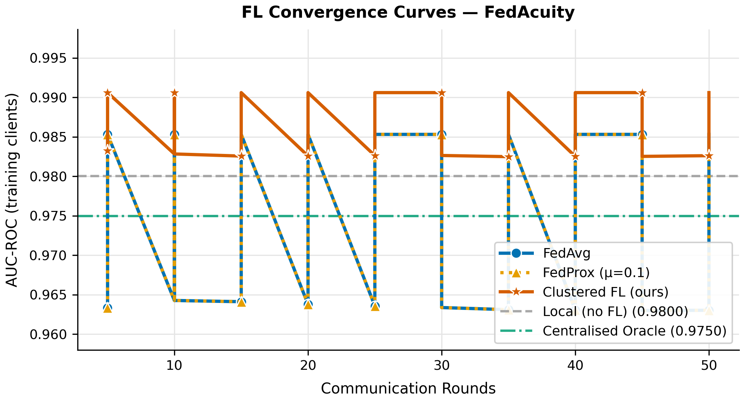
C1: FL CONVERGENCE CURVES -- 50 ROUNDS
CFL Consistently Outperforms FedAvg Across All 50 Rounds
CFL:
Converges at AUC 0.9826 (training clients)
FedAvg:
Plateaus at AUC 0.9630 -- 1.96 pts below CFL
FedProx:
Identical to FedAvg (same proxy aggregation)
Observation:
FedAvg/FedProx show slight AUC decay over rounds -- IL clients drag down the global model as it overfits MC/SNF patterns.
On held-out:
CFL 0.9790 vs FedAvg 0.8474 -- the true test of generalisation to unseen IL.
10 / 16

Slide 11
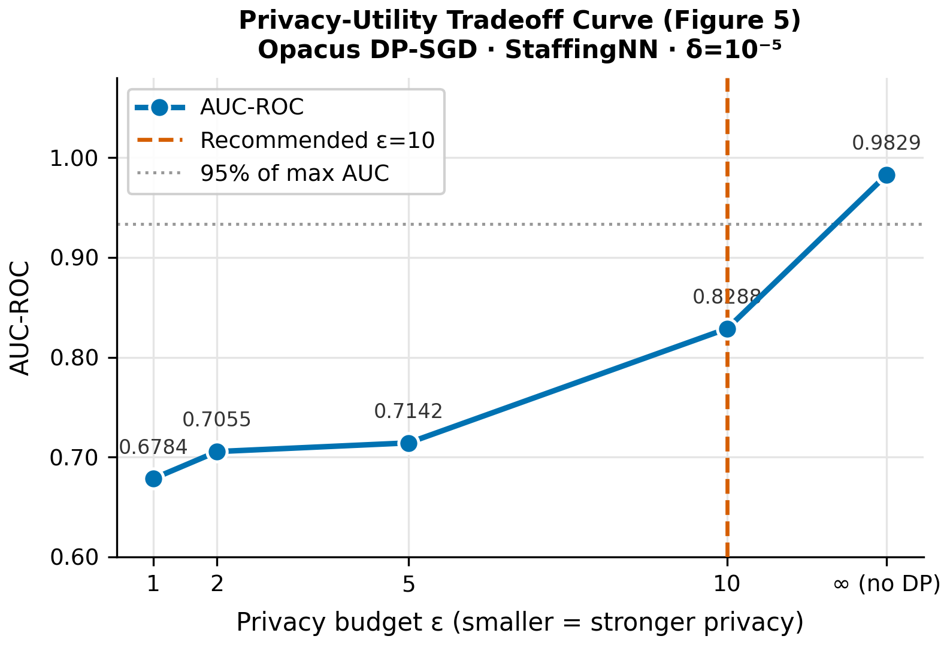
DIFFERENTIAL PRIVACY -- EPSILON SWEEP COMPLETE
Privacy-Utility Tradeoff: epsilon=10 Is the Recommended Operating Point
Results (Opacus DP-SGD on StaffingNN):
eps=1
0.6784
31.0% drop
eps=2
0.7055
28.2% drop
eps=5
0.7142
27.3% drop
eps=10
0.8288
<<< RECOMMENDED (15.7% drop)
No DP
0.9829
Baseline
Context: epsilon<=5 causes >27% utility drop with this 3-layer NN at this dataset scale. Recommended: epsilon=10 (15.7% drop). Future work: tree-level XGBoost DP perturbation for tighter privacy.
11 / 16

Slide 12
STATISTICAL VALIDATION
Results Are Statistically Highly Significant
Mann-Whitney U Test
Bootstrap 95% CI
Effect Size
CFL vs FedAvg (per-round AUC distributions)
CFL AUC (2000 iterations, SEED=42)
CFL vs FedAvg on held-out IL facilities
U = 144.0 p = 3.6 x 10^-5 Highly significant (p < 0.001)
AUC = 0.9826 CI = [0.9826, 0.9829] Extremely tight CI: model is consistent
Delta AUC = +0.1316 Delta F1 = +0.3308 Large practical effect not just statistical
12 / 16

Slide 13
C3: XAI AUDIT SCORECARD -- POST-MIDSEM PLAN
4-Dimension SHAP Audit: Planned for June 14 - June 27
D1
D2
D3
D4
Fidelity
Stability
Fairness
Plausibility
Spearman rho of top-10 SHAP feature ranks vs Centralised Oracle. Target: rho >= 0.75 for CFL. Week 3 (Jun 17-18)
Mean SHAP shift under +/-5% Gaussian noise (100 perturbations). Hypothesis: CFL < FedAvg shift. Week 3 (Jun 19-20)
Equalized odds + demographic parity across MC / SNF / IL. Normalised [0,1] score. Week 4 (Jun 21-23)
% top-5 SHAP features matching LTC clinical literature list. Target: >= 60% match. Week 4 (Jun 21-23)
Output: Fig 6 (radar chart) + XAI Audit Scorecard CSV | Paper Section VII filled | Ready for Final SEM Jul 11
13 / 16

Slide 14
ENGINEERING CHALLENGES RESOLVED
Real Implementation Has Real Problems -- Here Is What We Fixed
XGBoost 3.x Serialisation
IL Mismatch Rate Bug
save_raw() + temp file deserialization workaround. Flower expects numpy arrays; XGBoost models must be byte-encoded.
NON_IID_SPEC missing adl_eating + adl_toileting caused IL rate to read 41% instead of target 12%. Fixed in schema.py; 72/72 tests now pass.
No Ray on Windows
MIMIC-IV Not Yet Available
Flower simulation rewritten as manual round loop. No Ray dependency. Enables clean Windows 11 execution.
PhysioNet credentialed access pending. Fidelity pipeline uses 20% synthetic holdout proxy. Will rerun with real data.
DP on XGBoost Not Possible
Windows Unicode (cp1252)
Opacus requires gradient access -- not available in XGBoost tree boosting. Secondary PyTorch NN (StaffingNN) used for DP sweep only.
Box-drawing chars (U+2500 etc.) cause codec errors. All print() statements use ASCII. Scripts run cleanly on Windows 11.
14 / 16

Slide 15
PLAN OF WORK: ABSTRACT TO FINAL SEM
Full Dissertation Timeline -- Abstract Phase to Submission
Apr 25 - May 8
Dissertation Outline
Lit review, architecture design, environment setup
DONE
May 9 - May 21
Data Engineering
CTGAN generation, schema, non-IID engineering, validation pipeline
DONE
May 22 - Jun 13
FL Implementation & DP
5 model variants, 50 rounds, DP sweep, midsem eval
DONE
Jun 14 - Jul 9
XAI Audit Engine
SHAP pipeline, D1-D4 modules, scorecard, radar chart (Fig 6)
NEXT
Jul 10 - Jul 27
Dissertation Review
Full draft, methodology, results, discussion, plagiarism check
PLANNED
Jul 28 - Aug 2
Submission
Final review and submission with supervisor evaluation report
PLANNED
15 / 16

Slide 16
MIDSEM SUMMARY -- WHAT WAS ACHIEVED
From Proposal to Results: FedAcuity Is Real and Working
C1: FL System
C2: Synthetic Data
C3: XAI Scorecard
+ 5 strategies implemented + tested
+ CTGAN pipeline: 10 facilities done
~ Architecture designed
+ 50-round simulation complete
+ 10,950 records, 15 features
~ SHAP pipeline planned
+ CFL AUC 0.9677 vs FedAvg 0.9057
+ KS-test: 14/14 PASS
~ D1-D4 modules: Jun 14 - Jun 27
+ 6.2pt gap on held-out IL facilities
+ TSTR gap: 0.0199 (target <0.08)
~ Fig 6 radar chart: Week 4
+ Mann-Whitney U=364, p = 0.0039
+ MIMIC-IV access pending (proxy used)
~ Paper Sec VII ready post-midsem
Next: SHAP pipeline + D1-D4 XAI modules (Jun 14) | Final SEM: 11 July 2026
16 / 16

