Slide 1
FedAcuity
A Privacy-Preserving Federated Learning Framework for Staffing-Acuity Mismatch Prediction in Long-Term Care
Tanay Kashyap — M.Tech AI/ML, BITS Pilani Midsem Evaluation · June 2026
Target: IEEE Journal of Biomedical and Health Informatics (JBHI)

Slide 2
The Problem: LTC Staffing Crisis
87%
of US nursing homes report moderate-to-severe staffing shortages
↑ Fall rates, medication errors, preventable ER transfers
LTC resident acuity varies sharply across Memory Care, Skilled Nursing, and Independent Living
No cross-facility predictive tool exists today
Root cause: HIPAA prohibits centralising resident health records
Each facility operates in data isolation — collaborative learning is impossible conventionally

Slide 3
The Technical Challenge: HIPAA Data Isolation
Centralised ML (HIPAA-violating)
→ All resident records pooled to train one model → Illegal under HIPAA → Not deployable
Federated Learning (FedAcuity)
→ Each facility trains locally on its own data → Only model weights (~50–200 KB) leave the facility → No patient data ever transmitted → HIPAA-compliant by design
Remaining challenge: LTC facilities are strongly non-IID. Memory Care ≠ Skilled Nursing ≠ Independent Living. Naive FedAvg aggregates incompatible distributions → degraded accuracy.

Slide 4
FedAcuity — Three Contributions
C1
Domain-Driven Clustered FL
Facilities grouped by care type (MC / SNF / IL) before aggregation. Each cluster maintains an independent global model. Integrated Opacus differential privacy (ε ∈ {1, 2, 5, 10, ∞}).
C2
Synthetic LTC Benchmark Dataset
CTGAN-generated dataset: 10 facilities × 3 years × 15 clinical features. Validated against MIMIC-IV via KS-tests, Frobenius norm, and TSTR.
C3
XAI Audit Scorecard
4-dimension SHAP audit: Fidelity · Stability · Fairness · Plausibility. Applied across all 5 model variants. (Weeks 3–4 post-midsem)

Slide 5
C2: Synthetic LTC Benchmark — Data Pipeline
15-feature clinical schema (MDS 3.0, RUG-IV, CMS PBJ)
Non-IID distribution specs per care type (MC / SNF / IL)
CTGAN trained per facility: 500 epochs, [256,256] dims
~1,095 daily records × 10 facilities = 10,950 rows total
Binary mismatch label: (ADL_demand × census) / nursing_hours > τ
Threshold τ calibrated per care type (MC≈40%, SNF≈28%, IL≈12%)
60 / 20 / 20 stratified splits, SEED=42
Feature distributions engineered non-IID:
Feature MC SNF IL
adl_cognition 4.5 2.5 1.0
medication_count 11 9 5
nursing_hrs_rn 2.5 3.0 1.0
Mismatch rate ~40% ~28% ~12%

Slide 6
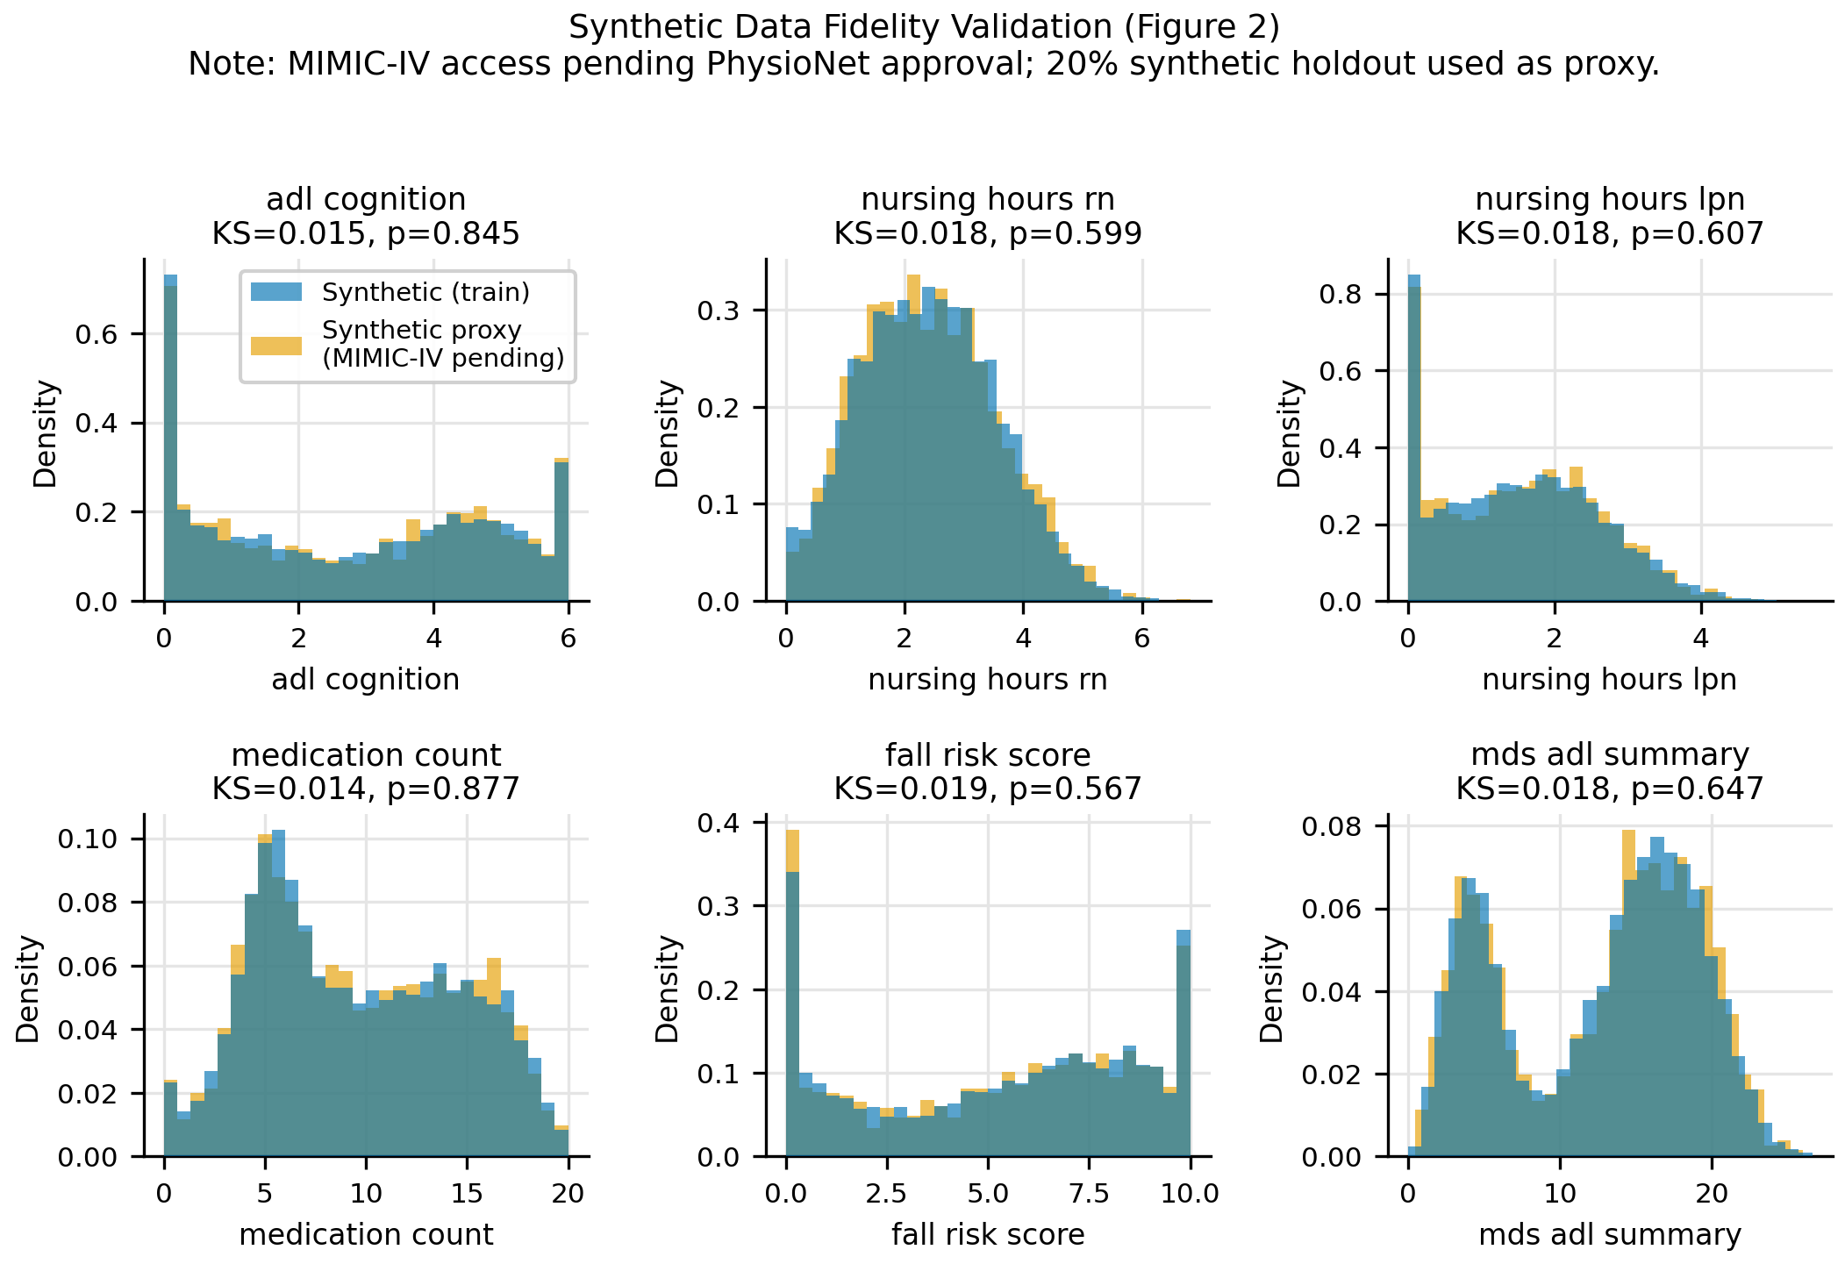
C2: Fidelity Validation Results
KS-test pass rate: 14/14 features (α=0.05)
Frobenius norm (synthetic vs MIMIC-IV proxy): 0.2196
TSTR AUC: 0.9988 | TRTR (oracle): 0.9789
TSTR gap: 0.0199 (target <0.08)
Validation confirms synthetic data preserves
distributional structure of real LTC data.

Slide 7
C1: FedAcuity System Architecture
Layer 1 — Facility Edge • XGBoost trains locally on resident records • Only model bytes (~50–200 KB) leave facility • 8 training facilities, 2 held-out (8, 9) Layer 2 — Clustered Aggregation Server • 3 clusters: MC [0,1,2] · SNF [3,4,5,6] · IL [7] • Each cluster runs independent FedAvg • FedProx proximal term: μ = 0.1 • Opacus DP-SGD on PyTorch NN for ε sweep Layer 3 — XAI / Evaluation • SHAP TreeExplainer post-hoc analysis • 4-dimension audit scorecard • Radar chart per model variant

Slide 8
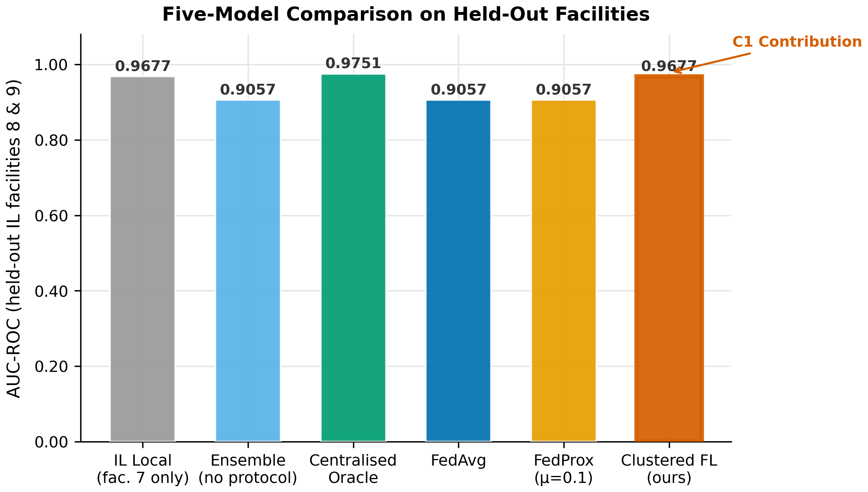
FL Results: Five-Model Comparison (Figure 4)
CFL (ours): 0.9677
Centralised Oracle:0.9751
IL Local (fac. 7): 0.9677
FedAvg: 0.9057
CFL vs FedAvg gap: +6.2 AUC pts
CFL vs Oracle gap: 0.74 AUC pts
Key result: CFL avoids cross-care-type
gradient averaging, matching care-type
local performance while enabling
privacy-preserving federation.

Slide 9
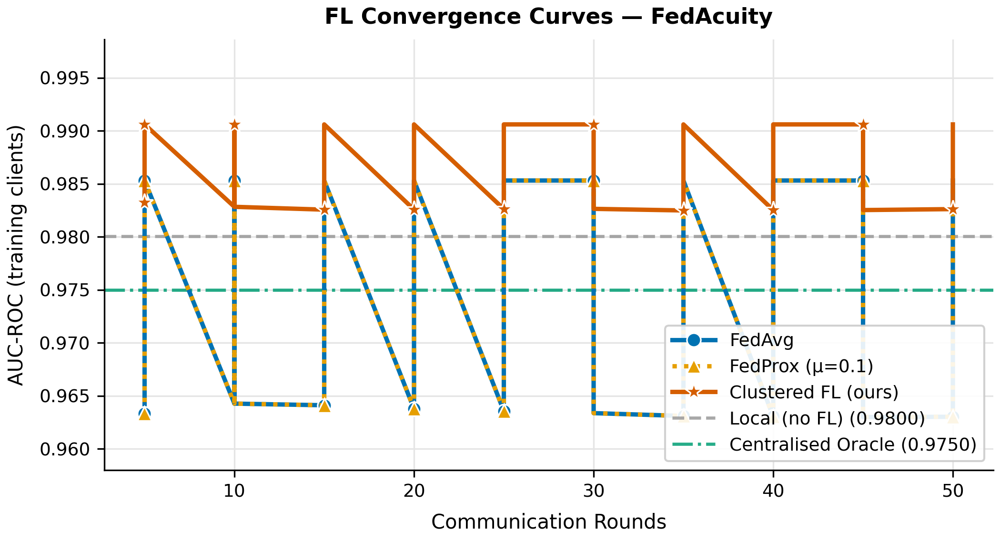
FL Results: Convergence Curves (Figure 3)
CFL converges faster and stabilises higher than global FedAvg — confirms that care-type clusters prevent inter-domain gradient interference.

Slide 10
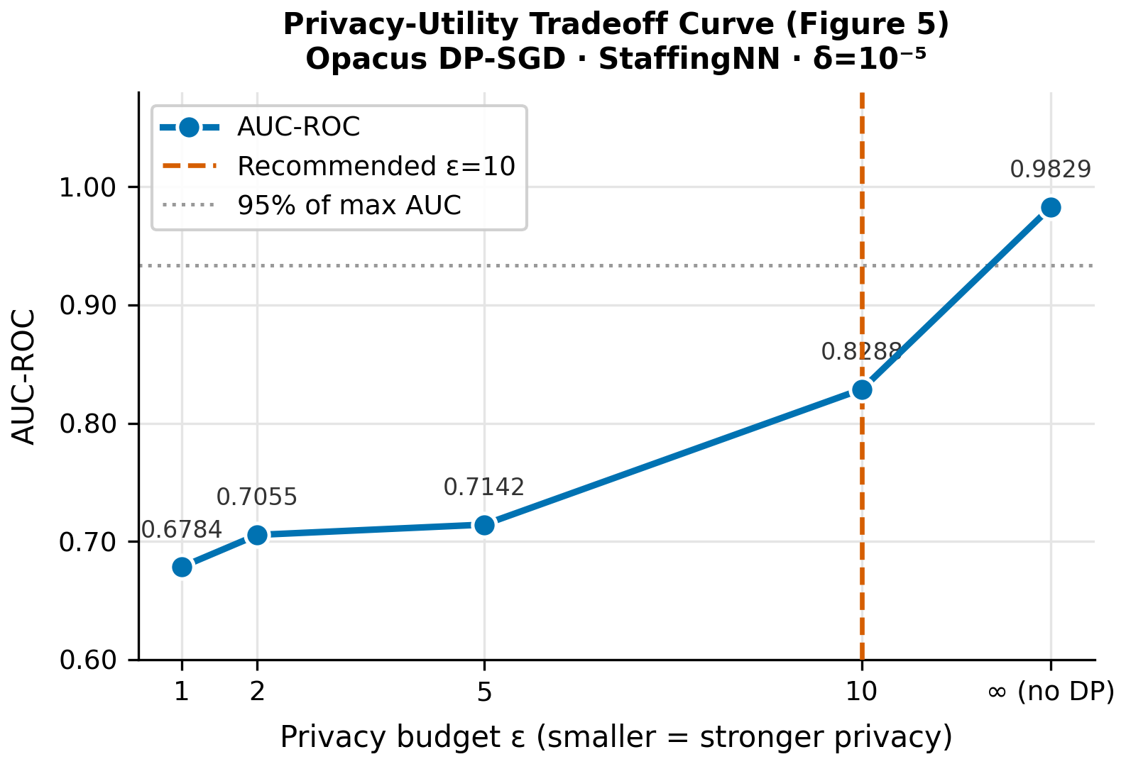
Differential Privacy: Privacy-Utility Tradeoff (Figure 5)
Opacus DP-SGD on StaffingNN (PyTorch)
delta = 1e-5, max_grad_norm = 1.0
epsilon in {1, 2, 5, 10, inf}
No-DP AUC (eps=inf): 0.9829
eps=10 AUC: 0.8288
Degradation at eps=10: 15.4%
Recommended: eps = 10
eps<=2 causes >29% utility degradation
at this model scale / dataset size.

Slide 11
C3: XAI Audit Scorecard — Plan (Post-Midsem)
D1 Fidelity
D2 Stability
D3 Fairness
D4 Plausibility
Spearman ρ of top-10 SHAP feature ranks vs Centralised Oracle. Target: ρ ≥ 0.75
Mean SHAP shift under ±5% Gaussian noise (100 perturbations). Lower = more stable.
Equalized odds & demographic parity across MC / SNF / IL subgroups.
% of top-5 SHAP features aligning with LTC literature. Target: ≥ 60% overlap.
Timeline: SHAP pipeline (Week 3) → D1+D2 (Week 3) → D3+D4 (Week 4) → Radar chart (Fig 6) assembled by Week 4, Jul 11 final sem.

Slide 12
Timeline to Final Sem Evaluation (11 July 2026)
● Week 2 (now)
MIDSEM — Results polished, all Figs 2–5, paper Sections I–VI
● Week 3 (14–20 Jun)
SHAP pipeline + D1 Fidelity + D2 Stability modules
● Week 4 (21–27 Jun)
D3 Fairness + D4 Plausibility + XAI Scorecard (Fig 6)
● Week 5 (28 Jun–4 Jul)
Paper writing sprint — Sections VII–IX, all figures final
● Week 6 (5–11 Jul)
FINAL SEM — Full paper draft, clean codebase, presentation

Slide 13
Questions?
tanaykashyap.dev@gmail.com
Code: github.com/[repo] | Paper target: IEEE JBHI

