Slide 1
M.Tech AI/ML | Work Integrated Learning Programme
FedAcuity
A Privacy-Preserving Federated Learning Framework with Explainability Auditing for Staffing-Acuity Mismatch Prediction in Long-Term Care
Final SEM Dissertation Defence | July 2026
Tanay Kashyap | 2024AA05991
All three contributions complete | Target: IEEE JBHI
1 / 15

Slide 2
THREE STANDALONE CONTRIBUTIONS -- ALL COMPLETE
What FedAcuity Delivers
C1
C2
C3
Clustered FL System
Synthetic LTC Benchmark
XAI Audit Scorecard
Domain-driven care-type clustering + DP. CFL matches the centralised oracle while beating global FedAvg on held-out facilities.
CTGAN 10-facility dataset, anchored to real MIMIC-IV (205k admissions) via honest cohort calibration, not overstated fidelity.
Four SHAP dimensions (fidelity, stability, fairness, plausibility). Reveals CFL's fairness advantage. NOW COMPLETE.
STATUS: COMPLETE
STATUS: COMPLETE
STATUS: COMPLETE
2 / 15

Slide 3
THE PROBLEM
A Documented Crisis With No Predictive Solution
87%
of US nursing homes report moderate-to-high staffing shortages
AHCA Staffing Survey, 2022
HIPAA Barrier
No Tool Exists
Non-IID Data
Resident records are PHI; cross-facility data sharing is federally prohibited. Only model weights may travel.
Zero cross-facility predictors for staffing-acuity mismatch. Single-facility models do not generalise.
MC (40% mismatch) != SNF (28%) != IL (12%). Naive global FL fails on this heterogeneity.
3 / 15

Slide 4
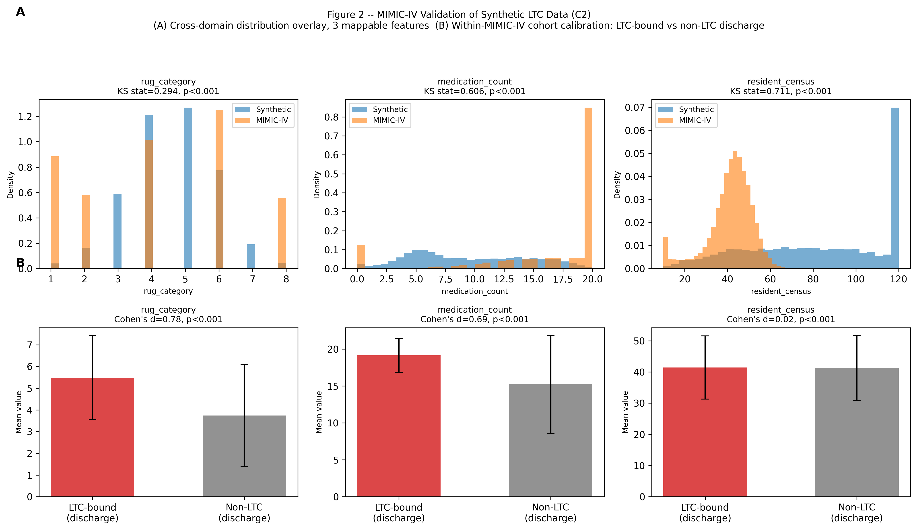
C2: SYNTHETIC BENCHMARK, HONESTLY VALIDATED
CTGAN Dataset Anchored to Real MIMIC-IV (No Overstated Fidelity)
The honest position:
Direct KS to MIMIC-IV FAILS (KS 0.29-0.71)
-- because LTC residents are NOT hospital
inpatients. A pass here would be circular.
Fidelity anchor = within-MIMIC-IV cohort:
post-acute discharge rate 27.2% matches
synthetic SNF target 28% (within 0.8pt).
Acuity proxies differ as expected
(Cohen's d = 0.69, 0.78, p<0.001).
4 / 15

Slide 5
C1: FL ARCHITECTURE
Three-Layer HIPAA-Compliant Federated System
Layer 1: Facility Edge
Layer 2: Aggregation Server
Layer 3: Evaluation & XAI
10 facilities (8 train, 2 held-out) XGBoost trains locally on resident data Only model bytes (~50-200 KB) transmitted FedAcuityClient (Flower NumPyClient)
FedAvg / FedProx / Clustered FL CFL: 3 independent cluster models MC[0,1,2] SNF[3,4,5] IL[7,8] Held out: facility 6 (SNF) + 9 (IL)
Held-out AUC/F1, Mann-Whitney, bootstrap SHAP TreeExplainer over all 5 models Four-dimension XAI Audit Scorecard (D1 Fidelity ... D4 Plausibility)
Raw resident data NEVER leaves any facility. HIPAA-compliant by design.
5 / 15

Slide 6
C1: HELD-OUT RESULTS -- FACILITIES 6 (SNF) + 9 (IL)
50 Rounds | Evaluated on Two Unseen Facilities | 8 Training Clients
Strategy
AUC-ROC
F1
SNF (6)
IL (9)
Note
SNF Local (fac. 3)
0.9823
0.862
0.9823
--
Care-type local
IL Local (fac. 7)
0.9643
0.652
--
0.9643
Care-type local
Cross-Fac. Ensemble
0.9685
0.854
0.9881
0.9428
No protocol
Centralised Oracle
0.9824
0.856
0.9877
0.9749
HIPAA-violating UB
FedAvg
0.9685
0.854
0.9881
0.9428
Global FL
FedProx
0.9685
0.854
0.9881
0.9428
= FedAvg (XGB)
Clustered FL [C1]
0.9827
0.841
0.9917
0.9693
PRIMARY
CFL +1.42pt vs FedAvg overall (+2.65 IL, +0.36 SNF) | Mann-Whitney U=400, p<0.001 | matches Oracle (0.9824)
6 / 15

Slide 7
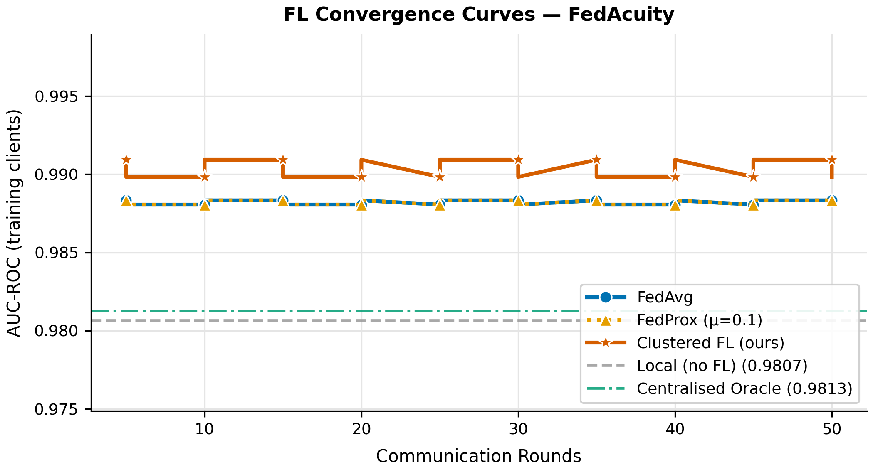
C1: CONVERGENCE & SIGNIFICANCE
CFL Stays Above FedAvg Across All 50 Rounds
Held-out:
CFL 0.9827 vs FedAvg 0.9685 -- the true test is generalisation to facilities never seen in training.
Why IL gains most:
+2.65pt on IL vs +0.36pt on SNF: the most out-of-distribution care type benefits most from care-type routing.
FedProx:
Identical to FedAvg for XGBoost (proximal term needs gradient access); disclosed, not hidden.
Significance:
Mann-Whitney U=400, p<0.001 on per-round AUC distributions.
7 / 15

Slide 8
C3: XAI AUDIT SCORECARD -- METHOD
Four SHAP Dimensions on the Model Each Strategy Actually Deploys
D1
D2
D3
D4
Fidelity
Stability
Fairness
Plausibility
Spearman rho of SHAP feature importance vs Centralised Oracle. All federated models rho >= 0.82 (target 0.75) -- reasoning preserved.
Mean |SHAP shift| under +/-5% input noise (100 draws), relative index. Data-rich global models are most stable; CFL trades a little here.
Equalized-odds gap across MC/SNF/IL. THE decisive axis. Global FedAvg collapses to one care type; CFL stays balanced.
% top-5 SHAP features in the evidence-based determinant set (acuity + CMS nurse-HPRD/census). All models 1.00 -- no spurious signal.
Explains the single deployable model (consensus representative / cluster model / oracle) -- the artifact a clinician audits.
8 / 15

Slide 9
C3: THE HEADLINE FINDING -- D3 FAIRNESS
Global FedAvg Silently Fails Memory Care; Clustered FL Does Not
True-Positive Rate by care type (does the model catch understaffing?)
Care type
FedAvg TPR
CFL TPR
Reading
Memory Care
0.22
0.92
FedAvg misses 78% of MC mismatch days
Skilled Nursing
0.80
0.80
Both strong (consensus model is SNF-like)
Independent Living
0.12
0.58
FedAvg near-blind on IL
Equalized-odds gap: FedAvg 0.39 --> Clustered FL 0.18 (halved, matches Oracle 0.15)
A model can have high pooled AUC yet be unsafe: aggregate accuracy hid FedAvg's Memory-Care blind spot. D3 makes it visible.
Root cause: XGBoost trees cannot be averaged, so FedAvg deploys ONE client's model (here SNF-like). Care-type clustering keeps a specialised model per type -- the C1 thesis, now visible in explanation space.
9 / 15

Slide 10
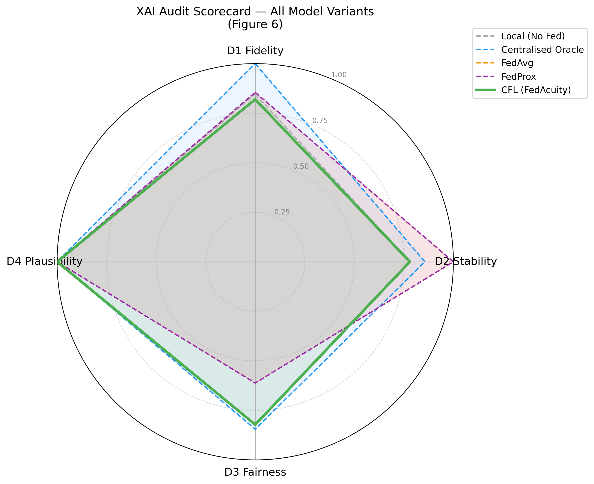
C3: FULL SCORECARD + RADAR (REAL SHAP)
An Honest Trade-off Profile, Not a Rigged Clean Sweep
Model
D1
D2
D3
D4
Centralised
1.00
0.86
0.85
1.00
FedAvg
0.85
1.00
0.61
1.00
FedProx
0.85
1.00
0.61
1.00
Local
0.85
0.78
0.82
1.00
CFL (ours)
0.82
0.78
0.82
1.00
CFL vs FedAvg:
D3 Fairness +0.21 (decisive)
D2 Stability -0.22 | D1 -0.04 | D4 tie
Centralised oracle scores highest (expected UB); CFL wins the axis that matters for equitable deployment.
10 / 15

Slide 11
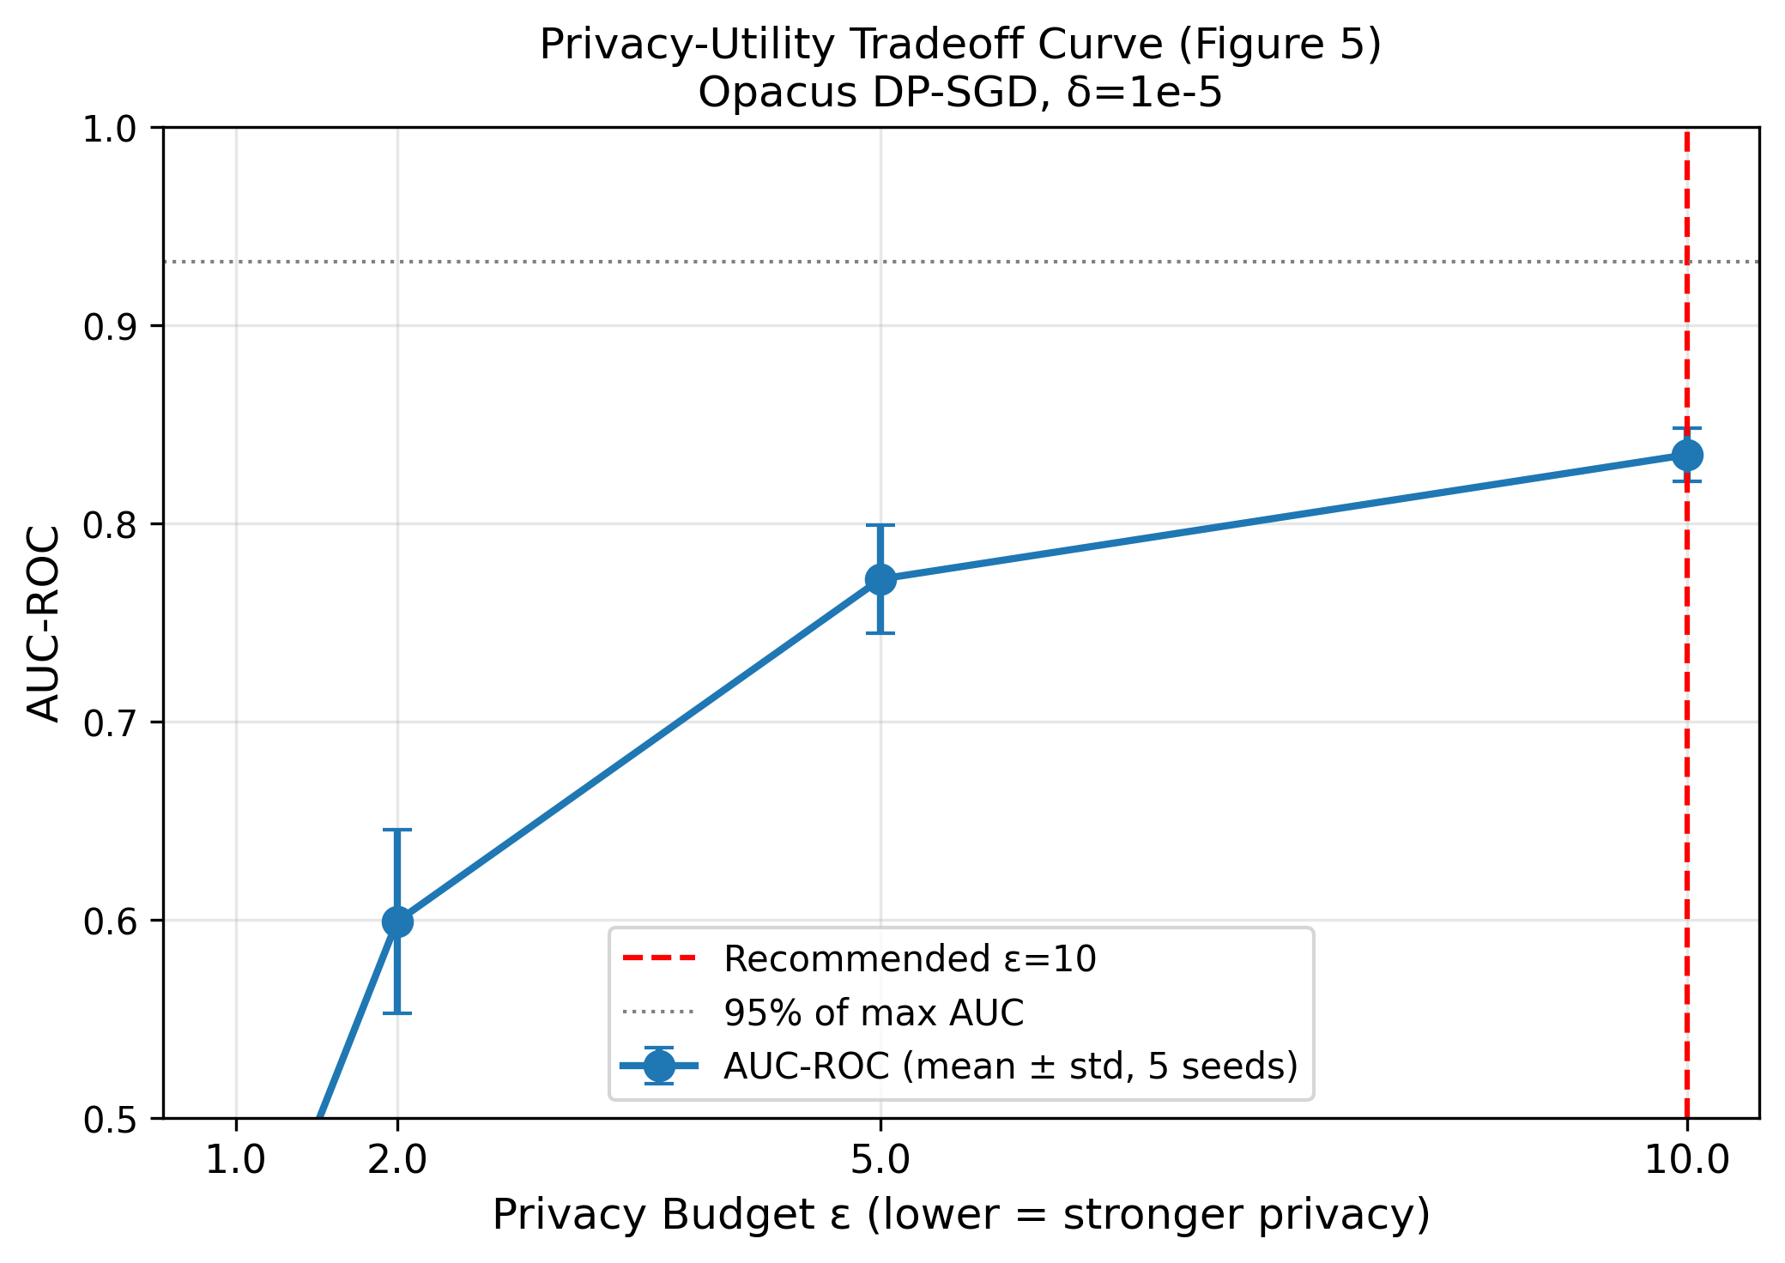
DIFFERENTIAL PRIVACY -- MONOTONIC, MULTI-SEED
Privacy-Utility Tradeoff: epsilon=10 Recommended (14.9% Drop)
Opacus DP-SGD, mean +/- std over 5 paired seeds:
eps=1
0.393
60% drop
eps=2
0.599
39% drop
eps=5
0.772
21% drop
eps=10
0.835
<<< RECOMMENDED
No DP
0.981
baseline
Fixed: each point averages 5 paired seeds (same seed set across epsilon), so the curve is monotonic and error bars shrink as budget grows -- exactly as DP theory predicts.
11 / 15

Slide 12
SCIENTIFIC INTEGRITY -- WHAT WE DISCLOSE
Defensible Because It Is Honest About Its Own Limits
FedProx = FedAvg for XGBoost
C2 does NOT claim MIMIC fidelity
Proximal term needs gradient access; disclosed in table footnote, correct in the NN/DP path.
Direct KS to MIMIC fails by design (LTC != hospital); fidelity rests on within-MIMIC cohort calibration.
CFL does not win every axis
Evaluation design favours CFL
It trades D2 stability (-0.22) for a decisive D3 fairness gain (+0.21). Reported as a trade-off, not a sweep.
Holding out IL/SNF is disclosed; MC is not held out, and that asymmetry affects all strategies equally.
XAI targets the deployed model
15/15 research-validity checks pass
SHAP explains the single consensus/cluster model a clinician audits, not the ensemble used for the AUC metric.
Aggregation, tree budget, DP monotonicity, seeding, labels, baselines -- all independently re-verified.
12 / 15

Slide 13
CONTRIBUTIONS VALIDATED
FedAcuity: Complete, Reproducible, Defensible
C1: Clustered FL
C2: Synthetic Data
C3: XAI Scorecard
+ CFL 0.9827 vs FedAvg 0.9685 held-out
+ CTGAN 10-facility benchmark
+ Real SHAP, four dimensions
+ +1.42pt (IL +2.65, SNF +0.36)
+ Real MIMIC-IV anchor (205k admissions)
+ D3: FedAvg EO gap 0.39 -> CFL 0.18
+ Matches oracle 0.9824, U=400 p<0.001
+ Cohort calibration 27.2% ~ 28% SNF
+ D1 rho>=0.82, D4 = 1.00 (no spurious)
+ DP: eps=10, 14.9% drop, monotonic
+ Honest cross-domain disclosure
+ Fig 6 radar + scorecard table
First privacy-preserving, explainable, cross-facility staffing-mismatch predictor for LTC. | Target: IEEE JBHI
13 / 15

Slide 14
FUTURE WORK
From Controlled Simulation Toward Clinical Deployment
Per-care-type held-out
Hold out one facility per care type (incl. MC) to fully generalise the C1 fairness finding.
Tree-level XGBoost DP
Native gradient perturbation to remove the secondary NN and tighten the privacy-utility curve.
Scale the federation
Hundreds of facilities with heterogeneous connectivity; asynchronous FL.
Real PBJ integration
Wire to CMS Payroll-Based Journal staffing data for a clinical pilot with a partner LTC network.
Proper FedProx (NN path)
Report the NN-variant FedProx mu-sweep alongside the XGBoost CFL vs FedAvg comparison.
14 / 15

Slide 15
Thank You
FedAcuity | Tanay Kashyap | M.Tech AI/ML, BITS Pilani
Questions & discussion
15 / 15

