Slide 1
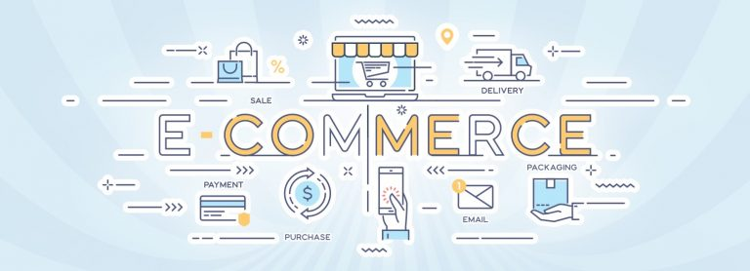
E-COMMERCE BUSINESS SYSTEM

Slide 2
PROJECT TEAM
ID | NAME
190030141 | B MOHANA VAMSI
190031065 | MD TARIQUE ANJUM
190031634 | T JOSEPH SUBHAKAR
TITLE : EKART
AUGUST 22,2020
Team: NPM_SDP 540

Slide 3

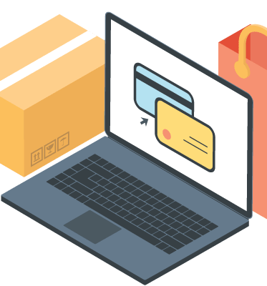
UNDERSTANDING OF E-COMMERCE BUSINESS SYSTEM
What is E-commerce?
E-commerce, also known as electronic commerce or internet commerce, refers to the buying and selling of goods or services using the internet, and the transfer of money and data to execute these transactions. E-commerce is often used to refer to the sale of physical products online, but it can also describe any kind of commercial transaction that is facilitated through the internet.
Whereas e-business refers to all aspects of operating an online business, ecommerce refers specifically to the transaction of goods and services.
History
The history of e-commerce begins with the first ever online sale: on the August 11, 1994 a man sold a CD by the band Sting to his friend through his website NetMarket, an American retail platform. This is the first example of a consumer purchasing a product from a business through the World Wide Web—or
“e-commerce” as we commonly know it today.
Since then, e-commerce has evolved to make products easier to discover and purchase through online retailers and marketplaces. Independent freelancers, small businesses, and large corporations have all benefited from e-commerce, which enables them to sell their goods and services at a scale that was not possible with traditional offline retail.

Slide 4
Types of E-commerce Models
There are four main types of e-commerce models that can describe almost every transaction that takes place between consumers and businesses.
1. Business to Consumer (B2C):
When a business sells a good or service to an individual consumer (e.g. You buy a pair of shoes from an online retailer).
2. Business to Business (B2B):
When a business sells a good or service to another business (e.g. A business sells software-as-a-service for other businesses to use)
3. Consumer to Consumer (C2C):
When a consumer sells a good or service to another consumer (e.g. You sell your old furniture on eBay to another consumer).
4. Consumer to Business (C2B):
When a consumer sells their own products or services to a business or organization (e.g. An influencer offers exposure to their online audience in exchange for a fee, or a photographer licenses their photo for a business to use).

Slide 5
Examples of E-commerce
1. Retail:
The sale of a product by a business directly to a customer without any intermediary.
2. Wholesale:
The sale of products in bulk, often to a retailer that then sells them directly to consumers.
3. Drop shipping:
The sale of a product, which is manufactured and shipped to the consumer by a third party.
4. Crowdfunding:
The collection of money from consumers in advance of a product being available in order to raise the startup capital necessary to bring it to market.
5. Subscription:
The automatic recurring purchase of a product or service on a regular basis until the subscriber chooses to cancel.
6. Physical products:
Any tangible good that requires inventory to be replenished and orders to be physically shipped to customers as sales are made.
7. Digital products:
Downloadable digital goods, templates, and courses, or media that must be purchased for consumption or licensed for use.
8. Services:
A skill or set of skills provided in exchange for compensation. The service provider’s time can be purchased for a fee

Slide 6
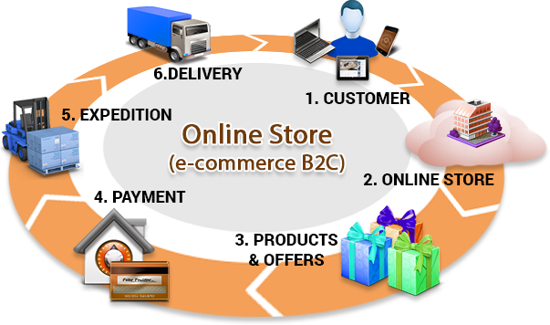
SERVICES
Register:
New user is added after filling details.
Login:
User is given access to the account after verification.
Search a Product:
Search for a particular product.
Browse Products:
Browse through products of various categories.
Add to Wish List:
Add Product to wish-list for later purchase of the product.
Add to Shipping cart:
Add product to shipping cart if you want to buy now.
View the Shipping cart:
View the shipping cart with total bill tagged with.
Payment:
Payment of the order using Credit/Debit/Net Banking etc.
Shipping:
User get shipment details.
Track your order:
Track the order where it is and when user will receive.
Feedback:
Write a review and rate the product.

Slide 7
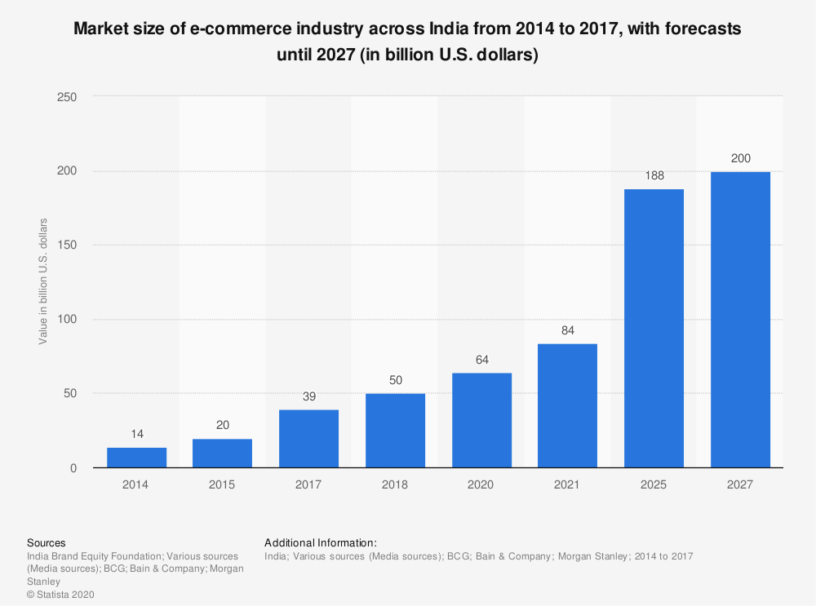

Slide 8
Advantages of E-Commerce
Through E-Commerce online shopping web sites for retail sales direct to consumers.
Easy trade between business to business of buying and selling
Gathering of data through web contacts and social media using demographic
Gives exposure of your products or services round the clock availability.
Customer get to choose from wide availability of products.
Easy accessibility and international reach.
Customers can compare the products with other providers for better products easily .
E-Commerce improves the brand image of the company.
It helps to provide better customer services to the customers.
E-Commerce helps to simplify the business process and makes them faster and effective.
E-Commerce reduces the effort.
It can provide 24/7 maintenance and can enquire about the product and services and can place the order anytime anywhere.
E-Commerce can provide options of virtual auctions.

Slide 9

IMPACT OF ARTIFICIAL INTELLIGENCE ON E-COMMERCE

Slide 10


Apart from product recommendations, artificial intelligence in Ecommerce industry is being utilized by online retailers for providing chatbot services, analysing customer comments, and for providing personalized services to online shoppers. In fact, a 2019 Ubisend study found that 1 in every 5 consumers are willing to purchase goods or services from a chatbot, while 40% of the online shoppers are looking for great offers and shopping deals from chatbots.

Slide 11
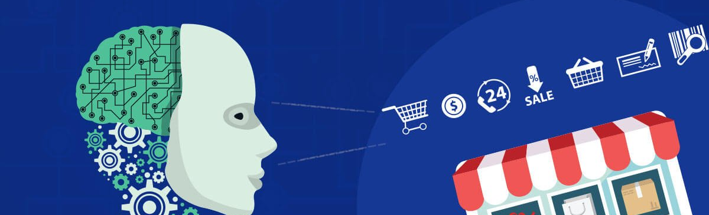
The use of artificial intelligence in online shopping is transforming the E-commerce industry by predicting shopping patterns based on the products that shoppers buy and when they buy them. For example, if online shoppers frequently buy a particular brand of rice every week, then the online retailer could send a personalized offer to these shoppers for this product, or even use a machine learning-enabled recommendation for a supplementary product that goes well with rice dishes.
Ecommerce AI tools or AI-enabled digital assistants such as the Google Duplex tool is developing capabilities like creating grocery lists (from the shopper’s natural voice) and even placing online shopping orders for them.

Slide 12

Major AI Applications in Ecommerce

Slide 13

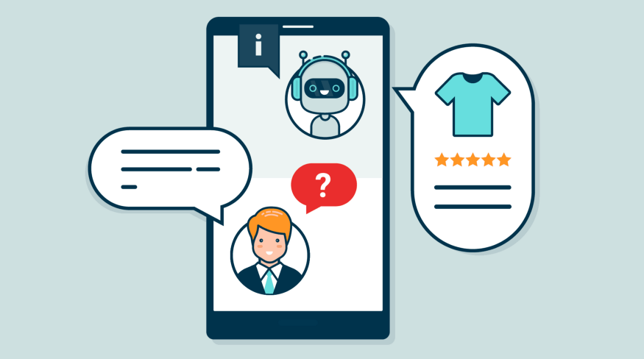

Chatbots and other virtual assistants
E-commerce retailers are increasingly turning towards chatbots or digital assistants to provide 24×7 support to their online shoppers. Built using AI technologies, chatbots are getting more intuitive and are enabling a better customer experience.
Apart from providing good customer support, chatbots are enhancing the impact of AI in Ecommerce through capabilities such:
Natural language processing (or NLP) that can interpret voice-based interactions with consumers.
Addressing consumer needs through deeper insights.
Self-learning capabilities that help them improve over time.
Provide personalized or targeted offers to customers.

Slide 14

Intelligent Product Recommendations
Among the major applications of artificial intelligence in Ecommerce, personalized product recommendations for online shoppers are increasing conversion rates by 915% and average order values by 3%. With the use of big data, AI in Ecommerce is impacting customer choices thanks to its knowledge of previous purchases, searched products, and online browsing habits.
Product recommendations provide multiple benefits for Ecommerce retailers including:
Higher number of returning customers
Improved customer retention and sales
A personalized shopping experience to online shoppers
Enable a personalized business email campaign.

Slide 15
AI Personalization in Ecommerce
Rated among the most effective modes, personalization is at the core of AI in Ecommerce marketing. Based on specific data gathered from each online user, AI and machine learning in Ecommerce is deriving important user insights from the generated customer data.
For instance, the AI-enabled tool, Boomtrain is able to analyse customer data from multiple touch points (including mobile apps, email campaigns, and websites) to see how they are performing online interactions. These insights enable Ecommerce retailers to make suitable product recommendations and provide a consistent user experience across all devices.

Slide 16

Inventory Management
Efficient inventory management is all about maintaining the right level of inventory that can fulfil market demand without adding to idle stock.
While the conventional form of inventory management was restricted to current stock levels, AI-enabled inventory management is enabling how to maintain stocks based on data related to:
Sales trends over the previous years
Projected or anticipated changes in product demands
Potential supply-related issues that could impact inventory levels

Slide 17
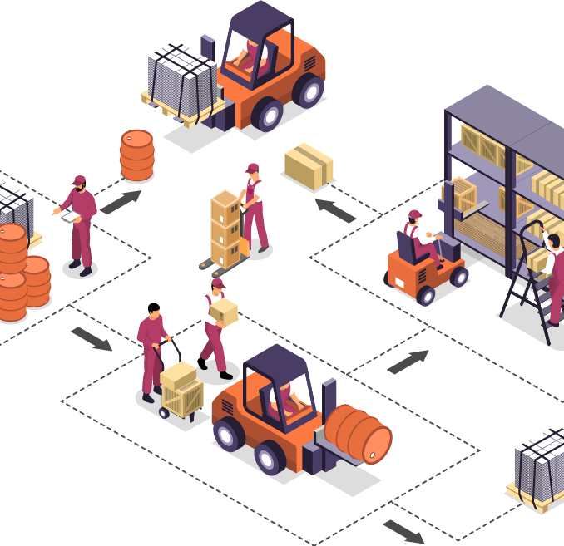
Warehouse Management
Apart from inventory management, AI is enabling warehouse management with the emergence of automated robots that is being projected as the future of artificial intelligence in Ecommerce. Unlike human employees, AI robots can be used to store or retrieve stocks 24×7 along with immediate dispatching of ordered items following an online order.

Slide 18

THANK YOU

