Slide 1


STUDYPLUS: A STUDY TRACKING APPLICATION WITH AI INTEGRATION FOR PERSONALIZED LEARNING RECOMMENDATIONS
Presented By-
Name
ID:
Supervisor: Name

Slide 2


Outlines
Research Gaps and Problem Statement
Objectives and Contribution
Research Scope and Literature Review
Methodology
References

Slide 3
Introduction
StudyPlus is a mobile app designed to help students manage their study time and increase productivity.
The app integrates real-time study session tracking with AI-driven recommendations for personalized learning strategies.
Built using Flutter for cross-platform compatibility (iOS and Android) and Firebase for secure real-time syncing.
It addresses the gap in existing study tracking apps by combining goal-setting, analytics dashboards, and AI-based suggestions for effective study habits.

Slide 4
Objective
Develop StudyPlus as a mobile application that integrates real-time tracking, AI-powered recommendations, and goal-setting features.
Help students improve their study productivity by providing personalized recommendations based on study behavior.
Provide real-time feedback through visual analytics and progress monitoring to improve study habits.
Ensure cross-platform compatibility (iOS and Android) to make the app accessible to a wider range of students.

Slide 5
Problem Statement
Students often struggle with managing their study time effectively due to distractions and lack of structured study plans.
Existing study tools like paper planners and basic apps don’t provide actionable insights or personalized recommendations.
Current study apps fail to offer real-time feedback or adaptive suggestions to improve productivity and time management.
Limited tracking features in most apps make it difficult to monitor long-term progress and adjust study habits accordingly.

Slide 6
Literature Review
App Name | Key Features | Strengths | Limitations | AI Integration
Focus Booster | Pomodoro timer, gamification, time tracking | Increases focus, fun, simple interface | Minimal tracking features, lacks AI-based recommendations | No AI integration
Forest | Gamification, time tracking, focus management | Motivates users, fun, encourages focus | Limited analytics, no personalized recommendations | No AI integration
Toggl | Time logging, manual start/stop tracking, basic reports | Simple, easy to use, accurate time tracking | No focus on learning, lacks personalized feedback | No AI integration
MyStudyLife | Goal setting, time management, task prioritization | Good for planning, goal setting, cross-platform | Limited insights, no advanced AI recommendations | No AI integration
RescueTime | Activity tracking, time management, productivity reports | Tracks time spent on activities, identifies distractions | Limited actionable advice, passive feedback | No AI recommendations
StudyPlus | Study session tracking, goal setting, AI-powered insights | Real-time data syncing, AI recommendations, customizable goals | Needs more advanced personalization, AI recommendations still in early stages | Yes, AI-driven study suggestions based on user behavior

Slide 7
System Design and Development
Modular architecture ensures scalability and easy updates.
Secure authentication and encrypted data handling with Firebase.
Real-time synchronization across multiple devices.
User-friendly UI/UX based on Material Design principles.

Slide 8
System Design and Development
Development Tools
Flutter SDK – for cross-platform mobile development (Android & iOS).
Dart Programming Language – primary language for building the app.
Android Studio – IDE with emulator support, debugging, and plugins for Flutter.
Git & GitHub – version control and project collaboration.
Backend & Cloud Services
Firebase Authentication – secure user login with email/password and third-party logins.
Firebase Realtime Database – cloud-based NoSQL database for study session and goal tracking.
Firebase Analytics – user activity tracking and performance monitoring.
Firebase Cloud Storage – for syncing and backup of user data.

Slide 9
System Design and Development
Testing & Evaluation Tools
Black-box Testing – for functional validation of app features.
Usability Testing – user trials for interface clarity and ease of use.
Performance Testing – response time and database efficiency testing.
AI Module Evaluation – verifying accuracy and impact of Gemini-powered study recommendations.
Visualization & Analytics
FL Chart Library – for creating dashboards, charts, and data visualizations.
Material Design Components – ensuring a clean, intuitive, and consistent UI/UX.

Slide 10
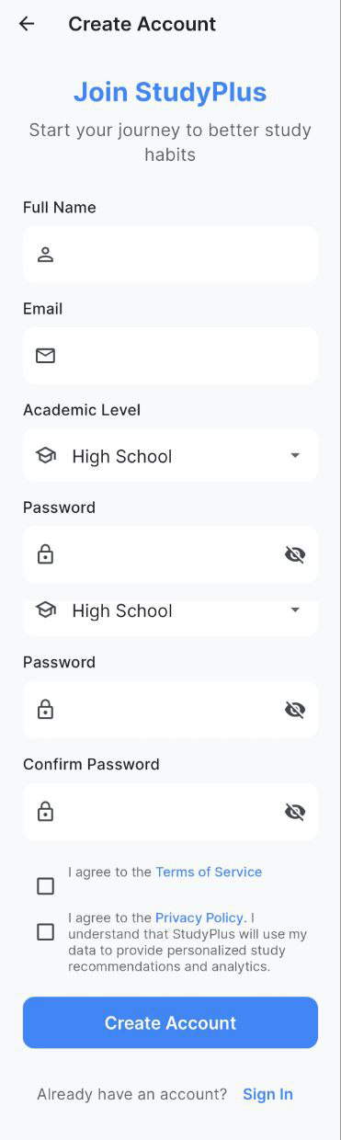
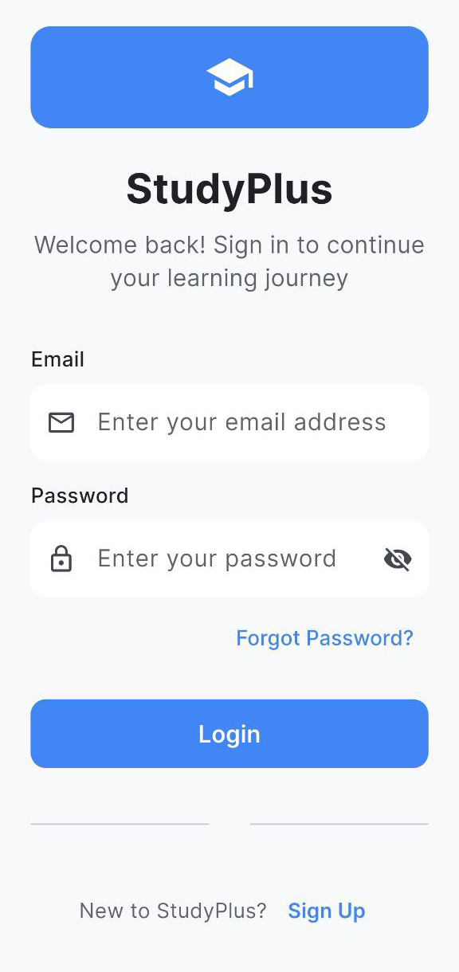

Slide 11
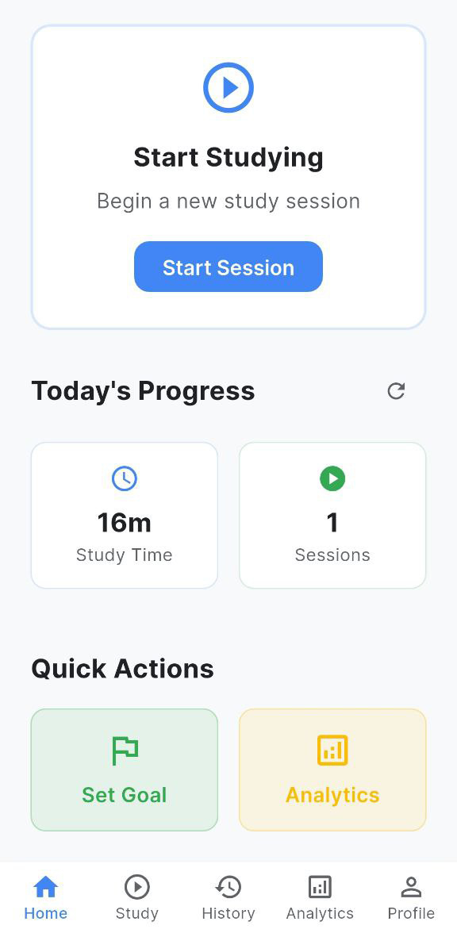

Slide 12
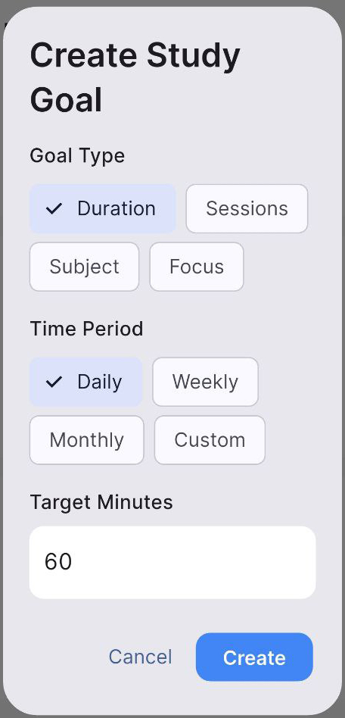
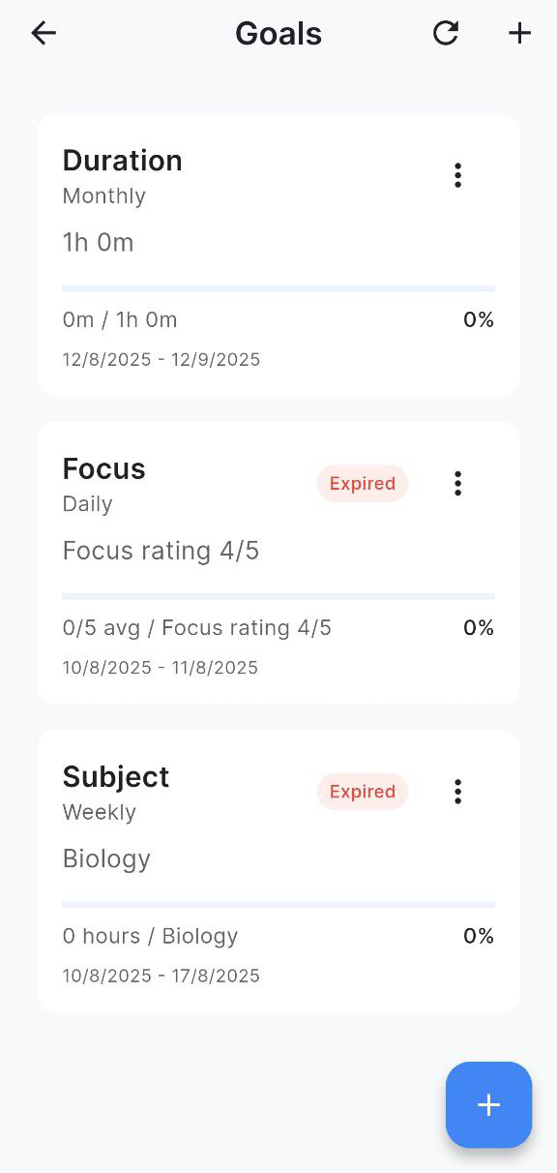

Slide 13
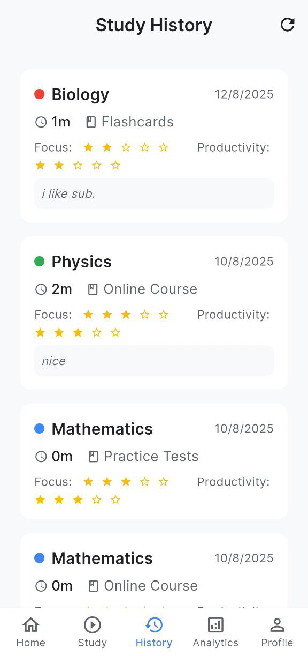
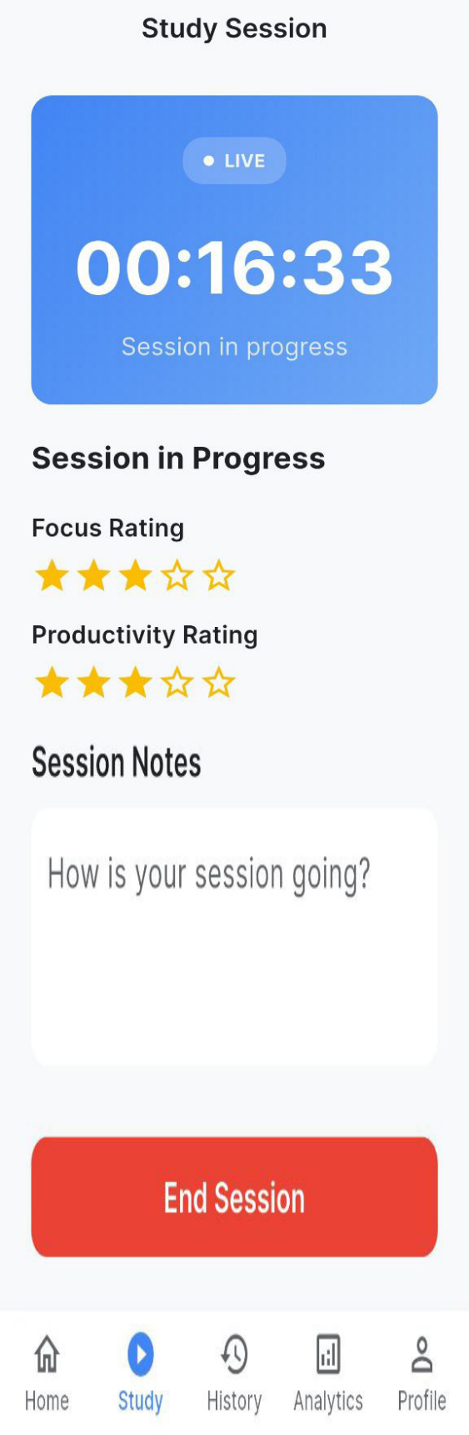

Slide 14
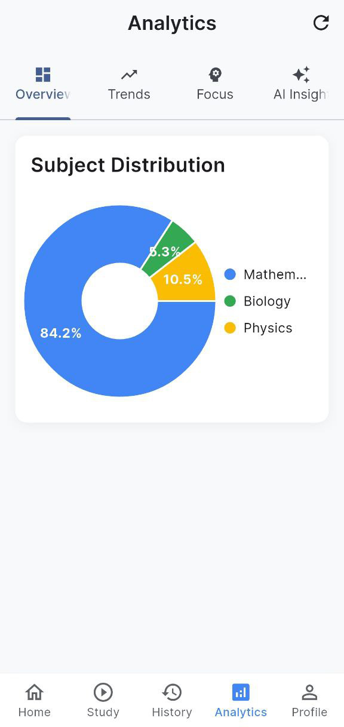
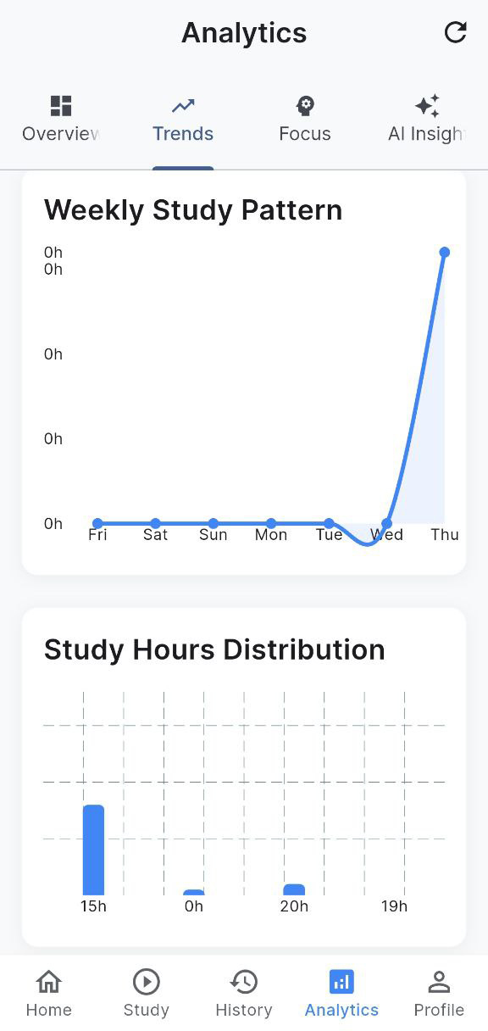
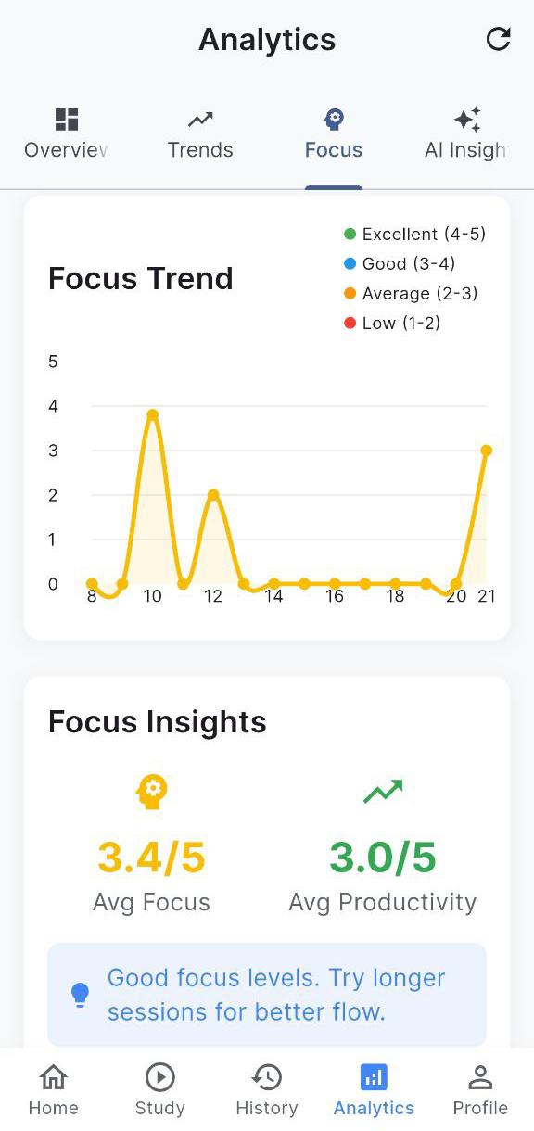

Slide 15
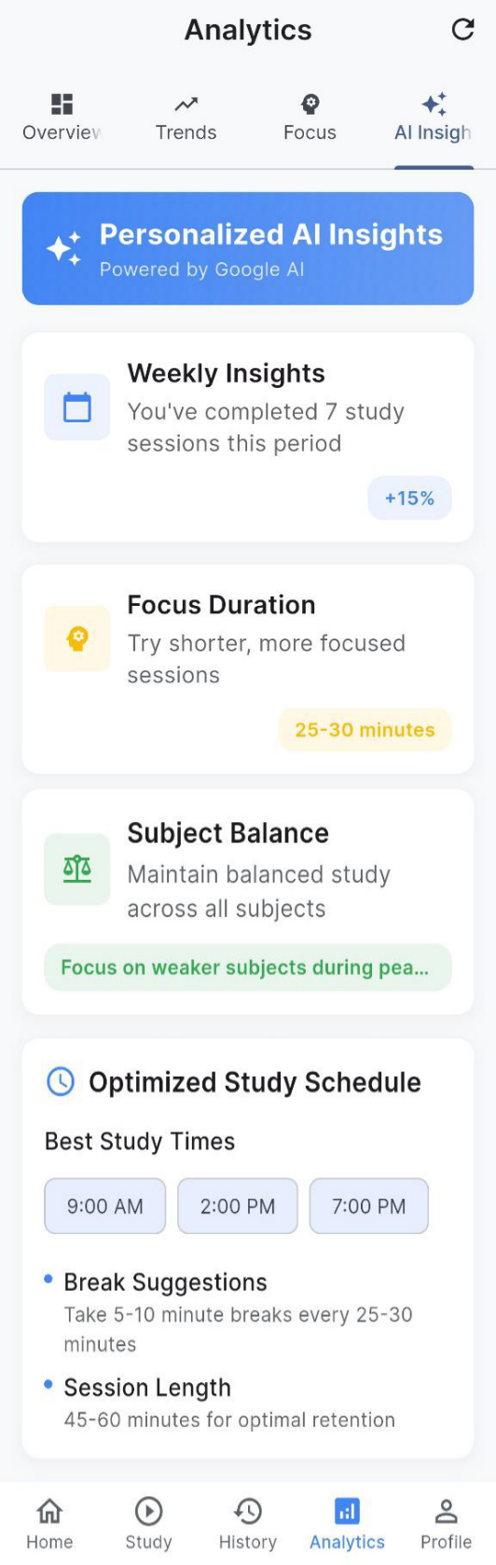

Slide 16
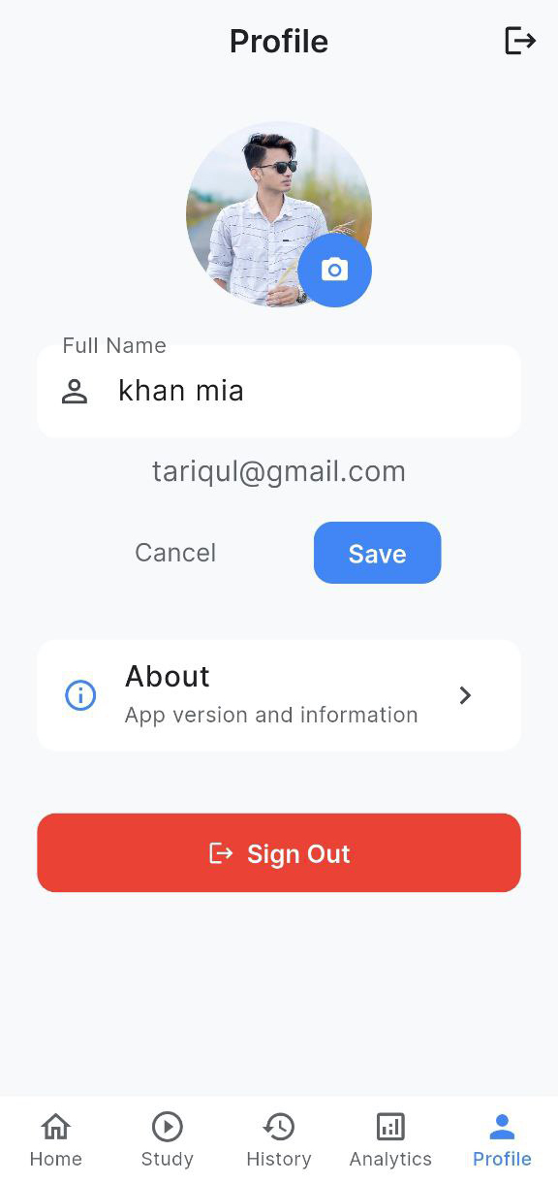

Slide 17
Conclusion
StudyPlus successfully addresses the need for personalized study management by integrating real-time tracking, AI-driven recommendations, and goal-setting functionalities.
AI-based recommendations enhance user productivity, providing personalized study strategies that improve focus and time management.
The app is built using Flutter and Firebase, ensuring scalability, cross-platform support, and secure real-time data synchronization for users.
Future improvements can focus on adaptive learning models, incorporating gamification, offline capabilities, and expanding compatibility across educational environments.

Slide 18
1. Almalki, A., & Jin, J. (2021). The Role of Personalized Feedback in Enhancing Student Productivity in Digital Learning Environments. Educational Technology Research and Development, 69(2), 457-471.
2. Buchanan, C. (2019). A Comparative Study of Mobile Study Applications: Features, Benefits, and Limitations. Journal of Educational Technology, 24(3), 159-173.
3. Jones, M., & Green, B. (2020). Time Tracking and Focus in Educational Apps: What’s Missing? International Journal of Educational Technology, 12(4), 22-35.
4. Kumar, P., & Ghosh, S. (2021). Artificial Intelligence in Education: Enhancing Personalized Learning. Journal of AI in Education, 32(1), 48-62.
5. Lee, Y., Lee, S., & Park, K. (2022). Leveraging AI in Personalized Learning: A Survey of Applications and Tools in Education. Journal of Educational Research, 59(1), 22-41.
6. Sharma, R., & Rani, P. (2020). A Review of Study Tracking Apps: Features, Challenges, and Future Directions. Journal of Mobile Learning Technologies, 15(2), 80-93.

Slide 19
THANK YOU

