Slide 1
KORMO
-দক্ষতার প্রতিচ্ছবি

Slide 2
Submitted To | Submitted By
Saddam Hossain Lecturer Dept. of CSE BUBT | Ahmed Mahir Shoaib (ID:18192103235 Intake:41/6)
 | Abu Zobayer Bin Siddique (ID:18192103226 Intake:41/6)
 | All Moon Tasir (ID:18192103256 Intake:41/6)
 | Abdullah Al Noman (ID:18192103255 Intake:41/6)
 | Julkar Naeem (ID:18192103227 Intake:41/6)
 | Team Name: INF1N1T3 V01D

Slide 3

What Is Kormo
kormo is a workers booking site. Through this, workers can be taken from online.

Slide 4
Why Kormo
Through this website people can get any kinds of workers including carpenters, painters, masons for their house. This is our smaint effort to make their life journey easier.

Slide 5
Features
Login
View Workers profile
Workers Login
Works Registration
User Login
User Registration
Book worker

Slide 6
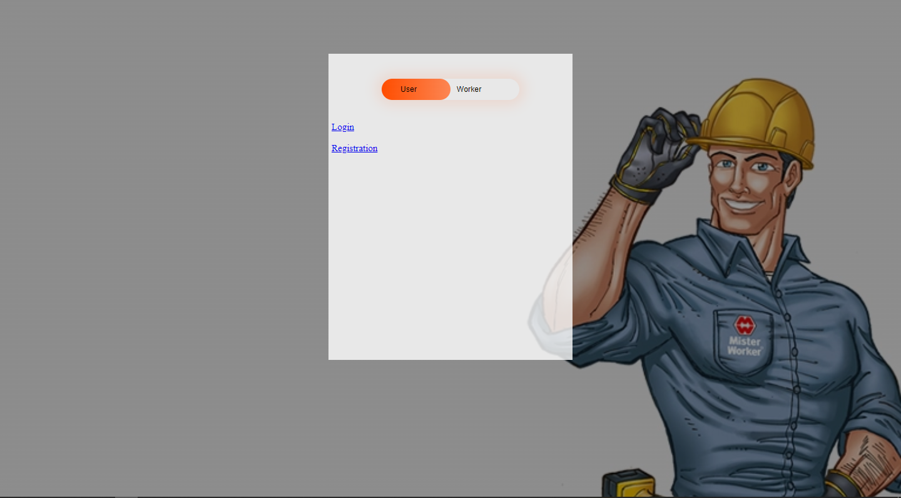
Start

Slide 7
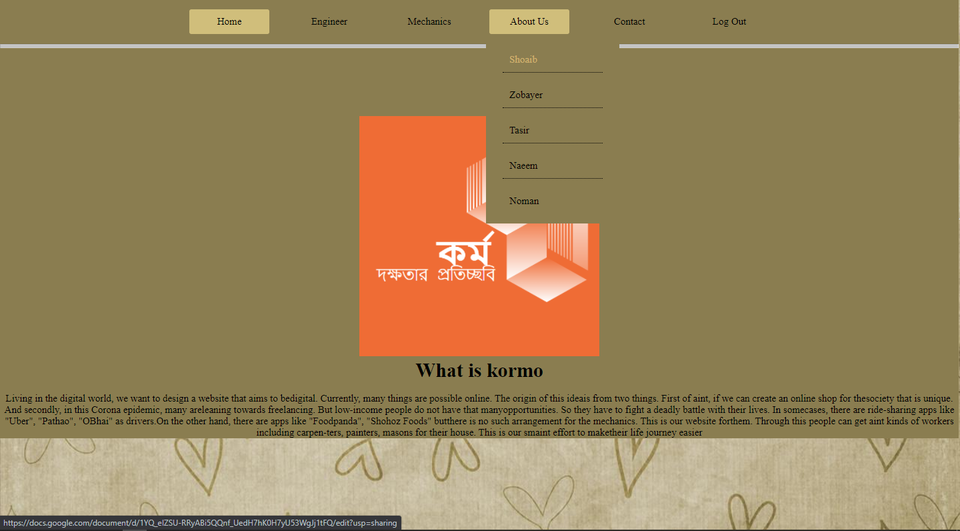
Select Staff

Slide 8
View Workers Profile

Slide 9
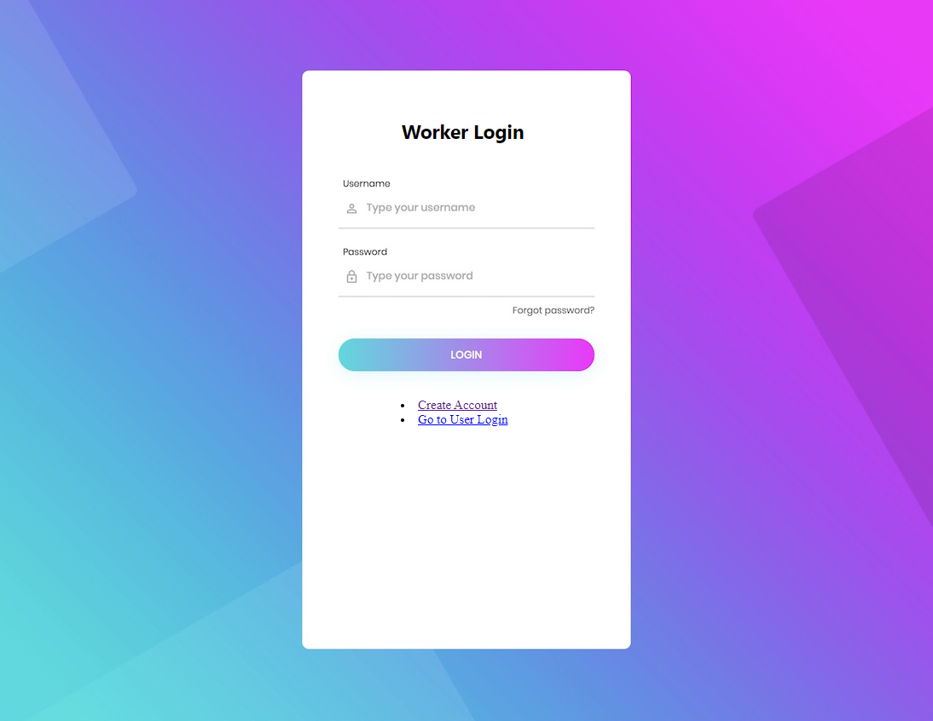
Workers Login

Slide 10

Workers Registration

Slide 11

User Login

Slide 12
User Registration

Slide 13
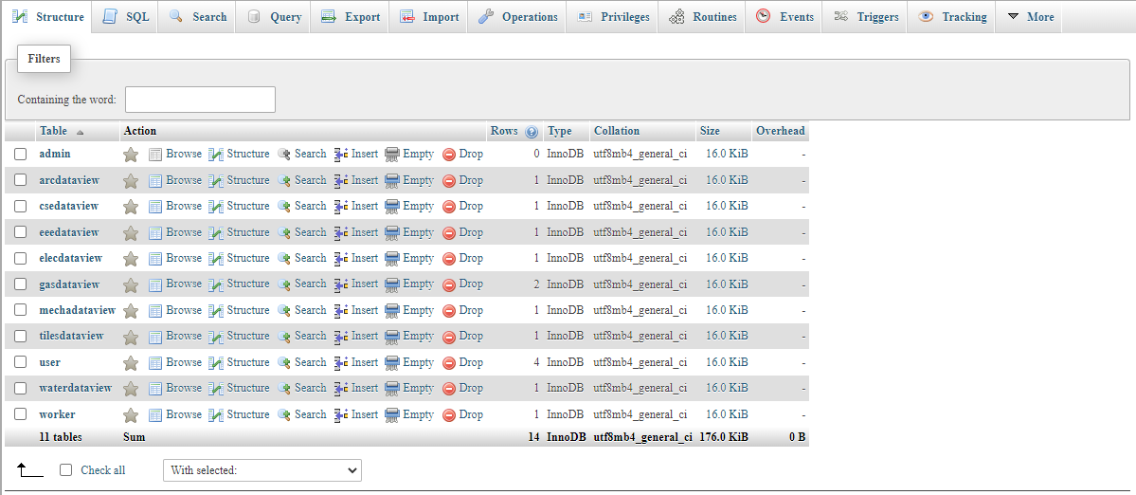
Database

Slide 14
Future Works
Add Online Payment System
Make more efficient for all kind of user
Change Design

Slide 15
Conclusion
We have now designed a website. Since this is our first design, we still have a lot to learn. That's why we will get reviews from our clients on how to make it more user friendly. Besides, our goal will be to make it work for society. In this way unemployed youth get jobs. Because since we have created a website, we will need a helpline so that many unemployed people in the country can get jobs. And since we designed it to work for the betterment of society, we will always prioritize freshers in our helpline.

Slide 16


