Slide 1
Ghar Dhundo
CS 699 – Software Lab Project
Autumn, 2022
IIT Bombay
Tathagata Dey | Nilava Sarkar
22M0765 | 22M0753

Slide 2

Ghar Dhundo
Tathagata Dey
Roll. No. 22M0765
Nilava Sarkar
Roll No. 22M0753
Find your Home Anywhere

Slide 3

What is Ghar Dhundo?
Ghar Dhundo is an online real-estate platform where anyone can look up for homes or apartments to buy, rent or lease and sellers can enlist.

Slide 4
TABLE OF CONTENTS
1
Till now
2
Show us
3
Future?
4
Resources
what have we achieved?
A brief demonstration of our platform
Ghar Dhundo
Possible future upgradations
Languages and resources we used

Slide 5
Till Now
Till now, we have developed the frontend webpages and also implemented backend and linked the database. All the basic functionalities are working right now.

Slide 6
Technologies We Used
HTML
CSS
JS
Django
Postgresql
Git

Slide 7
1
Walk the Webpage

Slide 8
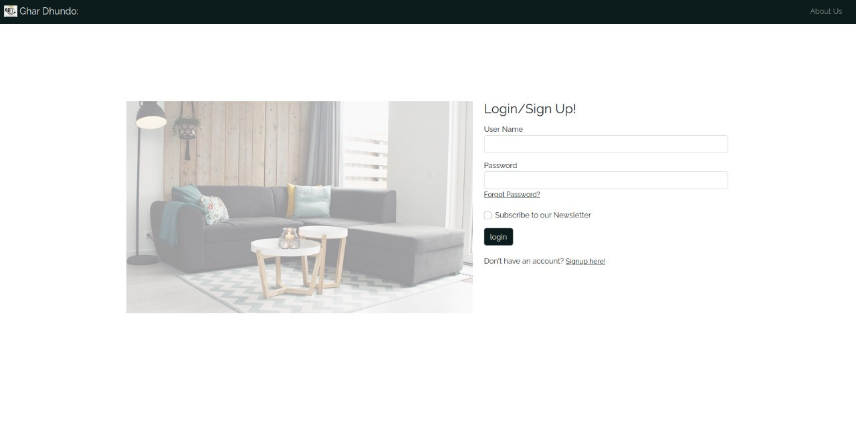

Slide 9
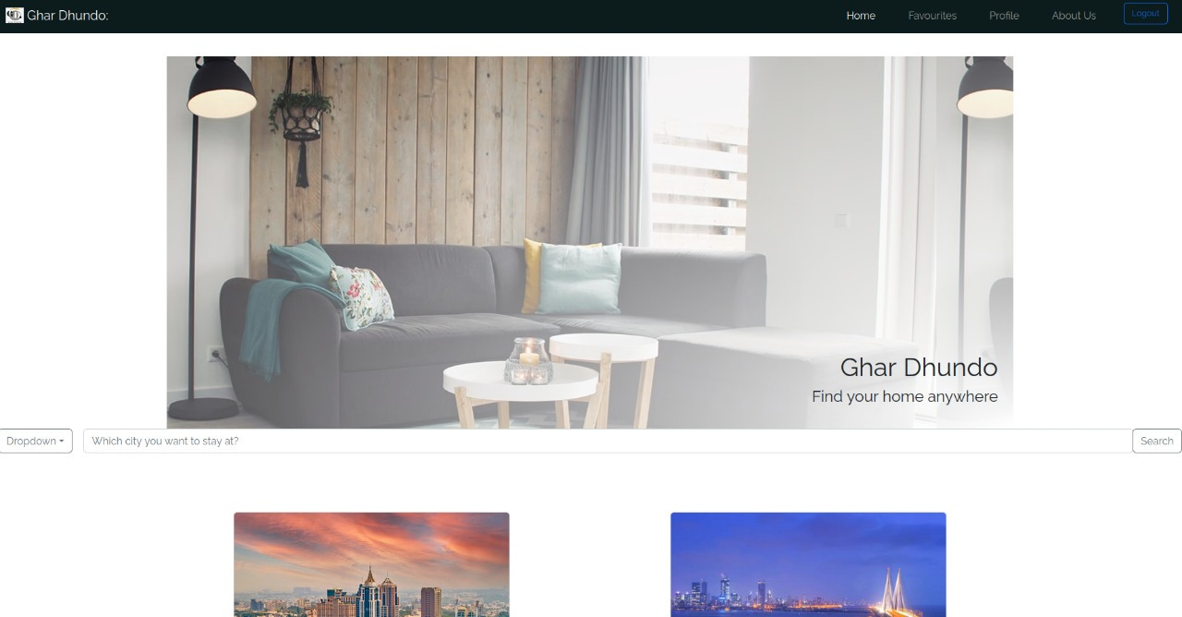

Slide 10
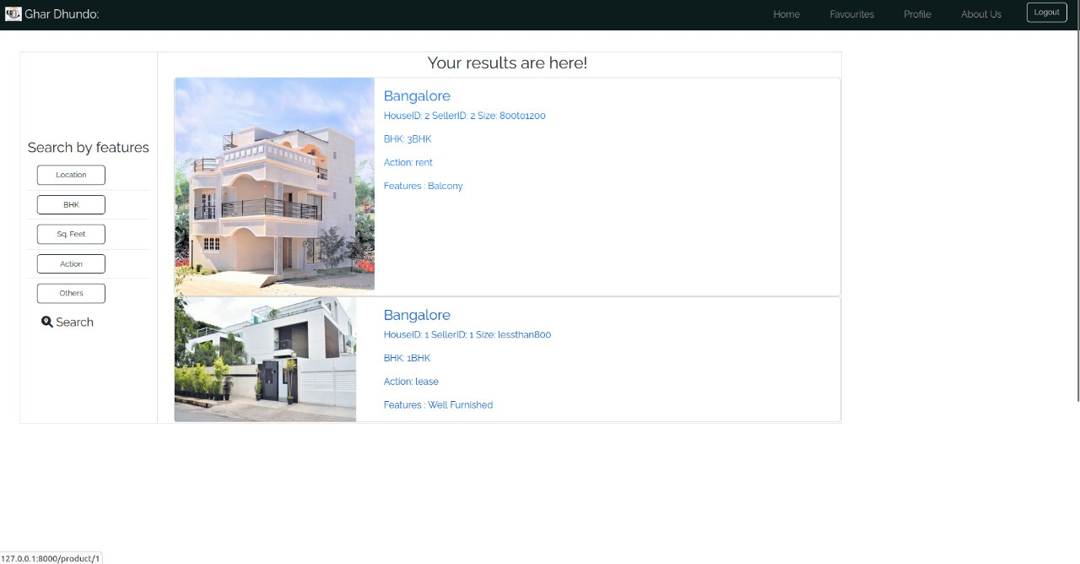

Slide 11
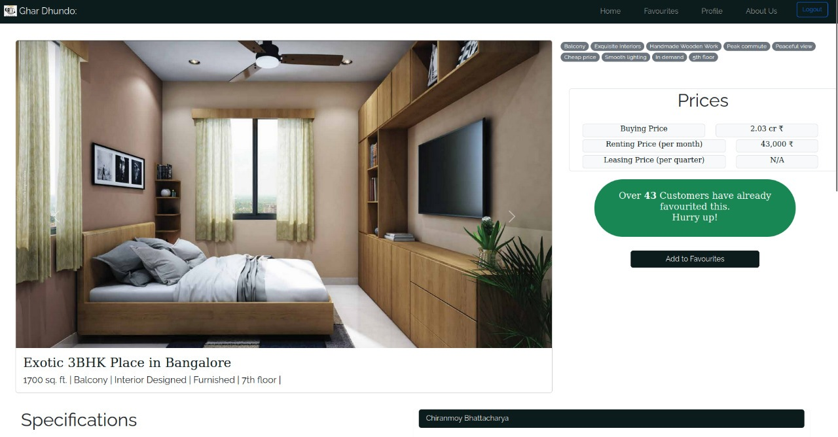

Slide 12
Future Possibilities

Slide 13
Favourites Page
Profile Page
Contact with seller
Chat with seller
Search City

Slide 15


OUR TEAM
Tathagata Dey
Nilava Sarkar
tathagata@cse.iitb.ac.in
nilavasarkar@cse.iitb.ac.in

Slide 16
RESOURCES
Bootstrap (https://getbootstrap.com/)
W3Schools (https://www.w3schools.com/html/)
Django Documentation (https://docs.djangoproject.com/en/4.1/)

Slide 17
Thank You!

