Slide 1
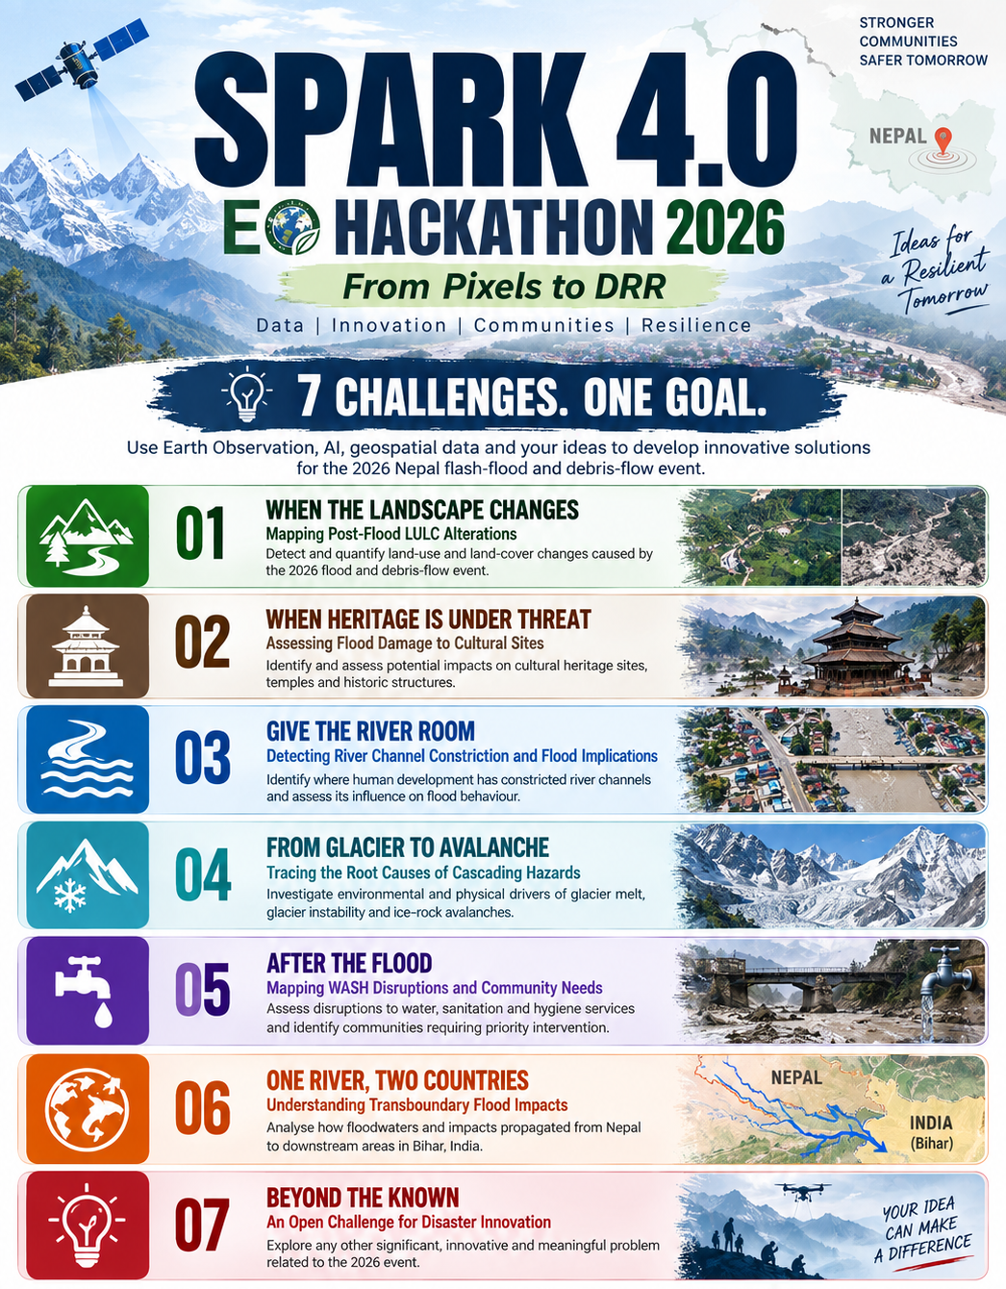
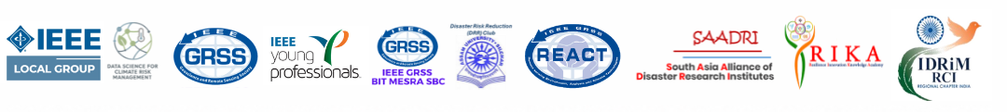
Rasuwa Flood Portal
An open, living 3D map of the 2026 Bhotekoshi flood
Theme 07 · Beyond the Known
An open challenge for disaster innovation
GeoDev
Tek Kshetri
OSGeo Nepal, Nepal
Notes:
Hi, we are [team]. Our entry for Theme 07 is the Rasuwa Flood Portal: one open 3D map that brings together everything known about the 26 August 2026 Bhotekoshi flood.

Slide 2

Project Overview
Summary
On 26 August 2026, a rock and ice collapse near Langtang Lirung sent a debris flood about 72 km down the Bhotekoshi–Trishuli valley in Rasuwa, Nepal. Information about the damage was scattered across agencies, volunteers and satellite platforms. The Rasuwa Flood Portal brings it into one open 3D web map: flood extent, impact layers, landslides and Sentinel-2 before/after imagery. It shows ~145 km of damaged road and 190 exposed settlements along a 45 km² flood extent.
Innovation statement
A living portal, not a one-off map. Anyone can add a dataset by editing one config file, with no code. It puts impact data, a 3D Sentinel-2 before/after swipe (True Color, False Color, NDVI) and a flood-surge elevation profile together in one free, open tool.
Notes:
The problem was not a lack of data, it was that data lived in ten different places. Our innovation is a portal that keeps growing: a new dataset is a few lines of JSON, not new code.

Slide 3

BASIC Information
Study Area
Data
Method
Bhotekoshi–Trishuli river corridor, Bagmati & Gandaki provinces, Nepal
From the Langtang Lirung glacier source to the downstream Trishuli
24 affected municipalities in 8 districts, incl. Rasuwa, Nuwakot, Dhading
Sentinel-2 L2A, 12 Aug & 21 Sep 2026 (Copernicus)
Vantor post-event imagery (HOT)
OSM-based impact layers: roads, settlements, facilities
BGS landslide inventory
HOT/HDX, Overture, NAXA; AWS terrain
Collect & check open datasets
Clean and reproject to GeoJSON
Register each layer in one config file
Render in 3D with MapLibre
Sentinel-2 swipe + NDVI for change
Output
Impact
SDG Connection
Live, open web portal
40 toggleable map layers
Before/after swipe, 3D tour, elevation profile
Layer stats + downloadable GeoJSON
Responders: see which roads, bridges and settlements to reach first
Mappers & researchers: one shared base map
Media & public: understand the event visually
SDG 11.5 reduce disaster losses
SDG 13.1 resilience to climate hazards
SDG 9.1 resilient infrastructure
SDG 17 open-data partnerships
Notes:
Quick facts: a 72 km corridor, 8 districts, data from more than ten open sources, and the output is a live portal anyone can open.

Slide 4
Method
1
2
3
4
5
Collect
Standardise
Configure
Visualise
Share & update
Gather open data from OSM, HOT/HDX, BGS, Copernicus and partners
Check, clean and reproject every layer to GeoJSON (EPSG:4326)
Register each layer in one JSON file: style, popup, legend
Render in 3D with MapLibre + terrain; Sentinel-2 via WMS
Publish on GitHub Pages; new data goes live via pull request
Adding a layer = a few lines of JSON
Built with open tools
{
"id": "road_damaged",
"label": "Damaged Road Network",
"type": "line",
"data": "data/.../Road_damaged.geojson",
"paint": { "lineColor": "#d62728" },
"active": true
}
MapLibre GL JS 3D map, terrain, swipe compare
Copernicus Sentinel Hub Sentinel-2 True/False Color, NDVI
GeoJSON + layers.json all data and styling in one config
Python data prep and the elevation profile
GitHub Pages free hosting, open contributions
Notes:
Five steps. The key design choice is step 3: the whole map is driven by one JSON file, so adding a dataset needs no programming.

Slide 5

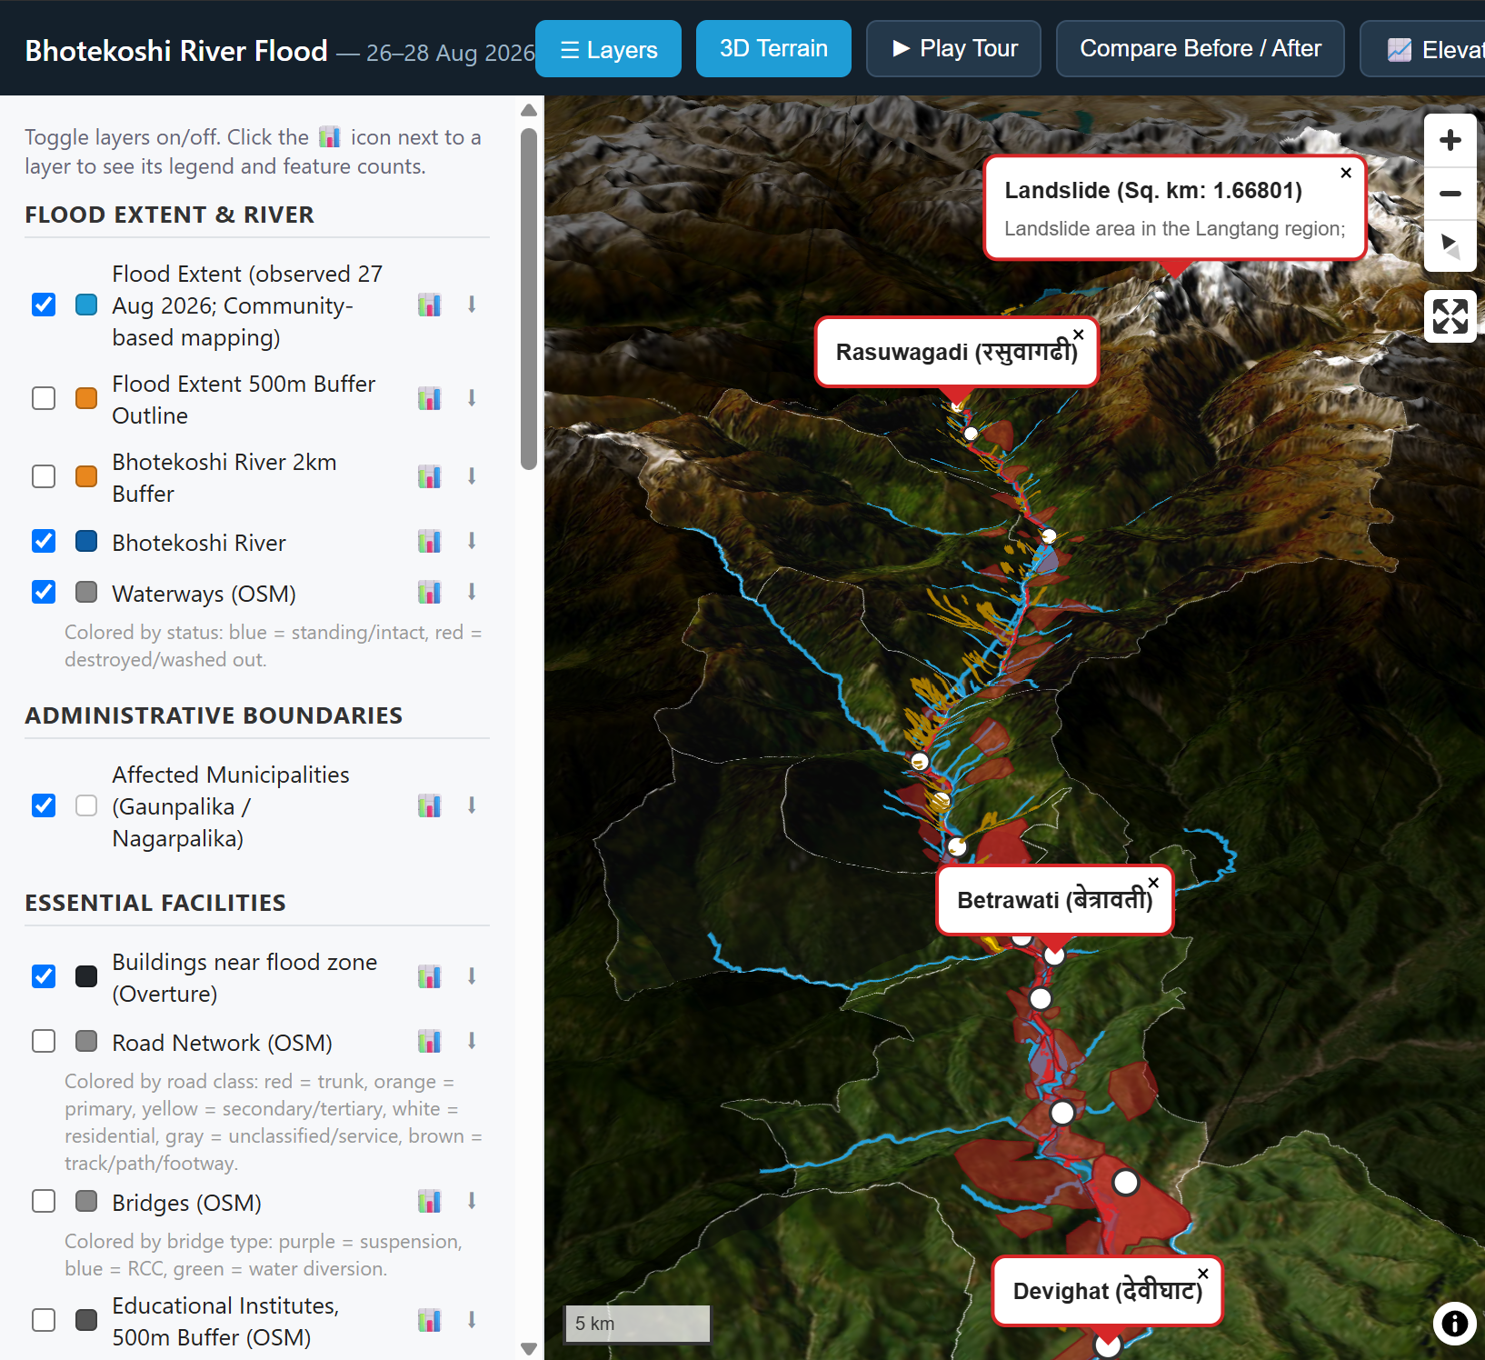
Results Impact at a glance
~145 km
~163 km
45 km²
damaged road
road at risk
flood extent
* within the mapped flood extent. Source: OSM-based impact layers on the portal; road lengths summed from segments.
Takeaway: with ~145 km of road damaged and 163 km more at risk, the map shows responders which settlements and facilities to reach first.
Notes:
This is the damage picture from the impact layers. Roads stand out: about 145 km damaged and 163 more at risk. Every number here can be clicked on the live map.

Slide 6
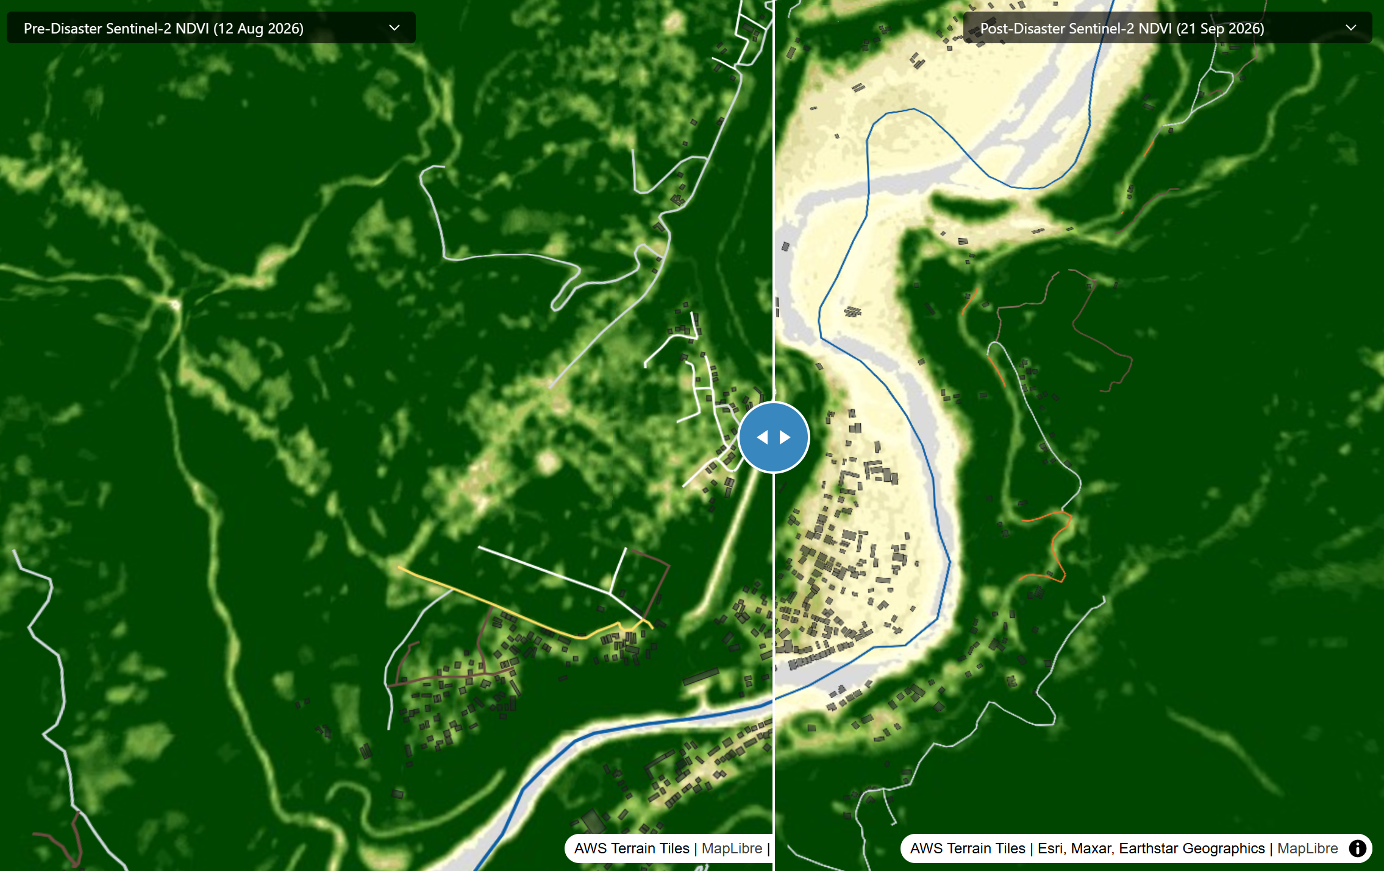
Results Before vs after, Sentinel-2
Takeaway: one swipe over 3D terrain shows how the river channel and vegetation changed between 12 Aug and 21 Sep, with no GIS skills needed.
Notes:
Same satellite, same pixels, two dates. Each side has its own dropdown, so you can compare True Color, False Color or NDVI. NDVI makes vegetation loss obvious.

Slide 7
References
In Same study area
Similar study
Similar solution
NDRRMA / OSM (2026). Flood impact layers for the Bhotekoshi–Trishuli corridor: roads, settlements, facilities.
HOT OSM (2026). Nepal Floods 2026 damage assessment. HDX dataset “hot_flood_npl” (data.humdata.org)
Shugar, D.H. et al. (2021). A massive rock and ice avalanche caused the 2021 disaster at Chamoli, Indian Himalaya. Science 373, 300–306.
ICIMOD (2021). The Melamchi flood disaster: cascading hazard and the need for multihazard risk management.
HOT OSM uMap (2026). Nepal Floods 2026 focus area & tasking map: umap.hotosm.org
Copernicus Browser / EMS Rapid Mapping. Satellite before/after viewing and emergency maps.
Notes:
Related work: the same area is covered by OSM impact layers and HOT's damage assessment; the Chamoli 2021 study is the closest hazard type; uMap and Copernicus are the closest existing tools. What they lack is everything in one maintained, 3D place.

Slide 8
Use / Scope of Knowledge-Driven AI
Where AI is used today
AI-assisted building-damage mapping in the HOT datasets, validated by human mappers before it reaches the portal
AI coding assistant used to speed up portal development
Where knowledge-driven AI adds value next
Sentinel-2 change detection: NDVI/NDWI differencing + an ML classifier to flag new debris and scoured banks
Priority ranking from expert rules, e.g. hazard × exposure (a school within 500 m of a damaged road)
Plain-language Q&A over the layers: “Which health posts lost road access?”
Why it fits: data is large and time-critical. Limits: monsoon cloud and scarce ground truth, so people stay in the loop.
Notes:
We are honest about AI: today it helps in the upstream damage mapping and in development. The next step is automatic change detection from Sentinel-2 and rule-based priority ranking.

Slide 9
CONCLUSIONS
The Rasuwa Flood Portal turns scattered, multi-source flood data into one open 3D map that anyone can explore. The impact layers show ~145 km of damaged road and 190 exposed settlements along a 45 km² flood extent, and the Sentinel-2 swipe makes landscape change visible without GIS skills. Because layers are added through one config file, the portal keeps improving as new data arrives.
Initial objectives
✓
Bring all event data into one place — achieved: 40 layers from 10+ sources
✓
Make the impact visible — achieved: roads, settlements, facilities, landslides
✓
Show before/after change clearly — achieved: 3D Sentinel-2 swipe with NDVI
↻
Keep it open and community-driven — ongoing: contributions via GitHub
Notes:
Three of our four objectives are met; the fourth, community contributions, is ongoing by design.

Slide 10
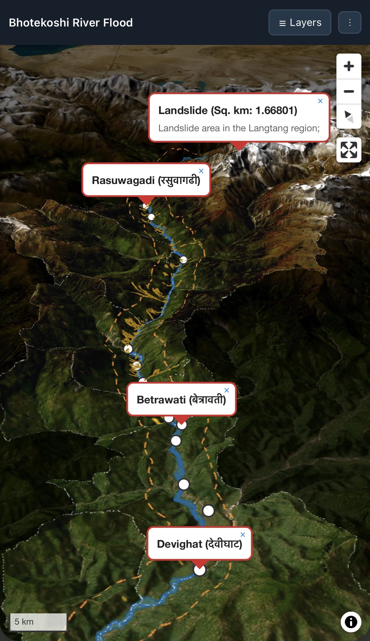
Graphical Abstract
!
10+
SCREENSHOT PLACEHOLDER · IMG 4
Full portal UI: 3D map with sidebar open and a few layers on (or the elevation-profile panel).
Portrait crop ≈ 0.62 : 1
✓
Problem
Data
People
Flood data scattered across agencies, volunteers and satellites
Sentinel-2
Vantor imagery
OSM impact layers
BGS landslides
Terrain DEM
Responders
Mappers & researchers
Media & public
45 km² flood extent 145 km damaged road 190 exposed settlements 915 landslides 40 open layers
Notes:
The whole project in one picture: scattered data goes in, one open portal comes out, and responders, researchers and the public all use the same map.

Slide 11

Thanks!
Live portal
iamtekson.github.io/rasuwa-flood
Code & data
github.com/iamtekson/rasuwa-flood
Contact
[email / LinkedIn]
Scan to open the portal
Notes:
Thank you. Scan the QR code to open the portal and try the before/after swipe yourself.

