Slide 1
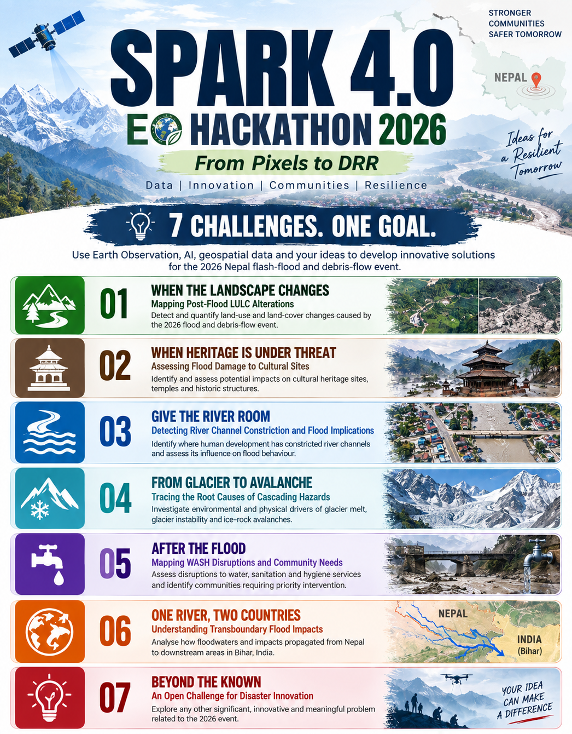

PROJECT Title
Selected Theme
Team Name
Participants’ name
Institute’s name

Slide 2

Project Overview
Summary
Briefly describe the problem studied, study area, disaster type/disaster event chosen, data used, and main result in 4–5 lines.
Innovation statement (50 words max)
State what is new or different in your project/approach compared to existing studies/research.

Slide 3

BASIC Information
Study Area
Data
Method
Mention the geographic location studied (state/district/basin/etc) and why it is relevant to the selected disaster.
List the main datasets used along with their source.
Briefly describe the steps or approach used to analyze the data (e.g., time-series analysis, mapping, comparison).
Output
Impact
SDG Connection
Specify what final products were generated, such as maps, graphs, indices, or risk zones.
Explain which people (farmers, policy makers, citizens) can be benefited from your outputs/results.
Mention which Sustainable Development Goal(s) your work supports and how it contributes to them.

Slide 4
Method
Briefly describe the steps or approach used to analyze the data (e.g., time-series analysis, mapping, comparison).

Slide 5

Results
Maps
Charts & Statistics
Highlight the main takeaway and its relevance to understanding or managing floods.

Slide 6
Results
Maps
Charts & Statistics
Highlight the main takeaway and its relevance to understanding or managing floods.

Slide 7
Results
Maps
Charts & Statistics
Highlight the main takeaway and its relevance to understanding or managing floods.

Slide 8
References
In Same study area
Similar study
Similar solution
List 1–2 published studies or official reports that analyzed a similar hazard in the same geographic region.
List 1–2 studies that used similar data, indicators, or methods, even if conducted in a different area.
List 1–2 studies, tools, or projects that proposed similar outputs or solutions (e.g., risk maps, early warning, indices).

Slide 9
Use / Scope of Knowledge-Driven AI
If artificial intelligence or machine learning was used in the project, clearly describe what AI/ML technique was applied and for which task.
If AI/ML was not used, explain where and how AI or knowledge-driven AI could be applied to improve the analysis or decision-making. Participants should briefly mention the type of data, expected benefit of AI, and why AI is suitable or not suitable for this problem.

Slide 10
CONCLUSIONS
This section should summarize the key findings of the study in 3–5 sentences.
Participants should clearly state whether the study objectives were achieved based on the results.
The conclusion should highlight the main takeaway and its relevance to disaster understanding or management.
ANALYSIS OF THE INITIAL OBJECTIVES

Slide 11
Graphical Abstract
Summarize your problem statement, approach, and key solution/findings in one clear visual. Use maps, icons, datasets, workflows, or key results instead of lengthy text. Keep it simple, visually engaging, and understandable at a glance.
ANALYSIS OF THE INITIAL OBJECTIVES

Slide 12
Thanks!

