Slide 1
PrandialTwin
A digital twin for post-meal hyperglycaemia that tests its own claims
Team: TODO team name | TODO college and incubator
Happiest Health Digital Twin Challenge 2026
Notes:
Introduce the team. One sentence: we built a digital twin for post-meal high glucose in type 2 diabetes and prediabetes, and we tested every claim it makes on real patients. Replace the team line before recording.

Slide 2
After-meal glucose is India's blind spot
26.7%
61.6%
53.5%
of Indian adults have diabetes (11.4%) or prediabetes (15.3%)
of energy in the average Indian diet comes from carbohydrate
of time above range in 649 Indian T2D patients on a first glucose sensor
The gap
HbA1c every three months averages the spikes away. A 14-day CGM report shows them, but only after they happened. Nobody tells the doctor or the patient before the meal, when a smaller portion or a walk could still change the outcome.
Sources: ICMR-INDIAB-17 (Lancet Diabetes Endocrinol 2023); Anjana et al. (Diabetes Care 2022); Gupta (Cureus 2025)
Notes:
Three numbers. One in four Indian adults has diabetes or prediabetes. The diet is carbohydrate heavy. And when Indian patients with type 2 diabetes wear a sensor, more than half the time is above range. HbA1c hides this; a CGM report shows it only afterwards. We want to show it before the meal.

Slide 3
Most "digital twins" are not twins
1
It updates
12%
Dynamically updated with data from the real patient
2
It predicts
of 149 published health "digital twins" meet that definition
Forecasts what happens next, with quantified uncertainty
1.3%
3
It informs a decision
Answers a what-if a clinician can act on, and shows its track record
mention verification, validation and uncertainty
Tudor et al., npj Digital Medicine 2025
National Academies (2023) definition, with verification, validation and uncertainty quantification built in
Notes:
The US National Academies define a digital twin by three things: it is updated from its physical twin, it predicts, and it informs decisions, with verification, validation and uncertainty built in. A 2025 review found only 12 percent of 149 published health twins meet that. We designed for those three tests and we report against them.

Slide 4
What the doctor asks, and what the twin answers
The doctor asks | The twin gives
Will this meal push her above 180 mg/dL? | Probability of glucose above 180 mg/dL for 15+ minutes in the next 2 to 3 hours, with a calibrated band
Why? | How much carbohydrate on board, current drift and recent activity add to the expected peak
What would help? | The same forecast re-run with a smaller portion, another meal, or a walk
Can I trust that? | The track record of such what-ifs on real matched meals, shown beside the answer
Is today unusual for her? | Today's carbohydrate response against her own baseline
Adverse event predicted: CGM above 180 mg/dL for at least 15 consecutive minutes, forecast while glucose is still at or below 180.
Notes:
The use case: a physician places a 10 to 14 day sensor on a patient with type 2 diabetes or prediabetes. Walk through the five rows. The adverse event we predict is glucose above 180 for at least 15 minutes, starting from below 180.

Slide 5
Two streams, one person, and real data first
CGMacros
ShanghaiT2DM
Synthetic cohort
45 real adults, USA
Labs + Dexcom CGM + Fitbit + meals with macros, about 10 days
Role: development, 5-fold by patient
PhysioNet, CC BY-NC-SA 4.0
109 real recordings, China
15-minute CGM, meals as text, half on insulin, no wearable
Role: unseen test only
figshare, CC BY 4.0
60 virtual patients, Indian meals
EHR tables + CGM, heart rate, steps, sleep from one hidden physiology
Role: verification and demo only
Generated here
Static record: age, sex, weight, BMI, HbA1c, fasting glucose, fasting insulin. Dynamic: CGM, meals, activity.
No Indian CGM dataset with linked labs is openly available. We say so, and do not claim Indian accuracy.
Notes:
The brief asks for a static record fused with a wearable stream. In our two real cohorts both belong to the same person. CGMacros is where we develop, always testing on patients the models never saw. Shanghai is never used for fitting. Synthetic data only verifies the method. We never glue a random synthetic chart to someone else's glucose trace.

Slide 6
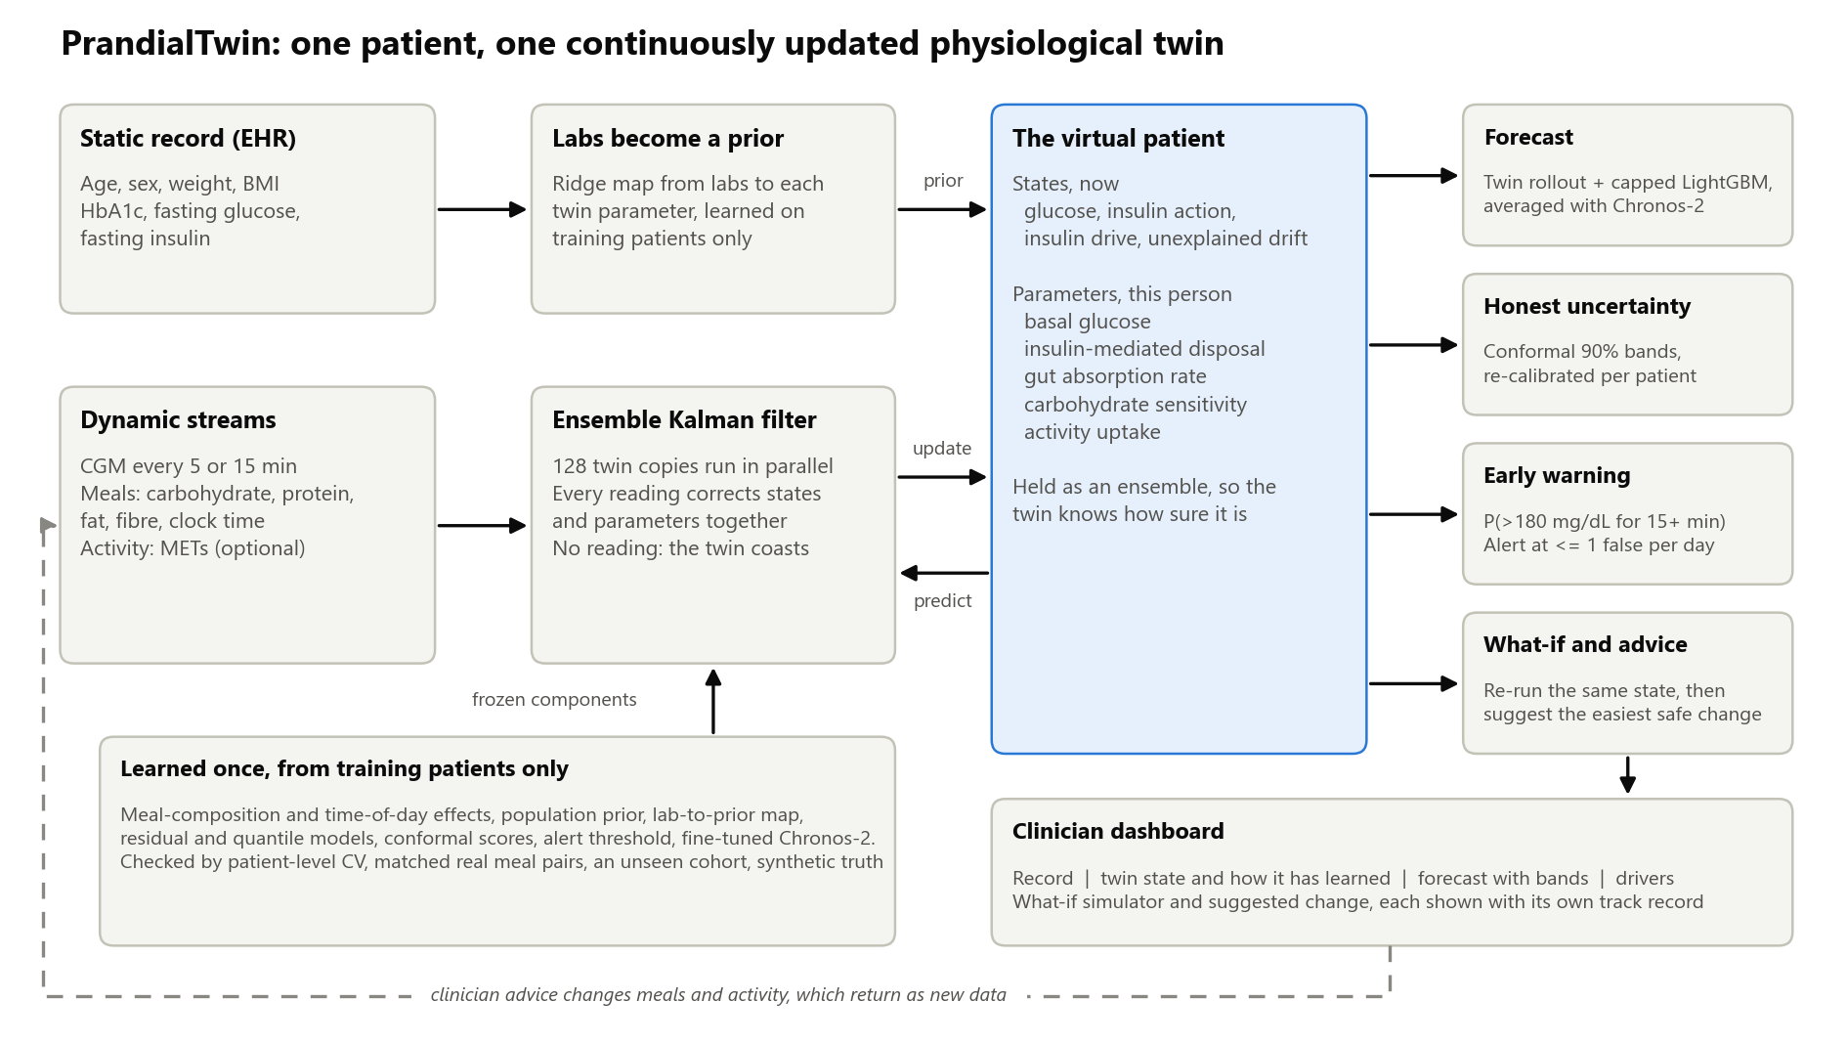
Architecture: labs set the prior, every reading updates the twin
Notes:
Left to right. The static record never becomes a feature column: it sets the prior on five physiological parameters. The stream goes through an ensemble Kalman filter that corrects the twin at every reading. From the twin we get a forecast, an honest band, an alert and a what-if. Everything learned across patients is learned on training patients only. The dashed loop is what makes it a twin and not a shadow: advice changes behaviour, and behaviour comes back as data. Since 17 October the forecast box also averages in fine-tuned Chronos-2, and the what-if box suggests the least-effort change.

Slide 7
A small physiology model, kept in step with the patient
1
Labs set the prior
The virtual patient
HbA1c, fasting glucose, fasting insulin and BMI map to a starting estimate of each parameter
States, now: glucose, insulin action, insulin drive, unexplained drift
Parameters, this person: basal glucose, insulin-mediated disposal, gut absorption rate, carbohydrate sensitivity, activity uptake
Shared by everyone: meal-composition and time-of-day effects
2
Every reading corrects it
A 128-member ensemble Kalman filter updates states and parameters together; it coasts through sensor gaps
3
Roll forward three hours
Physics forecast, a capped LightGBM correction, and a conformal band re-calibrated per patient
Never fitted to its own patient: prior, then online updates only
Notes:
Four states and five parameters. We only estimate what a glucose sensor can identify: for example the product of insulin secretion and sensitivity, not each separately. 128 copies of the twin run in parallel, which is where the uncertainty comes from. The key design choice: the twin is never fitted to the patient it describes. It gets a prior from labs and then only online updates.

Slide 8
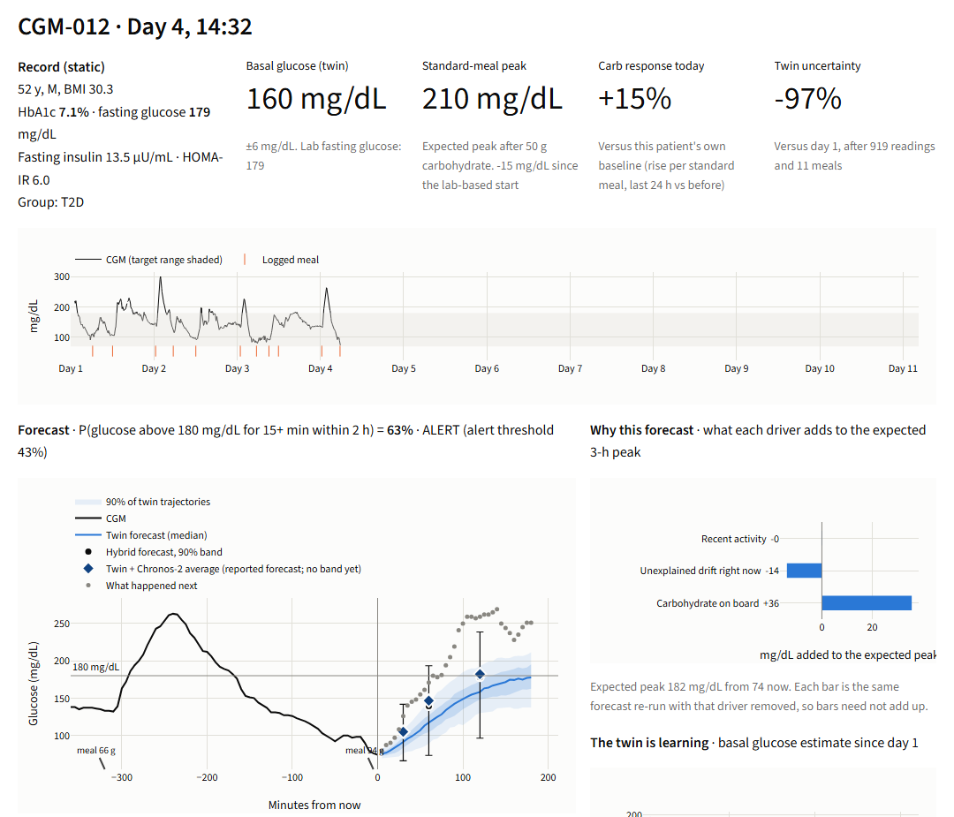
What the clinician sees
1
Record and twin state
Labs, basal glucose, standard-meal peak, today vs own baseline
2
Forecast and alert
Trajectories, 90% band, probability of the event, alert threshold
3
Why
Carbohydrate on board, drift, activity
4
What if
Portion, extra meal, walk, with the track record shown
Notes:
Switch to the live dashboard here. This is a real held-out participant, replayed. Top: the record and the twin's current state. Middle: the forecast with its band, the alert, and why. The dark diamonds are the reported forecast, the twin averaged with fine-tuned Chronos-2. Bottom: the what-if. Use the script in docs/DEMO_SCRIPT.md for the exact clicks.

Slide 9
At home it ties LightGBM; away from home it beats it
Hybrid minus LightGBM at 60 min: -0.02 (-0.71 to 0.57) mg/dL at home, -1.99 (-2.64 to -1.39) on the unseen cohort (95% interval, resampling patients).
Notes:
Be direct. On the home cohort the hybrid twin and a well-built LightGBM model are a tie: 24.9 versus 25.0 at 60 minutes. On the unseen Chinese cohort the population model falls back almost to persistence, and the twin does not: 26.4 versus 28.4. The baseline there was trained at the target site's modality, so it had its fairest shot. Intervals are from resampling patients. Then say what the next slide shows: we also tested the models we had ruled out, and one of them beat the twin abroad.

Slide 10
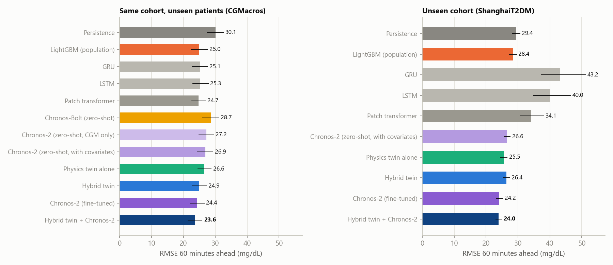
We tested every model we had ruled out
60-minute RMSE, 95% intervals by resampling patients. Small networks tie at home and fail abroad. Fine-tuned Chronos-2 is the best single model in both cohorts. The twin averaged with Chronos-2 is the most accurate forecast: 23.6 at home, 24.0 abroad.
Notes:
We first ruled out neural networks and fine-tuning without testing them. We tested them on the same folds and the same external cohort. GRU, LSTM and a patch transformer tie LightGBM at home (25.1, 25.3, 24.7 against 25.0) and fall apart abroad (43.2, 40.0, 34.1). Chronos-2, a pretrained foundation model, fine-tuned on each fold's training patients, is the best single model: 24.4 at home and 24.2 abroad, where it beats our hybrid (26.4). We say that plainly. Averaging the twin with Chronos-2 gives the best forecast of all; the twin still provides the state, the what-ifs and the advice.

Slide 11
Why the networks failed abroad, and Chronos-2 did not
+19
51%
24.2
mg/dL mean error of the GRU abroad, too high at every hour of the day. The physics twin: +1
of Shanghai recordings are on insulin, a drug the networks never saw; their errors are largest there
mg/dL for fine-tuned Chronos-2 abroad, against 26.4 for the hybrid twin. It reads a day of the patient's own data
Read it carefully
Small networks learn one population's glucose behaviour, and nothing in them adapts to a new person. The twin re-learns each patient from their readings; Chronos-2 conditions on the patient's last 24 hours. Averaged, they forecast best.
Notes:
Diagnose, do not just rank. Abroad the networks over-predict by 13 to 19 mg/dL on average, at every hour, and most for patients on insulin, whose glucose is pushed down by a drug they never saw. Their validation error on held-back CGMacros patients was good, so they did not fail to train; they failed to transfer. The twin's filter adapts per patient, which is why the physics twin alone is the most accurate twin variant abroad. Chronos-2 transfers because it conditions on a full day of the patient's own readings.

Slide 12
It warns of more events at the same alert burden
61%
30 min
0.45
of 693 real events warned of before onset, at 0.94 false alerts per patient-day. Standard model: 52%
median warning before glucose stays above 180 mg/dL
alert precision-recall area on the unseen cohort. Standard model: 0.36; difference 0.09 (0.06 to 0.14)
Read it carefully
Home cohort: alert AUROC 0.82 vs 0.81, precision-recall area 0.43 vs 0.42: a tie. Only forecasts made while glucose is still at or below 180 mg/dL are counted, which is harder than detecting a spike already under way.
Notes:
The alert threshold is fixed on calibration patients for about one false alert per patient-day, then run unchanged on test patients. The hybrid warns of 61% of 693 events, the standard model 52%. Median lead is 30 minutes. On the unseen cohort the precision-recall area is 0.450 versus 0.356. On the home cohort the discrimination itself is a tie; say that.

Slide 13
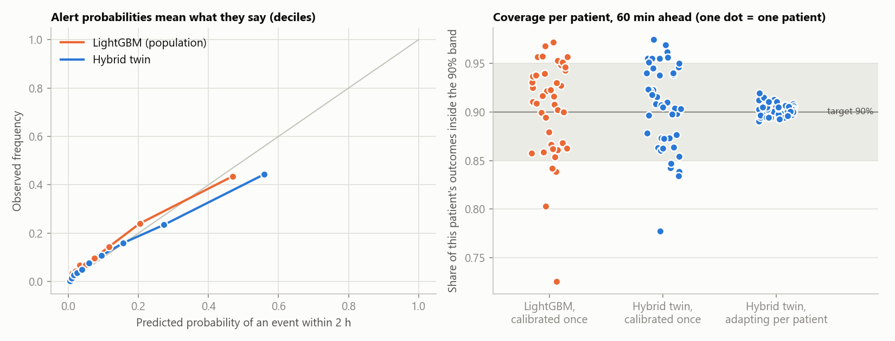
Its uncertainty is honest for every patient
Worst patient, 60 min ahead: 89% with per-patient adaptation vs 78% without. On the unseen cohort: 88% vs 64%.
Notes:
Pooled coverage hides the patients where a model is confidently wrong. Each dot is one patient. Calibrated once, the worst patient gets 78% of outcomes inside a nominal 90 percent band. When the band adapts online to each patient, the worst is 89% and all 45 are within five points. On the unseen cohort: 88% versus 64%.

Slide 14
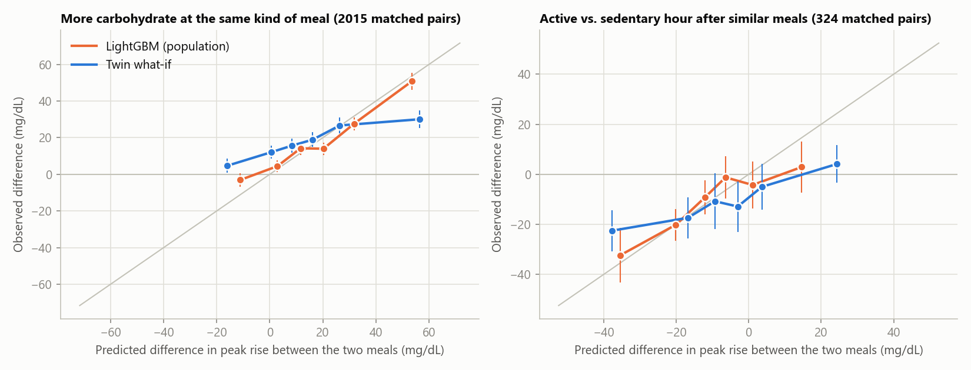
What-ifs were checked against what really happened
Direction right: 66% of 2,015 carbohydrate pairs, 61% of 324 activity pairs. Active hour after a meal: observed -10.7 mg/dL, twin -9.1. Not better than LightGBM on direction (68%, 63%).
Notes:
Inside one person we find pairs of meals of the same kind, starting from similar glucose, that differ in one thing: carbohydrate, or an active versus a sedentary hour afterwards. The twin got the direction right in 66% of 2015 carbohydrate pairs and 61% of 324 activity pairs. The observed effect of an active hour was -10.7 mg/dL; the twin attributes -9.1. Say clearly: the standard model does about as well on direction. These pairs are not randomised; it is a consistency check.

Slide 15
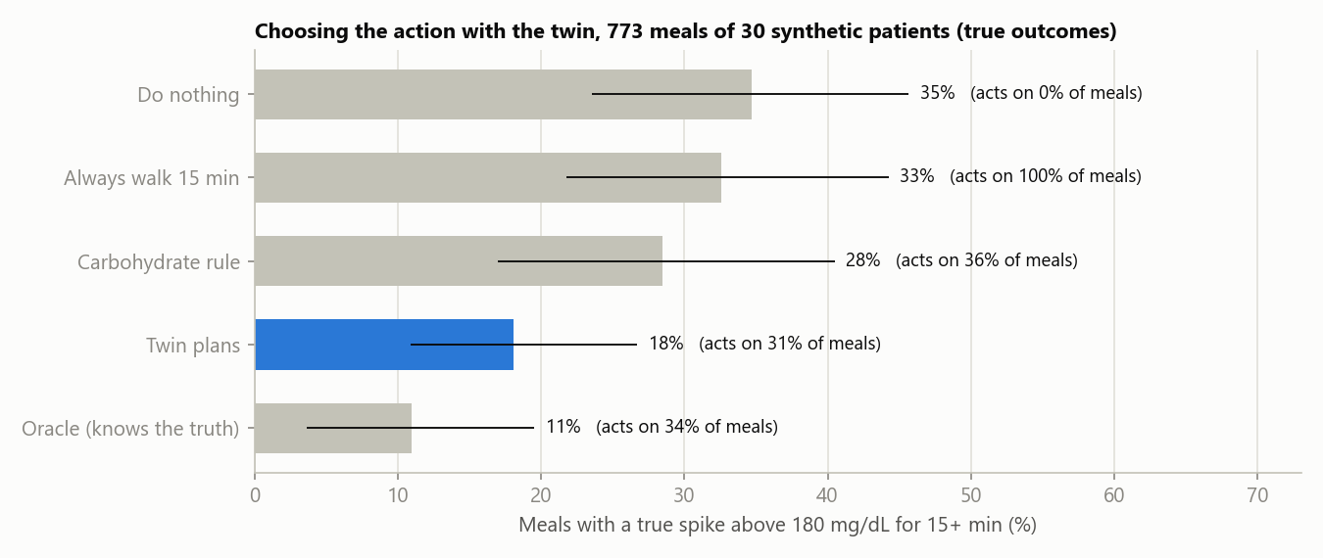
Twin-chosen changes nearly halve spikes in simulation
773 meals, 30 synthetic patients, true outcome of every action known. Twin minus doing nothing: -16.6 (-23.0 to -10.0) points; minus a carbohydrate rule: -10.3 (-17.5 to -3.5). An upper bound, not a trial.
Notes:
Reinforcement learning was the obvious idea. But choosing a portion or a walk at a meal is one decision with a result in three hours: a contextual bandit. The twin can simulate every option, so it simply tries all eight and picks the least effort that keeps its spike risk under 30 percent; that is the exact answer Q-learning would only approximate. Tested where the truth is known, synthetic patients: spikes at 35% of meals with no action, 28% with a carbohydrate rule, 18% when the twin chooses, 11% for an oracle. Same model family as the twin, so this is an upper bound. Lifestyle only, never medication.

Slide 16
What did not hold up
We hoped for | We found
Beat LightGBM on the home cohort | A tie: 24.9 vs 25.0 mg/dL at 60 min
Labs give a clear head start | First 24 h: -0.46 (-1.01 to 0.10) mg/dL. Not significant
The twin keeps improving with data | Updating vs frozen from day 4: -0.87 (-2.14 to 0.26). Not significant; worse in the first 3 days
Twin what-ifs beat an associative model | No: 66% vs 68% direction right on carbohydrate pairs
The twin transfers better than any model | No: fine-tuned Chronos-2 24.2 vs hybrid 26.4 mg/dL abroad. Now averaged in
What did hold
Personalised vs generic physiology from day 4: -5.6 (-9.4 to -2.1) mg/dL. Twin basal glucose vs lab fasting glucose: rho 0.62. Standard-meal peak vs HbA1c: rho 0.60, with the labs withheld from the twin.
Notes:
Show this slide on purpose. Four things we hoped for and did not get with 45 people. A stated negative is stronger than an untested claim, and these tell us where the next work is. A fifth one since 17 October: a fine-tuned foundation model transfers better than the twin. We had assumed fine-tuning needed more data; we tested it and were wrong.

Slide 17
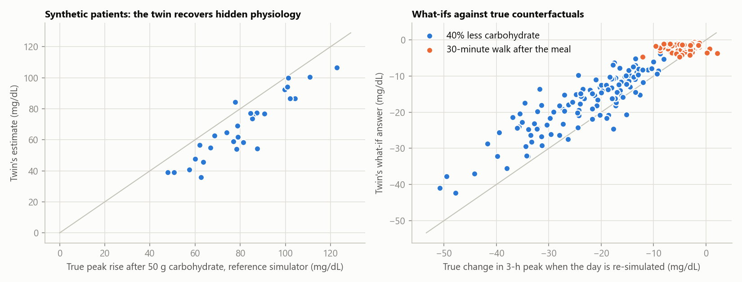
On synthetic patients, the twin recovers the truth
Basal glucose: rho 0.959, error 4.7 mg/dL. "40% less carbohydrate": r = 0.875, direction right 100%, true -22.9 vs twin -17.2 mg/dL. No accuracy claim rests on synthetic data.
Notes:
Verification, not validation. Our simulator is deliberately richer than the twin, and it can replay a day with one input changed, which gives a true counterfactual. Basal glucose is recovered with rank correlation 0.959. For forty percent less carbohydrate the twin's answer correlates 0.875 with the truth and has the right direction every time, though it underestimates the size. The walk effect in the simulator is too small to rank.

Slide 18
Limits and responsible use
Not Indian data
Retrospective
No drug or insulin model
45 people from the USA, 100 from China. The India case is problem fit, not measured accuracy
Replayed recordings. No prospective use, no clinical outcomes
Their effect lands in the drift term. Half the external cohort is on insulin
Meals must be logged
Decision support only
Data terms
With no meal log the 60-minute error rises by 8%
For a clinician. Lifestyle scenarios; no medication or dosing advice
CGMacros is non-commercial (CC BY-NC-SA). No raw data in the repository
Notes:
Read these out. This is a research prototype. It has not been tested on Indian patients, it is retrospective, it has no drug or insulin model, and it needs a meal log. It is decision support for a clinician and gives lifestyle scenarios only.

Slide 19
What comes next for India
1
Indian validation
Same protocol on an Indian CGM cohort with linked labs, with a hospital partner
2
Therapy in the model
Metformin, sulfonylurea and insulin effects; sleep and stress from the wearable
3
Meals without typing
Photo-based logging for Indian dishes; the twin already tolerates 30% carbohydrate error
4
Fit the health system
FHIR and ABDM records in and out
5
Prospective pilot
Alerts and what-ifs in clinic, measured against time in range
Notes:
Five steps, in order. The first is the one that matters: the same evaluation on an Indian cohort with a hospital partner. The code needs one new data loader for that.

Slide 20
A twin you can inspect, reproduce and challenge
It beats LightGBM abroad, pairs with Chronos-2 for the best forecast, keeps honest bands, and its what-ifs and advice were checked
One command reproduces every number: python -m twin.evaluate
Repository: TODO public GitHub link
Notes:
Close with what held, including the uncomfortable part: the twin beats the standard model abroad, a fine-tuned foundation model beats both, and together they are the best forecast; the bands are honest per patient; the what-ifs and the advice were tested. One command reproduces every number. Thank the organisers.

