Slide 1
See the glucose spike
before it happens
HAPPIEST HEALTH DIGITAL TWIN CHALLENGE 2026
PrandialTwin: a digital twin for type 2 diabetes and prediabetes in India
Team Adorable
Tharun J (team leader) · Vellore Institute of Technology, Vellore
Gargi Sharma · ABES Institute of Technology, Ghaziabad
Notes:
S01-L1-T THARUN
Hi, I'm Tharun, from VIT Vellore.
S01-L2-G GARGI
And I'm Gargi, from ABES Institute of Technology in Ghaziabad. We're team Adorable.
S01-L3-T THARUN
Our project is PrandialTwin, a digital twin for type 2 diabetes. It sees a sugar spike coming after a meal, early enough that you can still change the meal. We'll show you the problem, how it works, how well it does, and four live demos.

Slide 2
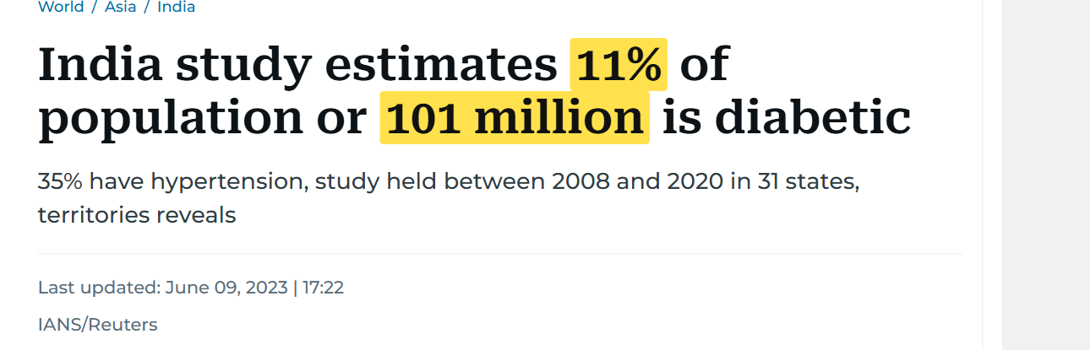
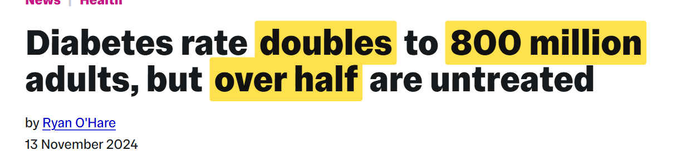
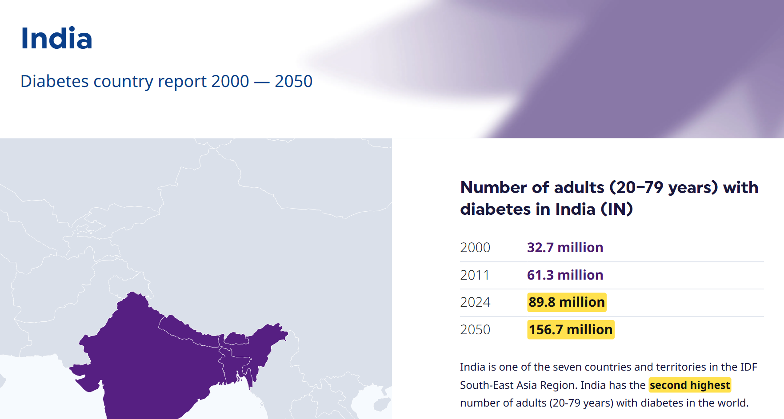
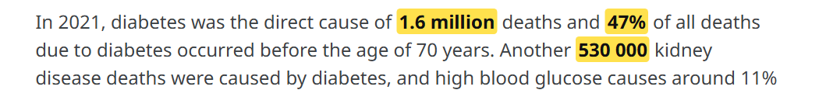
The headlines are already here
Imperial College London, 13 Nov 2024: NCD-RisC in The Lancet [3]
Gulf News (IANS/Reuters), 9 June 2023 [1, 2]
WHO diabetes fact sheet, 14 Nov 2024 [4]
Yellow marks are ours. Every number in this talk is referenced at the end.
IDF Diabetes Atlas 2025, India country report [5]
Notes:
S02-L1-G GARGI
Let's start with where India stands. None of these numbers are ours, they come straight from published studies. The ICMR found 101 million people in India living with diabetes. And a Lancet study from 2024 found that the share of adults with diabetes has doubled since 1990. Today that's over 800 million adults worldwide, and more than half of them aren't being treated.
S02-L2-T THARUN
The WHO says diabetes directly caused 1.6 million deaths in 2021, and almost half of those people were under seventy. And the International Diabetes Federation expects India's 89.8 million adults with diabetes to grow to 156.7 million by 2050.

Slide 3
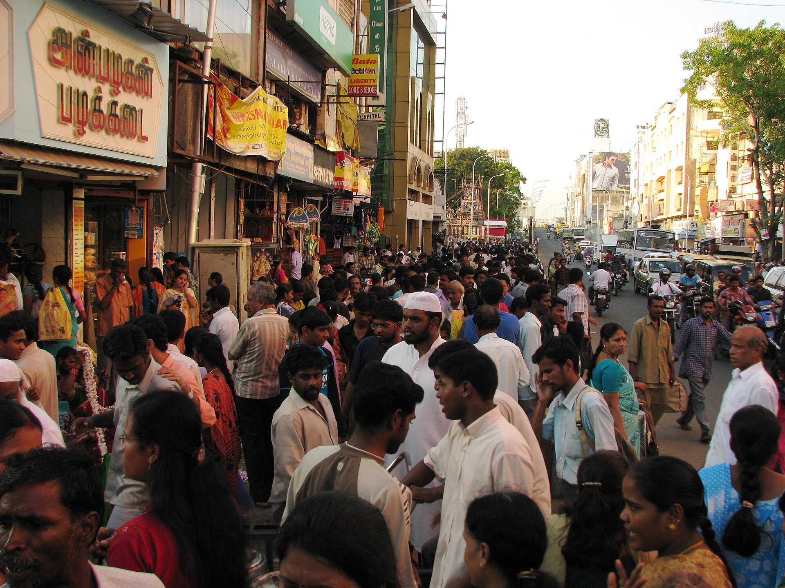

1 in 4
Indian adults has diabetes or prediabetes
101 million with diabetes 136 million with prediabetes
ICMR-INDIAB-17 [2]. Photo: T. Nagar, Chennai, McKay Savage from London, UK (CC BY 2.0), Wikimedia Commons
Notes:
S03-L1-T THARUN
Put simply, one adult in four in India has diabetes or prediabetes. That's 101 million with diabetes and another 136 million with prediabetes, the stage just before. Most of them feel fine. The damage builds up quietly, and a lot of it happens after meals.

Slide 4
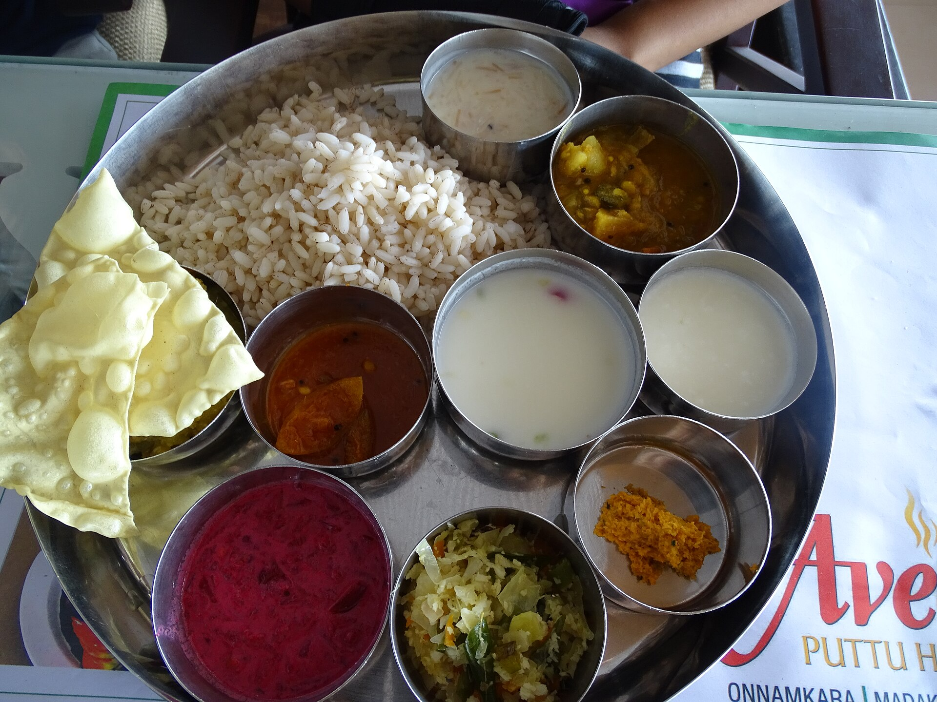
A plate built on rice, three times a day
61.6%
of the energy in the average Indian diet is carbohydrate
53.5%
of the time above range in 649 Indian patients with type 2 diabetes, on their first glucose sensor
Diet [6]; sensor study [7]. Photo: vegetarian Kerala thali, Rekhashastry (CC BY-SA 4.0), Wikimedia Commons
Notes:
S04-L1-G GARGI
So why after meals? Look at the plate. About 62 percent of the energy in the average Indian diet comes from carbohydrate. And when 649 Indian patients with type 2 diabetes wore a glucose sensor for the first time, they spent 53.5 percent of their time above the healthy range. That's more than half the day.

Slide 5
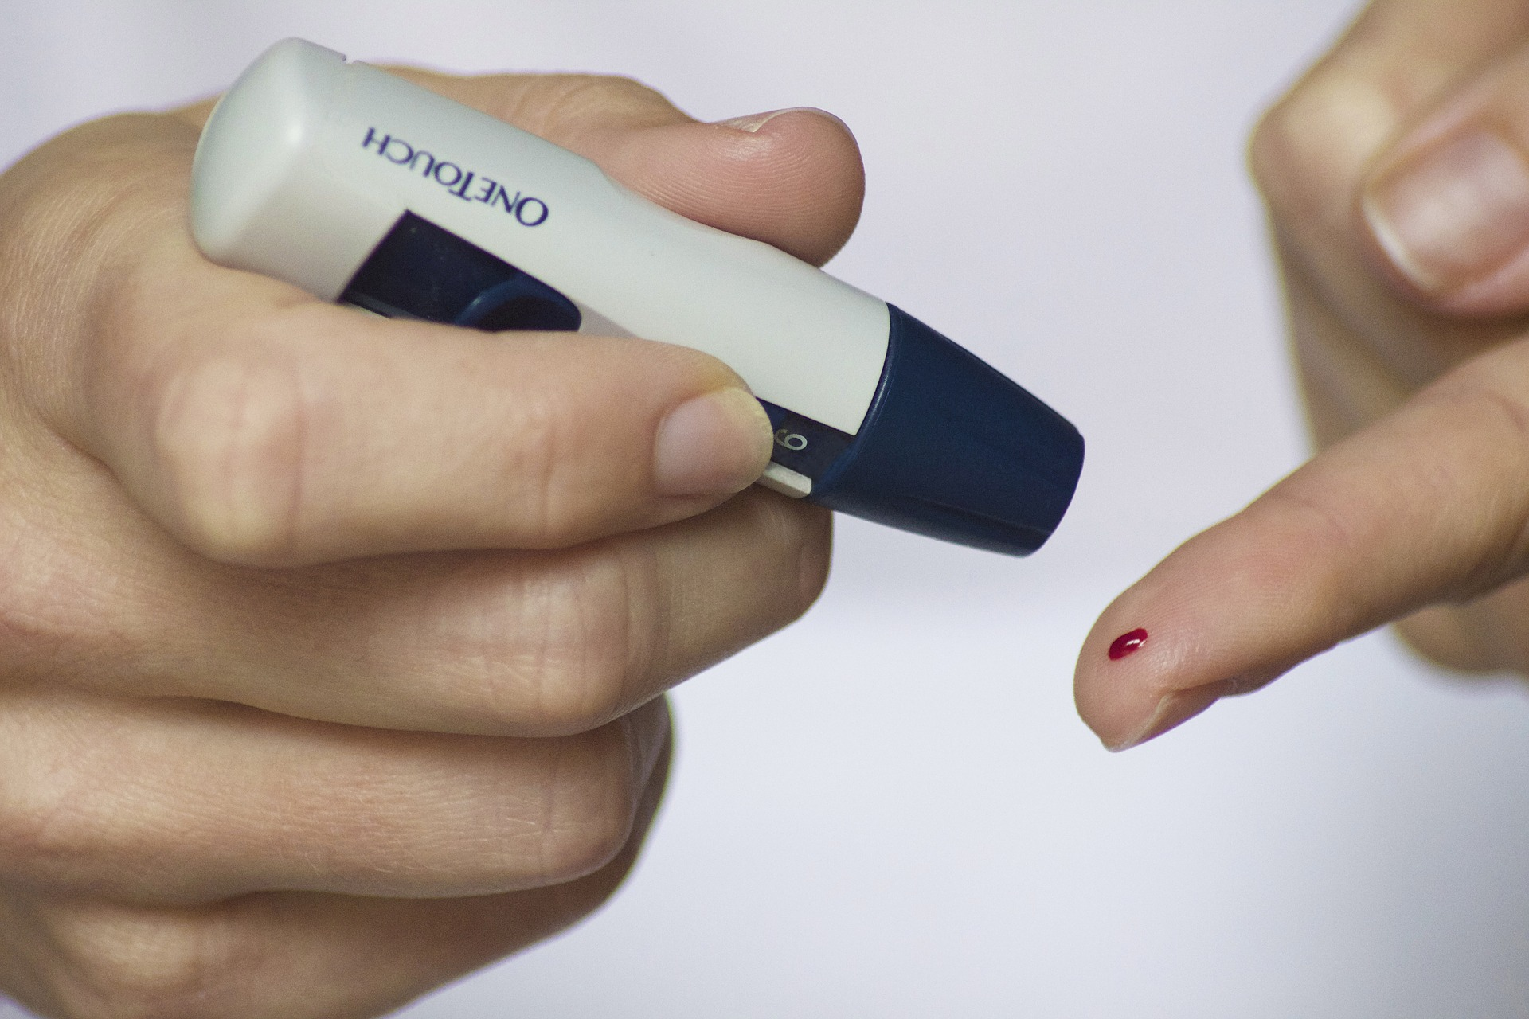
Diabetes care sees the average, not the spike
Every 3 months
an HbA1c test averages the spikes away
After 14 days
a sensor report shows them, too late to act
Missing
a warning before the meal, while a smaller portion or a walk can still help
Meals: 08:30 rava upma · 12:15 vangi bhat, curd · 17:15 chickpea sundal · 21:10 biryani, raita
Chart: PrandialTwin simulator, a simulated person (INS-001), not a real patient. 180 mg/dL is the international "above range" line [8]. Photo: blood glucose test, Reversing Your Diabetes Today (CC0), Wikimedia Commons
Notes:
S05-L1-T THARUN
This is one day for a simulated person from South India. Upma in the morning, vangi bhat at lunch, sundal in the evening, biryani at night. Two of those meals push his sugar above 180, which is the usual line for too high. And care today doesn't catch it in time. An HbA1c test is an average over three months, so the spikes get lost in it. A sensor report does show them, but two weeks later, when the meal is long gone.
S05-L2-G GARGI
What's missing is a warning before the meal, while a smaller portion or a short walk can still help. That's why we picked type 2 diabetes. A sensor reads sugar all day, a spike plays out within a few hours, the person can act straight away, and every single meal tells us whether the twin got it right.

Slide 6

What a digital twin is, in plain words
A virtual copy of one patient's body that stays in step with them, reading by reading.
12%
of 149 published health "digital twins" do all three
1
It updates
Learns from every new glucose reading, meal and walk
2
It predicts
Forecasts the next 2 to 3 hours, with an honest range
PrandialTwin does all three, and tests each claim on real people
3
It helps decide
Answers "what if they eat less, or walk?" and shows its own track record
Definition [9]; review of 149 studies [10].
Notes:
S06-L1-T THARUN
So what is a digital twin? It's a virtual copy of one patient that stays in step with them. To count as a twin it has to do three things. It updates itself from the person's own data, it predicts what happens next with an honest range, and it helps someone make a decision. A 2025 review of 149 health twins found that only 12 percent do all three. Ours does, and we test each part.

Slide 7
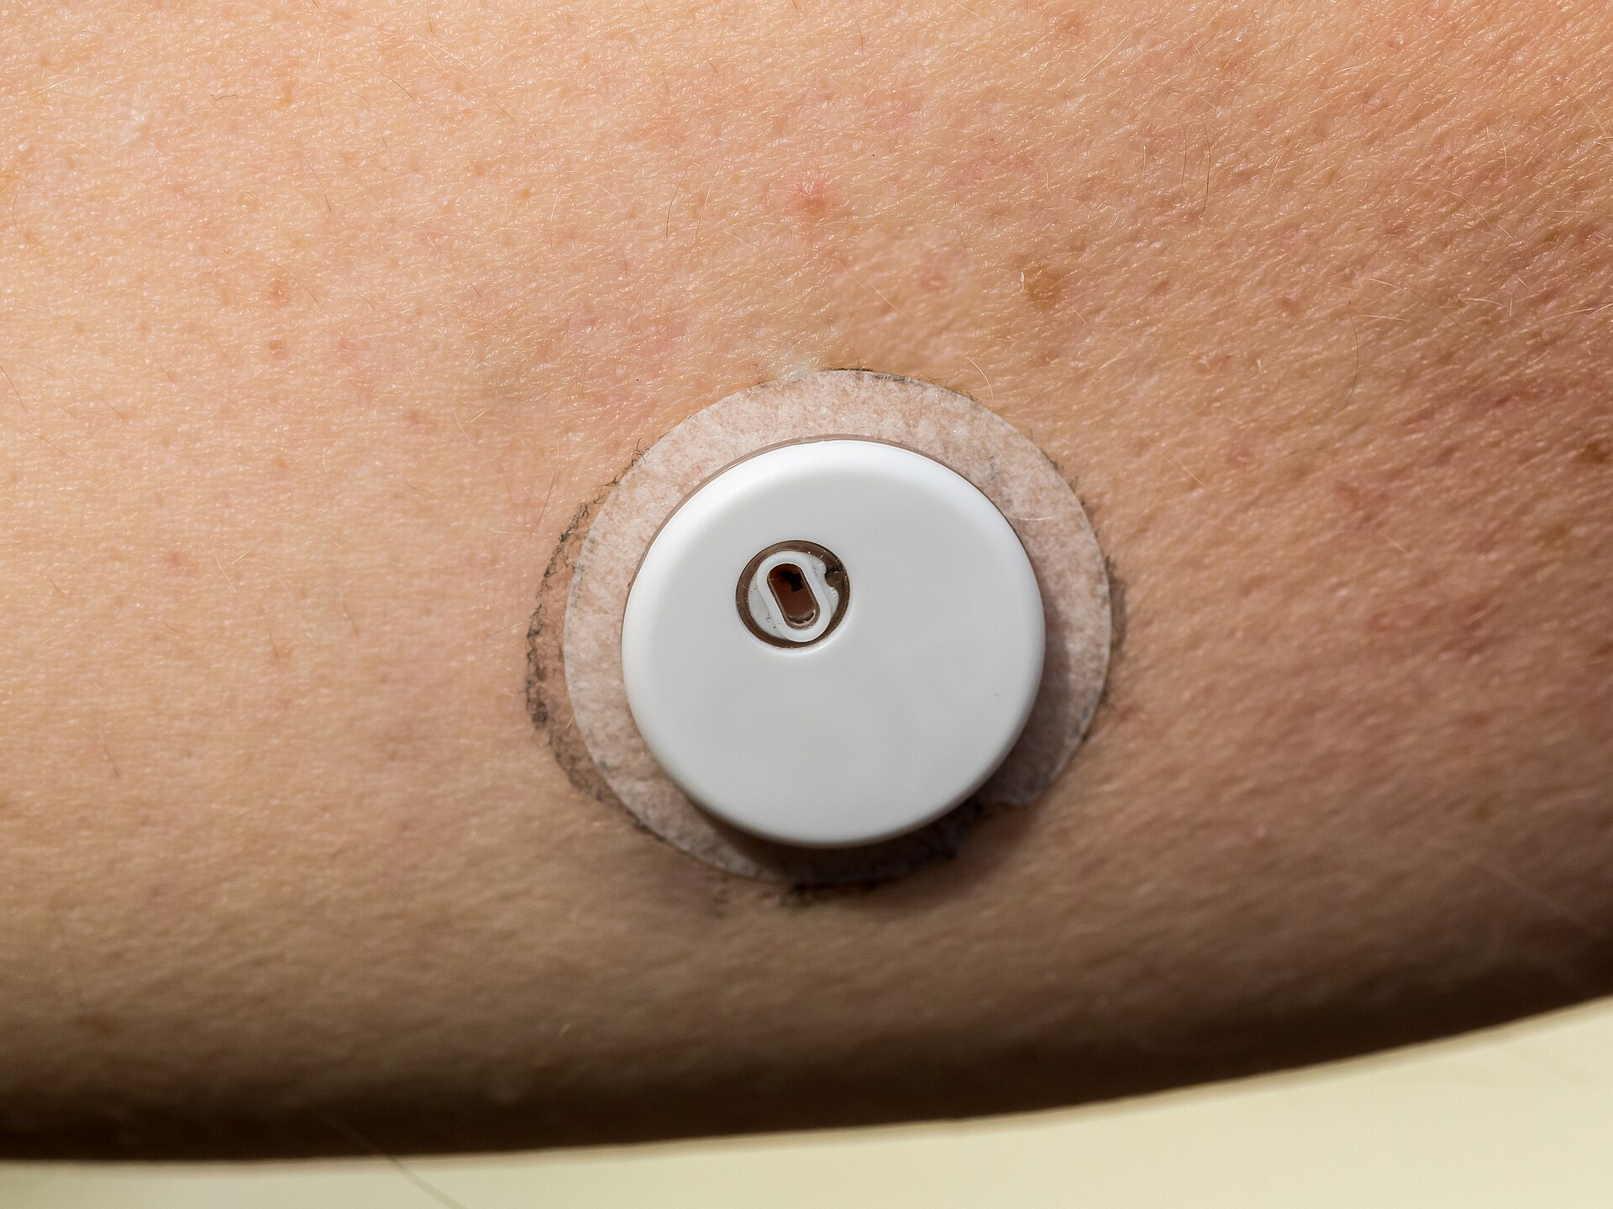
Three datasets, and why we trust them
CGMacros 45 real adults, USA
Labs + two glucose sensors worn at once (Dexcom, Libre) + Fitbit + meals with macros
Why trust it: Peer-reviewed (Scientific Data 2025), PhysioNet DOI, ethics board approval, written consent [11]
ShanghaiT2DM 109 real recordings, China
15-minute sensor, clinical records with insulin doses, meals as text; never used for fitting
Why trust it: Peer-reviewed (Scientific Data 2023), figshare, MD5-checked download [12]
Synthetic patients 60 + six Indian regions × 60
Health record + glucose, heart rate, steps, sleep from one hidden physiology
Why trust it: Ground truth known, so what-ifs can be checked exactly
A 14-day glucose sensor: the live stream
Fusion: record and stream belong to the same person and study window. We checksum every file (SHA-256), keep only native sensor readings, and split by patient.
Photo: FreeStyle Libre 3 sensor, Raimond Spekking (CC BY-SA 4.0), Wikimedia Commons
Notes:
S07-L1-T THARUN
A twin is only as good as its data, so we started with real people. CGMacros has 45 adults in the USA, with lab tests, two glucose sensors worn at the same time, a Fitbit, and every meal logged. It was published in Scientific Data, with ethics approval and written consent. ShanghaiT2DM has 109 recordings from China, with a different sensor and about half the patients on insulin. We never trained anything on it. It's our exam abroad.
S07-L2-G GARGI
In both, the health record and the sensor stream belong to the same person over the same weeks, and that's exactly the fusion the brief asks for. We checksum every file, we only use the sensor's own readings, and we split by patient, so nobody we test on was ever seen in training.

Slide 8
How our synthetic patients are made
1 Hidden severity
s ~ Beta(1.3, 1.6), from healthy to advanced type 2 diabetes
2 Physiology
insulin sensitivity, insulin release (about 15% lower per TCF7L2 risk allele), basal glucose
3 Health record
HbA1c from mean glucose (ADAG), fasting glucose and insulin, diagnoses, medications, family history
4 Daily life
meals from regional Indian plates (INDB recipes, measured GIs), walks, sleep, unlogged meals
5 Richer simulator
nonlinear stomach, first-phase insulin, liver suppression, circadian and dawn effects, sensor lag and noise
One synthetic health record (Synthea-style CSV tables) and its wearable stream
Id | Born | Sex | TCF7L2 risk alleles | Diagnosis (SNOMED) | HbA1c | Fasting glucose | Medication
SYN-001 | 1971 | F | 0 | Type 2 diabetes (44054006) | 6.5% | 105 mg/dL | metformin
+ every 5 minutes: glucose, heart rate, steps, METs, sleep stage
6 × 60 simulated adults in six Indian regions
± 4.5 points every regional diet vs ICMR-INDIAB-21
± 1 point prevalence of prediabetes and diabetes
Exact true counterfactual for every what-if
Survey [13]; recipes [14]; GIs [15]; HbA1c [16]; record format [27]. Code: twin/synth.py, twin/india.py.
Notes:
S08-L1-G GARGI
Real data has a gap though. It shows what someone ate, but never what would have happened if they'd eaten less. So we also made synthetic patients, where we know the right answer. Each one starts from a hidden severity, anywhere from healthy to advanced diabetes. That sets how well their insulin works and how much they release, a little less for each TCF7L2 risk gene. Their health record, HbA1c, fasting glucose, diagnoses and medicines, is worked out from that same body. Then come days of real regional Indian meals, walks and sleep, run through a simulator that's deliberately richer than our twin.
S08-L2-T THARUN
And they look like India. Every regional diet is within 4.5 points of the national survey, and the share with prediabetes and diabetes is within one point. Let's open the files.
[Do not press → yet. Demo A starts from this slide.]
DEMO A
[GARGI drives. Press Alt+Tab until the File Explorer window showing the folder 'synthetic' is in front.]
[Double-click 'patients.csv'. Excel opens. Point at row 2: SYN-001, 1971, F, TCF7L2 risk alleles 0, family history FALSE.]
DA-L1-G GARGI
This is the synthetic health record, laid out like Synthea, a standard open source patient generator. Patient SYN-001, born 1971, female. She has no copies of the TCF7L2 risk gene and no diabetes in her family.
[Alt+Tab back to the folder, double-click 'conditions.csv' and point at SYN-001, 'Type 2 diabetes mellitus', code 44054006. Then double-click 'observations.csv' and point at the first three rows (HbA1c 6.5 %, fasting glucose 105, insulin 7.7).]
DA-L2-T THARUN
Her diagnosis is type 2 diabetes, with its standard SNOMED code. Then her labs, with their LOINC codes. HbA1c 6.5 percent, fasting glucose 105. Each one uses the code a hospital system would expect.
[In the folder, double-click the folder 'wearables', then 'SYN-001.csv'. Point at the column headings: cgm_mgdl, heart_rate_bpm, steps, mets, sleep_stage.]
DA-L3-G GARGI
And this is her wearable stream. Every five minutes, a glucose reading, her heart rate, steps, activity level and sleep stage.
[Go back up one level, open 'india_south', double-click 'patients.csv' and point at the columns REGION and STATE (INS-001, Karnataka).]
DA-L4-G GARGI
The Indian cohorts add each person's region and home state. This one, INS-001, is from Karnataka.
[GARGI: close the Excel windows (Alt+F4 each; if asked, click 'Don't Save'). Press Alt+Tab until the slideshow is in front, then press →.]

Slide 9
The architecture, in four steps
1 ONE PERSON'S DATA
2 THE TWIN, CORRECTED AT EVERY READING
3 ONE FORECAST, WITH A RANGE
4 WHAT THE DOCTOR GETS
Health record (slow)
age, sex, BMI · HbA1c, fasting glucose and insulin · diagnoses · medicines · TCF7L2 gene marker · family history
Labs → first guess
a map learned on other patients turns the labs into this person's starting dials
Hybrid twin
physics + a small learned fix (LightGBM, capped)
Chronos-2
AI forecaster, fine-tuned, reads the last 24 h
Alert
when the chance of 15+ min above 180 in the next 2 h is high
Body model (physics)
4 moving parts: glucose, insulin, insulin drive, drift · 5 personal dials
Why
how much each cause adds to the peak
Final forecast
½ hybrid + ½ Chronos-2
Self-correction
ensemble Kalman filter: 128 copies of the twin, nudged toward every new reading
What-if
change the plan, replay the same twin
Live streams (fast)
glucose sensor every 5 to 15 min · logged meals (carbs, fat, protein, fibre) · watch: steps, heart rate, activity, sleep
90% range
widens after a miss, narrows after a hit, for each patient
Suggestion
the easiest change that keeps the spike risk under 30%
Look 3 hours ahead
128 possible futures for this person
Doctor's dashboard
record · forecast and alert · why · what-if · suggestion · track record
advice changes behaviour: new data
Learned beforehand, on training patients only: the labs-to-dials map, meal effects, LightGBM, the Chronos-2 fine-tune (Kaggle GPUs) and the range calibration. Checked on a simulator richer than the twin.
Notes:
S09-L1-T THARUN
So how does it work? This is the whole system, in four steps from left to right. Step one is what we know about one person. The health record is the slow part. Age, HbA1c, fasting glucose, diagnoses, medicines and a genetic marker. The live streams are the fast part. A glucose reading every five minutes, the meals they log, and steps, heart rate and sleep from a watch.
[Press → once. Step 2 (the twin) appears.]
S09-L2-G GARGI
Step two is the twin itself. The labs give us a first guess of how this person's body handles sugar, and that sets up a small body model with four moving parts and five personal dials. Then it corrects itself. We keep 128 slightly different copies of the twin, and every time a reading comes in, we nudge all of them toward it. Then we run all 128 forward three hours. That's 128 possible futures.
[Press →. Step 3 (the forecast) appears.]
S09-L3-T THARUN
Step three turns those futures into one forecast. The hybrid twin is the physics plus a small, capped correction learned from data. Chronos-2 is an AI forecaster, pretrained on huge collections of time series, and we fine-tuned it on glucose. We average the two half and half, and draw a 90 percent range around the result that adapts to each patient.
[Press →. Step 4 (what the doctor gets) appears.]
S09-L4-G GARGI
Step four is what a doctor actually needs. An alert when a spike is likely in the next two hours. The reasons behind it. A what-if, where you change the plan and replay the same twin. And a suggestion, the easiest change that keeps the risk under 30 percent.
[Press →. The dashboard bar appears.]
S09-L5-T THARUN
All of it lands on one dashboard. And the loop closes, because the advice changes what the person does, and that comes back to the twin as new data. Everything the twin learns from other people comes from training patients only. Now let's open up step two.

Slide 10




The physics: how blood sugar moves
dZ/dt = n · ( φ · max(G − G_{b}, 0) − Z )
Sugar above your normal level makes the body release insulin, Z. φ: how strongly
dX/dt = p₂ · ( Z − X )
Insulin acts with about a half-hour delay, which is why spikes happen
dG/dt = −( S_{G} + X + β·A ) · G + S_{G}G_{b} + R_{a}(t) + D
Sugar in (liver, food) minus sugar out (body, insulin, activity). D: what we can't explain
R_{a}(t) = (c / BW) · C · k² t e^{−kt}
Food reaches the blood as a wave, up then down. Fat, protein and fibre make it slower and flatter
5 dials per person: θ = ( G_{b}, φ, k, c, β ) normal sugar level · insulin strength · digestion speed · sugar per gram of carbs · benefit of activity
Variant of the minimal model [17]. φ combines insulin release and sensitivity: a glucose sensor only sees their product. n, p₂, S_G are shared constants. Code: twin/core.py.
Notes:
S10-L1-T THARUN
Now the maths, kept simple. Each line starts with d over dt, which just means how fast something is changing. The third line is the main one. The change in blood sugar is what comes in, from the liver and from food, minus what goes out, through the body, insulin and activity.
S10-L2-G GARGI
The first line says that when sugar rises above this person's normal level, the pancreas releases insulin, and phi is how strongly. The second line says insulin takes about half an hour to start working. That delay is why spikes happen at all, because food gets in faster than insulin can react. The last line is the food. It reaches the blood as a wave that rises and then fades, and fat, protein and fibre make that wave slower and flatter.
S10-L3-T THARUN
So each person comes down to five dials. Their normal sugar level, how strongly their insulin responds, how fast they digest, how much sugar one gram of carbs adds, and how much a walk helps. The labs set the dials to start with.

Slide 11
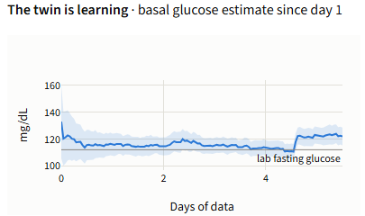
How the twin learns each person: 128 guesses
x = [ G, X, Z, D, log θ ]
4 moving parts + 5 dials; 128 copies, each with different dials
x_{i}⁻ = model( x_{i} )
each copy predicts the next reading
x_{i}⁺ = x_{i}⁻ + K · ( y + ε_{i} − G_{i}⁻ )
reading y arrives: pull each copy toward it, more if it was further off
From the dashboard: this patient's normal sugar level settles within a day and tracks the lab fasting glucose
K = Cov( x, G⁻ ) / ( Var( G⁻ ) + R )
pull hard if the copies disagree, gently if the sensor is noisy (R)
A running estimate, corrected at every new reading. Never fitted to its own patient in advance
Ensemble Kalman filter [18]: moving parts and dials corrected together; it coasts through sensor gaps.
Notes:
S11-L1-G GARGI
But how does the twin find the dials for someone it has never met? It keeps 128 versions of that person, each with slightly different dials. Every version predicts the next reading. When the real reading arrives, each version is pulled toward it, more if it was further off.
S11-L2-T THARUN
The last line says how hard to pull. If the versions disagree a lot, the twin trusts the sensor and pulls hard. If the sensor is noisy, that's R, it pulls gently. It's the same method that keeps GPS and weather forecasts on track. On the right you can see this patient's normal sugar level settle within about a day, close to their lab fasting glucose.

Slide 12
From the twin to a forecast, a range and an alert
ŷ_{hybrid} = ŷ_{physics} + clip( f_{LGBM}( x ), ± c )
physics forecast + a small learned fix, never more than c = 20 to 40 mg/dL. The physics drives; the learning only nudges
ŷ = ½ ŷ_{hybrid} + ½ ŷ_{Chronos-2}
two forecasters with different blind spots, simply averaged (fixed before testing)
band = [ q̂₅ − Q, q̂₉₅ + Q ], α_{t+1} = α_{t} + γ( α − miss_{t} )
a range that should hold 9 readings in 10. A miss widens it a little, a hit narrows it, for each patient
p = P( G > 180 for ≥ 15 min within 2 h ), alert if p ≥ τ
the chance of a spike in the next 2 hours; the bell rings above τ, set for about one false alarm a day
LightGBM [19]; Chronos-2 [20]; conformalized quantile regression [21]; adaptive conformal inference [22]. Code: twin/hybrid.py.
Notes:
S12-L1-T THARUN
Now the forecast. Line one is the hybrid twin. The physics forecast, plus a small correction learned by LightGBM, never more than 20 to 40 milligrams. The physics drives and the learning can only nudge, so it can't pick up shortcuts that break on a new kind of patient. Line two is our final forecast. Two forecasters with different blind spots, simply averaged half and half. We fixed that before we looked at any test result.
S12-L2-G GARGI
Line three is the range, and it should hold nine readings in ten. After a miss it widens a little, after a hit it narrows a little, separately for each patient. Line four is the alert. It's the chance of a spike in the next two hours, and we set the threshold for about one false alarm a day, because an alarm that keeps ringing gets ignored.

Slide 13
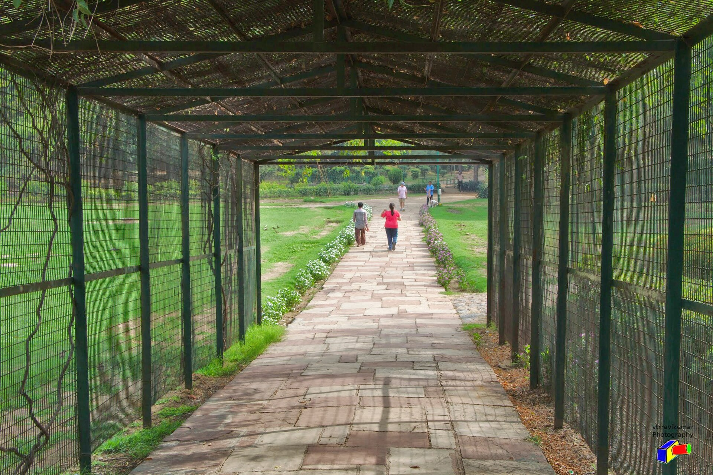
Why, what-if, and a suggestion
Why
Δ_{k} = peak − peak without cause k
remove one cause (food, activity, drift), replay, see how much the peak drops
What-if
inputs u → u′, same twin, same moment
change the plan (a smaller portion, a walk) and replay the twin from right now
Suggestion
a* = argmin effort( a ) s.t. P( spike | a ) < 0.30
8 easy changes (portion × walk); pick the easiest that keeps the risk under 30%
A 15-minute walk after lunch is one of the eight options the twin tries
Portion 100, 75 or 50% × walk 0, 15 or 30 min. Lifestyle options only, never medication. Photo: a park walk, Ravi Kumar (CC BY 3.0), Wikimedia Commons
Notes:
S13-L1-G GARGI
Then the decisions. First, why. We remove one cause, food, activity or drift, replay the twin, and see how much the peak drops. Second, what if. We change the plan, a smaller portion or a walk, and replay the same twin from right now. Third, a suggestion. The twin tries eight easy changes and picks the easiest one that keeps the chance of a spike under 30 percent.
S13-L2-T THARUN
Let's see it on a patient.
[Do not press → yet. Demo B starts from this slide.]
DEMO B
[THARUN drives. Press Alt+Tab until Chrome is in front. Click browser tab 1.]
[Point at 'Record (static)' at the top left.]
DB-L1-T THARUN
This is our dashboard, running on this laptop. INS-001 is a simulated twenty-year-old man from Karnataka, with prediabetes. Up here is his health record.
[Point at 'Basal glucose (twin)' (122 mg/dL), then at the line 'Forecast · P(glucose above 180 ...) = 74% · ALERT' and the shaded band under it.]
DB-L2-G GARGI
The twin has learned his normal sugar level, 122. He's about to have lunch, vangi bhat with curd, and it gives a 74 percent chance of a spike. That's an alert. The shaded part is the 90 percent range.
[Point at the 'Why this forecast' bars on the right; the long one is 'Carbohydrate on board'.]
DB-L3-T THARUN
Why so high? The carbohydrate still being digested adds about 70 to the expected peak.
[Point at the chart 'The twin is learning' under the bars.]
DB-L4-G GARGI
And this chart shows the twin learning him, its estimate of his normal sugar level, day by day since his first reading.
[Scroll down to 'What if?', click the blue dot of 'Portion of this meal' and press ← (left arrow) 5 times so it reads 50%. Wait 2 seconds: 'Expected 3-h peak' shows 173 mg/dL and the chance 21%. If the slider does not move, click browser tab 2 instead (already at 50%).]
DB-L5-T THARUN
Now, what if he eats only half the plate? The expected peak drops to 173, and the twin's own chance of a spike falls to 21 percent.
[Point at the 'Suggested change' line below the chart, then at 'Track record on real data' under it.]
DB-L6-G GARGI
That's also the change it suggests. And underneath is its track record on real meals, so a doctor can judge how far to trust it.
[Scroll to the top and click '+15 min' in the left sidebar twice.]
DB-L7-T THARUN
As new readings come in, everything updates.
[Scroll to the bottom and click 'How well does this work? Evidence and limits' to open it. Wait 3 seconds.]
DB-L8-G GARGI
And the evidence and the limits are always one click away, on the same page.
[THARUN: press Alt+Tab until the slideshow is in front, then press →.]

Slide 14
Twelve forecasters, the same test
Forecaster | Kind | American (home) | Shanghai (abroad) | Indian (simulated)
Repeat last reading | baseline | 30.1 | 29.4 | 31.5
LightGBM | gradient-boosted trees | 25.0 | 28.4 | 15.7
GRU | recurrent network | 25.1 | 43.2 | -
LSTM | recurrent network | 25.3 | 40.0 | -
Patch transformer | transformer (PatchTST-style) | 24.7 | 34.1 | -
TS2Vec | contrastive encoder + ridge | 25.9 | 26.8 | 21.0
MOMENT | foundation model, head trained | 26.8 | 29.2 | 18.6
Chronos-2, zero-shot | foundation model | 26.9 | 26.6 | -
Chronos-2, fine-tuned | foundation model, fine-tuned | 24.4 | 24.2 | 17.6
Physics twin | our physiology + filter | 26.6 | 25.5 | 20.4
Hybrid twin | physics + capped LightGBM | 24.9 | 26.4 | 15.3
Hybrid twin + Chronos-2 (ours) | equal average | 23.6 | 24.0 | 15.5
Error 60 minutes ahead (RMSE, mg/dL; lower is better), same patients and moments for every model. [19, 26, 25, 24, 23, 20] 95% intervals: results/RESULTS.md, results/ROUND2.md.
Notes:
S14-L1-G GARGI
So, does it work? We gave twelve forecasters the same test, the same patients at the same moments, each predicting one hour ahead. Each number is the typical miss in milligrams per decilitre, so lower is better. The top row just repeats the last reading, and that's the bar to beat. The small neural networks do fine at home but fall apart in Shanghai. MOMENT and TS2Vec, two foundation models we ran this week on Kaggle GPUs, come out weaker. Fine-tuned Chronos-2 is the best single model. And our twin averaged with Chronos-2 is the best of all, at home and abroad. That average is our forecast.

Slide 15
Why the twin plus Chronos-2 wins
RMSE²_{avg} = ¼ ( σ₁² + σ₂² + 2 ρ σ₁ σ₂ )
Accurate, and wrong differently
both are accurate, and their errors only partly line up (ρ = 0.84), so averaging cancels part of each
√( ¼ ( 24.9² + 24.4² + 2 · 0.84 · 24.9 · 24.4 ) ) = 23.6
In words: an average is good when both are good (small σ) and wrong in different ways (small ρ)
Abroad, the errors cancel
the twin guesses 5.4 too high, Chronos-2 3.4 too low: averaged, 24.0
Both adapt to a new person
the twin re-tunes its 5 dials at every reading; Chronos-2 re-reads the last 24 hours
σ: each forecast's own error; ρ: how alike the two forecasts' errors are (correlation, 0 to 1), measured on the 41,669 held-out forecasts.
Notes:
S15-L1-T THARUN
So why does averaging two models beat both of them? Sigma one and sigma two are each model's own error, 24.9 for the twin and 24.4 for Chronos-2. Rho is how alike their mistakes are, from zero to one. If rho were one, they'd always be wrong together and averaging would gain nothing. The lower it is, the more the mistakes cancel.
S15-L2-G GARGI
For the twin and Chronos-2, rho is 0.84, so the average comes down to 23.6, better than either one alone. LightGBM makes almost the same mistakes as the twin, rho 0.92, so averaging those two barely helps. In Shanghai you can see it cancel. The twin guesses about 5 too high and Chronos-2 about 3 too low. And both adapt to each new person. The twin re-tunes its dials, and Chronos-2 re-reads the last 24 hours.

Slide 16
Why the others lost
Model | How it works, in plain words | What went wrong | Evidence, 60 min unless noted
LightGBM | learns one fixed rule from one group of people | a new group: half on insulin, a slower sensor | 25.0 at home, 28.4 abroad; guesses 6.5 too high
GRU, LSTM, transformer | neural networks: one rule for everyone, from a few dozen people | can't adjust to a new person; never saw insulin | 24.7 to 25.3 at home, 34 to 43 abroad; 13 to 19 too high
MOMENT | reads each signal on its own, in a fixed 512-step window | never sees the meals; most of the window is empty | 30 min: 20.6, the same as repeating the last reading
TS2Vec | learns to tell series apart | built to recognise, not to forecast | 30 min: 18.5, against 17.2 for the hybrid
Chronos-2, zero-shot | patterns learned from many other kinds of data | has never seen how meals move glucose | 26.9, then 24.4 once fine-tuned
Physics twin alone | the right shape, simplified | misses what 5 dials can't describe | 26.6, then 24.9 with the small learned fix
"Too high": the average error is positive, forecasts above what happened. [23, 24, 20]
Notes:
S16-L1-G GARGI
And why did the others lose? LightGBM and the neural networks each learn one fixed rule from one group of people. In Shanghai, half the patients are on insulin, a drug those models never saw, so they keep guessing too high, by 6 to 19 milligrams.
S16-L2-T THARUN
MOMENT reads each signal on its own, so it never connects a meal to the rise that follows. Half an hour ahead it's no better than repeating the last reading. TS2Vec is built to recognise series, not to forecast them. Chronos-2 straight out of the box has never seen how meals move glucose, which is why fine-tuning helps it so much. And our physics alone is too simple, which is exactly why it gets that small learned correction.

Slide 17
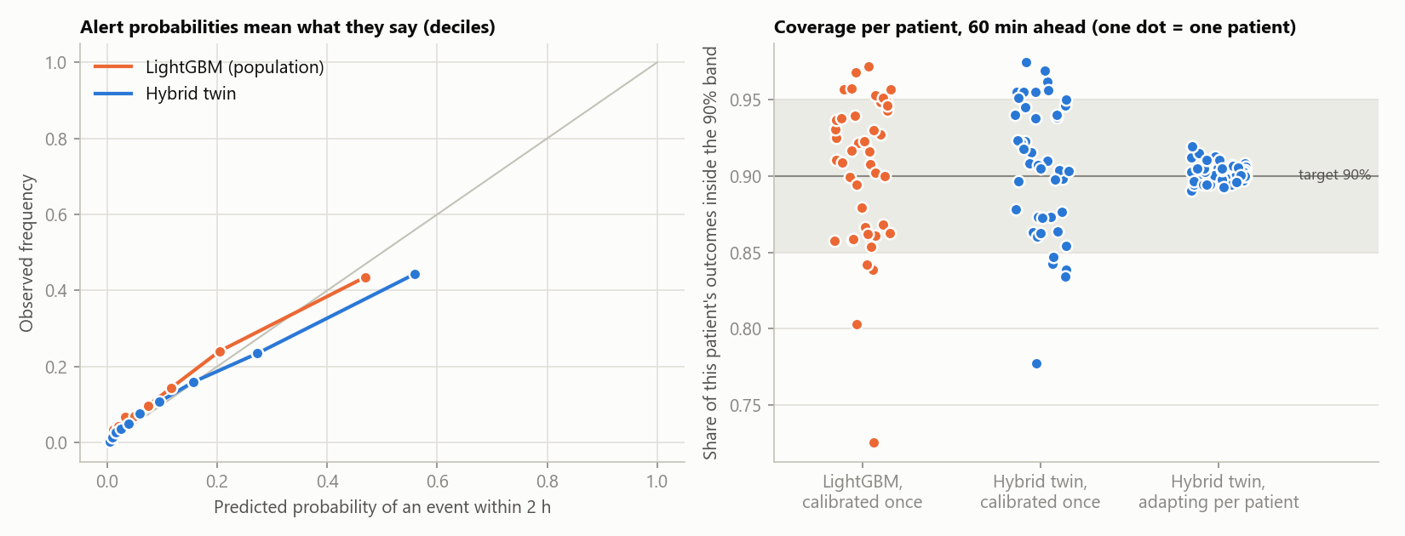
Earlier warnings, honest uncertainty
61% vs 52%
of 693 real spikes warned of before they began, twin vs standard model, at about one false alarm per patient-day
30 min
median warning before glucose stays above 180 mg/dL
89% vs 78% of readings inside the 90% range for the worst patient: adapting per patient vs set once for everyone. Abroad: 88% vs 64%.
0.45 vs 0.36
alert score on the unseen Shanghai cohort (precision-recall area; higher is better)
Alert threshold fixed on calibration patients, then run unchanged on test patients. Each dot in the right panel is one patient.
Notes:
S17-L1-T THARUN
Forecasts only matter if the alerts help. At about one false alarm per patient per day, the twin warned of 61 percent of 693 real spikes before they began. The standard model warned of 52 percent. The typical warning came 30 minutes ahead. And on the Shanghai patients, its alert score is 0.45 against 0.36.
S17-L2-G GARGI
The range is honest for each patient too. Even for the patient it served worst, 89 percent of readings fell inside the 90 percent range. A range set once for everybody only managed 78 percent for that same person. That's the widen and narrow rule at work.

Slide 18
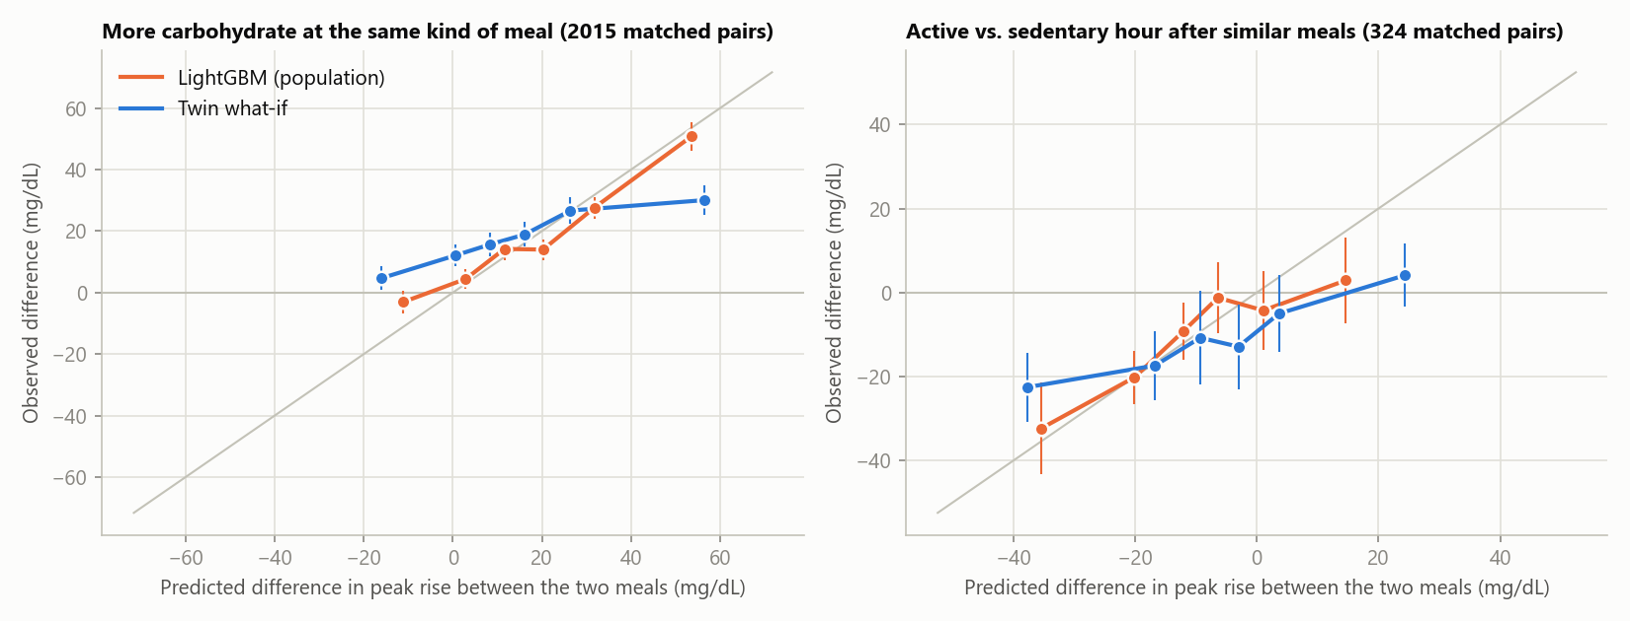
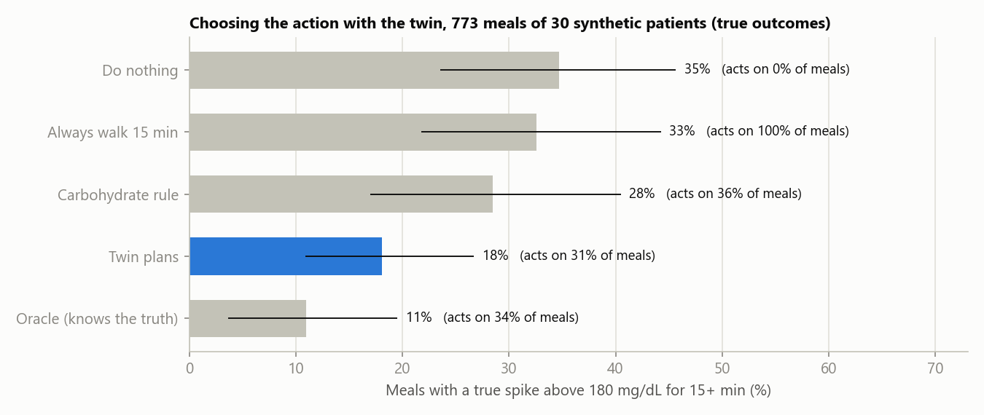
What-ifs and advice, checked
66% · 61%
direction right on real meal pairs: carbohydrate (2,015), activity (324)
−10.7 vs −9.1
active hour after a meal, mg/dL: observed vs the twin
r = 0.88
twin vs true effect of 40% less carbohydrate (synthetic truth)
35% → 18%
meals with a spike, no change vs the twin's suggestion (simulation; a carb rule: 28%)
Real pairs are matched, not randomised: a consistency check. Simulated results are an upper bound, not a trial.
Notes:
S18-L1-G GARGI
Are the what-ifs right? Nobody eats the same meal twice, so we compared pairs of similar meals from the same person. The twin got the direction right 66 percent of the time for carbohydrate and 61 percent for activity. And after an active hour, sugar was 10.7 lower, of which the twin explained 9.1.
S18-L2-T THARUN
On synthetic patients we know the true answer. The twin's estimate for forty percent less carbohydrate correlates 0.88 with the truth. And when the simulated patients followed its suggestions, meals with a spike fell from 35 to 18 percent. A simple carbohydrate rule only got to 28. That's simulation, not a clinical trial. Gargi, show them a real patient.
[Do not press → yet. Demo C starts from this slide.]
DEMO C
[GARGI drives. Press Alt+Tab until Chrome is in front. Click browser tab 3 (CGM-012).]
[Point at the 'Forecast' line showing 65% · ALERT.]
DC-L1-G GARGI
A real participant from CGMacros, with type 2 diabetes. Our models never saw this person. It's lunch, 94 grams of carbohydrate, and the forecast says 65 percent. Alert.
[GARGI scrolls to 'What if?', clicks the blue dot of 'Portion of this meal' and presses ← 3 times (70%), then clicks the blue dot of 'Walk after the meal (min)' and presses → 4 times (20). Wait 2 seconds: peak 171 mg/dL (-11), 'Twin's P' 27% (-18 points). If the sliders do not move, click browser tab 4 instead.]
DC-L2-T THARUN
What if they ate 70 percent of it and walked for 20 minutes? The peak drops by about 11, and the twin's own estimate, before we calibrate it, falls from 45 to 27 percent.
[Scroll to the top, click the switch 'Reveal what happened next' in the left sidebar. Grey dots appear: what really happened.]
DC-L3-G GARGI
The grey dots are what really happened. The spike did come, so the alert was right. But it went higher than our range, so we got the size wrong. We'd rather show you that than hide it.
[GARGI clicks the 'Cohort' box in the sidebar, chooses 'ShanghaiT2DM (real, de-identified, China; no wearable)', waits for the page, and clicks 'Next meal' twice.]
DC-L4-T THARUN
And this is Shanghai. A different country, a different sensor, half the patients on insulin, and nothing was refitted.
[GARGI: press Alt+Tab until the slideshow is in front, then press →.]

Slide 19
Built for India: six regional plates
North
roti, dal, aloo gobhi
meals with a spike: 24%
South
rice, sambar, rasam
meals with a spike: 32%
East
rice, dalma
meals with a spike: 42%
West
rotli, dal, bhat, shaak
meals with a spike: 32%
Central
dal, chawal, roti
meals with a spike: 29%
Northeast
rice, dal, fish tenga
meals with a spike: 37%
Best in 4 of 6 regions. The simulator shares the twin's physiology: a check, not a win.
Regional diets [13], recipes [14], glycaemic indices [15]. Simulated people, not evidence about real Indians.
Notes:
S19-L1-T THARUN
We also wanted to see how the twin handles Indian food. So we built six regional groups from the ICMR-INDIAB diet survey, the Indian Nutrient Databank and measured Indian glycaemic indices. Wheat in the North, rice in the South, East and Northeast, millets in the West. On them the hybrid twin has the lowest error, 15.3 against 17.6 for Chronos-2, and it's best in four of the six regions.
S19-L2-G GARGI
But to be fair, the simulator is built on the same kind of physiology as the twin, so the twin has a home advantage here. It's a sanity check, not proof. Real Indian patients are the next step.

Slide 20
What did not hold up, and our limits
We hoped for | We found
Beat LightGBM at home | A tie: 24.9 vs 25.0 mg/dL at 60 min
Labs give a head start | First 24 h: −0.46 (−1.01 to 0.10). Not significant
The twin keeps improving | Updating vs frozen from day 4: −0.87 (−2.14 to 0.26). Not significant
Twin what-ifs beat LightGBM | No: 66% vs 68% direction right
Limits
Not yet tested on real Indian patients
Retrospective: recordings replayed, no trial
No drug or insulin model
Meals must be logged
Lifestyle advice only, doctor in the loop
95% intervals by resampling patients. Full list: README, section 6.
Notes:
S20-L1-G GARGI
Now what didn't hold up. On the American patients, the twin only ties LightGBM, it doesn't beat it. The lab results didn't give it a significant head start on day one. Its what-ifs aren't better than a standard model at getting the direction right. And we haven't tested on real Indian patients yet.
S20-L2-T THARUN
There are limits too. It's retrospective, we replayed recordings and there was no trial. There's no model of medicines or insulin doses yet. Meals have to be logged. And the advice is lifestyle only, with the doctor in the loop.

Slide 21






The tech stack, all open source
The twin
Machine learning
AI forecasters
Python 3.11 · NumPy · SciPy
Body model and 128-copy Kalman filter written from scratch. SciPy fits the shared dials.
LightGBM · scikit-learn · pandas
Capped correction, 90% range and spike alert. scikit-learn calibrates the alert probability.
PyTorch · Chronos-2 · MOMENT · TS2Vec
Fine-tuned on Kaggle GPUs (2 × T4). GRU, LSTM and patch transformer baselines in PyTorch.
Doctor's dashboard
Data
Tested and reproducible
Streamlit · Plotly
Runs on a laptop. What-if sliders re-run the twin on the spot.
CGMacros · ShanghaiT2DM · synthetic
Checksum-verified PhysioNet and figshare downloads, plus Synthea-style synthetic records.
pytest · matplotlib · pinned versions
15 automated tests. One command rebuilds every number and figure in this deck.
Exact versions: requirements-lock.txt. Licences: code MIT; CGMacros CC BY-NC-SA 4.0; ShanghaiT2DM CC BY 4.0. Icons: Font Awesome (CC BY 4.0).
Notes:
S21-L1-T THARUN
Here's what it's built with, and all of it is free and open source. The twin itself is written from scratch in Python with NumPy and SciPy. LightGBM and scikit-learn handle the machine learning, and we fine-tuned the AI forecasters in PyTorch on Kaggle's free GPUs.
S21-L2-G GARGI
The doctor's dashboard runs on Streamlit and Plotly, and pytest runs our tests. Every version is pinned, so anyone can rebuild exactly what we ran.

Slide 22
Open, tested, reproducible
> .venv\Scripts\python -I -m pytest -q
15 passed physics · filter learning · range coverage · no future leaks · dashboard
> python -I -m twin.evaluate every number in this talk
Code, notebooks, tests and this deck: github.com/iamtharunj/Adorable_Vellore_Institute_of_Technology
Notes:
[Demo D, while Gargi speaks. Alt+Tab until the second black window (the test window) is in front. Type `.venv\Scripts\python -I -m pytest -q` and press Enter. Wait about 20 seconds for '15 passed'. Then Alt+Tab until the slideshow is in front and press →.]
S22-L1-G GARGI
Everything is open. One command reproduces every number, and our tests check the physics, the filter, and that no future data leaks into a forecast. Here they run now.
S22-L2-T THARUN
Fifteen tests, all passing, in about seventeen seconds. The code and notebooks are in our public repository.

Slide 23
See the spike before it happens
Next: a 3-month hospital pilot with 100 to 200 Indian patients. We'd love a hospital partner for it.
Thank you
Team Adorable · Tharun J, VIT Vellore · Gargi Sharma, ABES Institute of Technology, Ghaziabad
github.com/iamtharunj/Adorable_Vellore_Institute_of_Technology
Notes:
S23-L1-G GARGI
PrandialTwin sees the spike before it happens. Next, we'd like to run a three-month pilot with 100 to 200 Indian patients, and we'd love a hospital partner for it.
S23-L2-T THARUN
Thank you for watching.
S23-L3-G GARGI
Thank you.

Slide 24
References
[1] Gulf News (IANS/Reuters), 9 Jun 2023. India study estimates 11% of population or 101 million is diabetic.
[2] Anjana RM et al. Metabolic non-communicable disease health report of India: ICMR-INDIAB-17. Lancet Diabetes Endocrinol 2023;11:474-89.
[3] NCD Risk Factor Collaboration. Worldwide trends in diabetes prevalence and treatment, 1990-2022. Lancet 2024;404:2077-93 (Imperial College London news, 13 Nov 2024).
[4] World Health Organization. Diabetes fact sheet, 14 Nov 2024.
[5] International Diabetes Federation. IDF Diabetes Atlas, 11th edition, 2025; India country report 2000-2050.
[6] Anjana RM et al. Macronutrient recommendations for remission and prevention of type 2 diabetes in Asian Indians. Diabetes Care 2022;45:2883-91.
[7] Gupta (2025). Continuous glucose monitoring metrics in 649 Indian patients with type 2 diabetes on a first sensor. Cureus.
[8] Battelino T et al. Continuous glucose monitoring and metrics for clinical trials: an international consensus. Lancet Diabetes Endocrinol 2023;11:42-57.
[9] National Academies of Sciences, Engineering, and Medicine. Foundational Research Gaps and Future Directions for Digital Twins. 2023.
[10] Tudor BH et al. A scoping review of human digital twins in healthcare applications and usage patterns. npj Digital Medicine 2025.
[11] Das A et al. CGMacros: a scientific dataset for personalized nutrition and diet monitoring. Scientific Data 2025;12:1557; PhysioNet doi:10.13026/3z8q-x658.
[12] Zhao Q et al. Chinese diabetes datasets for data-driven machine learning (ShanghaiT2DM). Scientific Data 2023;10:35.
[13] Anjana RM et al. Dietary profiles and metabolic risk in India (ICMR-INDIAB-21). Nature Medicine 2025.
[14] Vijayakumar A et al. Development of an Indian Food Composition Database (INDB). Curr Dev Nutr 2024;8:103790.
[15] Shobana S et al. Carbohydrate profiling and glycaemic indices of selected traditional Indian foods. Indian J Med Res 2022;155:56-65.
[16] Nathan DM et al. Translating the A1C assay into estimated average glucose values (ADAG). Diabetes Care 2008;31:1473-8.
[17] Bergman RN et al. Quantitative estimation of insulin sensitivity (minimal model). Am J Physiol 1979;236:E667-77.
[18] Evensen G. Sequential data assimilation with a nonlinear model using Monte Carlo methods (ensemble Kalman filter). J Geophys Res 1994;99(C5).
[19] Ke G et al. LightGBM: a highly efficient gradient boosting decision tree. NeurIPS 2017.
[20] Ansari AF et al. Chronos-2: from univariate to universal forecasting. arXiv:2510.15821, 2025.
[21] Romano Y, Patterson E, Candès E. Conformalized quantile regression. NeurIPS 2019.
[22] Gibbs I, Candès E. Adaptive conformal inference under distribution shift. NeurIPS 2021.
[23] Goswami M et al. MOMENT: a family of open time-series foundation models. ICML 2024.
[24] Yue Z et al. TS2Vec: towards universal representation of time series. AAAI 2022.
[25] Nie Y et al. A time series is worth 64 words: long-term forecasting with transformers (PatchTST). ICLR 2023.
[26] Hochreiter S, Schmidhuber J. Long short-term memory. Neural Computation 1997; Cho K et al. GRU encoder-decoder. EMNLP 2014.
[27] Walonoski J et al. Synthea: an approach, method, and software mechanism for generating synthetic patients. JAMIA 2018;25:230-8.
Photos: Wikimedia Commons, credited on each slide and in docs/IMAGE_CREDITS.md. Template: Office "Dark Gradient". Icons: Font Awesome (CC BY 4.0).
Notes:
S24-L1-T THARUN
Every number we've used is referenced here, and in our repository.
[Wait five seconds, then stop the recording (OBS, Stop Recording).]

