Slide 1
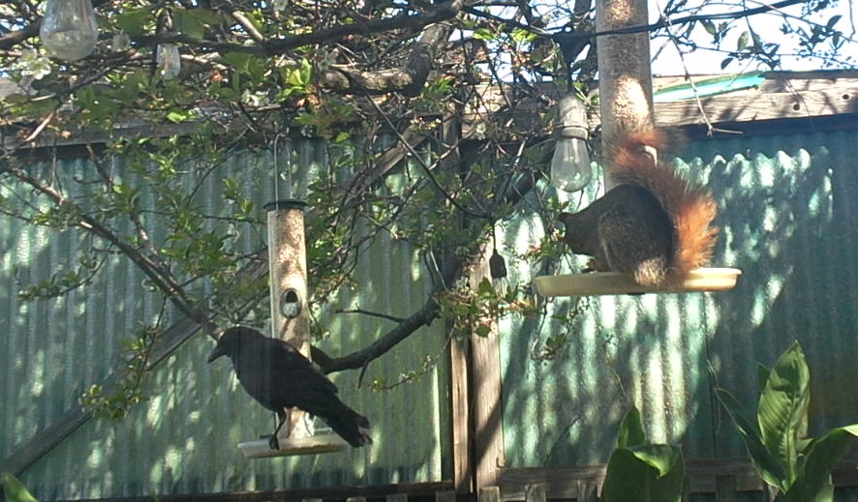

Machine Learning Image Based Pest Species Identification For Embedded Systems
Joshua Mehlman, SFSU ID #903035606, JMehlman@sfsu.edu
SFSU ENGR 859 Spring 2024

Slide 2
Gather Initial Image
Trigger On Motion to Capture Initial Dataset
Save the largest image we can as a JPEG
Use Image Diff to find motion on smaller BITMAPS
Subtract the R, G, and B from each prior to each image.
asdf
Did not work so well. Branch motion was too much to sort.
I should probably use some sort of Machine Learning to find the objects…
Capture a lot of images and manually tag.

Slide 3
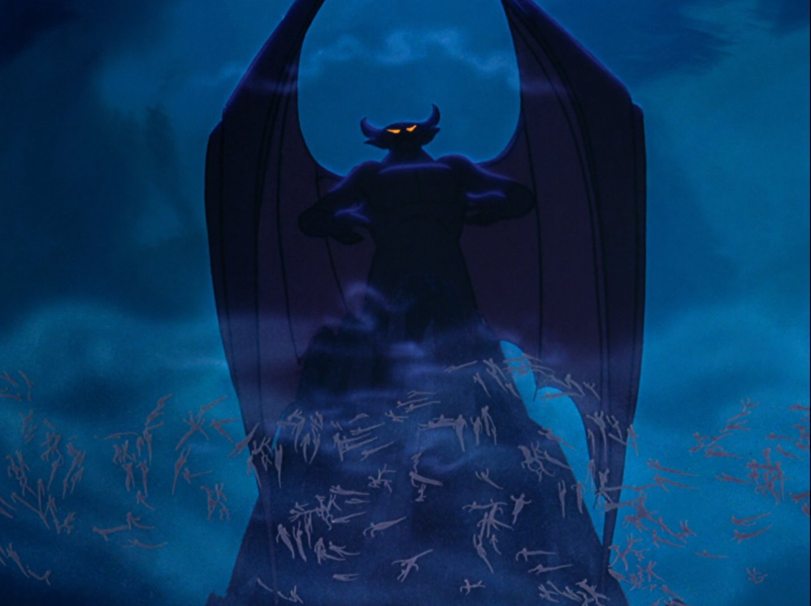
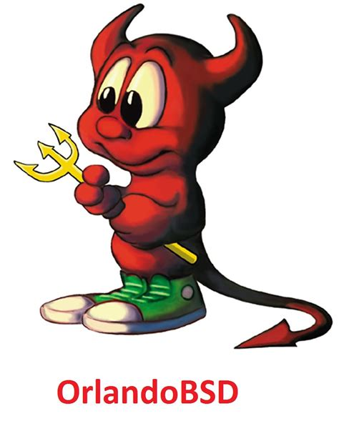
Get Working on Device
Start with super tiny leNet model to find out how large of image size we can handle.
Initial model size ~50kB
Still: 3M (At JPG Qual 70)
Video: 640x480
Notes:
The library has demons!
No, not damons, deamons!

Slide 4
Start Over With Arduino Library
Start with super tiny leNet model to find out how large of image size we can handle.
Initial model size ~50kB
Still: 640x 480 (VGA)
Video: 320x240 (QVGA)
Smallest image size is: 96x96
Max model size:
Camera Memor:1.5 MB
Image Size at QVGA: 153.6kB
Notes:
There is no way a 96x96 image will work.
This is called “Foreshadowing”

Slide 5
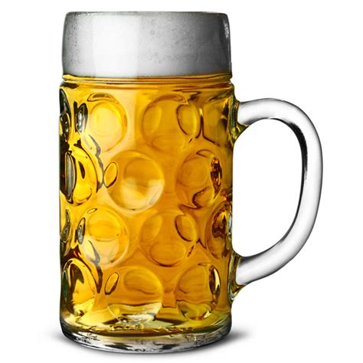
Model Wont Build
The Sony Spresense TFLite Build has no logging.
MIC to the rescue: The MIC Spresense TFLite Build Shows what is missing

Slide 6
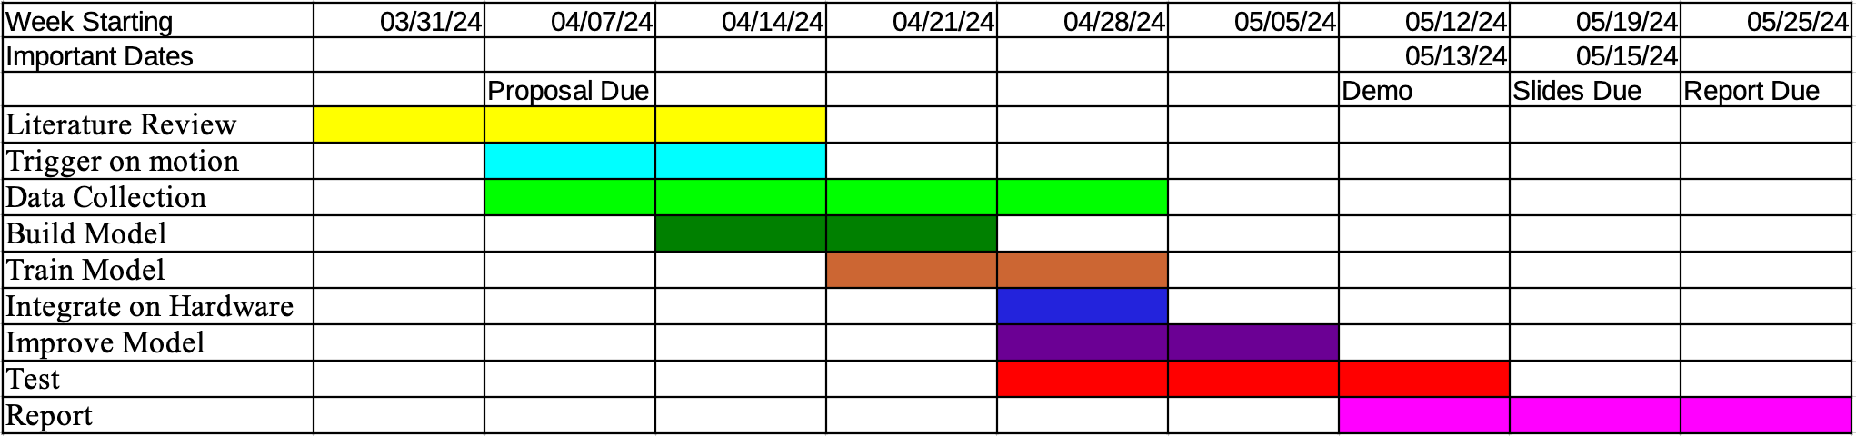
We have Pipeline: Now Build Model
Ok, we do not have enough time left for SSD or Yolo.
Start with a full sized leNetV5
Model Size = 480kB
Image size:
Video Stream:
Stills:
Notes:
Crap!

Slide 7
Use Pre-Trained Model
Start with a pretrained model
Prune
Model List:
Asdf
Notes:
Ok, new plan

Slide 8
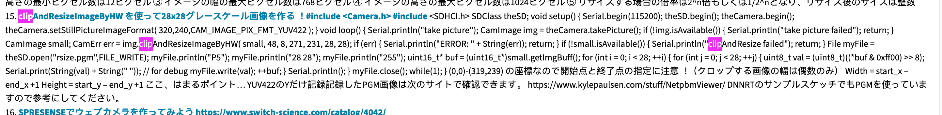
No Way It Will Work on Full Image
Have to go to 96x96 images to fit…
That is small <show image>
Crop, not scale
The Spresense Camera Arduino library Can only zoom with:
CAM_IMAGE_PIX_FMT_YUV422
Fun Fact: The only errors the camera seems to know is:
return CAM_ERR_INVALID_PARAM;
return CAM_ERR_NO_MEMORY;
Notes:
Guess how long that took to find out?
Sony documentation at is best
I saw both of these errors quite a lot

Slide 9
Not Enough Images (Too Many Empty)
Augment: Every Squirrel and Bird gets:
Permute
Rotate

Slide 10
Full Pipeline Aceved!
Capture Images
Tag Images
Train Model
Export Model
Install on Device
Run model!

Slide 11
Run Real data (AKA: And My Troubles Began)
Now that we have a Pipeline

Slide 12
Pruned Pre-Trained Model
Pruning a modern… back connected see slide
Notes:
Thanks for the help on that Mr Lin

Slide 13
It Works!
Time train for real.
Gather All the images. Set the model to save when it has a squirrel or a bird
Manually tag, using false positives in the “Empty” set
Switch to a faster MobileNetV5
Iterate on the training and Hyperperamiters

Slide 14
New Plan: Run With What I Have
Performance is remarkably good!

Slide 15
Results
Comair speed to Mr Lin

