Slide 1
📅 Timetable Scheduler
Discrete Mathematics & Genetic Algorithm Optimization
An intelligent university timetable generator using evolutionary computation

Slide 2
🔬 Theoretical Foundations
Discrete Mathematics in Scheduling

Slide 3
The Scheduling Problem as CSP
• Timetable scheduling is a Constraint Satisfaction Problem (CSP)
• Variables: A finite set of classes that need to be scheduled
• Domains: Discrete set of (room, time slot, instructor) combinations
• Constraints: Rules that restrict valid assignments
• This is a combinatorial optimization problem
• We seek optimal solution from exponentially large set of possibilities

Slide 4
📊 Graph Theory Connections
Graph Theory Concept | Scheduling Equivalent
Vertices | Classes/Courses to be scheduled
Edges | Conflicts between classes
Graph Coloring | Assigning time slots (colors)
Chromatic Number | Minimum time slots needed
NP-hard Problem | Requires heuristic algorithms

Slide 5
⚡ Computational Complexity
Aspect | Complexity Analysis
Problem Class | NP-hard (no known polynomial-time solution)
Solution Space | O((R × T × I)^n) - R=rooms, T=time slots, I=instructors
Brute Force | Infeasible for realistic problem sizes
Genetic Algorithm | Polynomial time per generation, near-optimal solutions

Slide 6
📐 Set Theory & Relations
Formal Definition of the Scheduling Problem:
Let S = {s₁, s₂, ..., sₙ} be the set of sections
Let T = {t₁, t₂, ..., tₘ} be the set of time slots
Let R = {r₁, r₂, ..., rₖ} be the set of rooms
Let I = {i₁, i₂, ..., iₗ} be the set of instructors
Let C = {c₁, c₂, ..., cₚ} be the set of courses
A valid schedule is a function:
f: Classes → T × R × I
Subject to all constraints being satisfied

Slide 7
🧬 Genetic Algorithm
Discrete Optimization in Action

Slide 8
Genetic Algorithm Overview
• Metaheuristic optimization inspired by natural selection
• Operates on principle of 'survival of the fittest'
• Effective for discrete optimization problems
• Key Operations:
• 1. Initialize Population - Random schedules
• 2. Fitness Evaluation - Count constraint violations
• 3. Selection - Tournament selection
• 4. Crossover - Combine parent schedules
• 5. Mutation - Random alterations
• 6. Termination - Return best schedule

Slide 9
🧬 Chromosome Encoding
Each schedule is encoded as a sequence of genes:
Schedule = [Gene₁, Gene₂, ..., Geneₙ]
where Geneᵢ = (courseᵢ, roomᵢ, timeᵢ, instructorᵢ)
Fitness Function:
fitness(schedule) = 1 / (1 + number_of_conflicts)
Properties:
• Perfect schedule (0 conflicts) has fitness = 1.0
• More conflicts → lower fitness → less likely to survive

Slide 10
⚙️ Genetic Operations
Operation | Mathematical Description | Purpose
Selection | Tournament: max(fitness) from k individuals | Choose fittest parents
Crossover | Uniform with p=0.5: Gene from A or B | Combine successful traits
Mutation | Probability p=0.05: Replace with random gene | Introduce diversity
Elitism | Preserve top 2 schedules unchanged | Prevent loss of best solutions

Slide 11
Discrete Math in Genetic Operators
• Tournament Selection uses:
• • Combinatorics: C(n,k) ways to select k from n individuals
• • Probability: Selection proportional to relative fitness
•
• Crossover applies:
• • Boolean Algebra: Random boolean decides gene parent
• • Permutations: Creating new arrangements
•
• Mutation employs:
• • Bernoulli trials with p=0.05 for each gene
• • Uniform random sampling from valid domain

Slide 12
🔒 Constraints
Logical Predicates in Discrete Mathematics

Slide 13
Hard Constraints as Predicate Logic
Section Conflict:
∀ c₁, c₂ ∈ Classes, c₁ ≠ c₂: ¬(section(c₁) = section(c₂) ∧ time(c₁) = time(c₂))
Room Conflict:
∀ c₁, c₂ ∈ Classes, c₁ ≠ c₂: ¬(room(c₁) = room(c₂) ∧ time(c₁) = time(c₂))
Instructor Conflict:
∀ c₁, c₂ ∈ Classes, c₁ ≠ c₂: ¬(instructor(c₁) = instructor(c₂) ∧ time(c₁) = time(c₂))
Room Capacity:
∀ c ∈ Classes: capacity(room(c)) ≥ students(course(c))

Slide 14
Conflict Detection as Boolean SAT
The fitness function transforms this into a weighted MAX-SAT problem:
minimize: Σ violation(constraint_i)
subject to: all hard constraints should have violation = 0
Key Insight:
• Each constraint is a Boolean predicate
• Satisfied constraint = TRUE (violation = 0)
• Violated constraint = FALSE (violation = 1)
• Goal: Find assignment where all predicates are TRUE

Slide 15
📊 Algorithm Complexity
Performance Analysis

Slide 16
⏱️ Time Complexity Analysis
Phase | Complexity | Description
Initialization | O(P × n) | Create P random schedules with n classes
Fitness Evaluation | O(n²) | Compare all pairs for conflicts
Selection | O(P × k) | Tournament selection, k size, P times
Crossover | O(P × n) | Create P offspring with n genes
Mutation | O(P × n) | Potentially mutate each gene
Per Generation | O(P × n²) | Dominated by fitness evaluation
Total Algorithm | O(G × P × n²) | G generations

Slide 17
Space Complexity & Convergence
• Space Complexity:
• • Population: O(P × n) - Store P schedules with n classes
• • Auxiliary: O(n) - Temporary storage during operations
• • Total: O(P × n) - Linear in population and problem size
•
• Convergence Properties:
• • Exploration vs Exploitation: Mutation rate (5%) balances both
• • Elitism: Ensures monotonic improvement of best fitness
• • Tournament Selection: Creates selection pressure
•
• Algorithm terminates when:
• • Perfect fitness (1.0) achieved, or
• • Maximum generations (100) reached

Slide 18
🎛️ Algorithm Parameters
Parameter | Value | Mathematical Rationale
Population Size | 30 | Balance between diversity and computation
Elite Schedules | 2 | Guarantees monotonic improvement
Tournament Size | 8 | ~27% of population for selection pressure
Mutation Rate | 0.05 | 5% chance per gene for exploration
Max Generations | 100 | Convergence typically within 50-100

Slide 19
💻 Application Screenshots
Django Web Application

Slide 20

Home Page
Main dashboard for the timetable scheduler

Slide 21
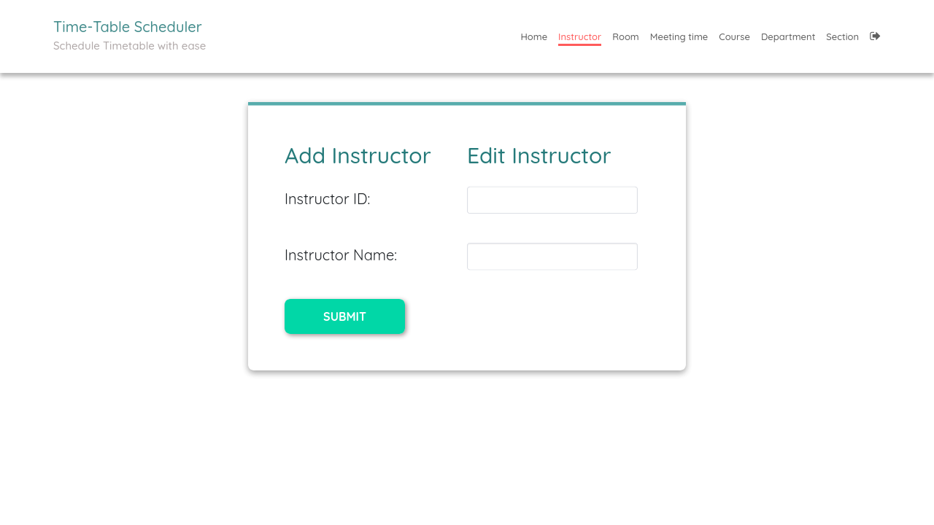
Add Instructor
Interface for adding new instructors

Slide 22
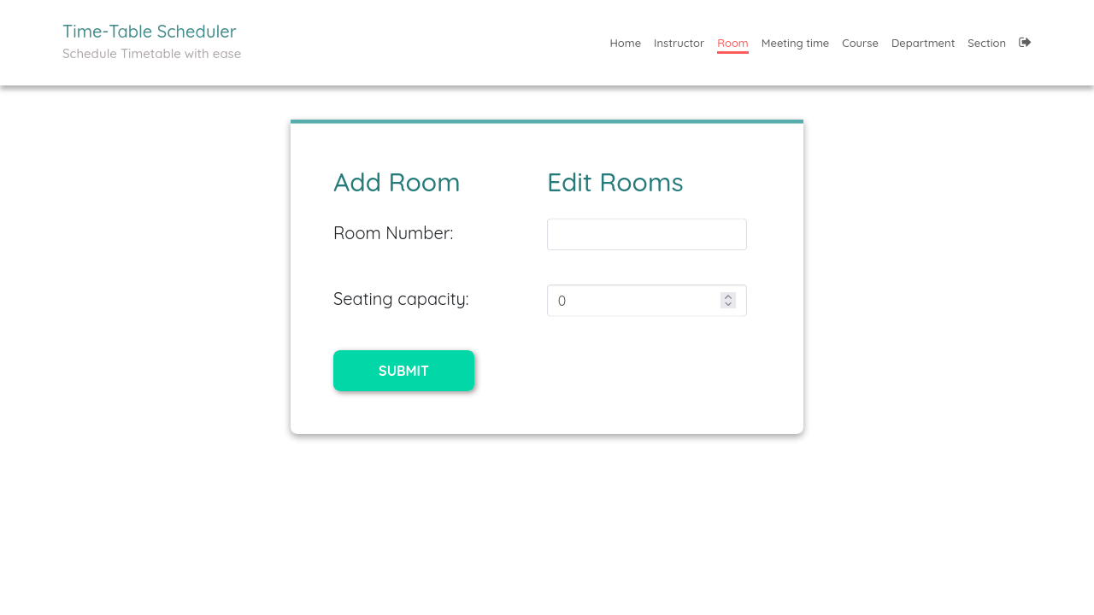
Add Room
Room management with capacity settings

Slide 23
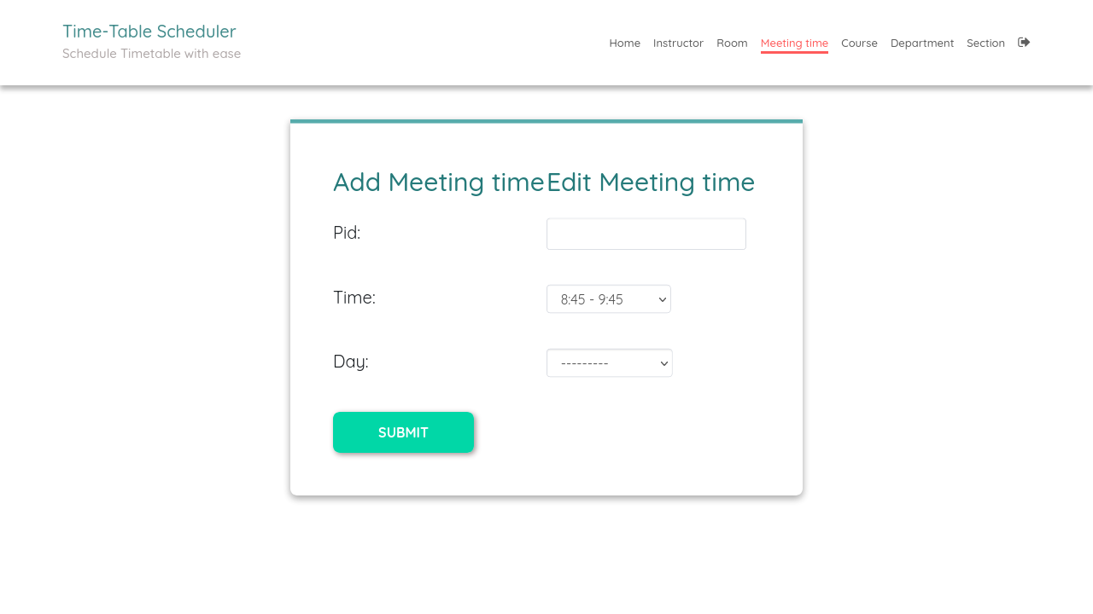
Add Course
Course creation and instructor assignment

Slide 24
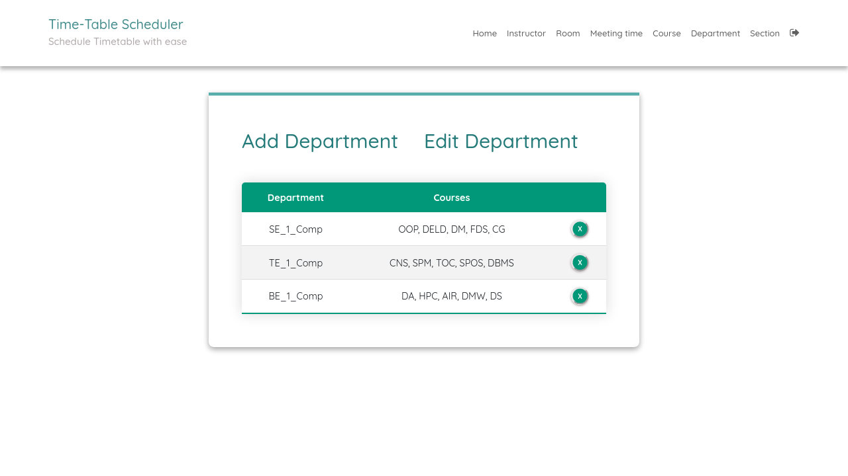
Generated Timetable
Optimized schedule produced by the genetic algorithm

Slide 25
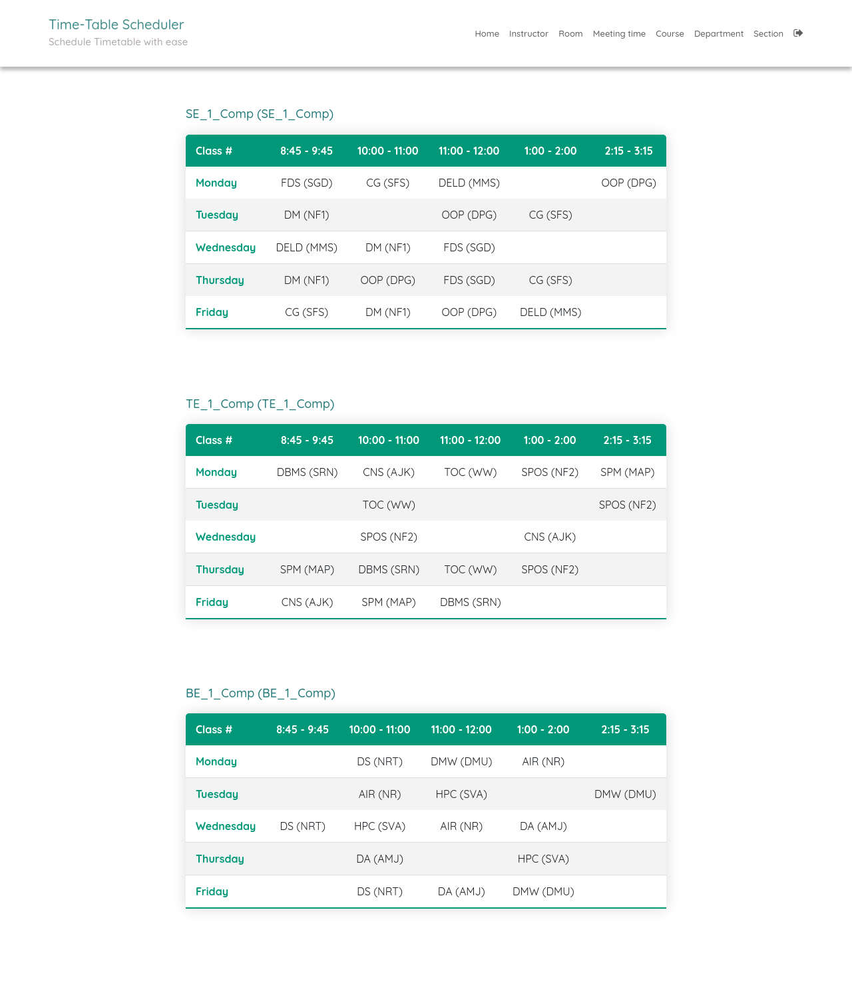
Timetable View
Final timetable display with all assignments

Slide 26
📚 Related Problems
Classical Combinatorial Optimization

Slide 27
Related Discrete Math Problems
• Graph Coloring Problem:
• • Assign colors to vertices with no adjacent same colors
• • Scheduling = coloring with time slots as colors
•
• Bin Packing Problem:
• • Fit items into minimum containers
• • Scheduling = packing classes into time slots
•
• Job Shop Scheduling:
• • Schedule jobs on machines with precedence
• • Similar constraint satisfaction structure
•
• All these are NP-hard → Require heuristic approaches

Slide 28
🎯 Key Takeaways

Slide 29
Summary: Discrete Math in Scheduling
• ✅ CSP Framework: Variables, Domains, Constraints
• ✅ Graph Theory: Scheduling ≡ Graph Coloring (NP-hard)
• ✅ Set Theory: Formal definitions using sets and relations
• ✅ Predicate Logic: Constraints as Boolean predicates
• ✅ Combinatorics: Exponential solution space O((R×T×I)^n)
• ✅ Genetic Algorithm: Polynomial-time heuristic approach
• ✅ Optimization: MAX-SAT formulation for constraint satisfaction
•
• The power of discrete mathematics transforms complex
• real-world scheduling into solvable algorithmic problems!

Slide 30
Thank You! 🙏
Questions?

