Slide 1
ToiPlan
🎉
Seating 100 guests without starting a family war
A Genetic Algorithm for the toi seating problem
Asylbek Zhunusov & Emir Sakiev · Optimization with Metaheuristic Algorithms · Friday, 30 October 2026
Notes:
Hi! We are ToiPlan. Everyone in this room has been to a toi, and everyone has seen the drama about who sits where. Today we show how a Genetic Algorithm solves it.

Slide 2
Meanwhile, at every toi
🎉
Toi Problems
👵⚡👵
@toi_problems · 2m
Nobody:
Absolutely nobody:
Aunt Gulnara at every toi:
“Why am I sitting next to HER?!” 😤
100 guests · 25 feuds · 1 tör
What could possibly go wrong?
Notes:
The classic toi problem: relatives who must sit together, aunties who must never sit together, and elders who expect the tör. Organisers spend days on paper lists, and someone is always offended.

Slide 3
The problem: who sits where?
100
10×10
19
8
25
guests
tables × seats
families
elders
feuds 😬
👪
🤝
⚔️
👴
Relatives together
Friends together
Feuds apart
Elders at the tör
+10 per pair
+5 per pair
−100 per pair
+100 per elder
Families want to sit together and catch up.
Classmates, colleagues and neighbours.
One argument ruins the whole table.
The tör is the place of honour, far from the door.
Notes:
Our test toi: 100 guests, 10 tables with exactly 10 seats, 19 families, 8 elders and 25 feuds. The goal is to maximise one number, the happiness score, built from these four rules.

Slide 4
Why not just try every seating?
10⁹²
Me: “I'll just check every seating.” 🤓
💻🔥
possible seatings = 100! / (10!)¹⁰
🌌
Atoms in the observable universe: ~10⁸⁰
My laptop, checking 1 billion seatings per second:
“Done in ~10⁷⁶ years.” 💀
Seating = balanced graph partitioning → NP-hard.
No fast exact algorithm is known, so we use a metaheuristic.
(The universe is ~1.4 × 10¹⁰ years old.)
Notes:
There are about 10^92.4 ways to seat 100 guests at 10 tables of 10. That is more than the atoms in the universe. Even at a billion seatings per second, brute force would take ~10^76 years. The problem is a balanced graph partitioning problem, which is NP-hard, so we use a metaheuristic.

Slide 5
It's not just a toi problem
Same math everywhere: split people into groups of fixed size so that “who likes whom” is maximised.
💍
Weddings
📝
Exam seating
🏢
Office desks
Hundreds of guests, the same family drama.
Keep friends (and cheat sheets) apart.
Teams that work together sit together.
👥
Student groups
🎤
Conferences
🚌
Buses & flights
Groups of 3 with balanced skills, like this project!
Networking tables that mix the right people.
Families and friends seated side by side.
Notes:
Why it matters: the same optimisation appears at weddings, exams, offices, conferences and even when forming student groups. ToiPlan's market is every event that has seats.

Slide 6
Our secret weapon: evolution
🙅
Seating 100 guests by hand for three days
😎
Letting a Genetic Algorithm do it in 6 seconds
Notes:
A Genetic Algorithm copies natural selection: keep a population of solutions, let the best ones have children, add small random changes, and repeat. Good seating plans survive, bad ones die out.

Slide 7
The Genetic Algorithm in one picture
👪
😊
🏆
💞
🎲
1. Population
2. Fitness
3. Selection
4. Crossover
5. Mutation
100 random seating plans
Score the happiness of every plan
Tournament: best of 3 random plans
Mix two parent plans into a child
Swap two random guests
🔁 Repeat for 1000 generations, then return the happiest plan 🎉
Like natural selection: happy plans survive and have children, unhappy plans die out.
Notes:
The loop: start with 100 random plans, score them, pick parents with a tournament, mix them with crossover, add a small mutation, and repeat for 1000 generations. Steps 2 to 5 repeat; at the end we return the best plan ever seen.

Slide 8
How the computer sees a seating plan
Tör (seats 1–10)
Table 2 (seats 11–20)
12
57
3
88
41
70
25
9
64
33
91
18
46
7
52
80
29
66
2
75
… 80 more
Chromosome = a list of all 100 guest ids in some order (a permutation)
📋
🪑
✅
One list = one plan
Position → table
Capacity for free
Each of the 100 guests appears exactly once.
Seats 1–10 are the tör, seats 11–20 are table 2, and so on.
Every table always has exactly 10 guests, so that rule can never be broken.
Notes:
Encoding: a plan is a permutation of the 100 guest ids. The first 10 positions are the tör, the next 10 are table 2, and so on. Because it is a permutation, every guest is seated exactly once and every table has exactly 10 guests, so the capacity rule is satisfied automatically.

Slide 9
Fitness: how happy is this toi?
happiness = Σ points of every pair at the same table + 100 × elders at the tör
Rule | Points
👪 Relatives at the same table | +10 per pair
🤝 Friends at the same table | +5 per pair
⚔️ Feud at the same table | −100 per pair
👴 Elder at the tör | +100 per elder
Example: one table
3 relatives → 3 pairs × 10 = +30
1 pair of friends = +5
1 feud = −100
Total: −65 😬
One fight at the table ruins the whole toi 💥
Big rules (±100) always beat small wishes (+5, +10).
Notes:
The fitness function adds up points for every pair of guests at the same table, plus a bonus for each elder at the tör. Feuds cost so much that one feud outweighs ten happy relative pairs, so the GA learns to avoid them first.

Slide 10
Selection and crossover
🏆
Tournament selection
💞
Order crossover
Plan #17 happiness 1250
Mom
1
2
3
4
5
6
7
8
Plan #42 happiness 2310 👑
Dad
8
6
4
2
7
5
3
1
Plan #73 happiness 1980
Child
8
6
3
4
5
2
7
1
Pick 3 random plans: the happiest one becomes a parent.
Hunger Games, but for seating plans 🏹
① Copy a block of seats from Mom
② Fill the empty seats with the other guests, in Dad's order
✅ No guest twice, no guest missing
Notes:
Selection: we pick 3 random plans and the happiest wins the right to be a parent, so good plans have more children. Crossover: the child copies a block of seats from Mom and fills the remaining seats with the other guests in the order they appear in Dad. The result is always a valid seating.

Slide 11
Mutation, elitism and settings
Setting | Value
Population size | 100 plans
Generations | 1000
Tournament size | 3
Crossover rate | 90%
Mutation rate | 30%
Elite plans | 2
🎲
Mutation: swap two guests
Before
8
6
3
4
5
2
7
1
After
8
7
3
4
5
2
6
1
Uncle Bakyt after a mutation:
“Why am I at the kids' table?” 🤨
👑 Elitism: the 2 best plans go to the next generation unchanged, so the best happiness never goes down.
All settings live at the top of toi_seating.py, so you can change them and re-run.
Notes:
Mutation swaps two random guests. It keeps the population diverse so the search does not get stuck. Elitism copies the 2 best plans unchanged, so we never lose the best plan found so far. The table shows the settings we used.

Slide 12
The whole algorithm in pseudocode
population ← 100 random seating plans
repeat 1000 generations:
score every plan with happiness()
next ← 2 best plans # elitism
while next has fewer than 100 plans:
mom ← tournament(population) # best of 3
dad ← tournament(population)
child ← crossover(mom, dad) # 90% chance
swap two guests in child # 30% chance
add child to next
population ← next
return the happiest plan
🤏
That's it!
The GA part of toi_seating.py is about 40 lines of Python.
Code + README on GitHub:
iamthefamous/presentation
Notes:
This is the full algorithm. The real Python code in our repository follows these lines one to one.

Slide 13
Evolution in action
🔥
Generation 0
Best plan: 515 happiness. “This is fine.” 🐶☕
🚀
Generation 6
Already beats the best of 100,000 random seatings
🏁
Generation 1000
Happiness 2625: 0 feuds, 8/8 elders at the tör
Notes:
The red line is the best plan in each generation, the teal line the average. Generation 0 is random chaos. After only 6 generations the GA already beats the best of 100,000 random seatings. By generation 300 it reaches 94% of its final happiness, then it fine-tunes.

Slide 14
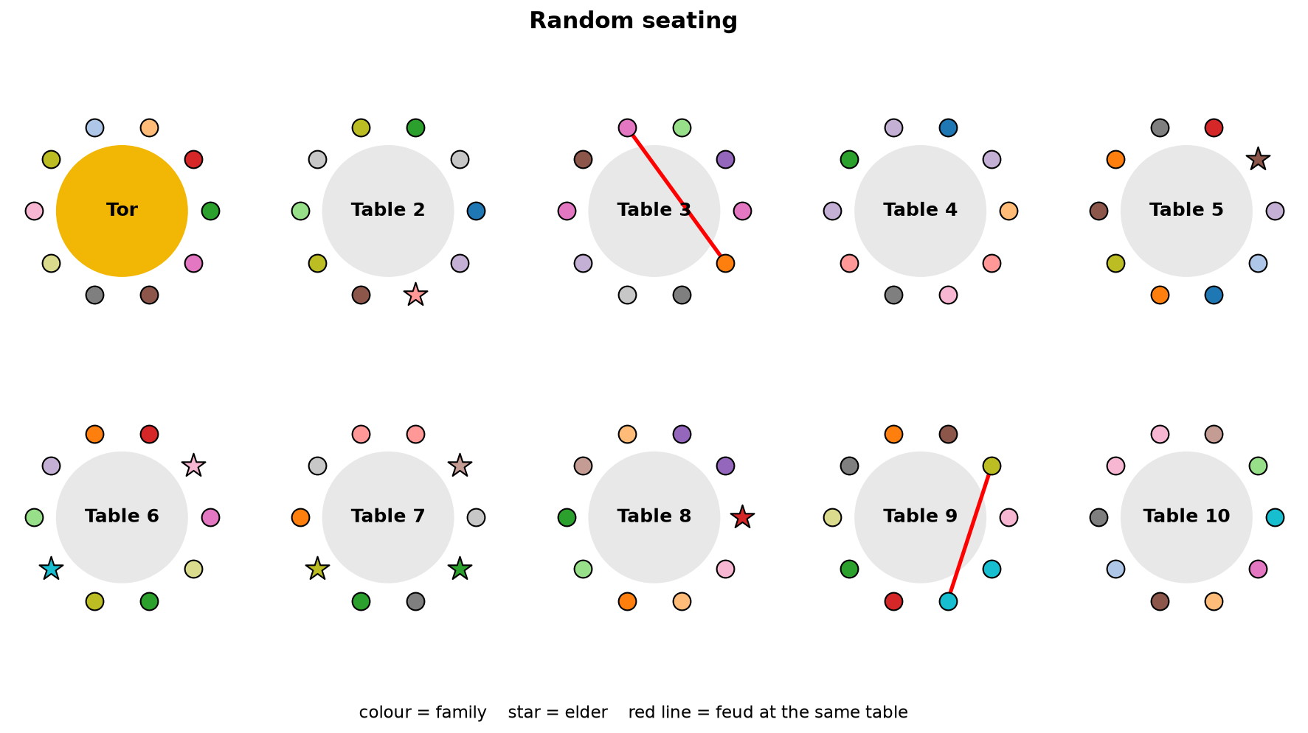
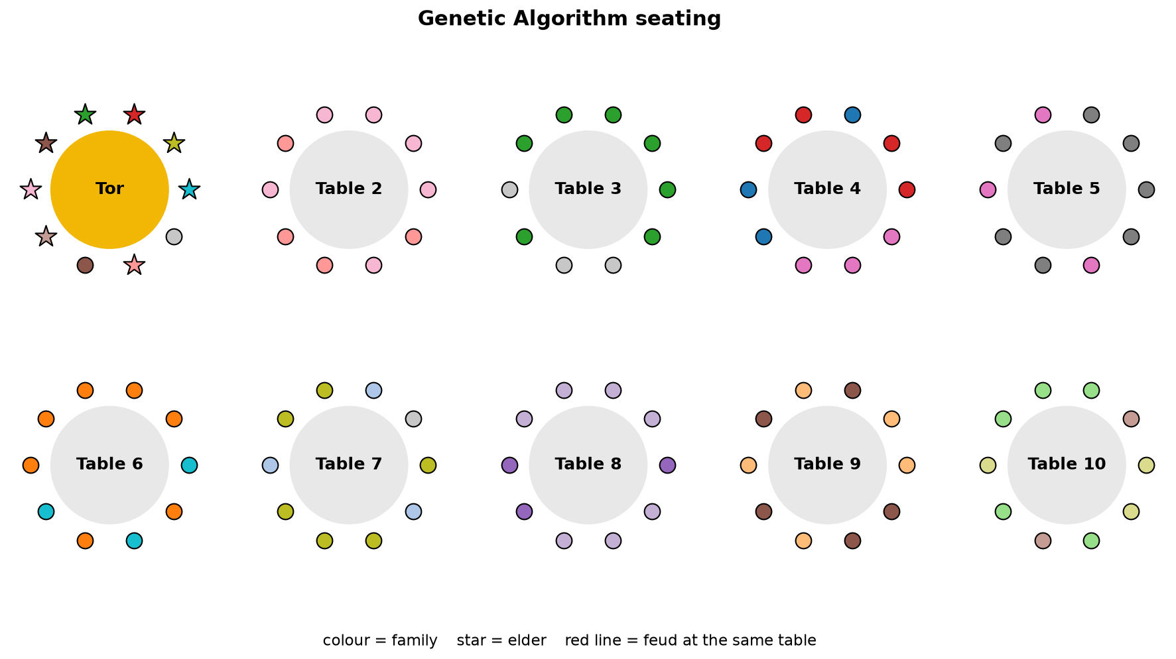
Before vs after
2
0/8
-10
0
8/8
2625
feuds at a table
elders at the tör
happiness
feuds at a table
elders at the tör
happiness
Notes:
Left: a random seating. Colours are families, stars are elders, red lines are feuds at the same table. Families are scattered and elders are everywhere. Right: the GA seating. Families sit together, all elders are at the tör and there are no red lines.

Slide 15
GA vs random search: same number of tries
 | Random | Best random | GA
Feuds at a table | 2 | 0 | 0
Elders at the tör | 0/8 | 5/8 | 8/8
Relatives together | 7.5% | 12.5% | 75.8%
Friends together | 5% | 7.5% | 2.5%
Run time | – | 3.4 s | 5.7 s
With the same 100,000 happiness evaluations, the GA's toi is 3.2× happier than the best random one.
Notes:
Fair comparison: random search also gets 100,000 tries, the same number of fitness evaluations as the GA. Random search can avoid feuds, but it cannot get families together or all elders to the tör. The GA does all of that.

Slide 16
What we learned and what's next
🔍
Analysis
🚀
ToiPlan roadmap
Hard rules always satisfied: 0 feuds, 8/8 elders at the tör
94% of the final happiness is reached by generation 300, then fine-tuning
Friends lose to relatives (+5 vs +10): the points set the priorities
A GA gives a very good plan, but no proof that it is the best one
Guests are generated (seed 42), not a real toi… yet
Telegram bot: send a guest list, get a seating plan
More rules: kids' table, dance floor, guests who share a language
Smarter search: add local search to the GA for even happier tois
Pilot at a real toi (we accept invitations 🙃)
Notes:
Analysis: the GA always satisfies the hard rules and improves quickly at the start. The weights decide the trade-offs, so friends get less attention than relatives. Like every metaheuristic, it gives no proof of optimality. Next steps for ToiPlan: a Telegram bot, more rules, and a hybrid GA with local search.

Slide 17
Рахмат! Thank you
👵🤝👵
← aunties after ToiPlan
Questions? (No feuds, please 🙏)
Code, README and results: github.com/iamthefamous/presentation
Notes:
Thank you! Happy to take questions.

