Slide 1

IILM UNIVERSITY, GREATER NOIDA
INTERNSHIP PRESENTATION · 2026–27
PraDCT and
PrakritM2M
Directional checkpoint transfer for low-resource
Prakrit–English neural machine translation
Machine Intelligence Signals and Networks (MISN) Lab · IIT Delhi
STUDENT
ENROLLMENT NUMBER
PROGRAM & SEMESTER
ORGANIZATION
Himansh Raj
CS-23411324
B.Tech CSE · Semester VII
MISN Lab · IIT Delhi
Supervisor: Dr. Sandeep Kumar · Internship: 20 May–20 August 2026
Notes:
Introduce the internship, the host laboratory, and the project title. The semester is presented as VII, consistent with enrollment CS-23411324 in CSE1 for Odd 2026–27 and the 2023–2027 cohort.
[Sources]
- Supplied file: Internship Report Format updated 26-27 (IILM University logo and university name).
- Supplied file: Himansh.pdf (host, supervisor, and internship dates).
- Internship report, cover page and sections 4.1–4.2 (project title and context).

Slide 2
CONTEXT
Internship at a glance
A three-month, on-campus research engagement at IIT Delhi
20 MAY
20 AUG
2026
2026
HOST
DEPARTMENT
SUPERVISOR
MODE
MISN Lab
IIT Delhi
Electrical
Engineering
Dr. Sandeep
Kumar
On campus
Hauz Khas
Research focus
Build an auditable Prakrit–English translation workflow from scarce, heterogeneous data.
PRAKRITM2M · MISN LAB, IIT DELHI
02
Notes:
Describe the placement before introducing the technical problem.
[Sources]
- Supplied file: Himansh.pdf (internship placement, dates, supervisor, and on-campus mode).
- Internship report, section 4.2.

Slide 3
PROBLEM
Why Prakrit machine translation is difficult
1,696
Scarce and fragmented parallel data
IAST and Devanagari normalization
Dialectal and orthographic variation
Small evaluation sets vulnerable to leakage
Synthetic data can reproduce model errors at scale
cleaned Prakrit–English seed pairs
A culturally important language family with very limited aligned digital resources.
The bottleneck was reliable data and evaluation—not only model capacity.
PRAKRITM2M · MISN LAB, IIT DELHI
03
Notes:
Frame the project as a data-and-evaluation problem as much as a modeling problem.
[Sources]
- Internship report, sections 4.1 and 4.3.
- B. Haddow et al., Survey of Low-Resource Machine Translation: https://aclanthology.org/2022.cl-3.6/
- R. Pischel, A Grammar of the Prakrit Languages: https://catalog.hathitrust.org/Record/000148305

Slide 4
DESIGN
Three questions shaped the project
01
Adapt
Can a multilingual translation checkpoint learn from only 1,496 training pairs?
02
Transfer
Can the selected Prakrit→English checkpoint initialize the reverse direction?
03
Scale
Can synthetic generation increase volume while preserving an auditable quality signal?
Output
PrakritM2M model family + PraDCT procedure + synthetic resource + lexical analysis
PRAKRITM2M · MISN LAB, IIT DELHI
04
Notes:
Use the three questions as the narrative spine for the remaining slides.
[Sources]
- Internship report, sections 4.3–4.5.

Slide 5
DATA
The supervised foundation: 1,696 aligned pairs
SOURCE COMPOSITION
Deshika · 1,212
prakrit.info · 484
88.2% train
11.8% evaluation
Audit signal
12 / 200
1,496 records
200 records
evaluation items had similarity ≥ 0.90 to training data
The evaluation split also selected checkpoints, so it is not an independent final test set.
PRAKRITM2M · MISN LAB, IIT DELHI
05
Notes:
Explain both the data composition and the evaluation caveat before discussing scores.
[Sources]
- Internship report, sections 4.8.2–4.8.3 and tables 4.3–4.4.

Slide 6
DATA
Preprocessing turned mixed sources into a consistent corpus
1
2
3
4
5
SCRIPT
LANGUAGE
SURFACE
QUALITY
LENGTH
IAST →
Devanagari
English-side
validation
Punctuation
normalization
Exact
deduplication
Drop records
< 3 chars
Result
A reproducible seed corpus with rejected records and intermediate counts retained for audit.
PRAKRITM2M · MISN LAB, IIT DELHI
06
Notes:
Walk through the normalization sequence and stress that rejected records were retained for audit.
[Sources]
- Internship report, section 4.8.2.

Slide 7
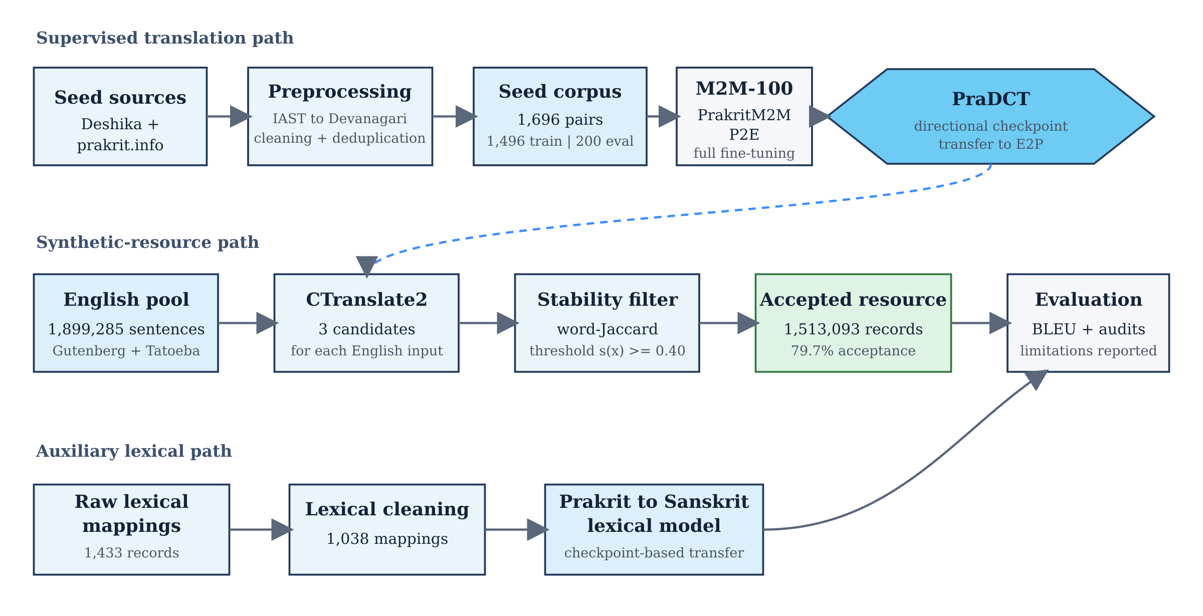
SYSTEM
One project, three connected paths
Supervised translation · synthetic-resource generation · auxiliary lexical transfer
All three paths converge on auditable evaluation rather than a single headline metric.
PRAKRITM2M · MISN LAB, IIT DELHI
07
Notes:
Use the architecture to orient the audience before entering training details.
[Sources]
- Internship report, section 4.7 and figure 4.1.

Slide 8
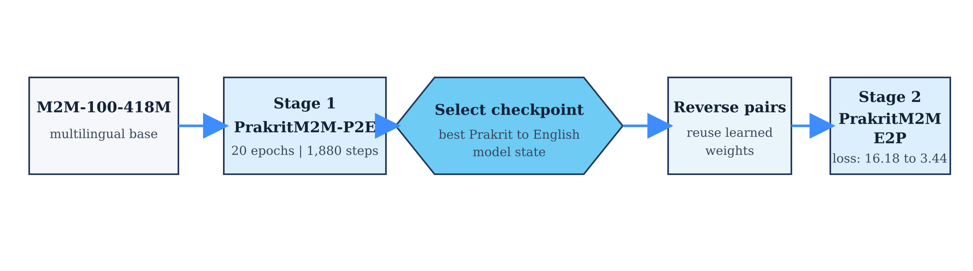
METHOD
PraDCT transfers the selected direction
The selected P2E checkpoint initializes reverse-direction training
16.18
3.44
→
Transfer effect
More stable reverse-direction optimization from the first update.
baseline E2P starting loss
PraDCT E2P starting loss
PRAKRITM2M · MISN LAB, IIT DELHI
08
Notes:
Clarify that PraDCT is a training procedure, not a dataset. The P2E checkpoint initializes E2P after reversing the pairs.
[Sources]
- Internship report, section 4.8.5 and figure 4.2.
- A. Fan et al., M2M-100: https://jmlr.org/papers/v22/20-1307.html

Slide 9
METHOD
Final PrakritM2M training configuration
20
BACKBONE
WEIGHT DECAY
M2M-100-418M
0.01
epochs
LEARNING RATE
PRECISION
5e-5
FP16
1,880
BATCH / ACCUMULATION
GRADIENT CLIPPING
8 / 2
1.0
optimization steps
MAXIMUM LENGTH
SCHEDULE
128
AdamW · linear
Reproducibility caveat
No fixed training-loop seed was recorded.
PRAKRITM2M · MISN LAB, IIT DELHI
09
Notes:
Summarize the training budget and flag the missing fixed seed.
[Sources]
- Internship report, table 4.6 and section 4.8.5.
- I. Loshchilov and F. Hutter, AdamW: https://openreview.net/forum?id=Bkg6RiCqY7

Slide 10
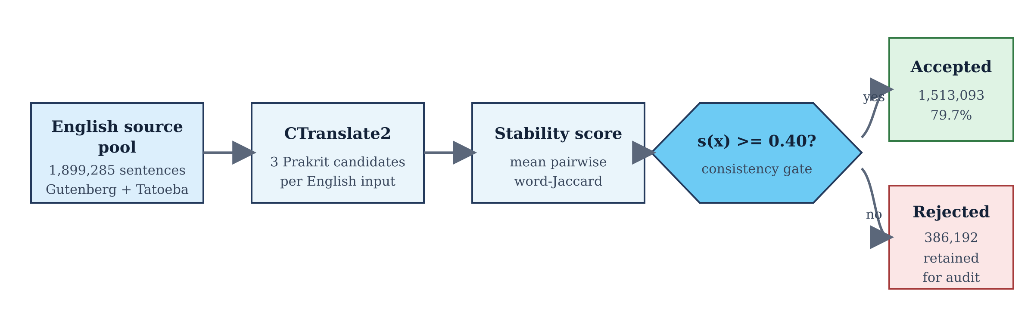
SCALE
Synthetic filtering accepted 1.51M records
1.51M
accepted records
79.7%
acceptance rate
386,192 rejected records were retained for audit.
Stability means candidate agreement—not human-verified semantic correctness.
PRAKRITM2M · MISN LAB, IIT DELHI
10
Notes:
Explain the three-candidate stability filter and its limitation.
[Sources]
- Internship report, section 4.8.6 and table 4.7.
- G. Klein et al., CTranslate2/OpenNMT: https://aclanthology.org/2020.ngt-1.25/
- R. Sennrich et al., back-translation with monolingual data: https://aclanthology.org/P16-1009/

Slide 11
EXPERIMENTS
Exploratory baselines informed model selection
Reported budgets differ; this is not a controlled leaderboard
Interpretation
These runs preserved useful negative and intermediate evidence, but unequal compute and data budgets prevent strict model ranking.
Final system: full M2M-100 fine-tuning
PRAKRITM2M · MISN LAB, IIT DELHI
11
Notes:
Treat these as learning evidence. Do not describe the highest exploratory bar as a fair benchmark winner.
[Sources]
- Internship report, section 4.8.4 and table 4.5.
- NLLB Team, Scaling Neural Machine Translation to 200 Languages: https://doi.org/10.1038/s41586-024-07335-x
- J. P. Gala et al., IndicTrans2: https://openreview.net/forum?id=vfT4YuzAYA
- E. J. Hu et al., LoRA: https://openreview.net/forum?id=nZeVKeeFYf9

Slide 12
RESULTS
Bidirectional translation worked—but the directions were not equally hard
PRAKRIT → ENGLISH
ENGLISH → PRAKRIT
47.08
14.38
BLEU on the project split
best BLEU checkpoint
Evaluation caveat
The 47.08 score must be read with the near-duplicate audit and the shared checkpoint-selection split.
PRAKRITM2M · MISN LAB, IIT DELHI
12
Notes:
Lead with the directional contrast, then immediately state the evaluation caveat.
[Sources]
- Internship report, sections 4.9.2–4.9.3 and table 4.9.
- K. Papineni et al., BLEU: https://aclanthology.org/P02-1040/
- M. Post, clarity in BLEU reporting: https://aclanthology.org/W18-6319/

Slide 13
INTERPRETATION
Why English→Prakrit remained harder
P→E
E→P
Generating English
Generating Prakrit
Better-supported target language
More standardized surface forms
Multilingual pretraining offers stronger target-side coverage
Sparse target-side training signal
Dialectal and orthographic alternatives
Exact n-gram overlap penalizes valid variation
PraDCT improved the starting point; it could not remove target-side data scarcity.
PRAKRITM2M · MISN LAB, IIT DELHI
13
Notes:
Interpret the gap through target-side resource availability and surface-form variability.
[Sources]
- Internship report, sections 4.8.5 and 4.9.3.
- M. Post, clarity in BLEU reporting: https://aclanthology.org/W18-6319/

Slide 14
AUXILIARY TASK
Lexical transfer exposed partial-form learning
1,433
raw lexical records
1,038
usable mappings
8 lemmas crossed the train/evaluation split
Exact match alone hides morphologically related outputs.
PRAKRITM2M · MISN LAB, IIT DELHI
14
Notes:
Explain why the exact-match score is low while LCS similarity is much higher.
[Sources]
- Internship report, sections 4.8.7–4.8.8 and table 4.8.

Slide 15
RESEARCH INTEGRITY
Limitations define the next experiment
LIMITATION
NEXT ACTION
Small supervised corpus
Expand expert-curated parallel data
Near duplicates in evaluation
Build a strict deduplicated test set
Validation and final scoring coupled
Reserve a sealed expert-reviewed set
No fixed training-loop seed
Run fixed-seed multi-trial experiments
No philologist-led human evaluation
Score meaning, grammar, dialect, and style
The strongest next step is better evaluation design—not a larger headline score.
PRAKRITM2M · MISN LAB, IIT DELHI
15
Notes:
Present the limitations as a research roadmap rather than as an afterthought.
[Sources]
- Internship report, sections 4.9.4–4.9.6 and table 4.10.
- M. Post, clarity in BLEU reporting: https://aclanthology.org/W18-6319/

Slide 16
PRAKRITM2M · PRAKRIT DIRECTIONAL CHECKPOINT TRANSFER
What the internship established
01
A complete bidirectional Prakrit–English research pipeline
02
A practical direction-to-direction checkpoint transfer procedure
03
An auditable synthetic resource and an honest evaluation roadmap
Questions
Himansh Raj
CS-23411324
Notes:
Close on the three durable outputs and invite questions.
[Sources]
- Internship report, section 4.9.6.

