Slide 1
CAPSTONE PROJECT · MID-TERM & PHASE III
DualNet-AL
A Bi-Network Meta-Learning Framework for Multi-Class Active Learning
Himansh Raj (CS-23411324) · Om Narayan Pandey (CS-2341893) · 4CSE1
Guide: Dr. Jaswinder Singh · Project ID BT-20 · SDG 9 · IILM University, Greater Noida
DualNet-AL · BT-20 · IILM University 1

Slide 2
The problem
Deep models need thousands of labels; labelling is slow and expensive
• Active learning: the model chooses which unlabelled images a human should label next
• Single-criterion selection has known failure modes:
  – Uncertainty sampling picks confusing outliers and near-duplicates
  – One model choosing its own data reinforces its own mistakes (confirmation bias)
  – Rare classes get ignored, so worst-class accuracy stays low
  – With very few labels, the model's own uncertainty is unreliable (cold start)
• Goal: more accuracy per label than Random sampling, consistently across datasets
DualNet-AL · BT-20 · IILM University 2

Slide 3
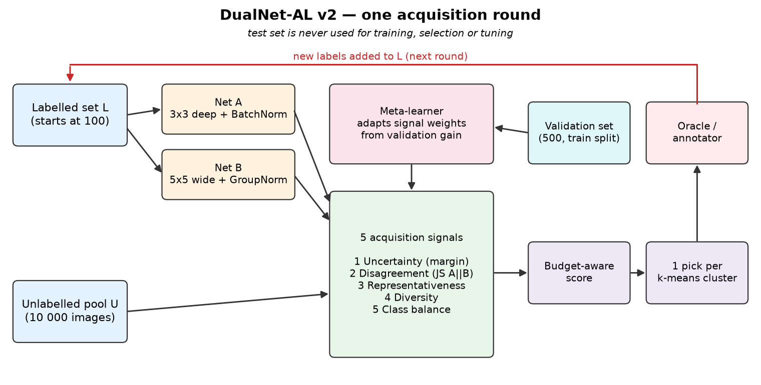
Our idea: two networks + five signals
DualNet-AL · BT-20 · IILM University 3

Slide 4
What each part does
Component | What it does | Why
Net A + Net B | 3x3 deep CNN (BatchNorm) and 5x5 wide CNN (GroupNorm) | different mistakes → informative disagreement
Uncertainty | margin between top-2 classes of A+B average | where the model is unsure
Disagreement | Jensen-Shannon divergence between A and B | counters single-model confirmation bias
Representativeness | density among 10 nearest neighbours | avoids outliers
Diversity | distance to nearest labelled image | covers unexplored regions
Class balance | rarity of predicted class in labelled set | protects rare classes
Meta-learner | re-weights the 5 signals after each round | learns how to select, per dataset
DualNet-AL · BT-20 · IILM University 4

Slide 5
Phase III improvement: DualNet-AL v2
Why v1 tied with Random at small budgets — and the fix
• v1 result (Phase II): best on CIFAR-10, but level with Random on Fashion-MNIST and behind on SVHN
• Diagnosis: at 100–300 labels, scores based on the model's own uncertainty are unreliable
• v2 change 1 — budget-aware score: early rounds favour typical (dense) images,
  – then the meta-learned informativeness score takes over as labels accumulate
• v2 change 2 — one pick per k-means cluster (100 clusters → 100 labels):
  – every batch covers the whole data distribution, with no near-duplicates
• Chosen setting (by validation only): c3_half_ramp4_margin (prior ramp 4 rounds, start weight 0.5, margin uncertainty)
DualNet-AL · BT-20 · IILM University 5

Slide 6
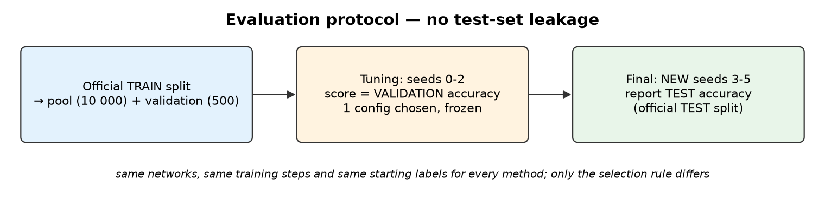
Fair, leak-free evaluation
• Datasets: Fashion-MNIST, SVHN, CIFAR-10 — 10 000-image pool, 500 validation, 2 000 test each
• 100 starting labels + 8 rounds of 100 → 900 labels; both networks retrained from scratch, 300 steps
• 9 methods × 3 datasets × 3 held-out seeds; hardware: NVIDIA GeForce RTX 5060 Ti
DualNet-AL · BT-20 · IILM University 6

Slide 7
Held-out results: label efficiency (AULC %)
Area under accuracy-vs-labels curve, mean ± std over new seeds 3, 4, 5 (test set)
Method | Fashion-MNIST | SVHN | CIFAR-10
Random | 78.92 ± 1.18 | 53.17 ± 1.49 | 47.20 ± 0.30
Entropy | 77.86 ± 0.88 | 38.71 ± 1.57 | 45.88 ± 1.01
Margin | 81.49 ± 0.38 | 49.34 ± 2.70 | 47.95 ± 0.21
BALD (MC-Dropout) | 79.94 ± 0.48 | 55.89 ± 1.25 | 47.05 ± 1.19
Core-Set (k-Center) | 78.42 ± 0.66 | 40.18 ± 1.65 | 46.81 ± 1.17
QBC (A/B disagreement) | 79.63 ± 0.81 | 47.58 ± 1.77 | 46.30 ± 0.64
DualNet-AL v1 (meta-learned) | 80.04 ± 0.67 | 49.30 ± 4.34 | 48.26 ± 0.68
DualNet-AL v2 (budget-aware, clustered) | 81.33 ± 0.34 | 57.56 ± 1.12 | 48.66 ± 0.52
DualNet-AL · BT-20 · IILM University 7

Slide 8
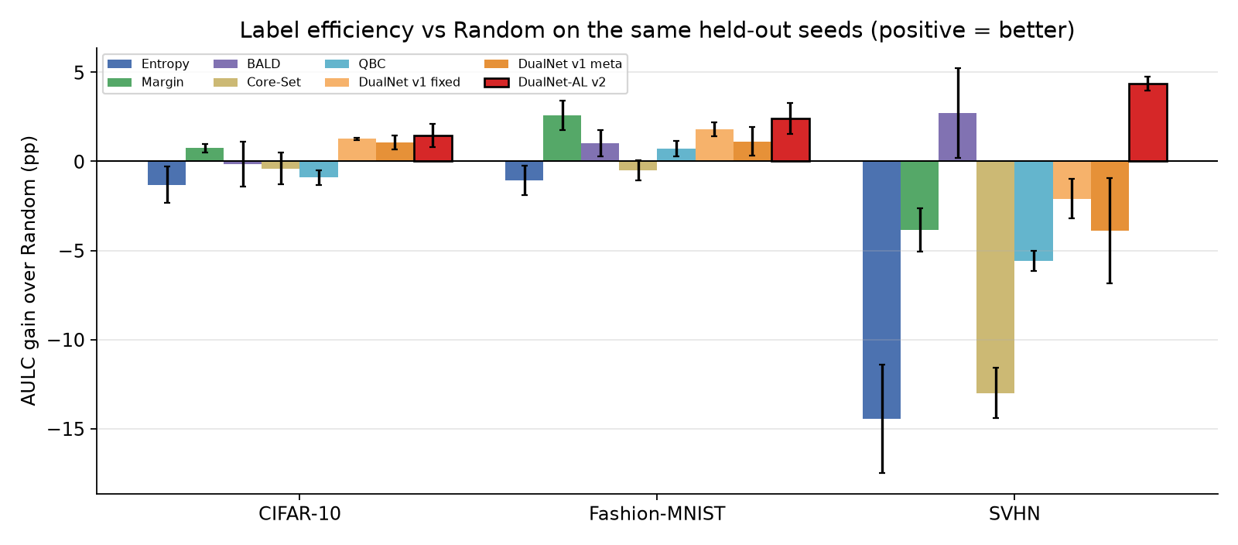
Gain over Random on the same seeds
Fashion-MNIST: +2.41 pp AULC vs Random, better on 3/3 seeds
SVHN: +4.38 pp AULC vs Random, better on 3/3 seeds
CIFAR-10: +1.46 pp AULC vs Random, better on 3/3 seeds
DualNet-AL · BT-20 · IILM University 8

Slide 9
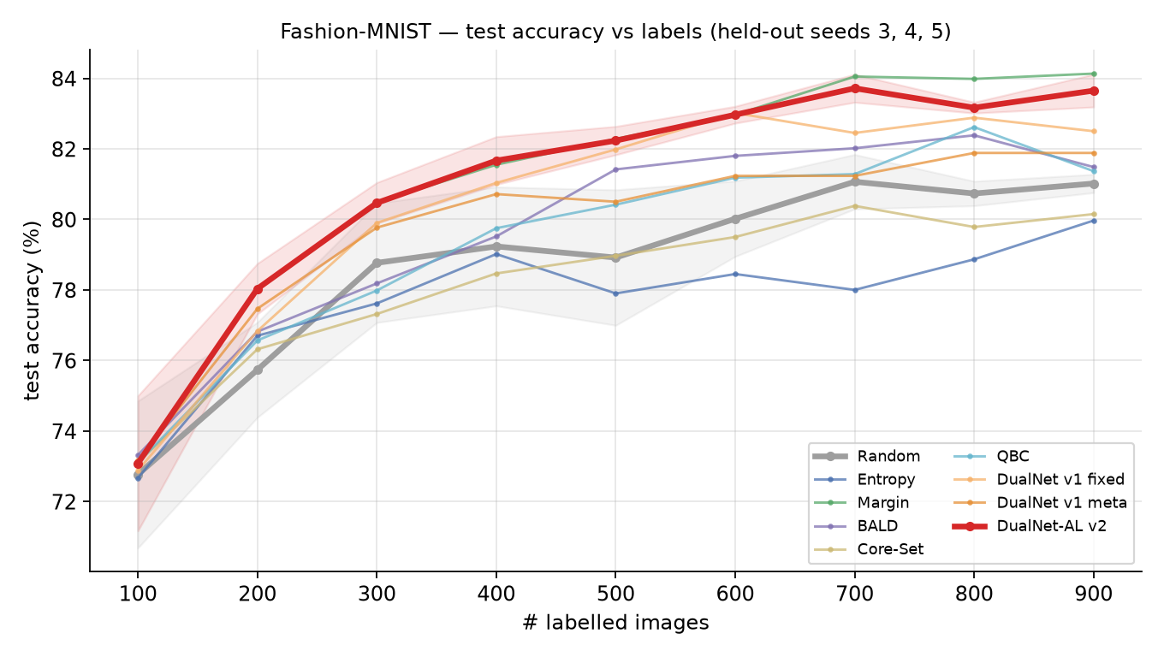
Fashion-MNIST: accuracy as labels grow
DualNet-AL v2 final accuracy: 83.7%
Random: 81.0%
Best baseline (Margin): 84.1%
Worst-class recall: v2 46.8% vs Random 38.0%
Macro-F1: v2 83.5% vs Random 80.7%
DualNet-AL · BT-20 · IILM University 9

Slide 10
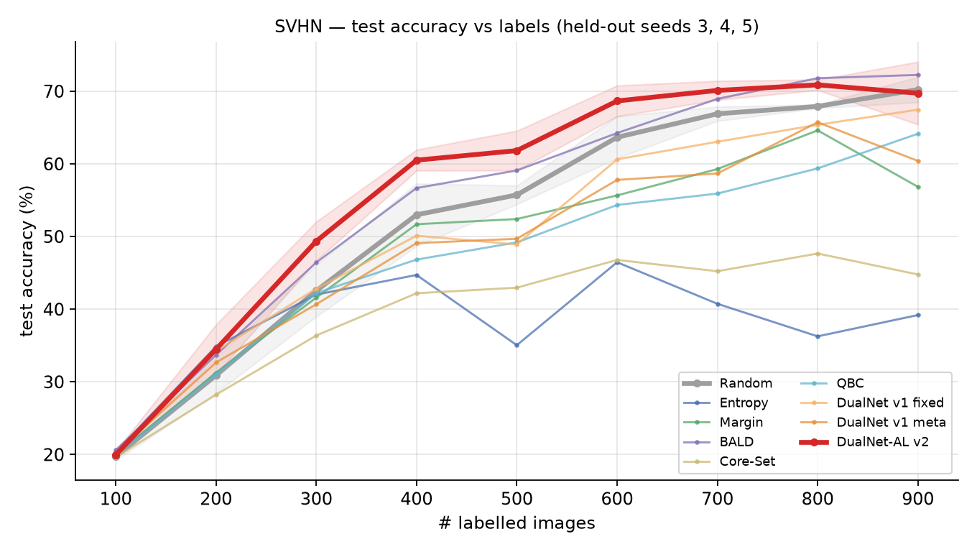
SVHN: accuracy as labels grow
DualNet-AL v2 final accuracy: 69.7%
Random: 70.2%
Best baseline (BALD): 72.2%
Worst-class recall: v2 40.5% vs Random 16.7%
Macro-F1: v2 65.8% vs Random 63.9%
DualNet-AL · BT-20 · IILM University 10

Slide 11
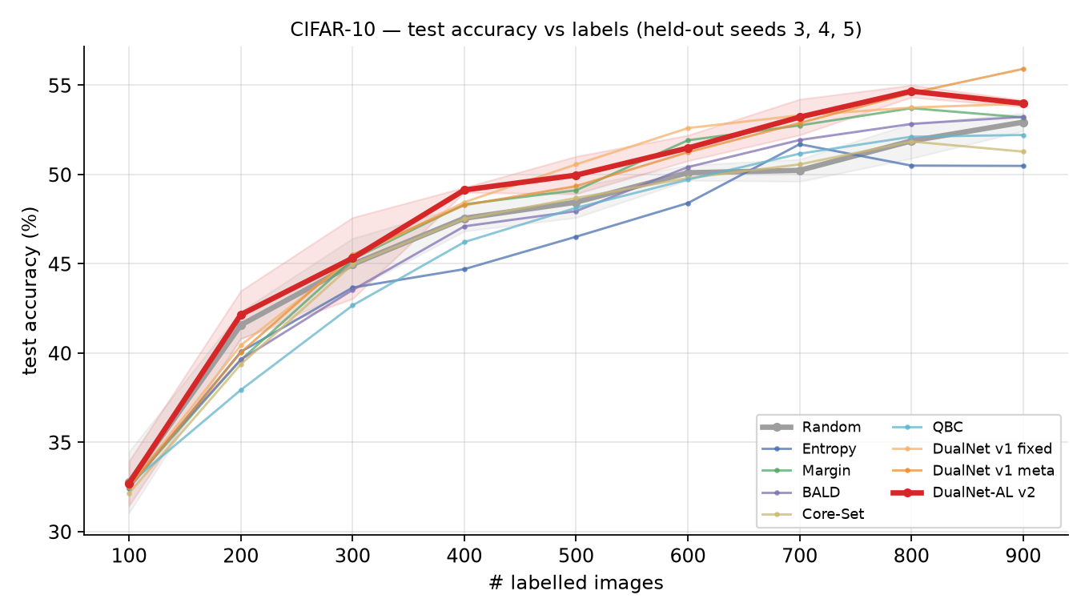
CIFAR-10: accuracy as labels grow
DualNet-AL v2 final accuracy: 54.0%
Random: 52.9%
Best baseline (Margin): 53.2%
Worst-class recall: v2 27.9% vs Random 21.2%
Macro-F1: v2 53.1% vs Random 51.7%
DualNet-AL · BT-20 · IILM University 11

Slide 12
Working prototype & testing
• Python / PyTorch package: data, models, training, 5 signals, meta-learner, v2 selection, 8 baselines
• Live web demo (Streamlit): runs the real loop round by round — accuracy of Net A, Net B and ensemble,
  – signal weights per round, the images it chose, class balance, side-by-side with Random
• One-command launcher for Windows / Linux / Mac: installs everything and opens the demo
• 30 automated tests pass: each signal's edge cases, clustering, de-duplication, budget ramp,
  – no image labelled twice, tuning mode provably never reads the test set
• Defects found and fixed: distance precision, weight floor, GPU pooling crash, 48 s → 0.03 s clustering
DualNet-AL · BT-20 · IILM University 12

Slide 13
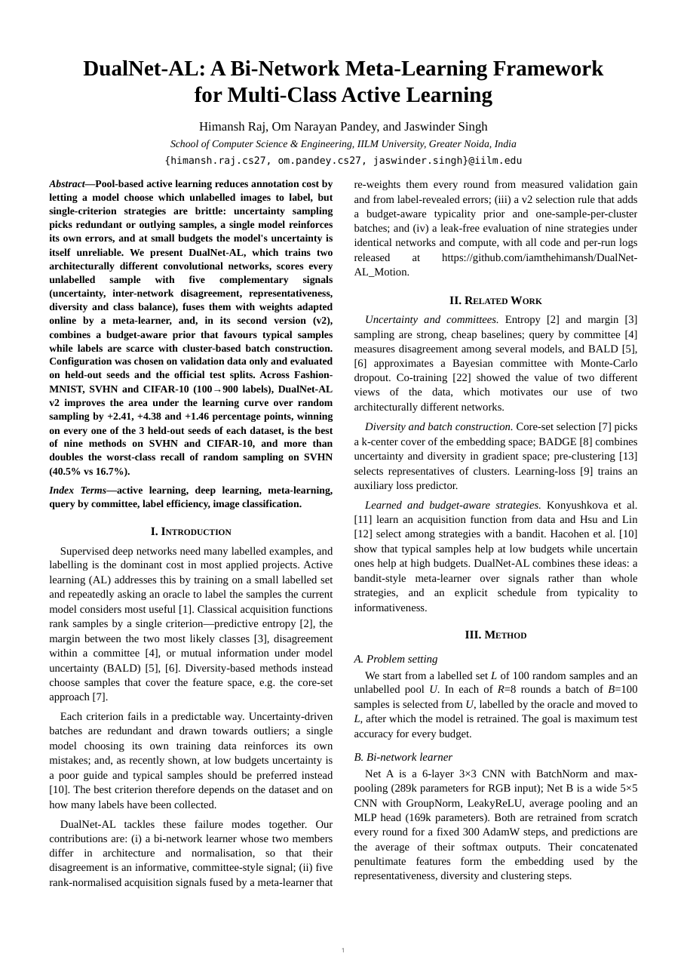
Research paper
• DualNet-AL: A Bi-Network Meta-Learning Framework for Multi-Class Active Learning
• Himansh Raj, Om Narayan Pandey, Dr. Jaswinder Singh — IILM University
• 5 pages, two-column IEEE style: method, leak-free protocol, 4 tables, 5 figures,
  – ablation study, cost and calibration, limitations, 22 references
• Every number generated from the held-out runs
• Code, per-run logs and demo: github.com/iamthehimansh/DualNet-AL_Motion
• Target: SCOPUS-indexed conference
DualNet-AL · BT-20 · IILM University 13

Slide 14
Limitations & next steps
• Low budget only (900 labels) and small pools; gaps are a few points
• 3 held-out seeds: paired comparison shown, formal significance tests still to do
• Meta-learner reward uses a 500-image validation set; a label-free reward is planned
• Calibration (ECE) is worse than Random; temperature scaling is the planned fix
• Next: CIFAR-100 and long-tail data, BADGE and Learning-Loss baselines, larger budgets,
  – ResNet backbones, 5+ seeds with Wilcoxon tests, conference submission
DualNet-AL · BT-20 · IILM University 14

Slide 15
DualNet-AL
learning how to select — not only what to classify
Thank you · Questions?
DualNet-AL · BT-20 · IILM University 15

