Slide 1
Hello

Slide 2
VS Code
Please Download VS code in your PC

Slide 3
Visual Recognition

Slide 4
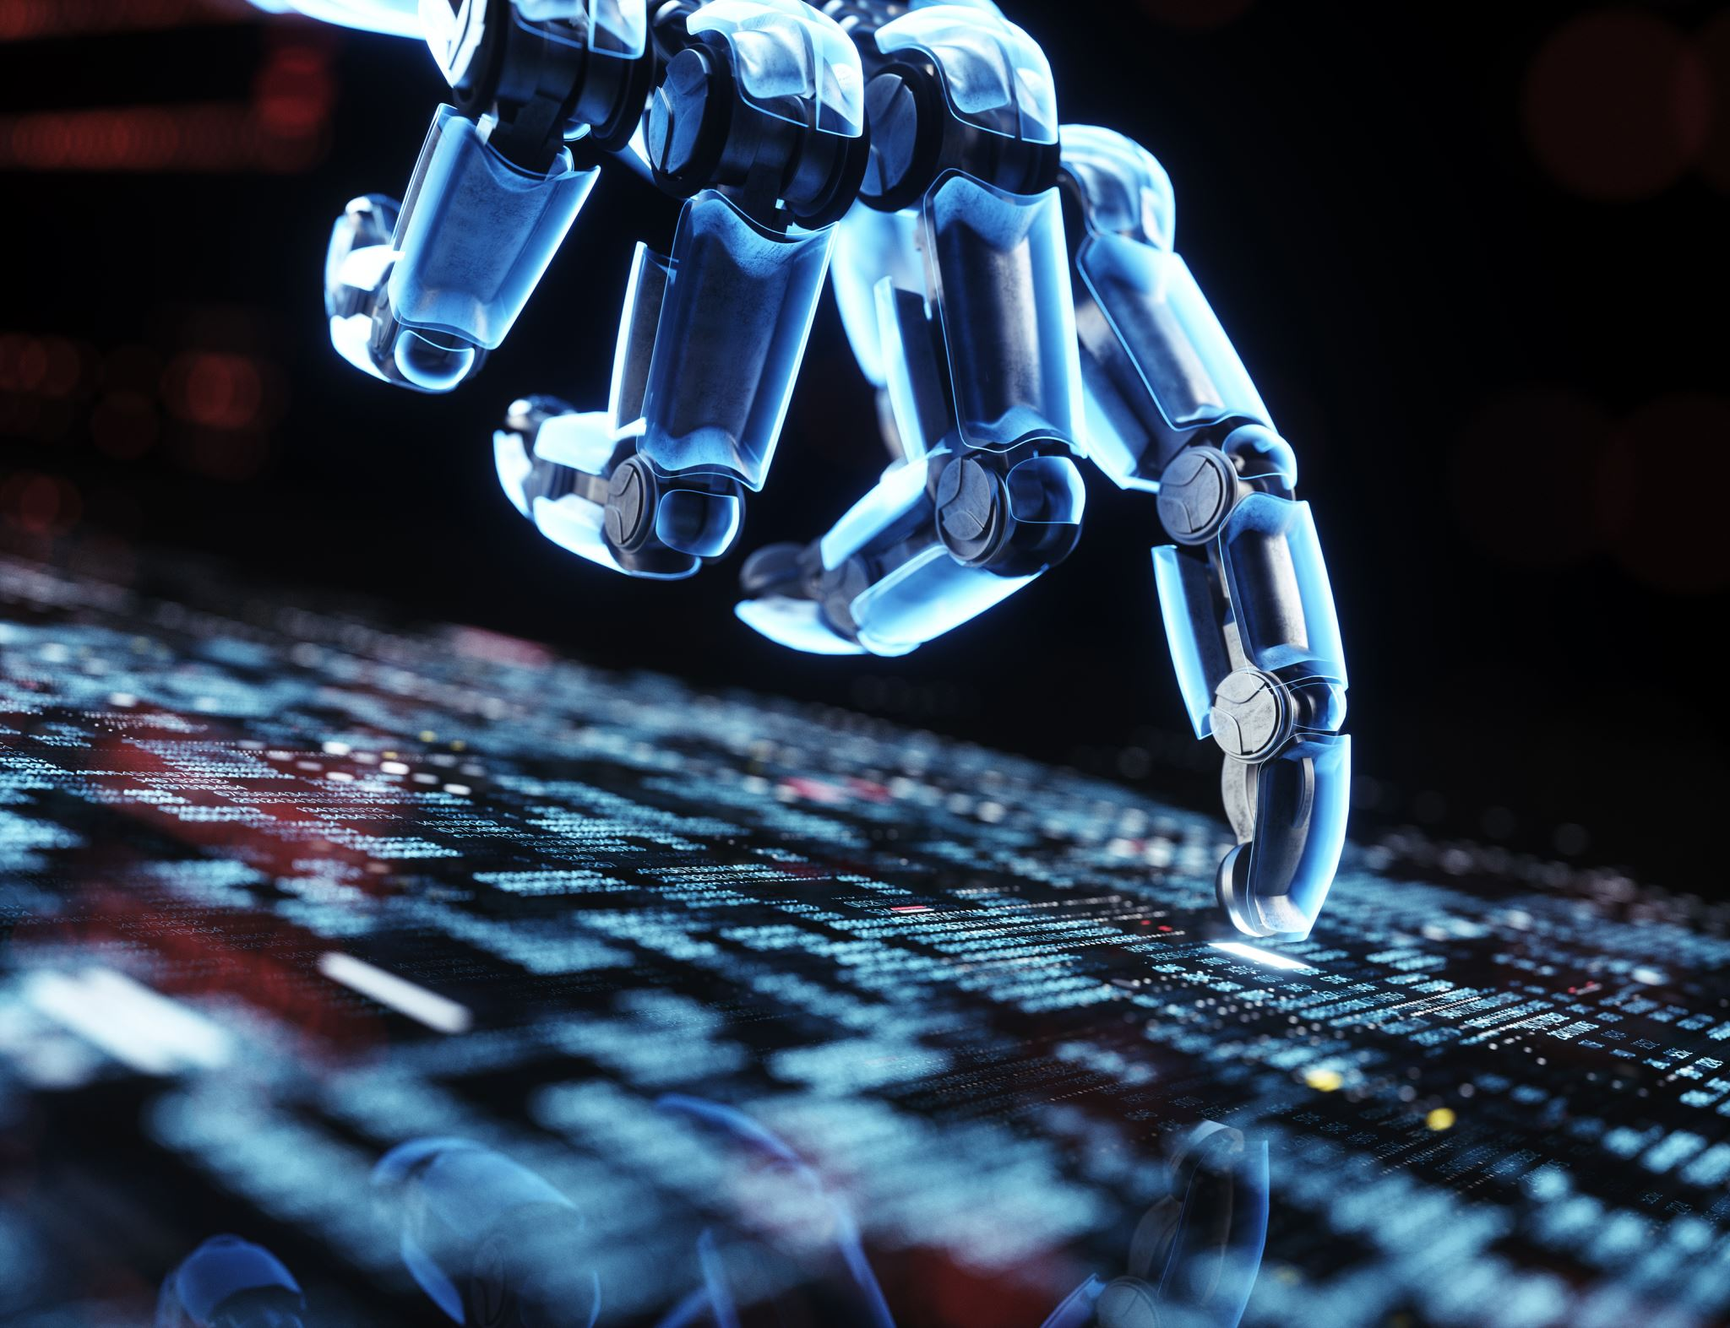
What is Visual Recognition and why robots need it?
Visual recognition is a branch of computer vision
Robots use visual recognition to detect different objects
Including human, QR code, images
Robots use sensors to collect data from the real world
And then recognize certain objects from those data
Smartphones have cameras
Robots want to see the world through computer vision

Slide 5
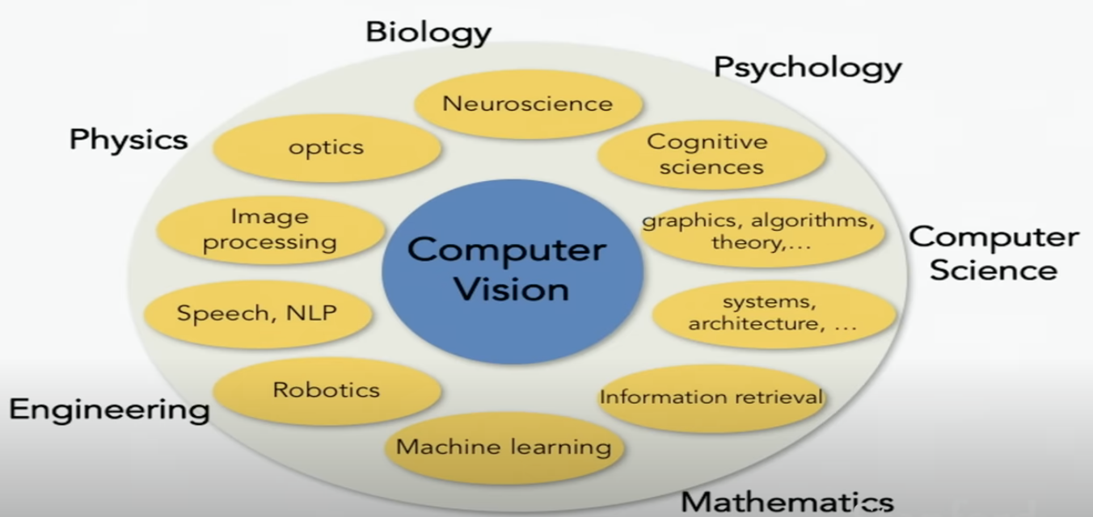
Computer Vision is everywhere

Slide 6

History of Vision
In the late 1960s, computer vision began at universities that were pioneering artificial intelligence. It was meant to mimic the human visual system as a stepping stone to endowing robots with intelligent behavior.
In 1966, it was believed that this could be achieved through an undergraduate summer project,^{[12]} by attaching a camera to a computer and having it "describe what it saw".

Slide 7

History of vision
Studies in the 1970s formed the early foundations for many of the computer vision algorithms that exist today, including extraction of edges from images, labeling of lines, non-polyhedral and polyhedral modeling, representation of objects as interconnections of smaller structures, optical flow, and motion estimation.
By the 1990s, some of the previous research topics became more active than others. Research in projective 3-D reconstructions led to better understanding of camera calibration. With the advent of optimization methods for camera calibration, it was realized that a lot of the ideas were already explored in bundle adjustment theory from the field of photogrammetry. This led to methods for sparse 3-D reconstructions of scenes from multiple images.

Slide 8

Image segmentation
A task of taking an image and group the pixels into meaningful areas
Image segmentation is a computer vision technique that partitions a digital image into discrete groups of pixels—image segments—to inform object detection and related tasks. By parsing an image’s complex visual data into specifically shaped segments, image segmentation enables faster, more advanced image processing.

Slide 9
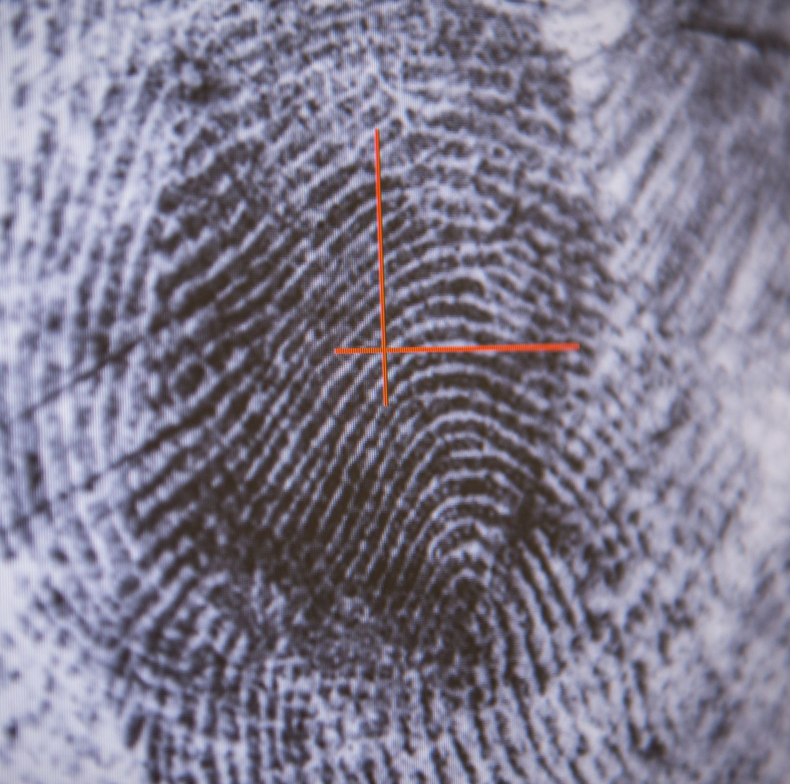
Image classification
Object detection
Action classification
Image captioning

Slide 10
What is a classification
Classification is a supervised machine learning method where the model tries to predict the correct label of a given input data. In classification, the model is fully trained using the training data, and then it is evaluated on test data before being used to perform prediction on new unseen data.

Slide 11
Supervised VS unsupervised learning
The biggest difference between supervised and unsupervised machine learning is the type of data used. Supervised learning uses labeled training data, and unsupervised learning does not.
More simply, supervised learning models have a baseline understanding of what the correct output values should be.
With supervised learning, an algorithm uses a sample dataset to train itself to make predictions, iteratively adjusting itself to minimize error. These datasets are labeled for context, providing the desired output values to enable a model to give a “correct” answer.
In contrast, unsupervised learning algorithms work independently to learn the data's inherent structure without any specific guidance or instruction. You simply provide unlabeled input data and let the algorithm identify any naturally occurring patterns in the dataset.

Slide 12
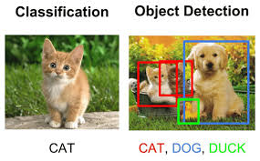
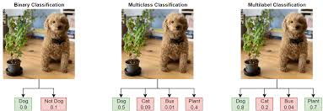
What does a robot see?

Slide 13
K-nearest neighbors (KNN)
The k-nearest neighbors (KNN) algorithm is a non-parametric, supervised learning classifier, which uses proximity to make classifications or predictions about the grouping of an individual data point. It is one of the popular and simplest classification and regression classifiers used in machine learning today.
While the KNN algorithm can be used for either regression or classification problems, it is typically used as a classification algorithm, working off the assumption that similar points can be found near one another.

Slide 14
Understand of KNN
Imagine you come to a new city and you ask your friends who are familiar with the local area to recommend a restaurant. When you only ask your closest friend, k=1, when you consider the suggestions of 3 friends around you, k=3, and when you ask everyone for suggestions, k=n. In short, KNN is a method of making decisions based on the suggestions of people around you.

Slide 15
Xiaoming's Confession
Xiaoming wants to confess to a girl, can you help him predict his possibility to success?
import numpy as np
from sklearn.model_selection import train_test_split
from sklearn import datasets
from sklearn import svm
import pandas as pd
df = pd.read_excel('confession_data.xlsx')
print(df)
import matplotlib.pyplot as plt
from sklearn.neighbors import KNeighborsClassifier
import matplotlib.pyplot as plt
knn_model = KNeighborsClassifier(n_neighbors = 9)
knn_model.fit(X_train,y_train)
X_xiaoming = {'attractiveness':[3], 'income':[75], 'dating times':[8]}
y_pred = knn_model.predict(xiaoming)

Slide 16
KNN: lazy learning
KNN is a kind of lazy learning, because it doesn't learn a model, it instead remember all training data and classify them when using.
For example, when k is 3, there are 2 cats and 1 dog in the 3 items, then the input data will be labeled as a cat automatically.

Slide 17
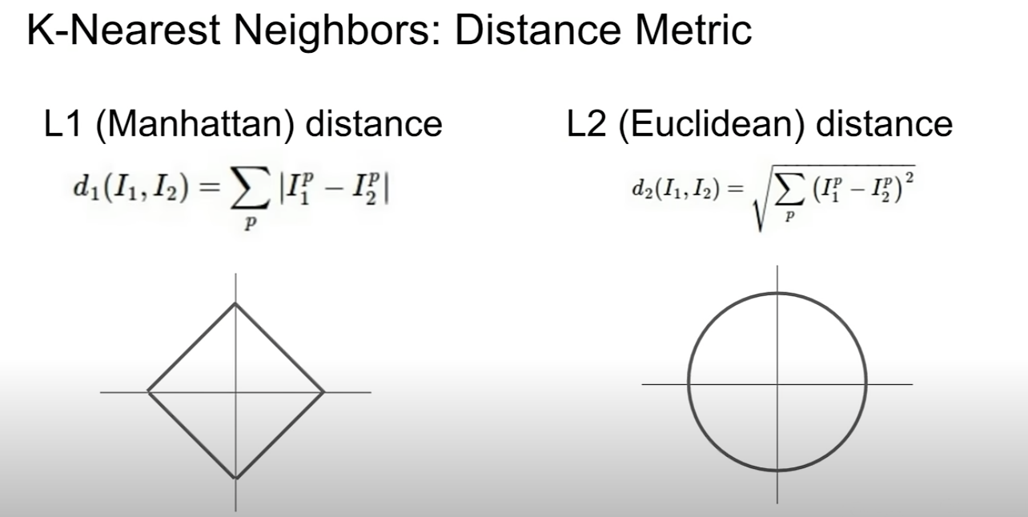
k-nearest neighbors (KNN)
L1 distance: takes the sum of the absolute values between the pixel
L2 distance: takes the square root of the sum of the squares as the distance

Slide 18
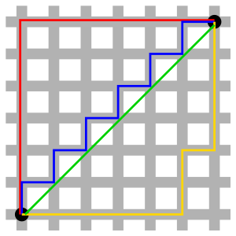
Manhattan distance and. Euclidean distance
Red, blue and yellow lines have the same length which is 12
While the green line represents Eliude distance which is 6 times square root 2 = 8.48
In mathematics, the Euclidean distance between two points in Euclidean space is the length of the line segment between them. It can be calculated from the Cartesian coordinates of the points using the Pythagorean theorem, and therefore is occasionally called the Pythagorean distance.

Slide 19
Why we rarely use k-nearest neighbors (KNN)?
Very slow at test time
Distance metrics on pixels are not informative
Curse of dimensionality (needs exponential dimension)
A good try, but a bad practice

Slide 20
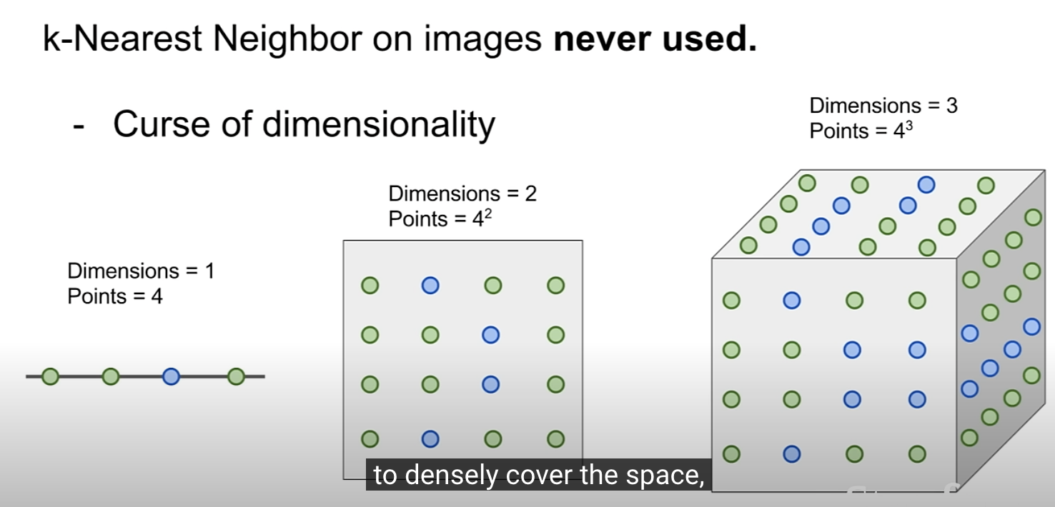
Slow at test time

Slide 21
How does data labeling work?
Today, most practical machine learning models utilize supervised learning, which applies an algorithm to map one input to one output. For supervised learning to work, you need a labeled set of data that the model can learn from to make correct decisions. Data labeling typically starts by asking humans to make judgments about a given piece of unlabeled data. For example, labelers may be asked to tag all the images in a dataset where “does the photo contain a bird” is true. The tagging can be as rough as a simple yes/no or as granular as identifying the specific pixels in the image associated with the bird. The machine learning model uses human-provided labels to learn the underlying patterns in a process called "model training." The result is a trained model that can be used to make predictions on new data.

Slide 22
What are some best practices for data labeling?
There are many techniques to improve the efficiency and accuracy of data labeling. Some of these techniques include:
Intuitive and streamlined task interfaces to help minimize cognitive load and context switching for human labelers.
Labeler consensus to help counteract the error/bias of individual annotators. Labeler consensus involves sending each dataset object to multiple annotators and then consolidating their responses (called “annotations”) into a single label.
Label auditing to verify the accuracy of labels and update them as necessary.
Active learning to make data labeling more efficient by using machine learning to identify the most useful data to be labeled by humans.

Slide 23
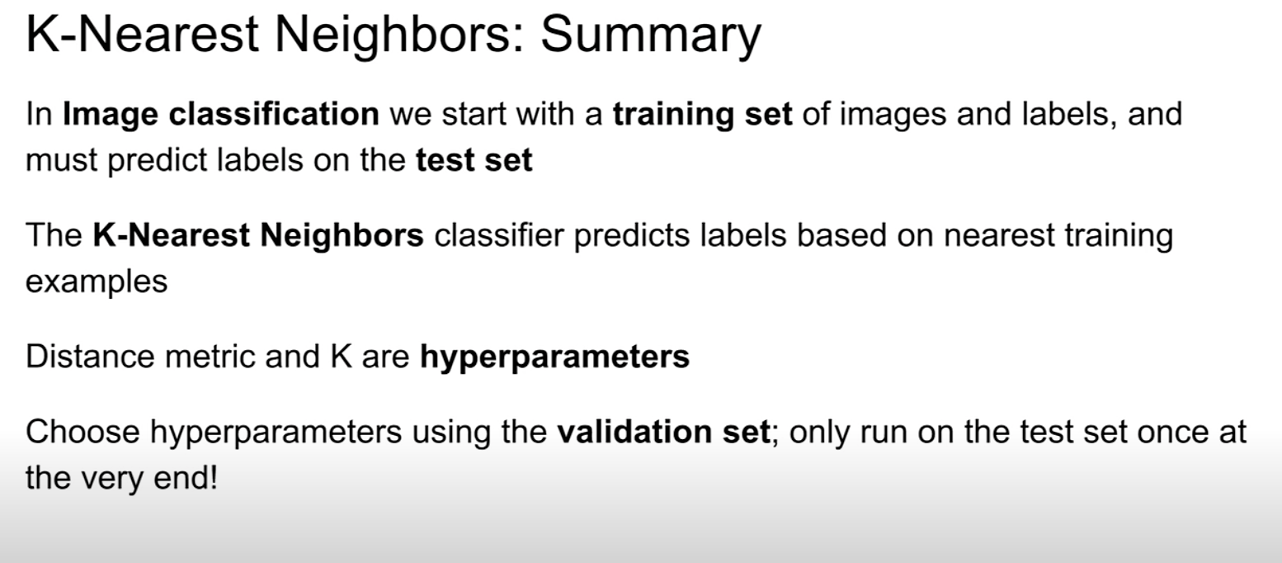

Slide 24
Linear classifiers
In the field of machine learning, the goal of statistical classification is to use an object's characteristics to identify which class (or group) it belongs to. A linear classifier achieves this by making a classification decision based on the value of a linear combination of the characteristics. An object's characteristics are also known as feature values and are typically presented to the machine in a vector called a feature vector. Such classifiers work well for practical problems such as document classification, and more generally for problems with many variables (features), reaching accuracy levels comparable to non-linear classifiers while taking less time to train and use

Slide 25
Parametric approach (linear classifier)
F(x,W) = Wx + b
Array of 32x32x3 = 3072 numbers in total which is x
W is parameters or weights
B is bias(data independence)
Wx: matrix mutiplication

Slide 26
Lecture website
Resources from lecture 1 has been released on the website, just check it

Slide 27
Following lectures
CNN understanding and practice
Python and Pytorch introduction
Image recognition projects
Large language model

Slide 28
KNN algorithm demo

