Slide 1

optimization and gradient descent
Theo Zhang

Slide 2
Loss function
In mathematical optimization and decision theory, a loss function or cost function (sometimes also called an error function) is a function that maps an event or values of one or more variables onto a real number intuitively representing some "cost" associated with the event. An optimization problem seeks to minimize a loss function. An objective function is either a loss function or its opposite (in specific domains, variously called a reward function, a profit function, a utility function, a fitness function, etc.), in which case it is to be maximized. The loss function could include terms from several levels of the hierarchy.
Cost function quantitively represent the square difference between prediction and actual value, we use gradient descent to minimize this square difference

Slide 3
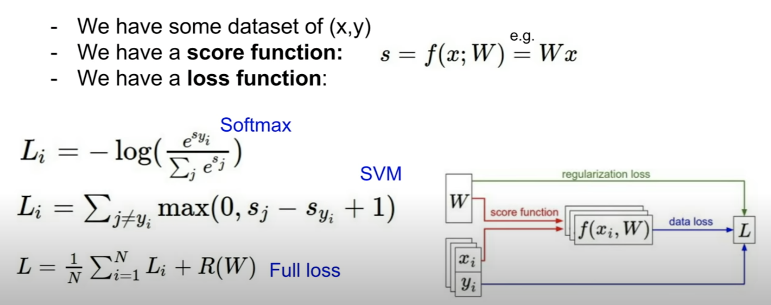

Slide 4
Optimization—To find W
Method1: random search (about 15% accuracy)
Method2: slope search using local geometry
In one dimension, slope is the derivative of function
In multiple dimensions, slope(gradient) is partial derivatives along each dimension
The slope in any direction is the dot product of the direction with the gradient
The direction of the steepest descent is the negative gradient

Slide 5
Learning rate: n
When n is too large, it means we go down the hill in a fast speed, we might hence miss the target point, may not converge to a point
When n is too small, it means we go down the hill in a slow speed, we might hence waste a long time
Therefore it's important to ensure n is approprate

Slide 6
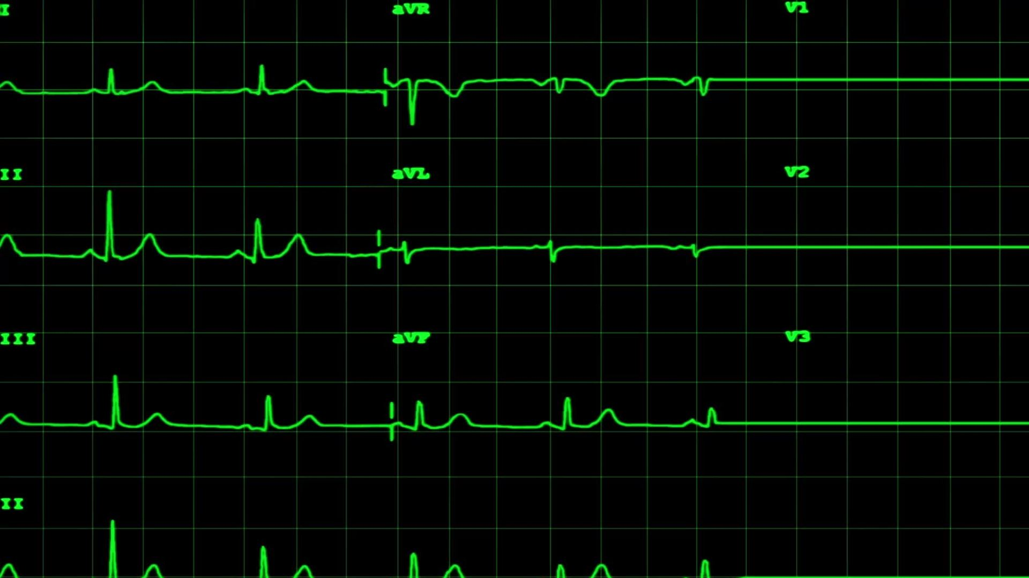
Gradient descent
Aim: to minimize a loss function
In one dimension, find the point where the gradient(tangent gradient) is the greatest, gradient descent is the opposite direction on this point (where the descent rate is the greatest)
Can be considered as negative gradient

Slide 7
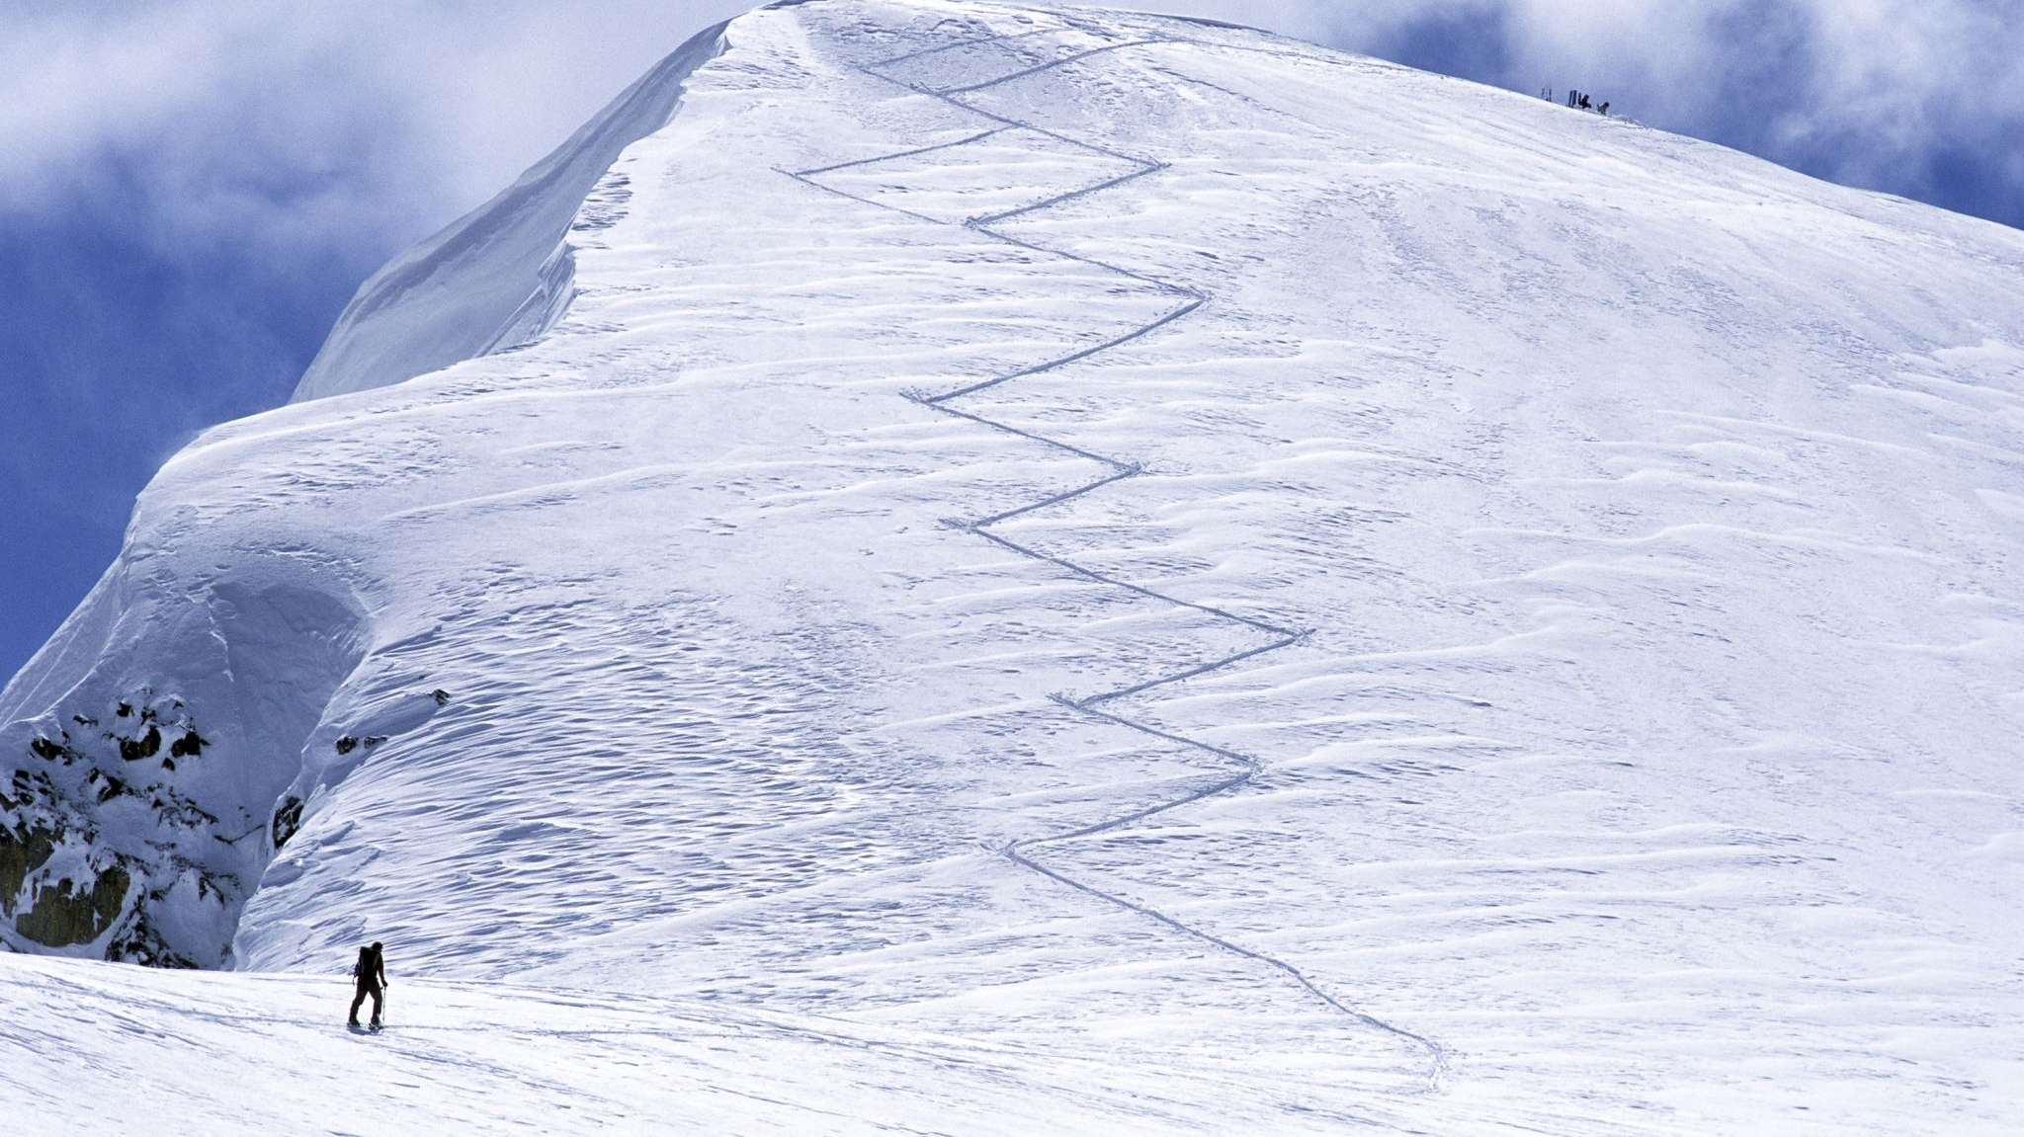
3 types of gradient descent

Slide 8
Batch gradient descent
It's useful when there's a large amount of training data
The training result is considered to be accurate but need long time to train
Need all data for each iteration, use average loss to approximity target function
Slow, slow, slow

Slide 9
2. Stochastic gradient descent
SGD is not as accurate as BGD
SGD is faster than BGD
SGD randomly goes down the hill, and then change its direction

Slide 10
3. mini-batch gradient descent
It has better accuracy than SGD and faster than BGD

Slide 11
Gradient descent algorithm
Using numpy only
Using torch

