Slide 1
Android Application Development
George Jone
SFSU Fall 2015

Slide 2
References
This tutorial is a brief overview of some major concepts…Android is much richer and more complex
Developer’s Guide
  http://developer.android.com/guide/index.html
API Reference
  http://developer.android.com/reference/packages.html

Slide 3
Tools
Android Studio (https://developer.android.com/sdk/index.html )
  Android SDK
Phone (optional)
  You may need to install drivers for your device
Computer

Slide 4
Project Components
src – your source code
gen – auto-generated code (usually just R.java)
Included libraries
Resources
  Drawables (like .png images)
  Layouts
  Values (like strings)
Manifest file

Slide 5
XML
Used to define some of the resources
  Layouts (UI)
  Strings
Manifest file
Shouldn’t usually have to edit it directly, Eclipse can do that for you
Preferred way of creating UIs
  Separates the description of the layout from any actual code that controls it
  Can easily take a UI from one platform to another

Slide 6
R Class
Auto-generated: you shouldn’t edit it
Contains IDs of the project resources
Enforces good software engineering
Use findViewById and Resources object to get access to the resources
  Ex. Button b = (Button)findViewById(R.id.button1)
  Ex. getResources().getString(R.string.hello));

Slide 7
Layouts (1)
Android Studio has a great UI creator
  Generates the XML for you
Composed of View objects
Can be specified for portrait and landscape mode
  Use same file name, so can make completely different UIs for the orientations without modifying any code

Slide 8
Strings
In res/values
  strings.xml
Application wide available strings
Promotes good software engineering
UI components made in the UI editor should have text defined in strings.xml
Strings are just one kind of ‘Value’ there are many others

Slide 9
Manifest File (1)
Contains characteristics about your application
When have more than one Activity in app, NEED to specify it in manifest file
  Go to graphical view of the manifest file
  Add an Activity in the bottom right
  Browse for the name of the activity
Need to specify Services and other components too
Also important to define permissions and external libraries, like Google Maps API

Slide 10
Basic Android Programming Components
Activity
  http://developer.android.com/guide/topics/fundamentals/activities.html
Android in a nutshell:
  http://developer.android.com/guide/topics/fundamentals.html

Slide 11
Activities (1)
The basis of android applications
A single Activity defines a single viewable screen
  the actions, not the layout
Can have multiple per application
Each is a separate entity
They have a structured life cycle
  Different events in their life happen either via the user touching buttons or programmatically

Slide 12
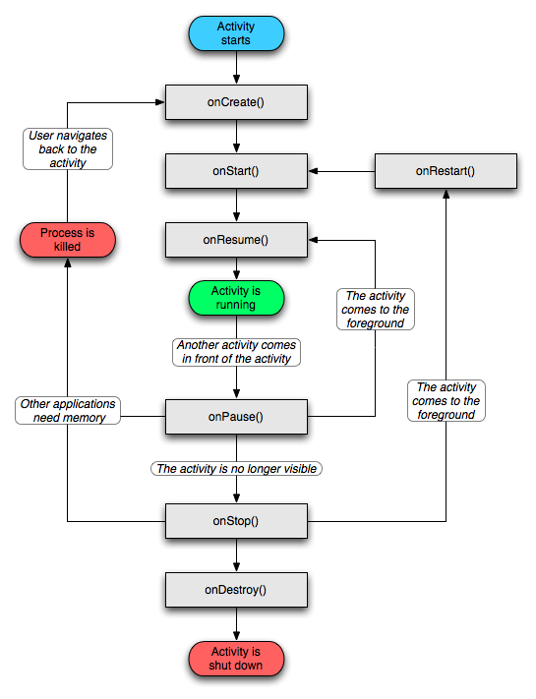
Activities (2)

Slide 13
USB Debugging
Should be enabled on phone to use developer features
In the main apps screen select Settings -> Applications -> Development -> USB debugging (it needs to be checked)

Slide 14
Android Debug Bridge
Used for a wide variety of developer tasks
  Read from the log file
  Show what android devices are available
  Install android applications (.apk files)
In the ‘platform-tools’ directory of the main android sdk directory
  Recommend putting this directory and the ‘tools’ directory on the system path
adb.exe

Slide 15
Debugging
Instead of using traditional System.out.println, use the Log class
  Imported with android.util.Log
  Multiple types of output (debug, warning, error, …)
  Log.d(<tag>,<string>)
Can be read using logcat.
  Print out the whole log, which auto-updates
    adb logcat
  Erase log
    adb logcat –c
  Filter output via tags
    adb logcat <tag>:<msg type> *:S
    can have multiple <tag>:<msg type> filters
    <msg type> corresponds to debug, warning, error, etc.
    If use Log.d(), then <msg type> = D
Reference
  http://developer.android.com/guide/developing/debugging/debugging-log.html

Slide 16
Acknowledgements
Larry Walters – google “android tutorial powerpoint” it’s the first result that comes up

