Slide 1

Hemang Murugan
Portfolio
Project 1: Web Development Course
Northeastern University

Slide 2
Objective
The goal of this project is to design and develop a personal homepage that serves as my digital portfolio and professional introduction. Built entirely with vanilla HTML5, CSS3, and ES6+ JavaScript, the site showcases my background, skills, and featured projects in a clean, responsive, and visually engaging way.

Slide 3

Design and Mockups
Landing page, with a picture of me in my background, I plan on making a parallax effect that responds to cursor movements.

Slide 4
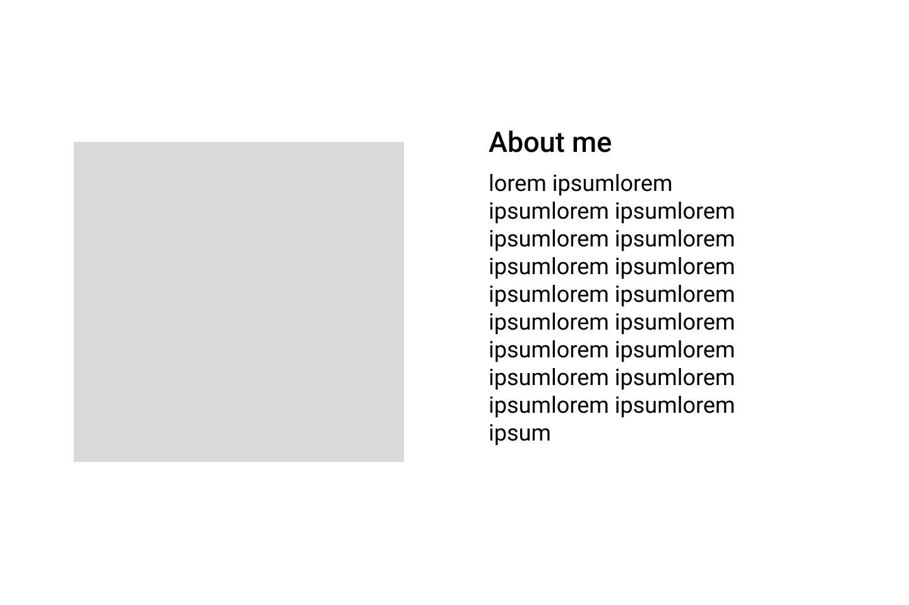
Design and Mockups
A simple about me section with something about me and my experience

Slide 5
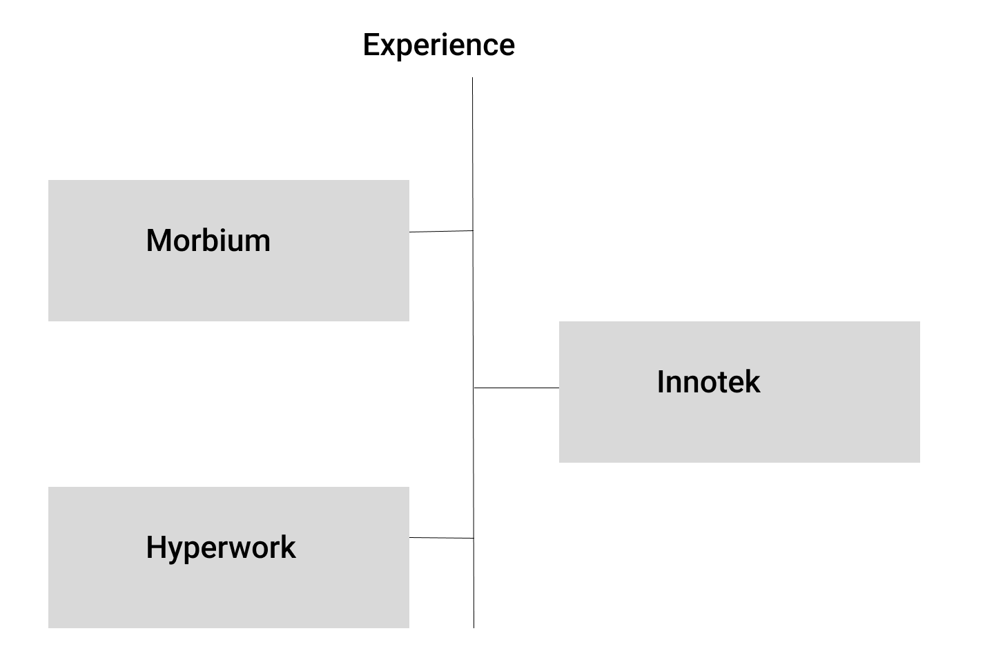
Design and Mockups
This is my experience section, I plan to use a timeline like structure to make it more visually appealing

Slide 6
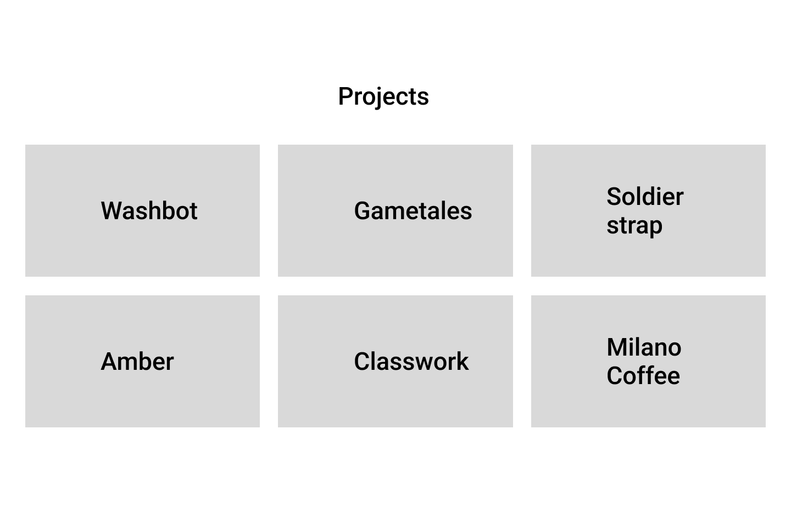
Design and Mockups
This is the projects section to showcase all my projects.

Slide 7
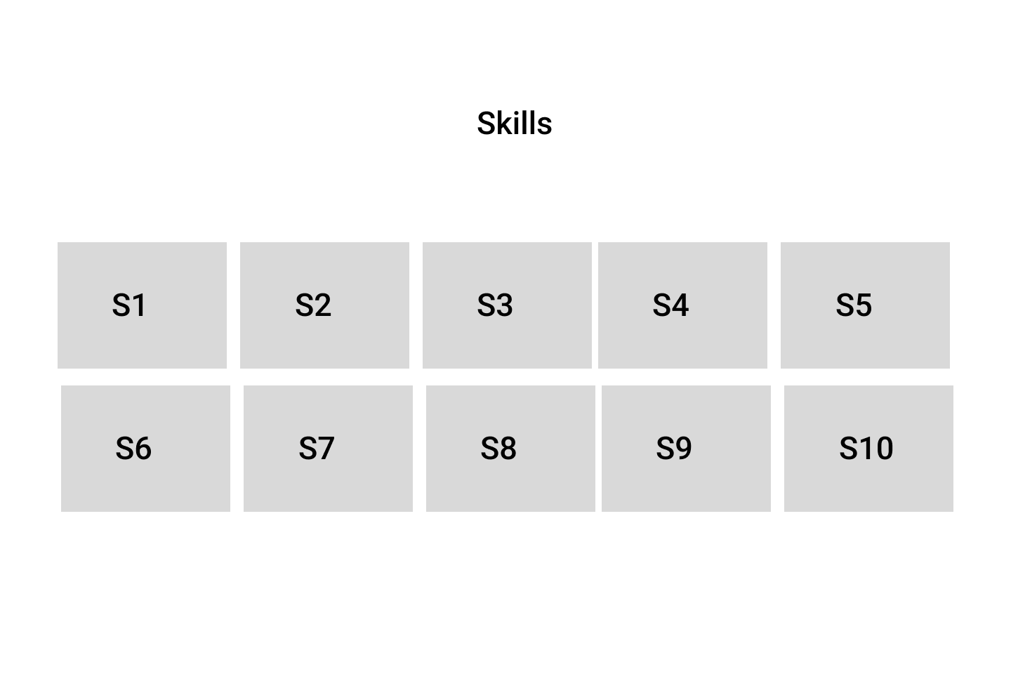
Design and Mockups
This is the skills section to showcase all my skills

Slide 8
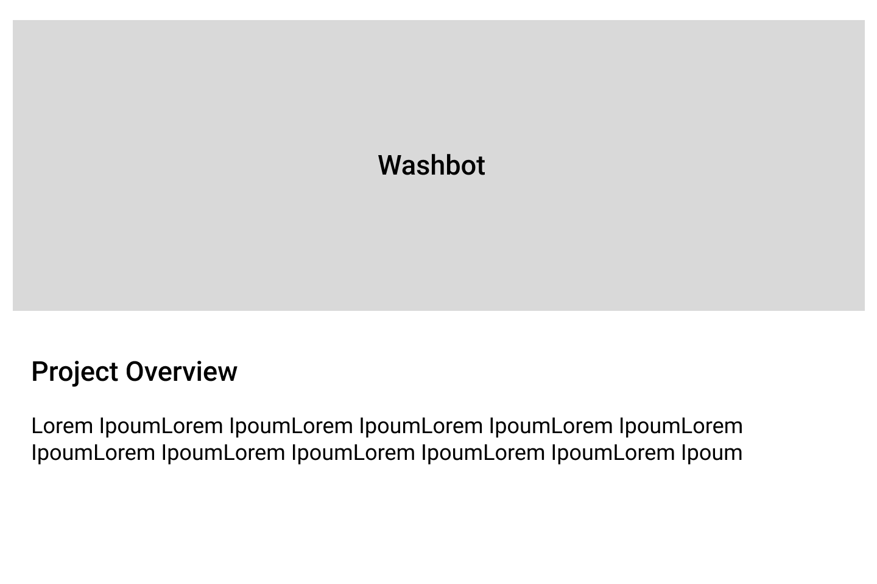
Design and Mockups
This page opens when a project is clicked

Slide 9
Technologies used
HTML5C
CSS3 (Flexbox & Grid)
JavaScript (ES6+ Modules)

Slide 10
What I'm proud of
I’m really proud of how my hero page turned out, it looks exactly like I envisioned. One of my favorite parts is the parallax, mouse-responsive effect that creates a sense of 3D depth and immersion on the screen. I’m also proud of building a fully responsive site and, for the first time, following W3C compliance standards, something I hadn’t done before. Overall, this project was both a creative and technical milestone for me, and I learned a lot along the way.

Slide 11
What I struggled the most with
The biggest challenge I faced was implementing the parallax effect. While I initially had clear ideas for a scroll-based implementation, switching to a mouse-hover interaction proved tricky. Getting the calculations right for the depth and movement took significant time and effort, but it was ultimately a valuable learning experience.

Slide 12
Demo
https://hemangmurugan.netlify.app

