Slide 1
Overviews
Digital signal path definition
In: System design requirement & description
Out: Signal path description document
Matlab Simulation
Out: Matlab module and test scripts
3. Configuration generation
Out: Profile Generator Rules
Out: SW profile struct definition, GUI
4. RTL prototype design
Out: RTL module and testbench
5. FPGA Verification
HW implementation & verification
需求和设计文档
Matlab仿真
自动化配置软件
RTL原型设计
FPGA功能验证

Slide 2
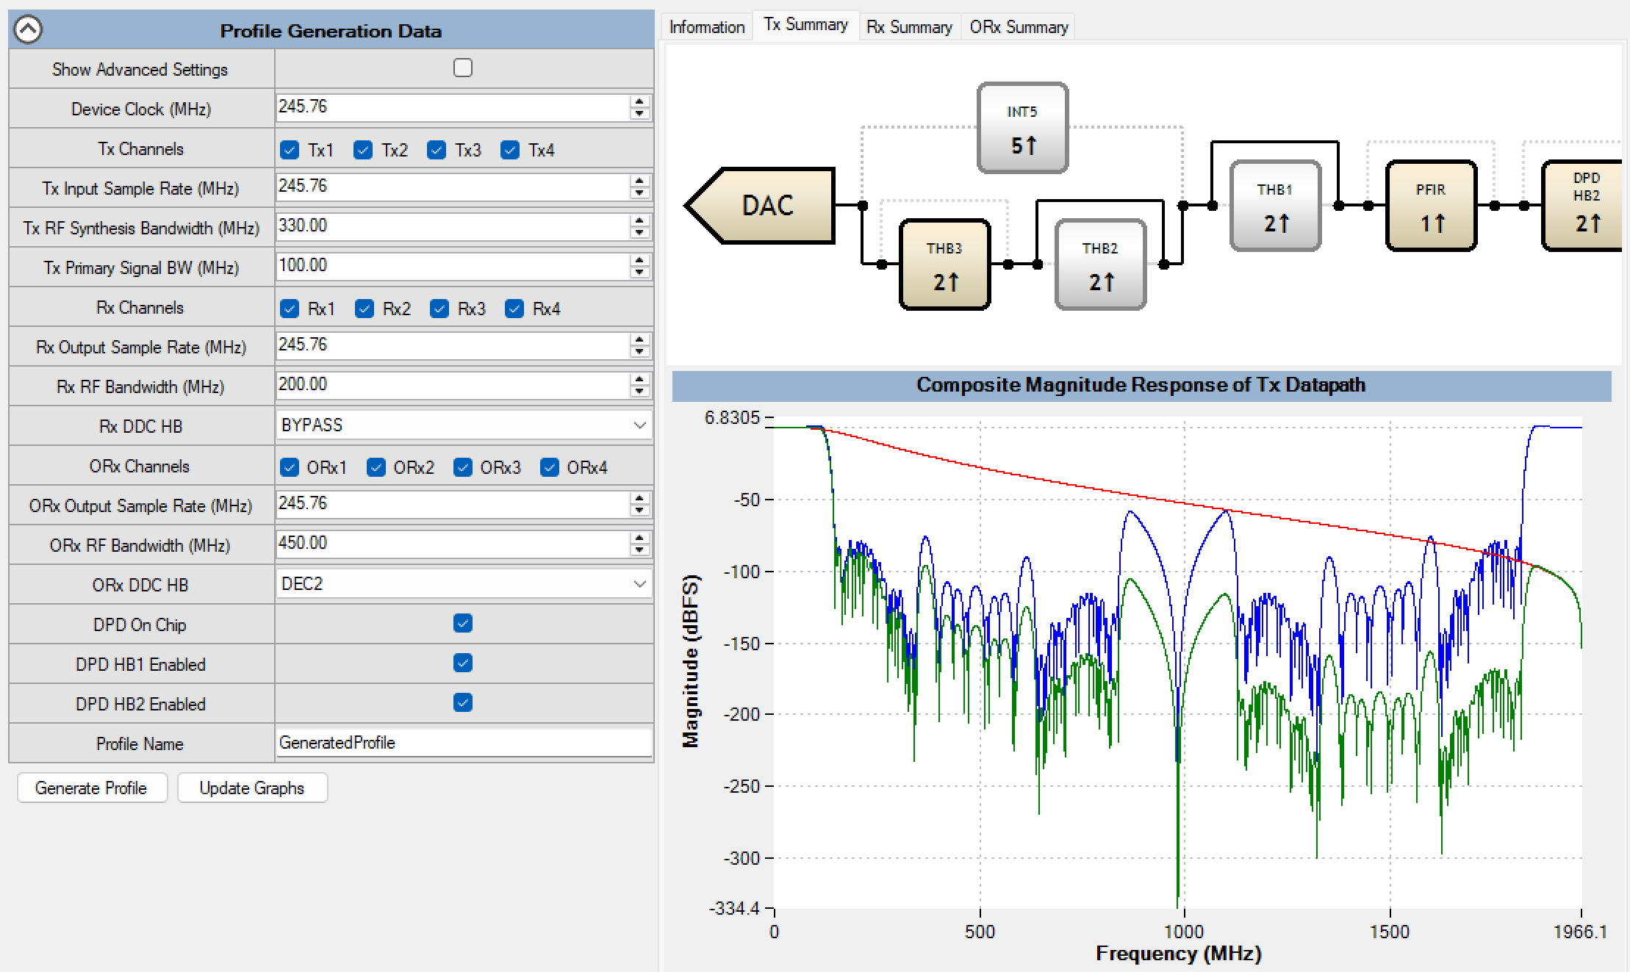
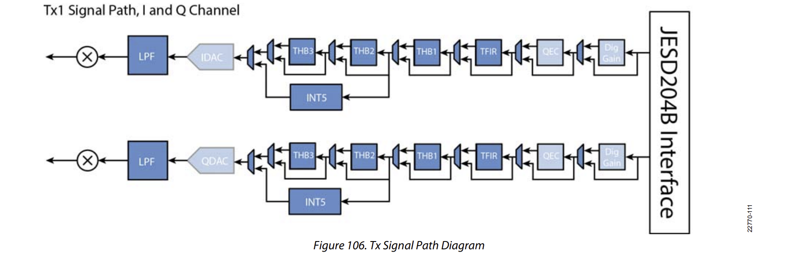
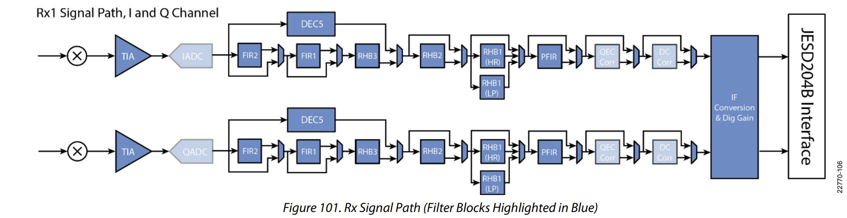
1. Signal Path Description
Tx
Rx
Components in signal path
Profile generator Rules
Path selection based on Rules and params
ORx

Slide 3
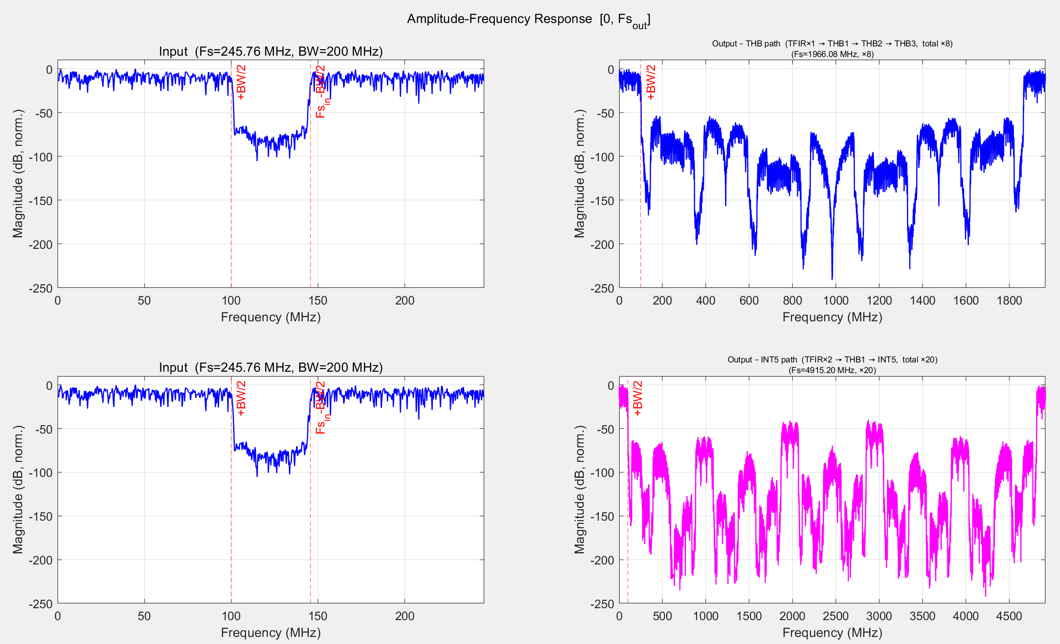
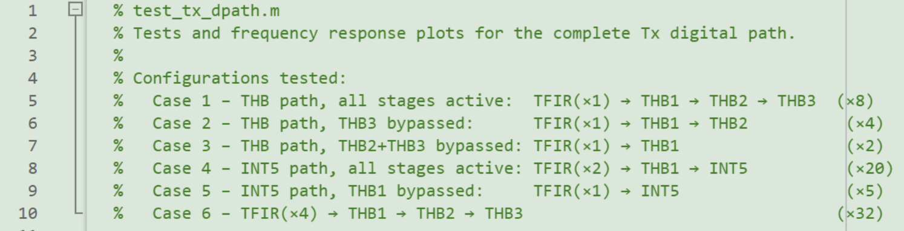
2. Matlab Simulation
Tx path
Top: tx_dpath.m
submodules: tfir_filter.m, thb1_filter.m,
thb2_filter.m, thb3_filter.m, int5_filter.m
Testbench: test_rx_dpath.m
Rx path
Top: rx_dpath.m
Submodules: rx_dec5_filter.m, rx_fir1.m, rx_fir2.m,
rx_rhb2_filter.m, rx_rhb3_filter.m, rx_hr_filter.m, rx_lp_filter.m
Testbench: test_rx_dpath.m
ORx Path (skip)

Slide 4
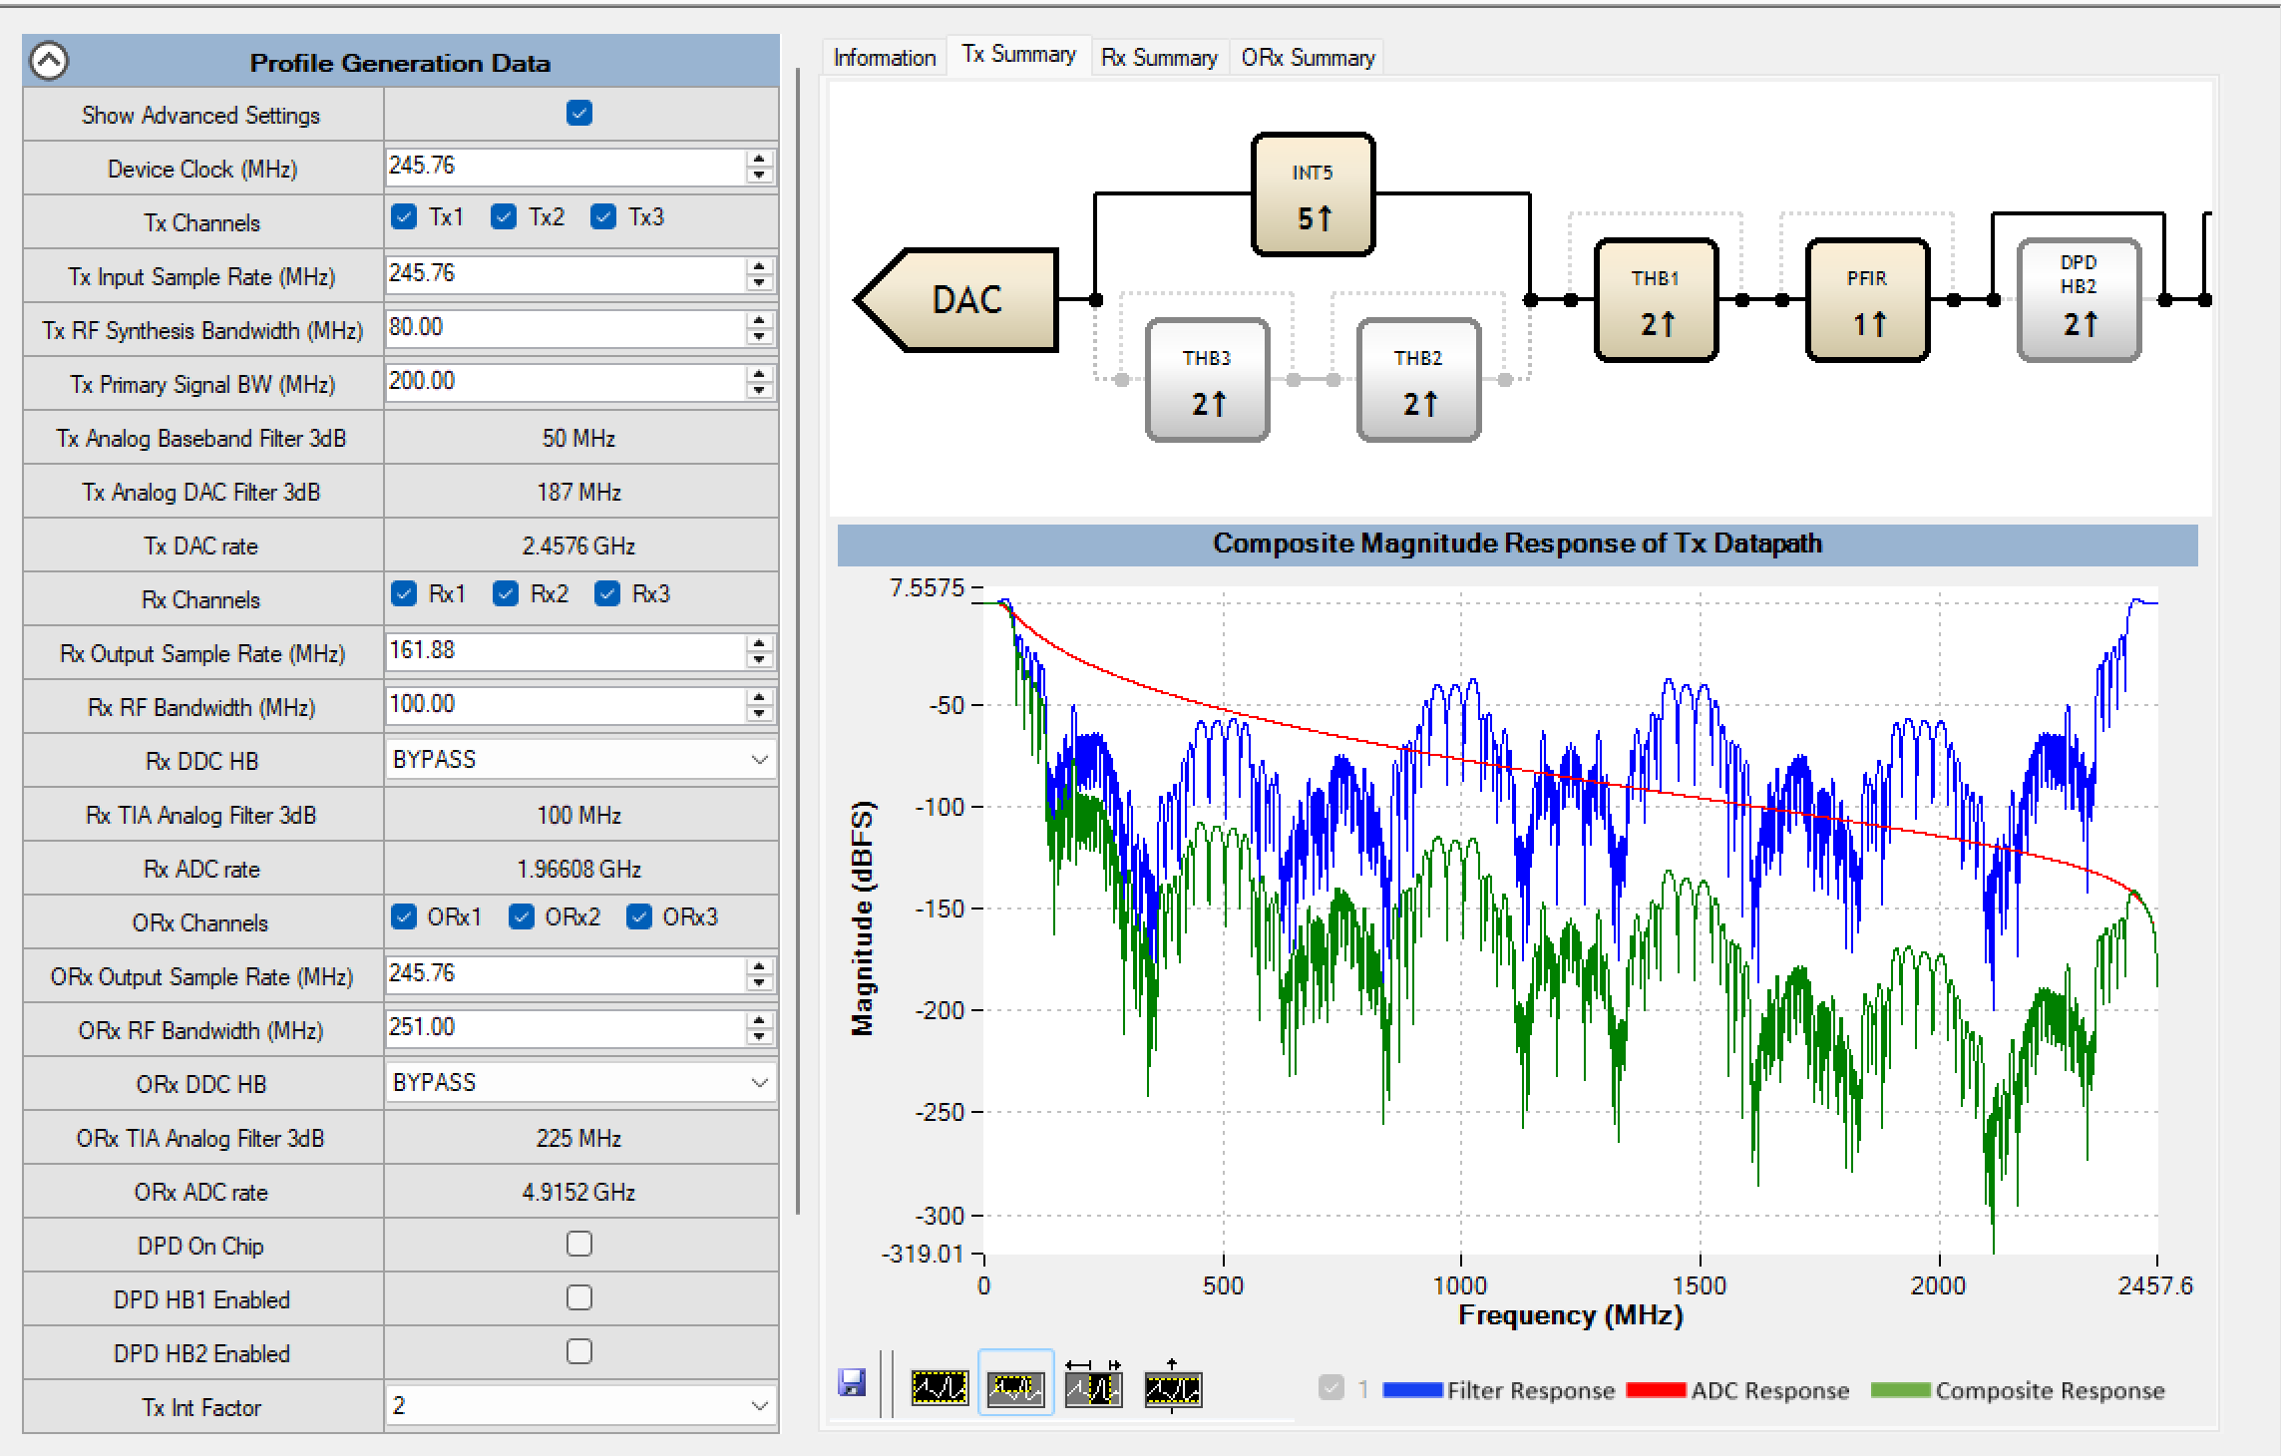
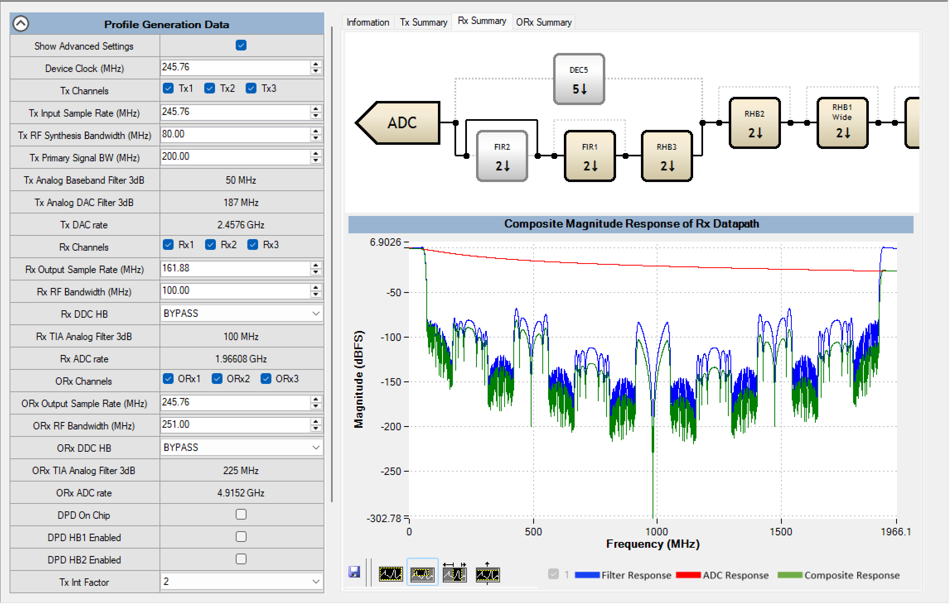
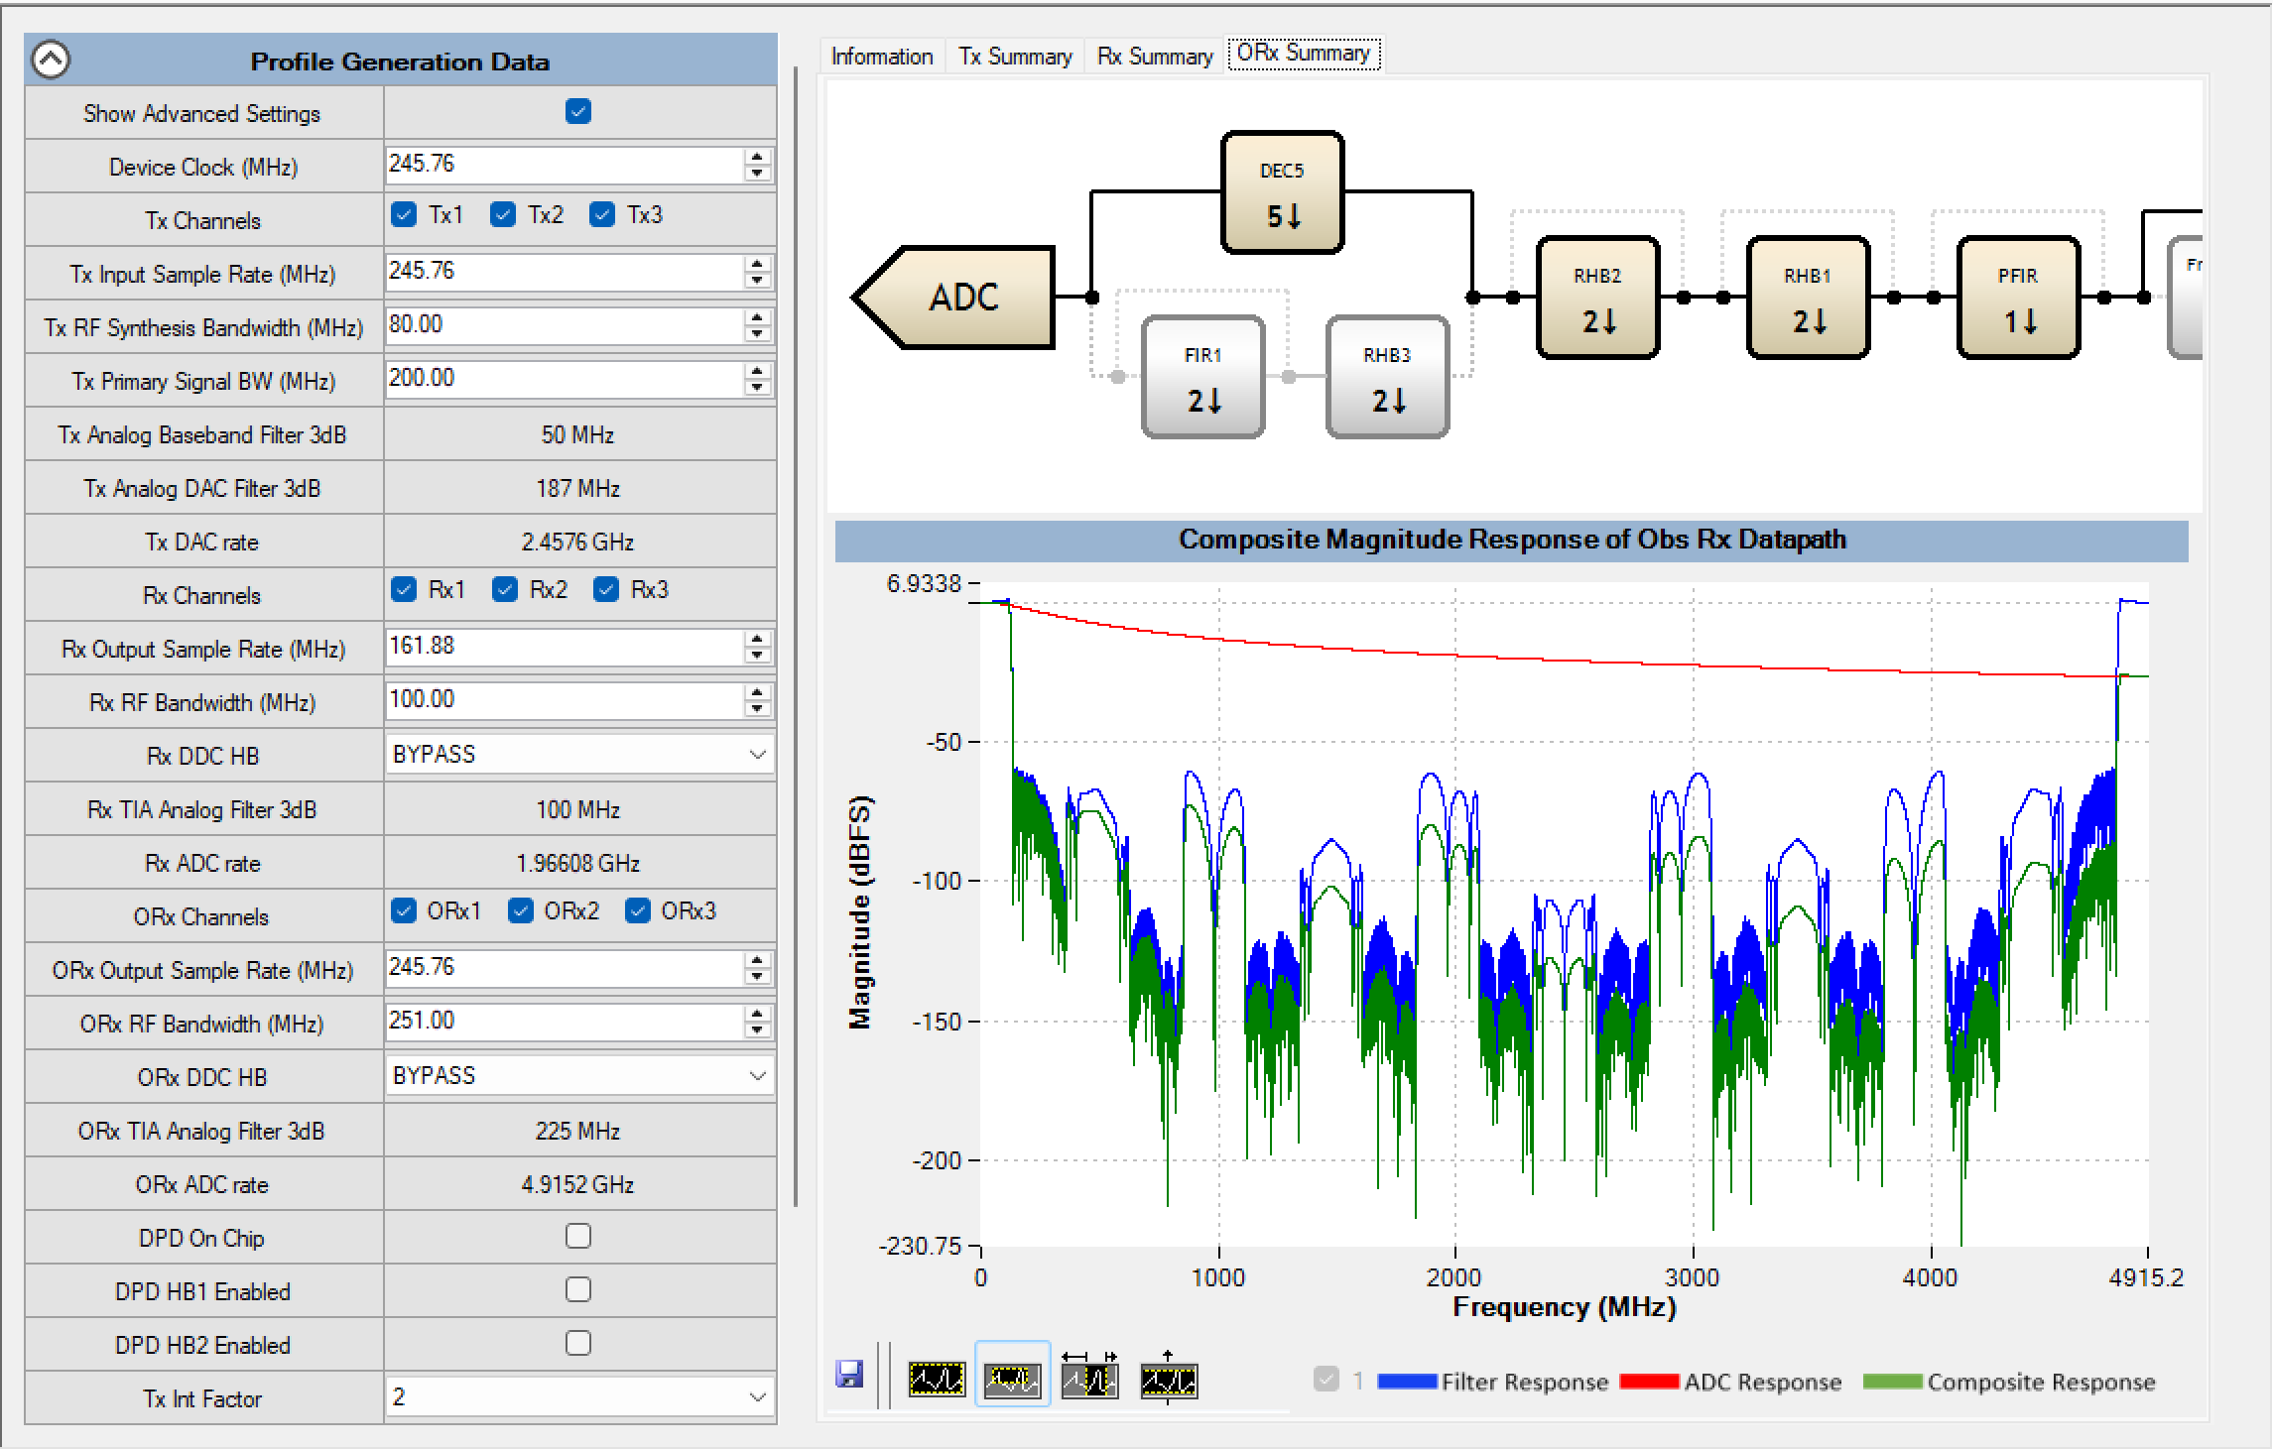
3. Configuration GUI

Slide 5
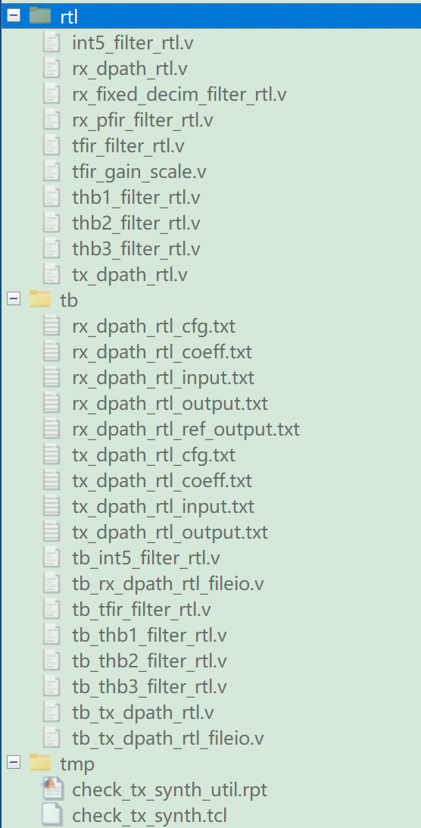
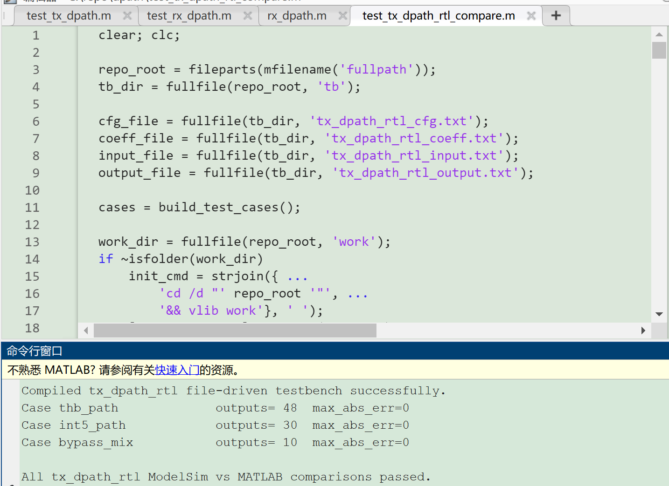
4. RTL prototype design
Design: rtl
Testbench: tb
Scripts
Run test_tx_path_rtl_compare.m to check RTL simulation result

Slide 6
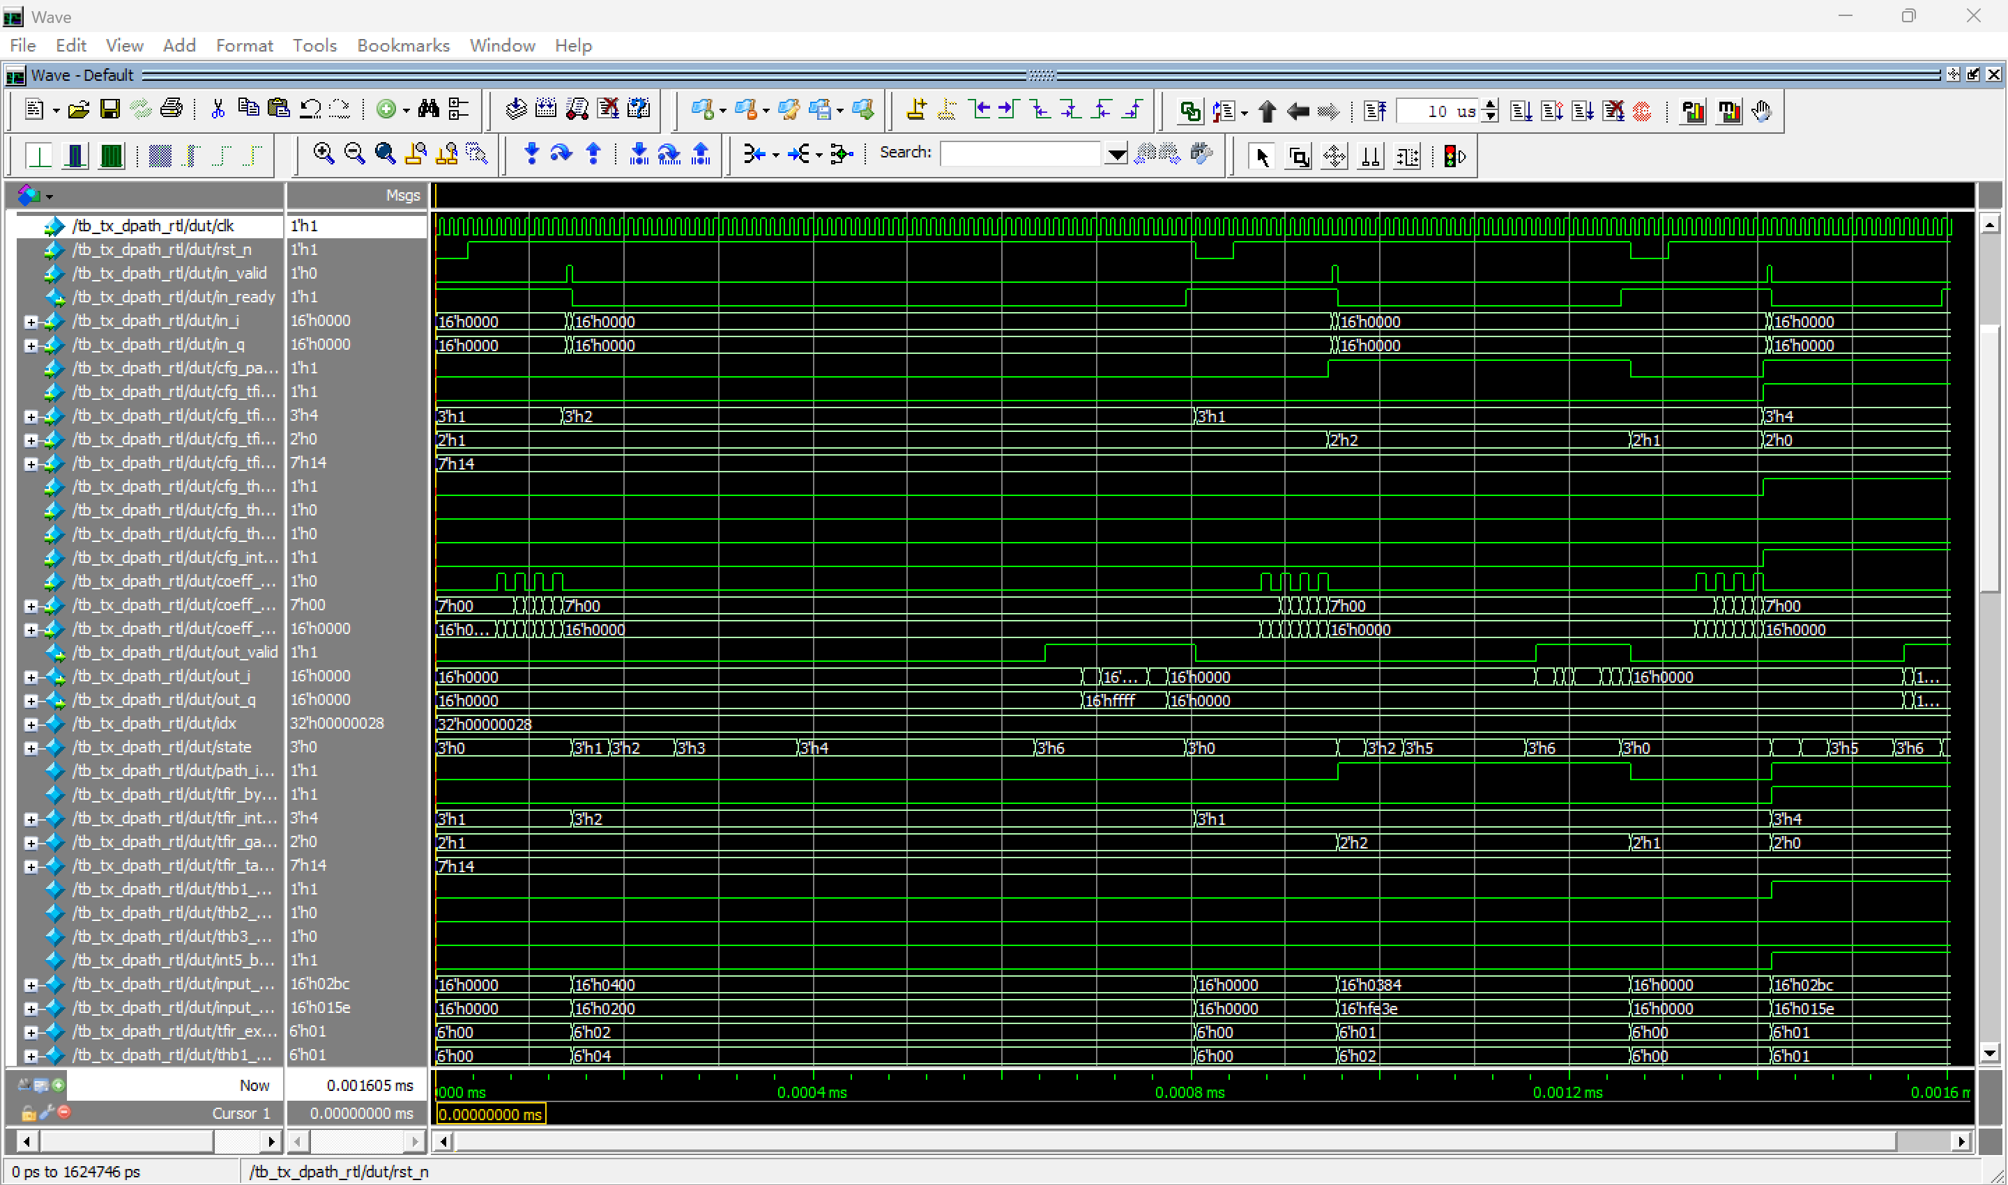
4. RTL prototype design
Simulation Waveforms

Slide 7
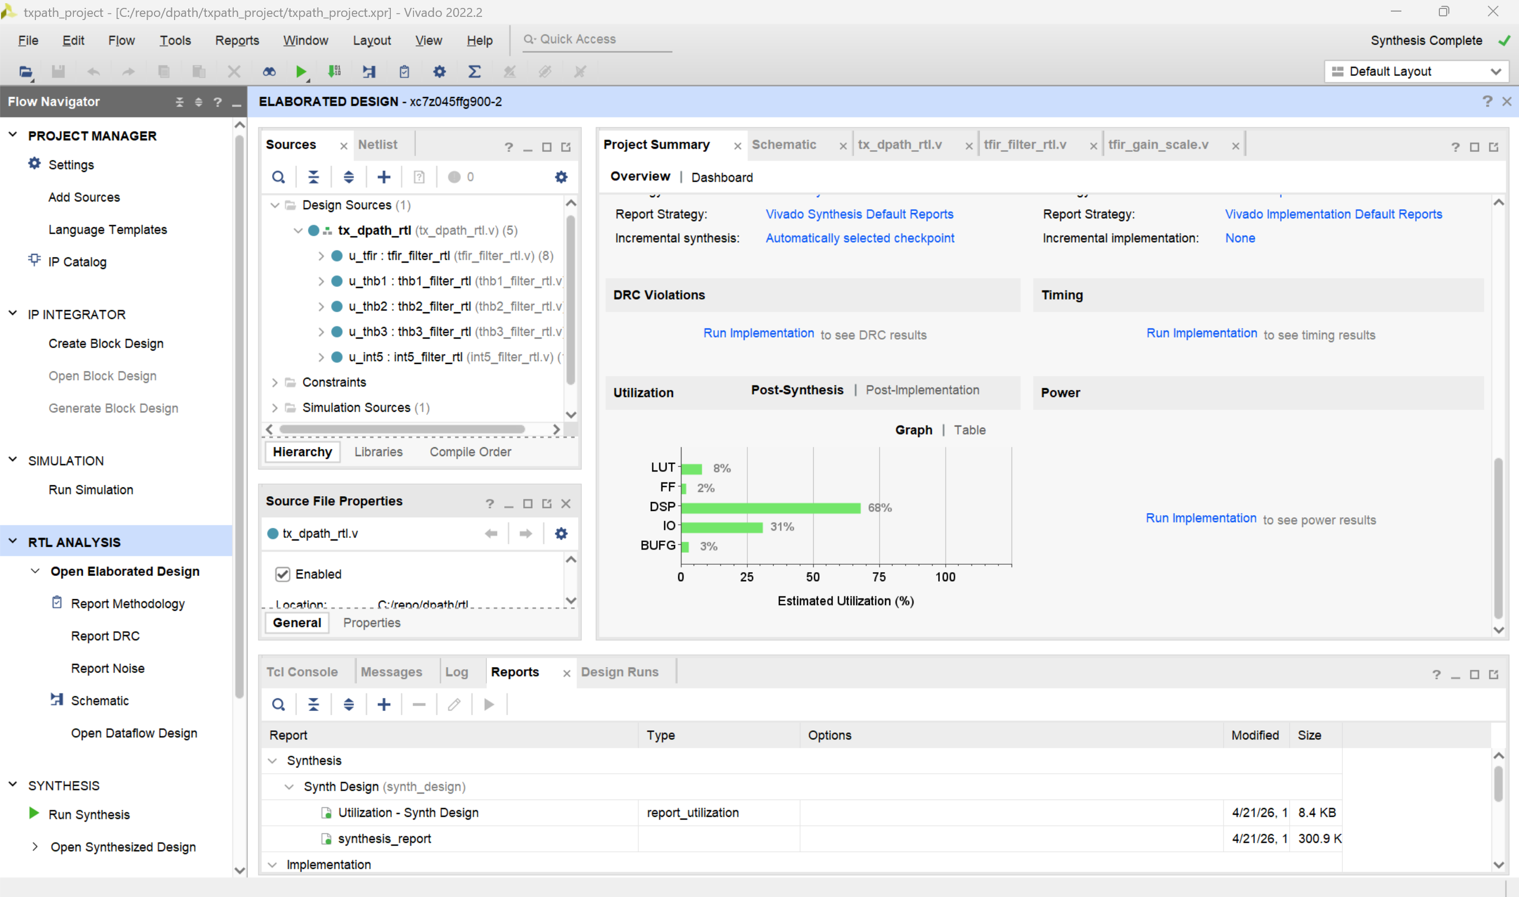
5. FPGA Verification
Synth pass, good for FPGA implementation

