Slide 1
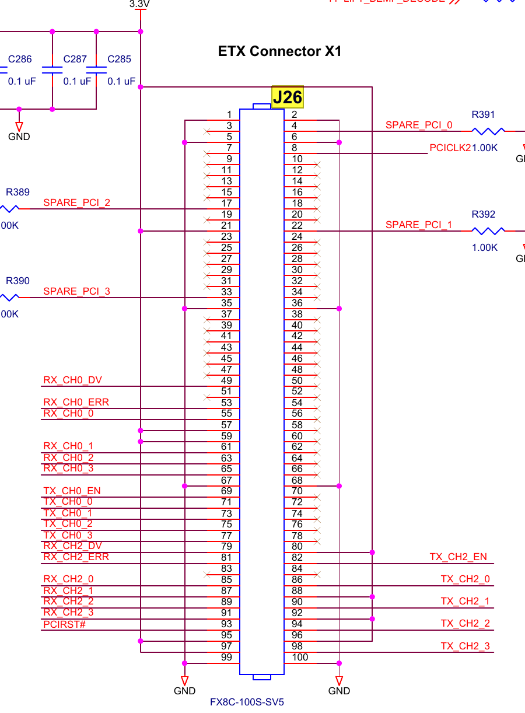
PC
RS232
DSP
PCI BUS
PCI_EMU_TARGET
FPGA
OPB BUS
SCRATCH_PAD
AD7663
AD8803
GANTRY_MOT
…
FGPA: 3APE3000-FGG484 → MPF100T-FCG484E

Slide 2
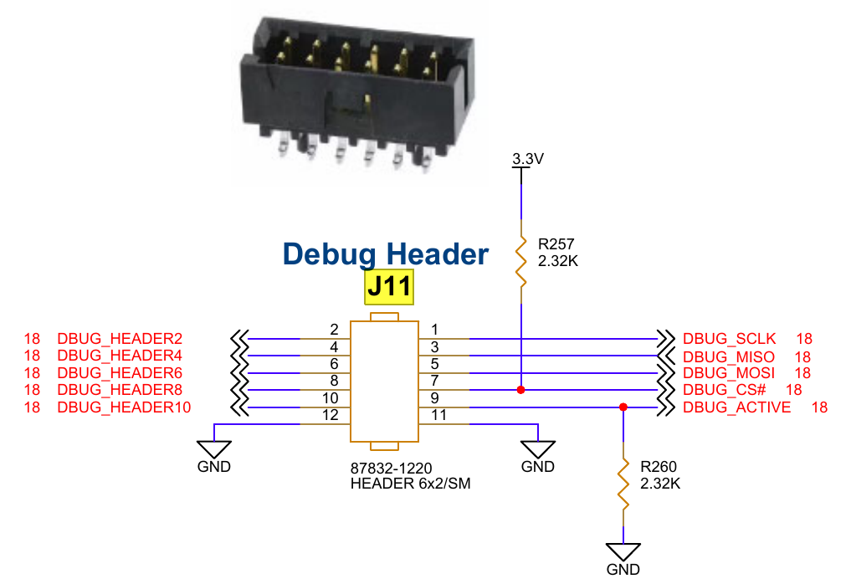
Risk: DSP ADC/DAC is used for measurement.
PC
RS232
USB串口转接线
UART
UART_INTERFACE
FPGA
PARSE_COMMAND
PCI_EMU_TARGET
OPB BUS
SCRATCH_PAD
AD7663
AD8803
GANTRY_MOT
…
FGPA: 3APE3000-FGG484 → MPF100T-FCG484E

