Slide 1
STN PCBA Test System Setup
Workstation
(JabilTest)
Eth…
Flashpro4
Programmer
USB2TTL
Adapter
Custom EXT Board
Instruments
Signal Source, DMD, OSC, etc.
Jtag
Debug
Jtag
Debug
STN PCBA
J35
J36
J41
J40

Slide 2
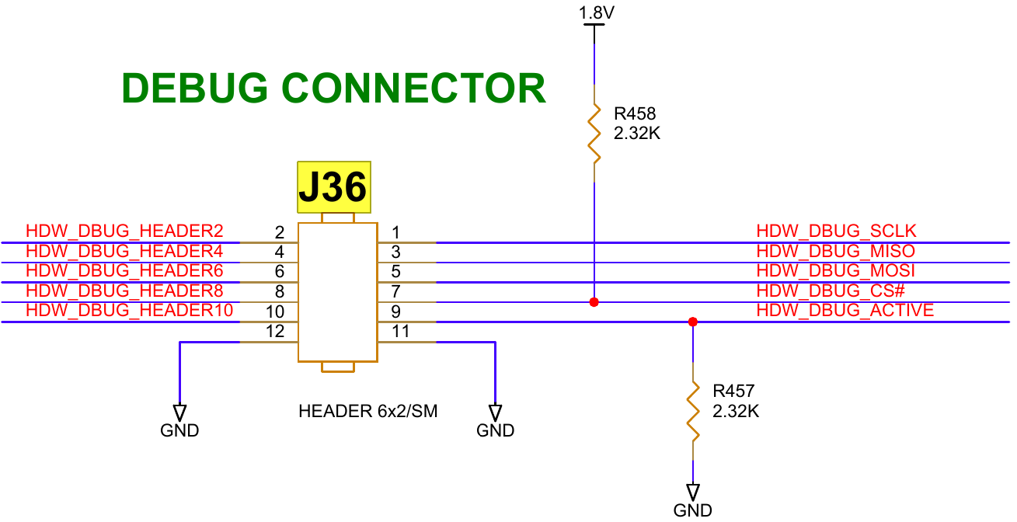
HW FPGA Design Diagram
PC
USB Cable
USB-Adapter
UART
CMD_SERVER
HW-FPGA
UART_INTERFACE
MSG_GET/SET
OPB_EMU_TARGET
ADDER_DECODE
OPB BUS
SCRATCH_PAD
CLOCK GEN
GPIO_IF
FPGA_IF
EEP_IF
PHY TEST
…

Slide 3
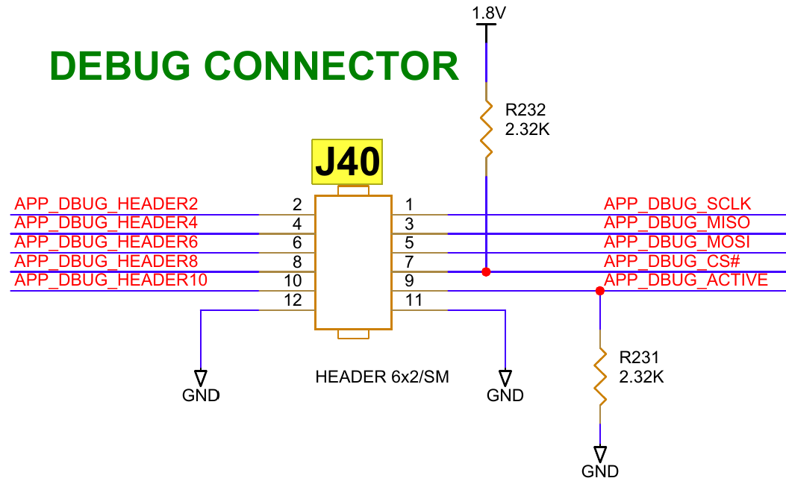
APP FPGA Design Diagram
PC
USB Cable
USB-Adapter
UART
CMD_SERVER
APP-FPGA
UART_INTERFACE
MSG_GET/SET
OPB_EMU_TARGET
ADDER_DECODE
OPB BUS
SCRATCH_PAD
CLOCK GEN
GPIO_IF
ADC_IF
DAC_IF
RS422 TEST
CAN_IF

Slide 4
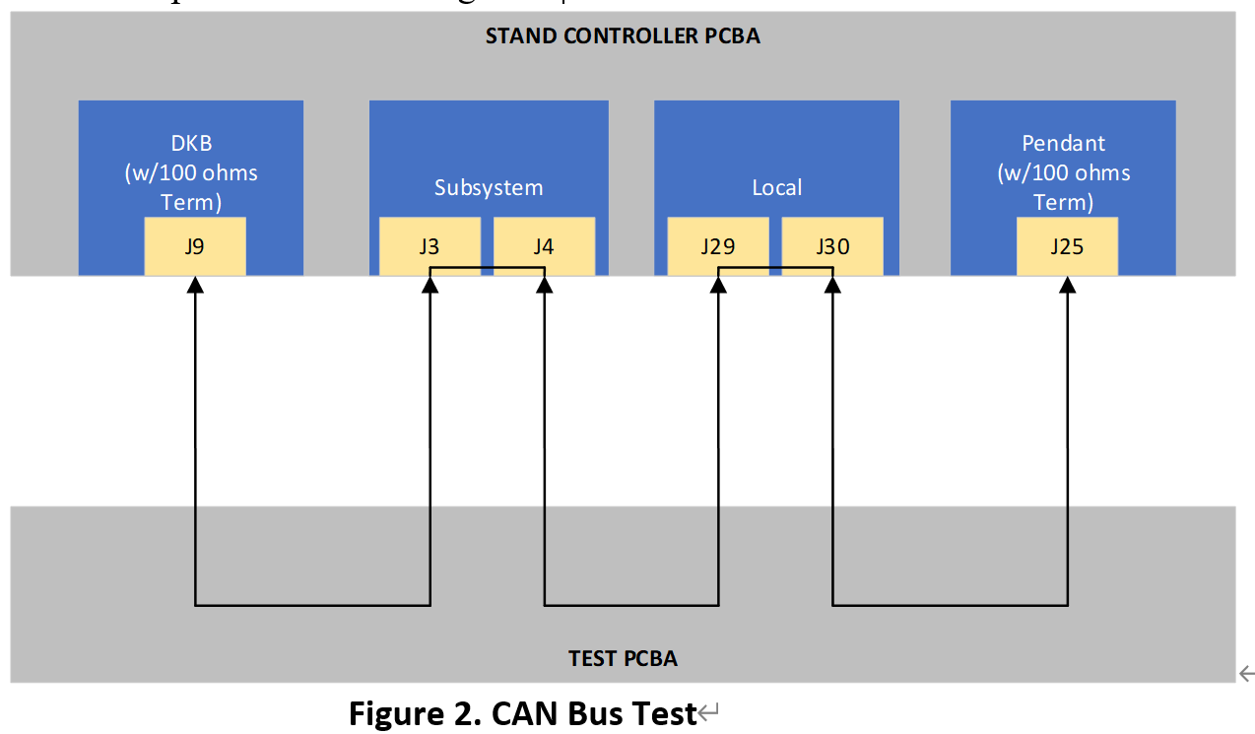
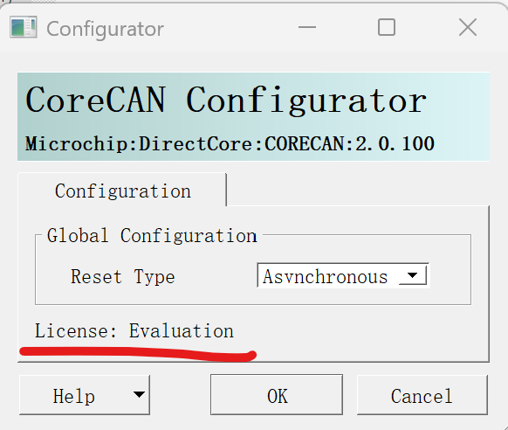
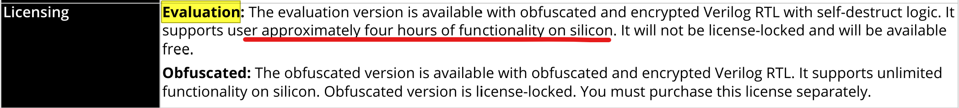
CAN_IF Module
IP: coreCAN
Evaluation License
Silver Libero
4 hours limitation
CMD_SERVER
USB
Adapter
coreCAN
coreCAN
coreCAN
coreCAN
JabilTest SW
canInst1
canInst2
canInst3
canInst4

Slide 5
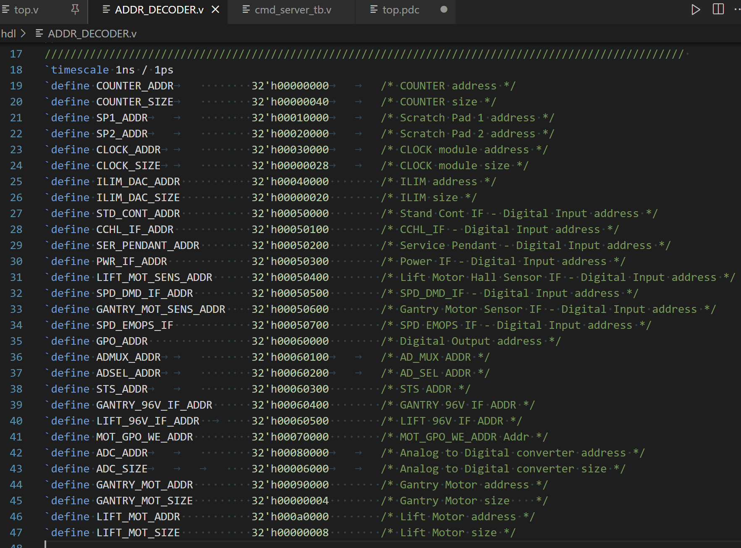
FPGA Design
FPGA Register Map
Write Register
- OPB Write
Read Register
- OPB Read
Communication Protocol
OPB Write
Send OPB-Write Message
Receive OPB-Write Message
OPB Read
Send OPB-Read Message
Receive OPB-Read Message
Bytes | 1 | 2 | 3 | 4 | 5 | 6 | 7 | 8 | 9 | 10
OPB-Write | 5A | OPB_ADDR[31:0] |  |  |  | OPB_DO[31:0] |  |  |  | A5
OPB-Read | 5B | OPB_ADDR[31:0] |  |  |  | OPB_DI[31:0] |  |  |  | A4

Slide 6
读PREADY和INT_N状态
读RX_BUF Status
4-Iters:
CAN[1…4]
PREADY==1 &&
INT_N ==1
Status != 0
测试失败
测试失败
Y
Y
读RX_MSG_ID
读RX_MSG_WORD1
读RX_MSG_WORD0
并和TX_MSG比较
4-Iters
CORECAN寄存器初始化配置
包括：INT ENA, CMD, CONFIG, TX_MSG ID, TX_MSG WORD, AMR, ACR…
4-Iters
4-Iters
RX_MSG==TX_MSG
写TX_MSG_CTRL发送消息
测试失败
Y
测试通过

Slide 7
CAN TX
CAN RX
TX1
RX1
TX2
RX2
TX3
RX3
TX4
RX4

