Slide 1
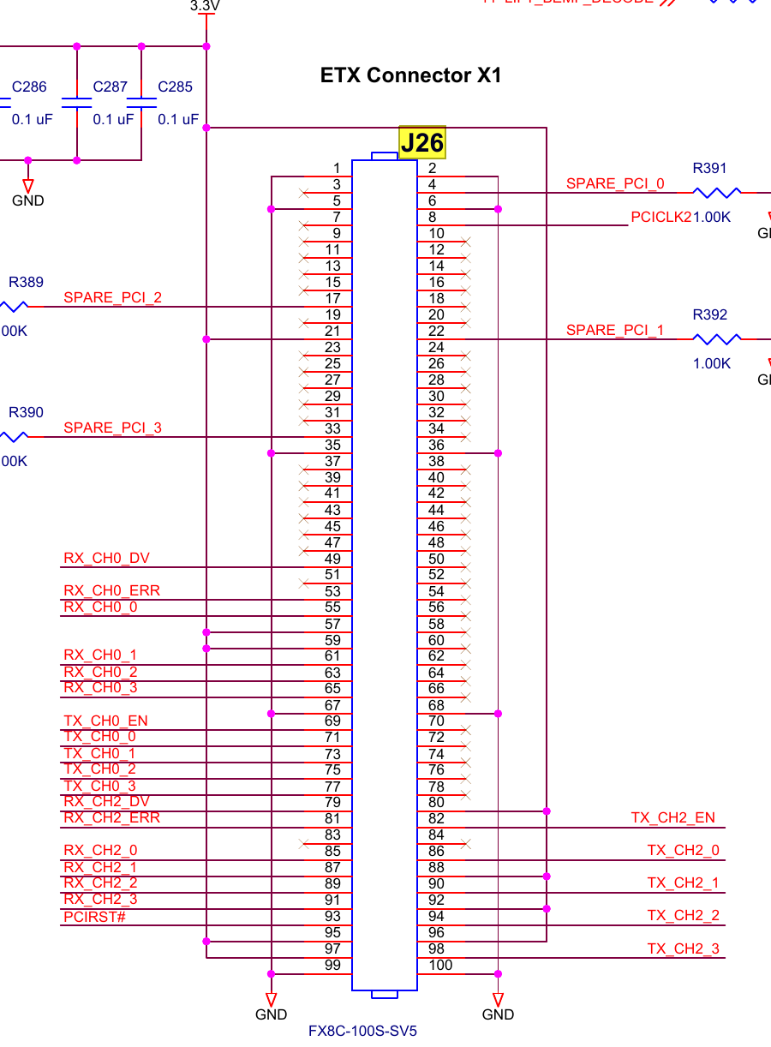
PC
RS232
DSP
PCI BUS
PCI_EMU_TARGET
FPGA
OPB BUS
SCRATCH_PAD
AD7663
AD8803
GANTRY_MOT
…
FGPA: 3APE3000-FGG484 → MPF100T-FCG484E

Slide 2
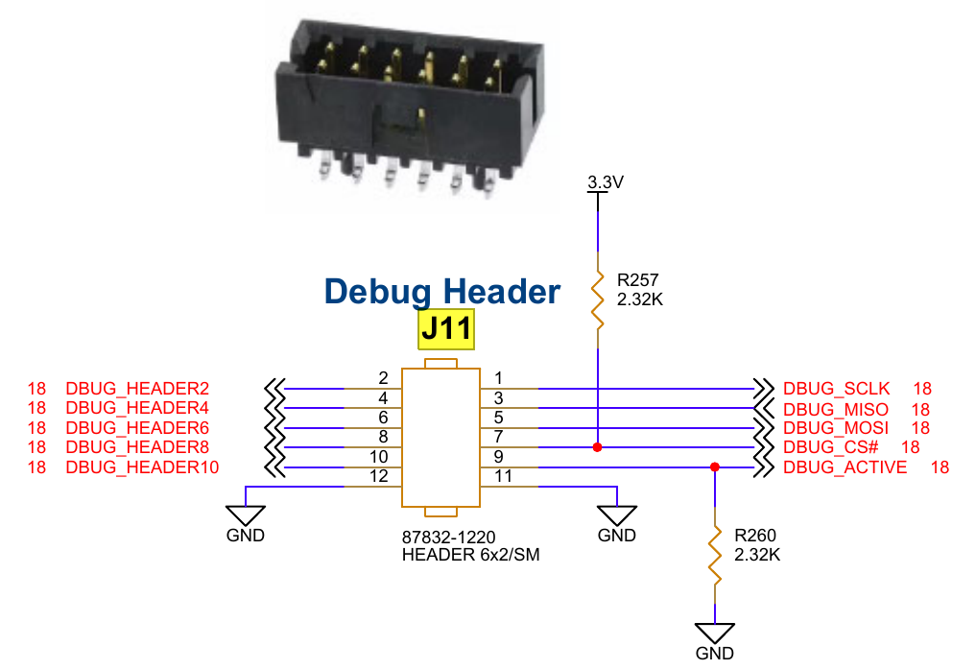
Risk: DSP ADC/DAC is used for measurement.
PC
RS232
USB串口转接线
UART
UART_INTERFACE
FPGA
PARSE_COMMAND
PCI_EMU_TARGET
OPB BUS
SCRATCH_PAD
AD7663
AD8803
GANTRY_MOT
…
FGPA: 3APE3000-FGG484 → MPF100T-FCG484E

Slide 3
Note:
J18, 24V_IN and GND
J11-10, DEBUG_HEADER10, 16KHz Ref Clock
J11-2, J11-3, RXD and TXD
PC
RS232
USB串口转接线
UART
CMD_SERVER
UART_INTERFACE
FPGA
MSG_GET/SET
OPB_EMU_TARGET
ADDER_DECODE
OPB BUS
SCRATCH_PAD
ADS8864
DACx0504
GANTRY_MOT
…
FGPA: 3APE3000-FGG484 → MPF100T-FCG484E

Slide 4
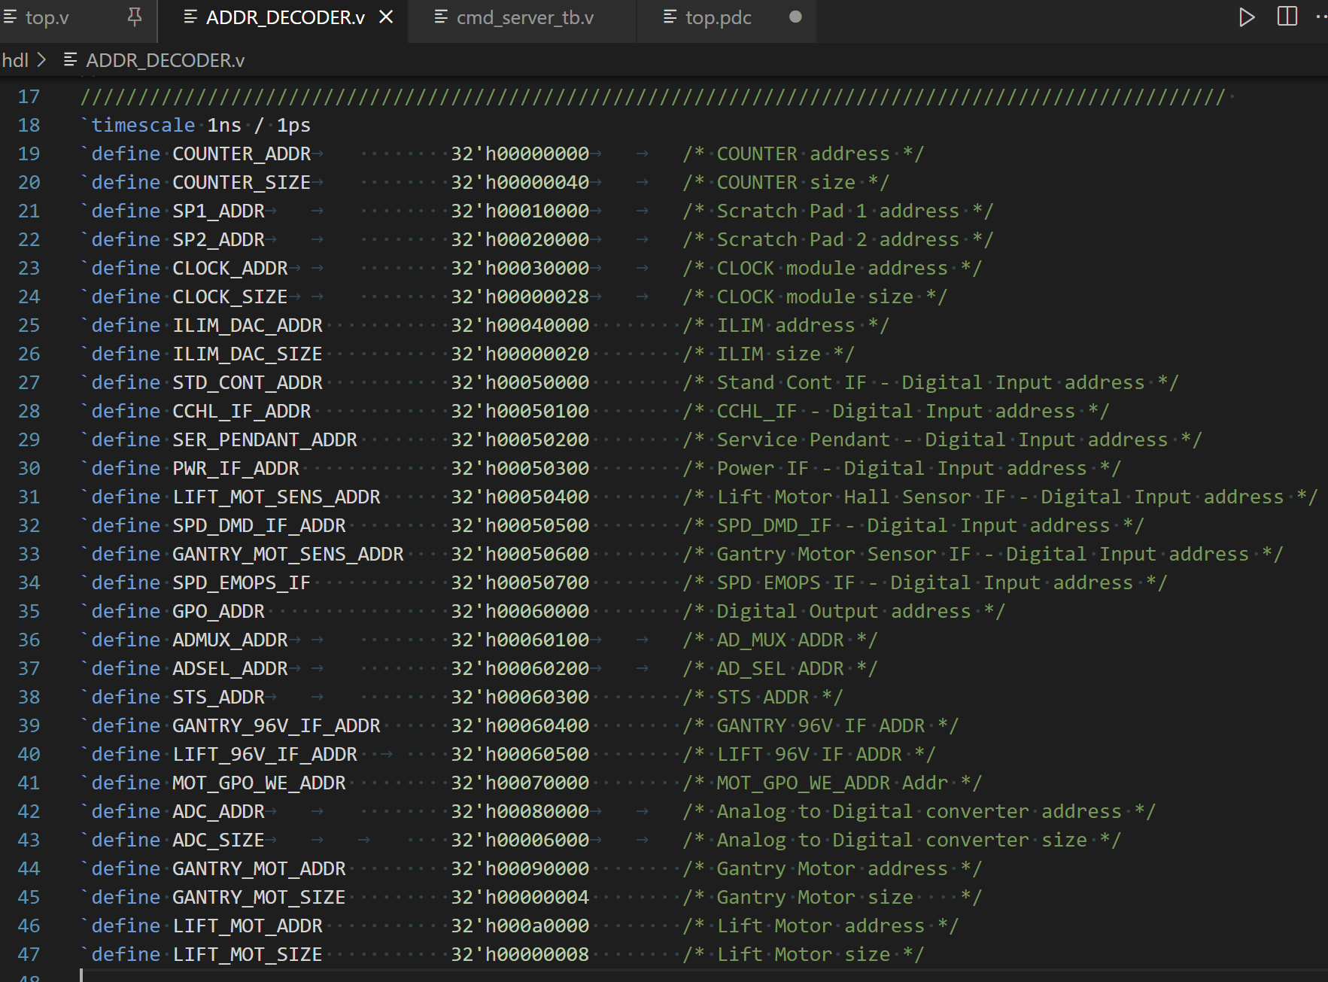
FPGA Design
FPGA Register Map
Write Register
- OPB Write
Read Register
- OPB Read
Communication Protocol
OPB Write
Send OPB-Write Message
Receive OPB-Write Message
OPB Read
Send OPB-Read Message
Receive OPB-Read Message
Bytes | 1 | 2 | 3 | 4 | 5 | 6 | 7 | 8 | 9 | 10
OPB-Write | 5A | OPB_ADDR[31:0] |  |  |  | OPB_DO[31:0] |  |  |  | A5
OPB-Read | 5B | OPB_ADDR[31:0] |  |  |  | OPB_DI[31:0] |  |  |  | A4

Slide 5
