Slide 1
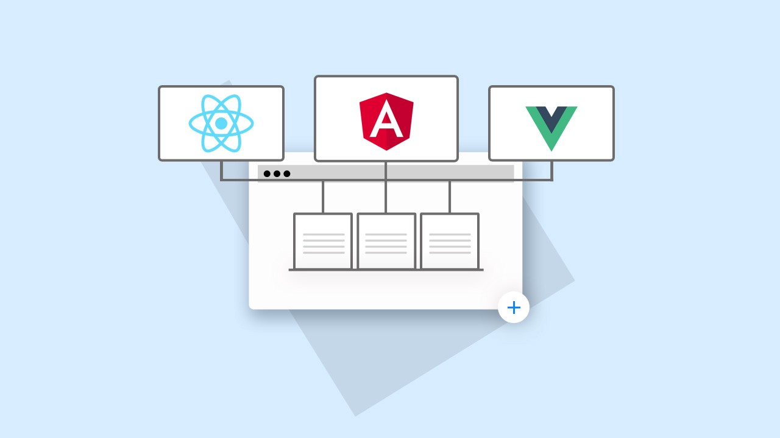
Micro Frontends
Micro-frontend architecture is a design approach in which a frontend app is decomposed into individual, semi-independent “micro-apps” working loosely together.
Micro applications are a game-changer for app development teams.
Multiple teams can work independently to contribute to multiple systems.
This allows us to divide the work and scale it through multiple teams.
This allow each team to build components with a single responsibility.

Slide 2

Single-spa
single-spa is a framework for bringing together multiple JavaScript micro frontends in a frontend application.
It allows the creation of multiple applications that can run on the same page, with each application being a single page application in itself.
Single SPA allows developers to compose application from multiple smaller and independent application known as “micro frontends” .
Each micro frontend can be build in different JavaScript framework.
This allows the developers to easily update the individual micro frontends without affecting the rest of the application.

Slide 3
How Single-spa Works
Single-spa uses HTML ‘div’ elements as the container for each micro front-end.
All these micro front-end gets rendered on single page but inside its corresponding ‘div’ independent to each other, while still being able to interact with each other.
It uses ‘id’ or ‘data-app’ attribute of the div to locate and load the micro front-end JavaScript and render it inside the div.
The Single-spa lifecycle consists of a series of events that occur when a micro front-end is loaded and rendered on a page.
These events include Bootstrapping, Mounting, Unmounting, Unloading, Updating, Destroying.

Slide 4
Advantages of Single spa
Improved Scalability : single-spa allows micro front-ends to be built and deploy independently, this makes it easy to scale and maintain a large application.
Better Performance : micro front-ends are loaded only when they are needed, this affects the overall performance of the application in positive manner.
Better Collaboration : Single-spa allows multiple teams to work on different micro front-ends concurrently, this improves collaboration and allows for faster development.
Better Security : Single-spa allows the micro front-ends to be deployed on different domains, which provides an additional layer of security.
Easier Maintainance : The developer can easily update an individual micro front-end without affecting the rest of the application.

Slide 5
Getting Started
npm i –g create-single-spa type this command to globally install single-spa cli.
create-single-spa this command will generate a standard template that is provided by single-spa. Select the ‘root config’ type to generate our root config .
To create micro frontends again type the command create-single-spa and create a react app or any other app by your choice.
Assuming we have created react app, now we need to build that app, npm run build:webpack command will build the app and will create a js file dist folder.
Now host the react app individually, run http-server . --cors command.
Now paste the path of react app in the import map of index.ejs file.
To render this react app on browser, go to microfrontend-layout.html file and change the applications name to react application.
Now run the root config app with npm start command.

Slide 6
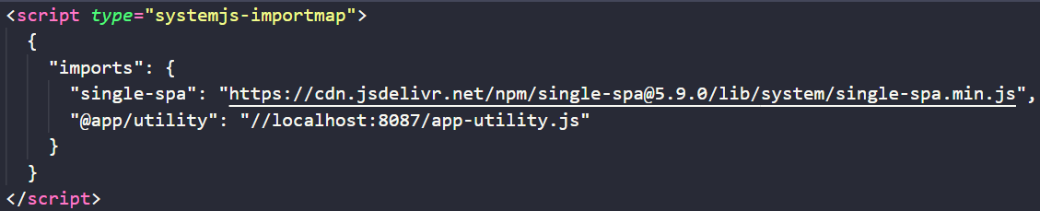
Important Concepts
import map :
import map is a JavaScript object that maps the names of modules such as “react” or “lodash” to their locations on the web.
It allows the single-spa framework to know where to find the modules that are needed by the different micro frontends.
By specifying the location of the modules in an import map, single-spa can dynamically load the modules as needed, rather than requiring them to be loaded upfront. This helps in improving the performance of the overall application.
In case we need to add multiple micro frontends, we can add that within this import map configuration and just give the path of executable file from which it needs to be loaded.

Slide 7
Communication in micro front-ends
In single-spa, communication between micro frontends can be achieved through a few different methods, such as : Utility module, rxjs, custom browser events, cookies/local and session storage.
Utility module : Steps to use utility module for data transfer and communication :
Run create-single-spa command and select “Browser utility module”.
Now in the app-utility.js file write the functions that you want to export and that will be shared to all the micro front-ends.
We can access data through API which is shared across multiple micro front-ends.
Certain changes to be made before accessing the data are : go to webpack.config.js file of micro front-ends and add external keyword eg:(externals : [“@app/utility”];).
Then build our utility module.
Then in index.ejs file add its path to shared import map and its ready.

Slide 8
Future outlook
The future outlook for micro front-ends and single-spa framework is promising as more and more companies are adopting these technologies to improve their web development process.
There will be an increase in the use of single-spa frameworks like React, Angular and Vue to build micro front-ends, as they allow for building performant and scalable applications.
Micro front-ends will continue to gain popularity as they allow organizations to break down monolithic front-end architecture into smaller, more manageable parts. This allows for better scalability, maintainability and faster development cycles.
In summary the future looks bright for micro front-ends and single-spa as they provide a way to build more scalable and maintainable app.

Slide 9
Thankyou

