Slide 1
Infant Face Detection and Censor Using NCC and Covariance Tracking
Team Members: Chowduri Suhrit and Utkarsh Pratap Singh Jadon
Description:
Due to privacy reasons, infant’s faces are blurred out in images posted on social media by people and celebrities.
We aim to automate this task using two computer vision algorithms: NCC and Covariance Tracking. We have also incorporated image pyramids in the algorithms to handle different image sizes to improve the performance.

Slide 2
Framework
Data: The input images used have been downloaded from the following royalty free image collection websites – Pexels, Pinterest and Adobe Stock Images
Algorithms/methods explored:
Normalized Cross Correlation(NCC): NCC technique was used to perform Template Matching by using a common template of an infant along with multiple search images
Covariance Tracking: Covariance Tracking was performed by matching the feature vectors of the template image with those of the different patches in search image to find the best possible match
Image Pyramids: We performed downscaling of the images so that search images of different sizes can be handled
Gaussian Blur: Censoring of the faces of the matched infant was performed using Gaussian Blur technique
Contribution per team member:
Suhrit – Worked on Normalized Cross Correlation. Using one template containing generic image of an infant, will perform NCC on given dataset, perform gaussian blurring in the region around best match in each image, generate output images, and calculate censor accuracy using Intersection over Union (IOU)
Utkarsh – Worked on Covariance Tracking. Using covariance matrix of one template containing generic image of an infant, will perform Covariance Tracking on given dataset, perform gaussian blurring in the segmented section in each image, generate output images, and calculate censor accuracy using Intersection over Union (IOU)

Slide 3


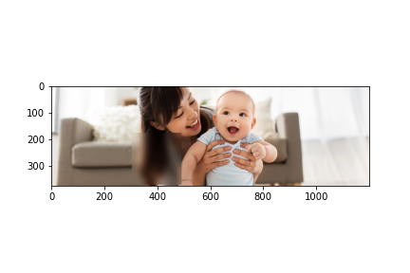
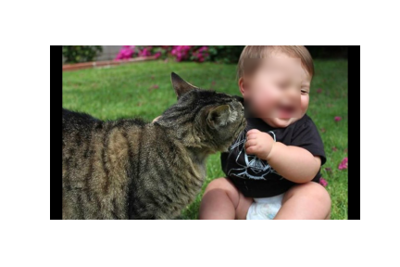
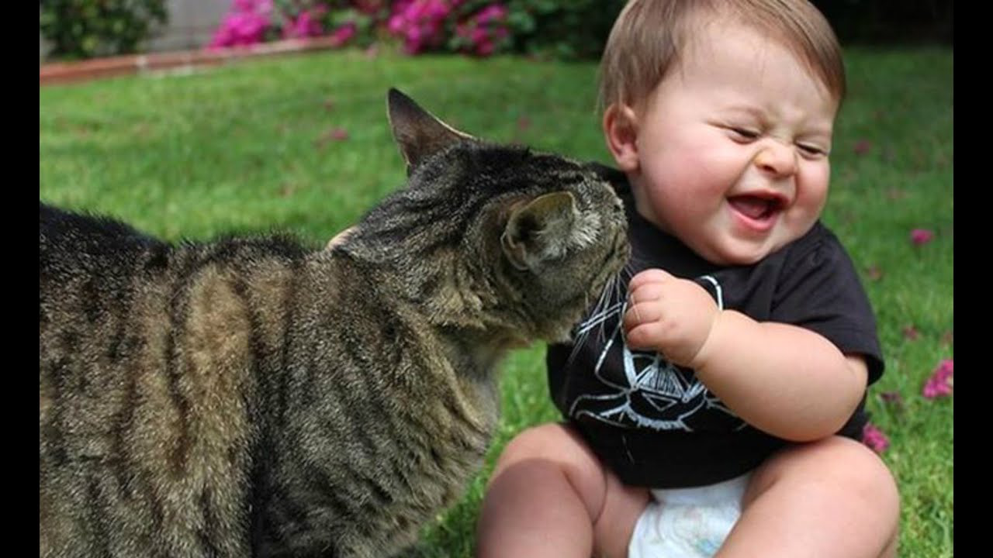
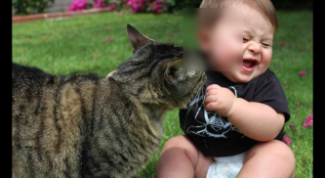
Results
Output Comparison
NCC Accuracy: 24.06% Covariance Accuracy: 0% NCC Accuracy: 62.12% Covariance Accuracy: 34.42%
Evaluate the results:
Detection Accuracy - Percentage of images in the dataset that were detected correctly (NCC - 75%, Covariance - 50%)
Censor Accuracy - Amount of overlap between the predicted and ground truth bounding box (IOU) (NCC – 80.43% / 24.06% / 0% / 62.12, Covariance – 75.41% / 0% / 0% / 34.42%)
Problems encountered: Algorithm did not perform well in cases where there is lower contrast between the primary subject versus the remaining objects in the search image
Lessons learned: NCC works better than covariance tracking when we perform detection using a single template-image
What else could be done (if you had more time)?: We would have explored techniques like Mean Shift and super-pixel segmentation to get better results on Edge Cases

