Slide 1
JSP Custom Tags
-Prof. Hariom A. Pandya
-Prof. Vivek S. Patel
(CE Dept. DDU)
Notes:
CHANGE to company name

Slide 2
TagFiles :
( Alternative to
c:import jsp:include and <%@include%>)
Header.tag:
<img src=“dduLogo.jpg”>
Output.jsp:
<%@taglib prefix=“a” tagdir=“/WEB-INF/tags”%>
<a:Header/>

Slide 3
Send Parameter to TagFile : (Partial Code)
Header.tag:
<img src=“dduLogo.jpg”>
Department : ${myAttribute}
Output.jsp:
<%@taglib prefix=“a” tagdir=“/WEB-INF/tags”%>
<a:Header myAttribute=“CE Department”/>
Note:
1)All tags have tag scope attribute. (i.e.myAttribute
Is not accessible outside a:Header
2)With custom tag : Attribute are in TLD
With tag file : Not in TLD (directly with @attribute)

Slide 4
Send Parameter to TagFile : (FULL Code)
Header.tag:
<%@attribute name=“myAttribute” required=“true”
rtexprvalue=“true” %>
<img src=“dduLogo.jpg”>
Department : ${myAttribute}
Output.jsp:
<%@taglib prefix=“a” tagdir=“/WEB-INF/tags”%>
<a:Header myAttribute=“CE Department”/>

Slide 5
When Attribute value is big (Supply as Body) ::::
[Partial]
Header.tag:
<img src=“dduLogo.jpg”>
Department : <jsp:doBody/>
Output.jsp:
<%@taglib prefix=“a” tagdir=“/WEB-INF/tags”%>
<a:Header>
Hello, This is a Page for CE Department
Welcome to Our Website
</a:Header>

Slide 6
When Attribute value is big (body_content ??)::::
[FULL]
Header.tag:
<%@attribute name=“dept_Color” required=“true” />
<%@ tag body-content=“tagdependent”/>
<img src=“dduLogo.jpg”>
<font color=“${dept_color}”><jsp:doBody/>
</font>
Output.jsp:
<%@taglib prefix=“a” tagdir=“/WEB-INF/tags”%>
<a:Header dept_Color=“#00FF00”>
Hello, This is a Page for CE Department
Welcome to Our Website
</a:Header>

Slide 7
Example 1- Create "Hello" Tag
JSP tag extensions let you create new tags that you can insert directly into a JavaServer Page just as you would the built-in tags.
To write a custom tag you can simply extend SimpleTagSupport class and override the doTag() method, where you can place your code to generate content for the tag.
Consider you want to define a custom tag named <ex:Hello> and you want to use it in the following fashion without a body:
<ex:Hello />
To create a custom JSP tag, you must first create a Java class that acts as a tag handler. So let us create HelloTag class as follows:
package myTags;
import javax.servlet.jsp.tagext.*;
import javax.servlet.jsp.*;
import java.io.*;
public class HelloTag extends SimpleTagSupport {
public void doTag() throws JspException, IOException {
JspWriter out = getJspContext().getOut();
out.println("Hello Custom Tag!");
}
}

Slide 8
Example 1- Create "Hello" Tag
Above code has simple coding where doTag() method takes the current JspContext object using getJspContext() method and uses it to send "Hello Custom Tag!" to the current JspWriter object.
Finally create following tag library file: WEB-INF\custom.tld.
<taglib>
<tlib-version>1.0</tlib-version>
<jsp-version>2.0</jsp-version>
<short-name>Example TLD</short-name>
<tag>
<name>Hello</name>
<tag-class>myTags.HelloTag</tag-class>
<body-content>empty</body-content>
</tag>
</taglib>

Slide 9
Example 1- Create "Hello" Tag
Now it's time to use above defined custom tag Hello in our JSP program(Hello.jsp) as follows:
Note : Hello.jsp should also be saved in WEB-INF folder
<%@ taglib prefix="ex" uri="WEB-INF/custom.tld"%>
<html>
<head>
<title>A sample custom tag</title>
</head>
<body>
<ex:Hello/>
</body>
</html>
Start server and Try to call above JSP in a browser using:
http://localhost:8080/Hello.jsp
This should produce following result:
Hello Custom Tag!

Slide 10
Accessing the Tag Body:
You can include a message in the body of the tag as you have seen with standard tags. Consider you want to define a custom tag named <ex:Hello> and you want to use it in the following fashion with a body:
<ex:Hello> This is message body </ex:Hello>
Let us make following changes in above our tag code to process the body of the tag:
package myTags; import javax.servlet.jsp.tagext.*; import javax.servlet.jsp.*; import java.io.*; public class HelloTag extends SimpleTagSupport { StringWriter sw = new StringWriter(); public void doTag() throws JspException, IOException{ getJspBody().invoke(sw); getJspContext().getOut().println(sw.toString()); }}

Slide 11
Accessing the Tag Body:
In this case, the output resulting from the invocation is first captured into a StringWriter before being written to the JspWriter associated with the tag. Now accordingly we need to change TLD file as follows:
<taglib> <tlib-version>1.0</tlib-version> <jsp-version>2.0</jsp-version> <short-name>Example TLD with Body</short-name> <tag> <name>Hello</name> <tag-class>myTags.HelloTag</tag-class> <body-content>scriptless</body-content> </tag> </taglib>
Now let us call above tag with proper body as follows:

Slide 12
Accessing the Tag Body:
<%@ taglib prefix="ex" uri="WEB-INF/custom.tld"%> <html> <head> <title>A sample custom tag</title> </head> <body> <ex:Hello> This is message body </ex:Hello> </body> </html>
This will produce following result:
This is message body

Slide 13
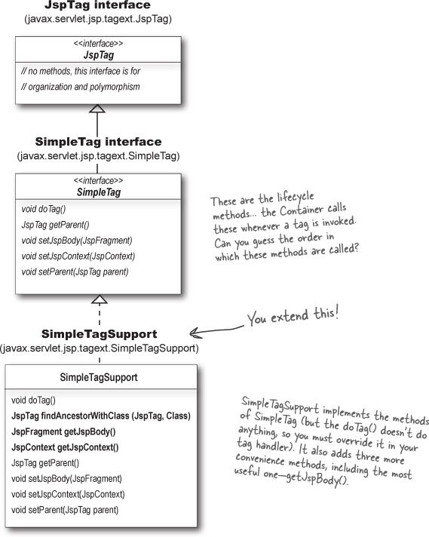

Slide 14
Tag body uses an expression ?
In jsp:
<t:myTag>
Message is: ${message}
</t:myTag>
In doTag()
public void doTag() throws JspException,IoException
{
getJspContext().setAttribute(“message”,”HELLO”);
getJspBody().invoke(null);
}

Slide 15
Example :
In JSP:
<table>
<t:myTag>
<tr><td>${myList}</td></tr>
</table>
Assume in your tag handler there is an array of string with some content. Write doTag() code to Print all data.
Public class tHandler extends SimpleTagSupports
{
String list[]={“Hello”,”DDU”,”CE Dept”);
Public void doTag() throws JspExcetion,IoException
{
???
}
}

Slide 16
Example :
Public class tHandler extends SimpleTagSupports
{
String list[]={“Hello”,”DDU”,”CE Dept”);
Public void doTag() throws JspExcetion,IoException
{
for(int i=0;i<list.length;i++)
{
getJspContext().setAttribute(“myList”,list[i]);
getJspBody().invoke(null);
}
}
}

Slide 17
Custom Tag Attributes:
Property | Purpose
Name | The name element defines the name of an attribute. Each attribute name must be unique for a particular tag.
Required | This specifies if this attribute is required or optional. It would be false for optional.
Rtexprvalue | Declares if a runtime expression value for a tag attribute is valid
Type | Defines the Java class-type of this attribute. By default it is assumed as String
Description | Informational description can be provided.
Fragment | Declares if this attribute value should be treated as a JspFragment.

Slide 18
Custom Tag Attributes:
You can use various attributes along with your custom tags. To accept an attribute value, a custom tag class needs to implement setter methods, identical to JavaBean setter methods as shown below:
package myTags; import javax.servlet.jsp.tagext.*; import javax.servlet.jsp.*; import java.io.*; public class HelloTag extends SimpleTagSupport { private String message; public void setMessage(String msg) { this.message = msg; } StringWriter sw = new StringWriter(); public void doTag()throws JspException, IOException { if (message != null) { /* Use message from attribute */ JspWriter out = getJspContext().getOut(); out.println( message ); } else { /* use message from the body */ getJspBody().invoke(sw); getJspContext().getOut().println(sw.toString()); } } }

Slide 19
Custom Tag Attributes:
The attribute's name is "message", so the setter method is setMessage(). Now let us add this attribute in TLD file using <attribute> element as follows:
<taglib> <tlib-version>1.0</tlib-version> <jsp-version>2.0</jsp-version> <short-name>Example TLD with Body</short-name> <tag> <name>Hello</name> <tag-class>myTags.HelloTag</tag-class> <body-content>scriptless</body-content> <attribute> <name>message</name> </attribute> </tag> </taglib>

Slide 20
Custom Tag Attributes:
Now let us try following JSP with message attribute as follows:
<%@ taglib prefix="ex" uri="WEB-INF/custom.tld"%> <html> <head> <title>A sample custom tag</title> </head> <body> <ex:Hello message="This is custom tag" /> </body> </html>
This will produce following result:
This is custom tag
Hope above example makes sense for you. It would be worth to note that you can include following properties for an attribute:

Slide 21
Custom Tag Attributes:
Following is the example to specify properties related to an attribute:
..... <attribute> <name>attribute_name</name> <required>false</required> <type>java.util.Date</type> <fragment>false</fragment> </attribute> .....
If you are using two attributes then you can modify your TLD as follows:
..... <attribute> <name>attribute_name1</name> <required>false</required> <type>java.util.Boolean</type> <fragment>false</fragment> </attribute> <attribute> <name>attribute_name2</name> <required>true</required> <type>java.util.Date</type> </attribute> .....

Slide 22
SkipPageException:
In tagHandler
public void doTag() throws JspException,IoException
{
getJspContext().getOut().print(“In doTag()”);
if(1==1)
throws new SkipPageException();
}
In JSP
<%@ taglib prefix=“a” uri=“myTag %>
Before Invoking Tag
<a:MyPersonalTAG/>
After Tag
Output:
Before Invoking Tag
In doTag()

Slide 23
SkipPageException:
In tagHandler
public void doTag() throws JspException,IoException
{
getJspContext().getOut().print(“In doTag()”);
if(1==1)
throws new SkipPageException();
}
JSP :: PAGE A:
In page A
<jsp:include page=“B.jsp”/>
Again in A

Slide 24
JSP:: PAGE B:
<%@ taglib prefix=“a” uri=“myTag %>
IN B : Before Invoking Tag
<a:MyPersonalTAG/>
IN B : After Tag
Output:
In Page A
In B : Before Invoking Tag
In doTag()
Again in A

Slide 25
Dynamic Select Example
index.jsp //Just to forward reqeust to servlet
ClientRequest.java
form.jsp
SelectTagHandler.java
myTld.tld

Slide 26
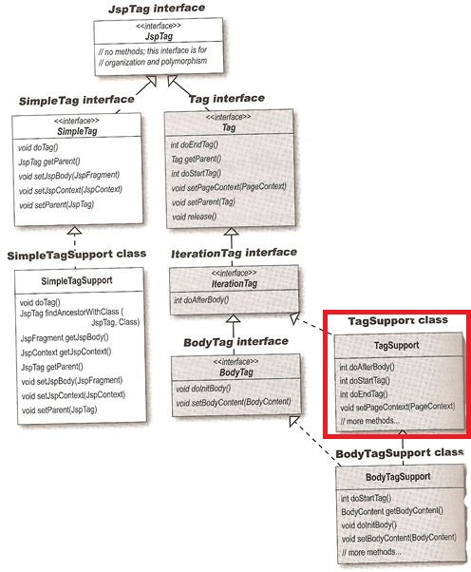
Classic Tag Handler

Slide 27
Example of Classic Custom Tag
# JSP file that uses tag
<%@ taglib prefix="myTags" uri="classicTags" %>
<html><body>
<myTags:classic1/>
</html></body>
# The TLD for the tag
<tag>
<description>classic custom tag</description>
<name>classic1</name>
<tag-class>foo.TagHandler</tag-class>
<body-content>empty</body-content>
</tag>
# The ClassicTag.java

Slide 28
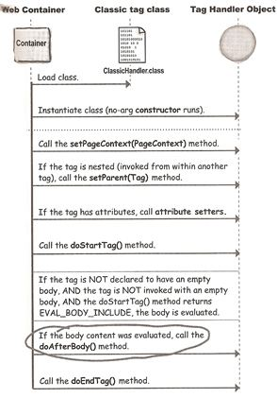

Slide 29
doStartTag() | SKIP_BODY (default) EVAL_BODY_INCLUDE EVAL_BODY_BUFFERED (if using BodyTagSupportinterface)
doAfterBodyTag() | SKIP_BODY (default) EVAL_BODY_AGAIN
doEndTag() | SKIP_PAGE EVAL_PAGE (default)

Slide 30
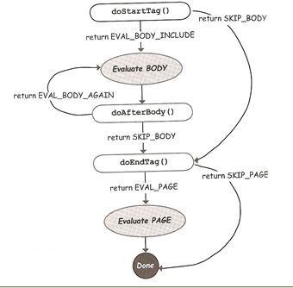

Slide 31
Example2 of Classic Custom Tag
# JSP that invokes the tag
<%@ taglib prefix="myTags" uri="classicTags" %>
<table border="1">
<myTags:iterateMovies>
<tr><td>${movie}</td></tr>
</myTags:iterateMovies>
</table>
# The TLD for the tag
<tag>
<description>classic custom tag</description>
<name>iteratemovies</name>
<tag-class>foo.ClassicTag2</tag-class>
<body-content>scriptless</body-content>
</tag>
# The ClassicTag2.java

Slide 32
If you want to access body of a tag
extend BodyTagSupport instead of TagSupport
Gives 2 more lifecycle methods from the BodyTag interface
setBodyContext() and doInitBody().
new return value for the doStartTag()
EVAL_BODY_BUFFERED

Slide 33
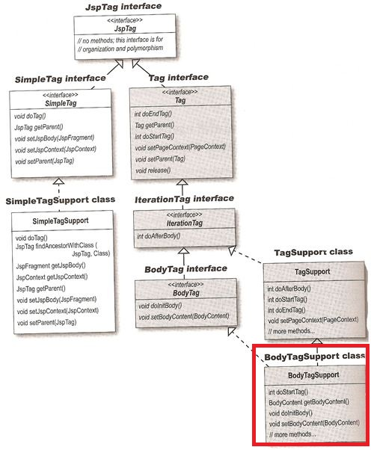

Slide 34
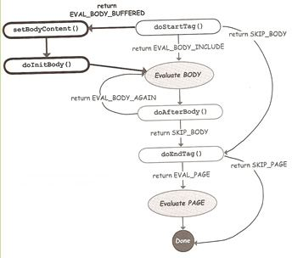

Slide 35
doStartTag()
 | BodyTagSupport | TagSupport
possible return values | SKIP_BODY EVAL_BODY_INCLUDE EVAL_BODY_BUFFERED | SKIP_BODY EVAL_BODY_INCLUDE
default return value from the implmenting class | EVAL_BODY_BUFFERED | SKIP_BODY
Number of times its can be called (per tag invocation from a JSP) | Exactly Once | Exactly Once
doAfterBody()
possible return values | SKIP_BODY EVAL_BODY_AGAIN | SKIP_BODY EVAL_BODY_AGAIN
default return value from the implmenting class | SKIP_BODY | SKIP_BODY
Number of times its can be called (per tag invocation from a JSP) | Zero to Many | Zero to Many
doEndTag()
possible return values | SKIP_PAGE EVAL_PAGE | SKIP_PAGE EVAL_PAGE
default return value from the implmenting class | EVAL_PAGE | EVAL_PAGE
Number of times its can be called (per tag invocation from a JSP) | Exactly Once | Exactly Once

Slide 36
doInitBody() and setBodyContent()
circumstances under which they can be called and number of times per tag invocation | Exactly once and only if doStartTag() returns EVAL_BODY_BUFFERED | NEVER

Slide 37
public class TestBody extends BodyTagSupport {
public int doStartTag() throws JspException {
try {
pageContext.getOut().print("doStartTag()");
return EVAL_BODY_BUFFERED; }
catch(IOException ioe) {
throw new JspException(ioe.getMessage()); }
}
public void doInitBody() throws JspException {
try {
// Note, that this is a different writer than the one
// you have in doStartTag and doEndTag.
bodyContent.print("doInitBody()"); }
catch(IOException ioe) {
throw new JspException(ioe.getMessage()); }
}

Slide 38
public int doAfterBody() throws JspException {
try {
// Note, that this is a different writer than the oneyou have in doStartTag and doEndTag.
bodyContent.print("doAfterBody()");
return SKIP_BODY;
}
catch(IOException ioe) {
throw new JspException(ioe.getMessage());
}
}
public int doEndTag() throws JspException {
try {
// Write from bodyContent writer to original writer.
pageContext.getOut().print(bodyContent.getString());
// Now we're back to the original writer.
pageContext.getOut().print("doEndTag()");
return EVAL_PAGE; }
catch(IOException ioe) {
throw new JspException(ioe.getMessage()); } }
}

Slide 39
Tags That Works together
<mine:Menu> tag that builds a custom navigation bar
<mine:Menu>
<mine:MenuItem itemValue=“JT" />
<mine:MenuItem itemValue=“Python" />
<mine:MenuItem itemValue=“php" />
</mine:Menu>

Slide 40
There is a mechanism for getting information to and from
outer and inner tags, regardless of the depth of nesting.
Both the SimpleTag and Tag interface have a getParent() method.
Tag getparent() returns a Tag
SimpleTag getParent() returns an instance of JspTag
(which means it can access a Classic Tag parent)

Slide 41
Classic tag handler
public in doStartTag() throws JspException {
OuterTag parent = (OuterTag) getParent();
// do something with it
return EVAL_BODY_INCLUDE;
}
Simple tag handler
public void doTag() throws JspException, IOException {
OuterTag parent = (OuterTag) getParent();
// do something with it
}

Slide 42
# In a JSP
<mine:NestedLevel>
<mine:NestedLevel>
<mine:NestedLevel/>
</mine:NestedLevel>
</mine:NestedLevel>

Slide 43
# Classic handler
public class NestedLevelTag extends TagSupport {
private int nestLevel = 0;
public int doStartTag() throws JspException {
nestLevel = 0;
Tag parent = getParent();
while (parent != null) {
parent = parent.getParent();
nestLevel++;
}
try {
pageContext.getOut().println(“Nested level: " + nestLevel);
}
catch (IOException ex) {
throw new JspException(IOException- " + ex.toString());}
return EVAL_BODY_INCLUDE;
}

Slide 44
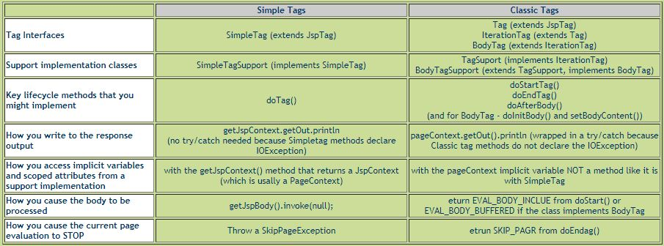

Slide 45


