Slide 1
IE 6700: Data Management for Analytics DMA Project: GYM MANAGEMENT SYSTEM
Section 01, Group 4
MOHAMMAD INSHAAL KHAN
VINAY SRIDHAR

Slide 2
Problem Definition
The dynamic nature of the fast-paced life today, has made it imperative for the people to be at their best fitness levels. But with limited amount of knowledge and understanding about how to maintain one’s fitness levels, people tend to depend upon experts.
Also, it is practically impossible for everyone to have all the equipment and the machines required for maintaining a good physique at their homes. So, people depend upon gyms for their needs.

Slide 3
But maintaining a gym is not that easy and involves various elements such as registration of members, tracking their billing details and diet plans, the equipment that the members need to use to achieve their fitness goals, maintaining payment details for various staff employed in the gym, assigning lockers to the members and staff, etc.
It becomes a tedious job to track and maintain large amount of these records on paper. Hence, in this modern era of technology and internet, there needs to be a lateral shift from paper records to a database management system.

Slide 4
Requirements
This lateral shift to a database management system is essential as databases have incredibly amazing features and advantages such as faster data retrieval, data backup and recovery, increased productivity, and reduced data inconsistencies.
Therefore, we have created a gym management system and achieved this goal by creating 7 entities: Member, Equipment Set, Personal Trainer, Nutritionist, Locker, Finance Department, and Manager. We will establish relationships between all the entities, define the attributes for all of them and then create a database system around it.

Slide 5
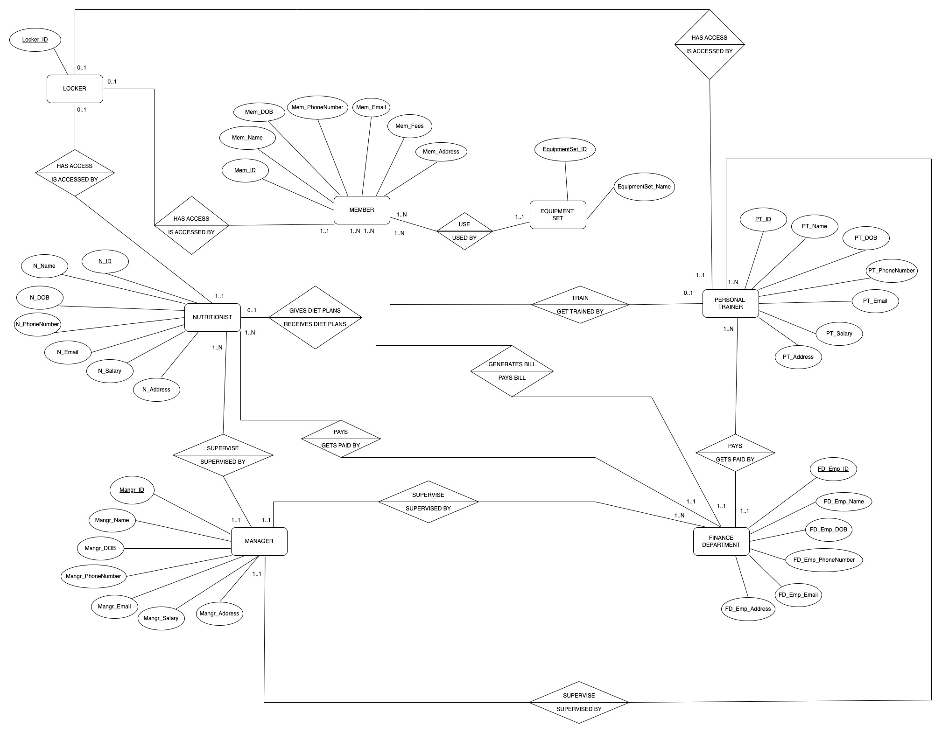
Conceptual Design: EER Diagram
EER Diagram: Gym Management System

Slide 6
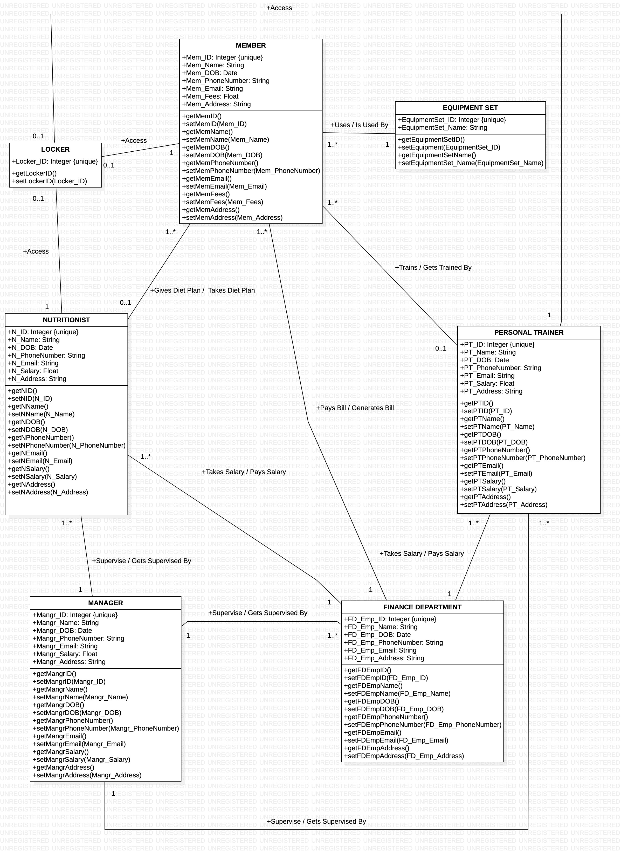
Conceptual Design: UML Class Diagram

Slide 7
Relational Model
Note – The primary keys are represented by bold font and the foreign keys are represented by italics font
EQUIPMENT_SET (EquipmentSet_ID, EquipmentSet_Name)
LOCKER (Locker_ID)
MANAGER (Mangr_ID, Mangr_Name, Mangr_DOB, Mangr_PhoneNumber, Mangr_Email, Mangr_Salary, Mangr_Address)
FINANCE_DEPARTMENT (FD_Emp_ID, FD_Emp_Name, FD_Emp_DOB, FD_Emp_PhoneNumber, FD_Emp_Email, FD_Emp_Address, Mangr_ID) where Mangr_ID refers to Mangr_ID taken from MANAGER table, NOT NULL
NUTRITIONIST (N_ID, N_Name, N_DOB, N_PhoneNumber, N_Email, N_Salary, N_Address, Locker_ID, FD_Emp_ID, Mangr_ID)
where Locker_ID refers to Locker_ID taken from LOCKER table, NULL ALLOWED,
FD_Emp_ID refers to FD_Emp_ID from FINANCE_DEPARTMENT table, NOT NULL,
Mangr_ID refers to Mangr_ID taken from MANAGER table, NOT NULL

Slide 8
PERSONAL_TRAINER (PT_ID, PT_Name, PT_DOB, PT_PhoneNumber, PT_Email, PT_Salary, PT_Address, Locker_ID, FD_Emp_ID, Mangr_ID)
where Locker_ID refers to Locker_ID taken from LOCKER table, NULL ALLOWED,
FD_Emp_ID refers to FD_Emp_ID taken from FINANCE_DEPARTMENT table, NOT NULL
Mangr_ID refers to Mangr_ID taken from MANAGER table, NOT NULL
MEMBER (Mem_ID, Mem_Name, Mem_DOB, Mem_PhoneNumber, Mem_Email, Mem_Fees, Mem_Address, Locker_ID, PT_ID, N_ID, EquipmentSet_ID, FD_Emp_ID)
where Locker_ID refers to Locker_ID taken from LOCKER table, NULL ALLOWED,
PT_ID refers to PT_ID taken from PERSONAL_TRAINER table, NULL ALLOWED,
N_ID refers to N_ID taken from NUTRITIONIST table, NULL ALLOWED,
EquipmentSet_ID refers to EquipmentSet_ID taken from EQUIPMENT_SET table, NOT NULL,
FD_Emp_ID refers to FD_Emp_ID taken from FINANCE_DEPARTMENT table, NOT NULL

Slide 9
MySQL Demo

Slide 10
NoSQL Demo

Slide 11
Application Demo in Python

Slide 12


