Slide 1

TECHNICAL SEMINAR ON “PHISHING”
Done By :
S VINAY

Slide 2
INDEX
What is social engineering?
Social Engineering attack techniques
What is Phishing?
Phishing Attack Example
How to recognize a phishing mail?
Types of Phishing
Phishing in Kali Linux
Preventing Phishing
Conclusion

Slide 3
What is social engineering?
Social engineering is the term used for a broad range of malicious activities accomplished through human interactions. It uses psychological manipulation to trick users into making security mistakes or giving away sensitive information.
Social engineering attacks happen in one or more steps.
A perpetrator first investigates the intended victim to gather necessary background information, such as potential points of entry and weak security protocols, needed to proceed with the attack.
Then, the attacker moves to gain the victim’s trust and provide stimuli for subsequent actions that break security practices, such as revealing sensitive information or granting access to critical resources.

Slide 4
Social engineering attack techniques
Baiting
Scareware
Pretexting
Phishing

Slide 5
What is Phishing ?
Phishing is a type of social engineering attack often used to steal user data, including login credentials and credit card numbers.
It occurs when an attacker, masquerading as a trusted entity, dupes a victim into opening an email, instant message, or text message.
The recipient is then tricked into clicking a malicious link, which can lead to the installation of malware, the freezing of the system as part of a ransomware attack or the revealing of sensitive information.

Slide 6
An attack can have devastating results. For individuals, this includes unauthorized purchases, the stealing of funds, or identify theft.
Moreover, phishing is often used to gain a foothold in corporate or governmental networks as a part of a larger attack, such as an advanced persistent threat (APT) event where employees are compromised in order to bypass security perimeters, distribute malware inside a closed environment, or gain privileged access to secured data.
An organization succumbing to such an attack typically sustains severe financial losses in addition to declining market share, reputation, and consumer trust.

Slide 7
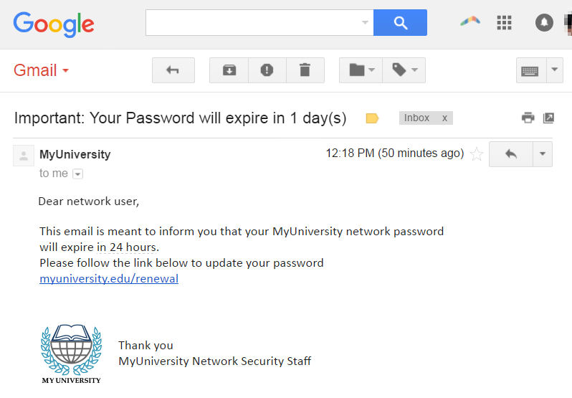
Phishing attack example

Slide 8
The following illustrates a common phishing scam attempt:
A spoofed email ostensibly from myuniversity.edu is mass-distributed to as many faculty members as possible.
The email claims that the user’s password is about to expire. Instructions are given to go to myuniversity.edu/renewal to renew their password within 24 hours.
Several things can occur by clicking the link.
The user is redirected to myuniversity.edurenewal.com, a bogus page appearing exactly like the real renewal page, where both new and existing passwords are requested.
The attacker, monitoring the page, hijacks the original password to gain access to secured areas on the university network.
The user is sent to the actual password renewal page. However, while being redirected, a malicious script activates in the background to hijack the user’s session cookie. This results in a reflected XSS attack, giving the perpetrator privileged access to the university network.

Slide 9
How to recognize a phishing email
A phishing email can include corporate logos and other identifying graphics and data collected from the company being misrepresented. Malicious links within phishing messages are usually also designed to make it appear as though they go to the spoofed organization.
However, there are several clues that can indicate that a message is a phishing attempt. These include:
The use of subdomains, misspelled URLs (typo squatting) or otherwise suspicious URLs.
The recipient uses a Gmail or other public email address rather than a corporate email address.
The message is written to invoke fear or a sense of urgency.
The message includes a request to verify personal information, such as financial details or a password.
The message is poorly written and has spelling and grammatical errors.

Slide 10
Types of Phishing
Some of the more common types of phishing attacks include the following:
Spear phishing attacks are directed at specific individuals or companies, usually using information specific to the victim that has been gathered to more successfully represent the message as being authentic. Spear phishing emails might include references to co workers or executives at the victim's organization, as well as the use of the victim's name, location or other personal information.

Slide 11
Whaling attacks are a type of spear phishing attack that specifically targets senior executives within an organization, often with the objective of stealing large sums. A typical whaling attack targets an employee with the ability to authorize payments, with the phishing message appearing to be a command from an executive to authorize a large payment to a vendor when, in fact, the payment would be made to the attackers.

Slide 12
Pharming is a type of phishing that depends on DNS cache poisoning to redirect users from a legitimate site to a fraudulent one, and tricking users into using their login credentials to attempt to log in to the fraudulent site.
Clone phishing attacks use previously delivered, but legitimate emails that contain either a link or an attachment. Attackers make a copy or clone of the legitimate email, replacing one or more links or attached files with malicious links or malware attachments. Because the message appears to be a duplicate of the original, legitimate email, victims can often be tricked into clicking the malicious link or opening the malicious attachment.

Slide 13
Phishers sometimes use the evil twin Wi-Fi attack by standing up a Wi-Fi access point and advertising it with a deceptive name that is similar to a legitimate access point. When victims connect to the evil twin Wi-Fi network, the attackers gain access to all the transmissions sent to or from victim devices, including user IDs and passwords.
Voice phishing is a form of phishing that occurs over voice communications media, including voice over IP (VoIP) or POTS (plain old telephone service). A typical vishing scam uses speech synthesis software to leave voicemails purporting to notify the victim of suspicious activity in a bank or credit account, and solicits the victim to respond to a malicious phone number to verify his identity thus compromising the victim's account credentials.
Another mobile device-oriented phishing attack, SMS phishing also sometimes called SMishing or SMShing uses text messaging to convince victims to disclose account credentials or to install malware.

Slide 14
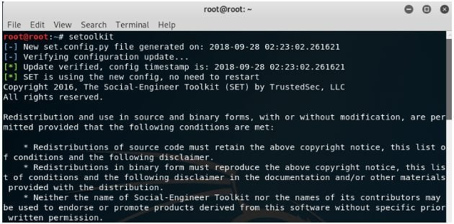
Phishing in Kali Linux

Slide 15
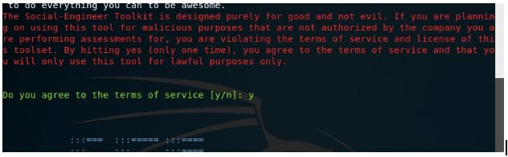

Slide 16
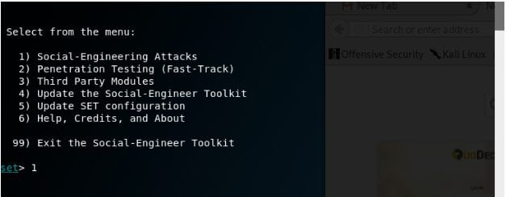

Slide 17
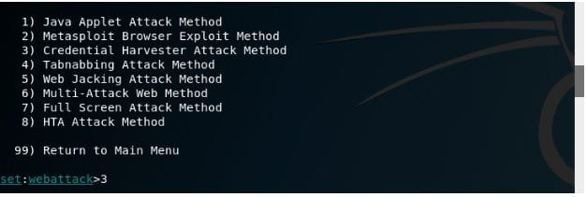

Slide 18
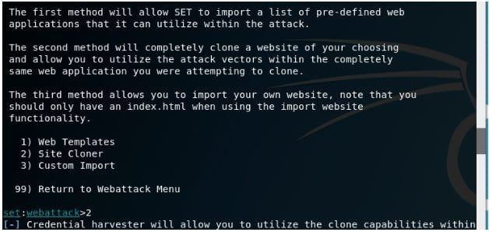

Slide 19
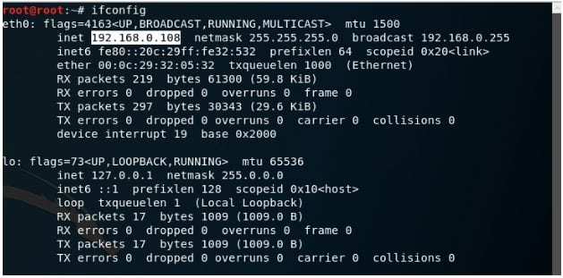

Slide 20
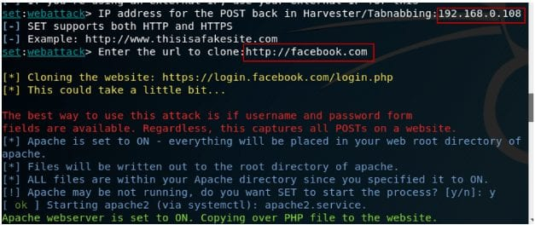

Slide 21
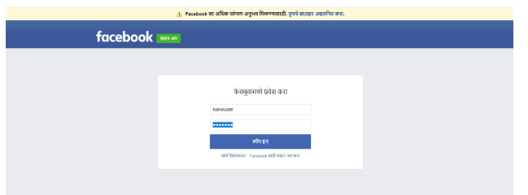
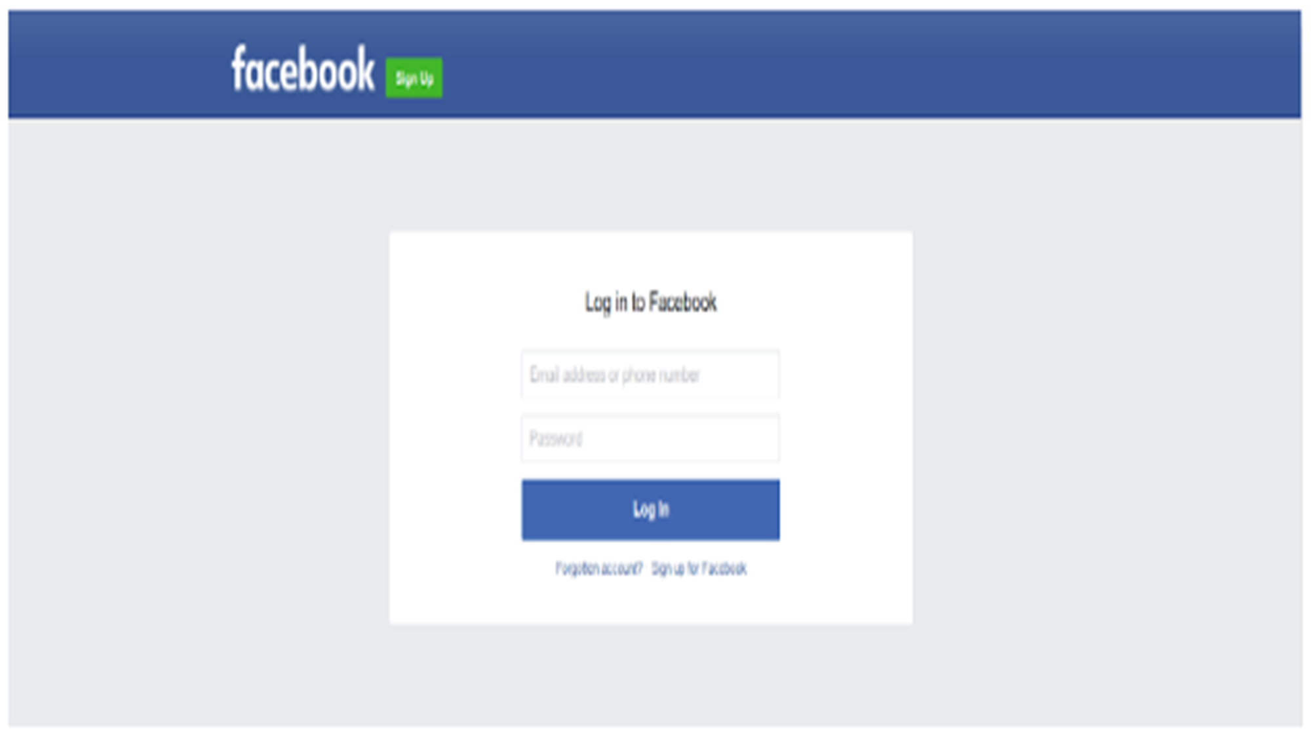

Slide 22
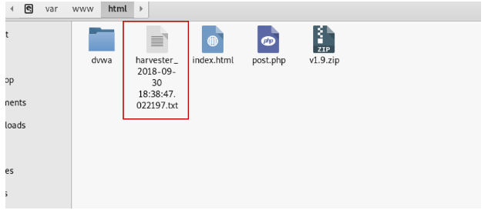
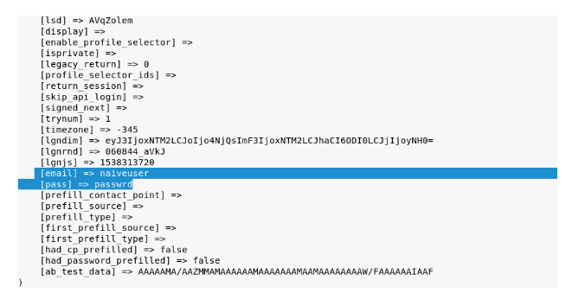

Slide 23
Preventing Phishing
To help prevent phishing messages from reaching end users, experts recommend layering security controls, including:
Antivirus software
Both desktop and network firewalls
Antispyware software
Anti-phishing toolbar (installed in web browsers)
Gateway email filter
Web security gateway

Slide 24
For enterprises, a number of steps can be taken to mitigate phishing attacks:
Two-factor authentication (2FA) is the most effective method for countering phishing attacks, as it adds an extra verification layer when logging in to sensitive applications. 2FA relies on users having two things: something they know, such as a password and user name, and something they have, such as their smartphones. Even when employees are compromised, 2FA prevents the use of their compromised credentials, since these alone are insufficient to gain entry.
In addition to using 2FA, organizations should enforce strict password management policies. For example, employees should be required to frequently change their passwords and to not be allowed to reuse a password for multiple applications.

Slide 25
Notable Anti-phishing programs
Avira Premium Security Suite
GeoTrust TrustWatch
Mozilla Thunderbird - e-mail client which warns users of e-mails which may be part of an e-mail scam.
PhishTank SiteChecker
PineApp Mail-SeCure
WOT (Web Of Trust) - browser extension
ZoneAlarm
OpenDNS

Slide 26
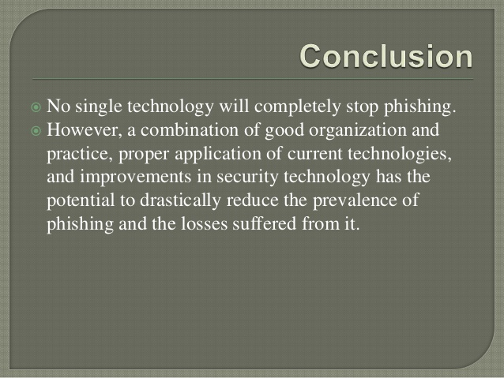

Slide 27


