Slide 1
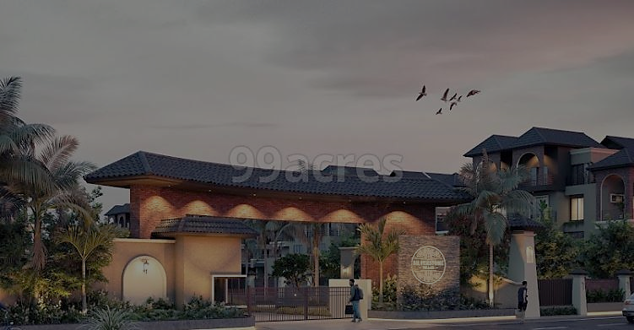
Socitey Management System

Slide 2

Group Members
Jay akabari
21-bca-003
01
Shreshtha Rabadiya
21-bca-062
02
Vishal padhiyar
21-bca-049
03

Slide 3
COMPNAY PROFILE
COMPNAY NAME : | VISION INFOTECH
OWNER NAME : | SUMIT DANGASIYA
ADRESS : | 3001, 3rd Floor APMC, Krushi Bazaar, Surat.
BRANCH : | 606 Seminole Trl, Murphy TX 75094, USA 2) 10-13 Venturo Appartments & Commercial Hub, Near Railway Station, Navsari. 3) 606 - Shivalik Shilp - 2, Opp ITC Narmada Hotel, Vastrapur, Ahmedabad, 380054
CONTACT NO : | 9726192924

Slide 4
INTRODUCTION
The society management system is created to manage activities of any housing society. Generally, in society all the work is manually. Mobile no, email, address, maintenance , notices are noted on the papers.
As all work is done on paper so it is very difficult to manage in the society. Society management system project track society problems solve it and easily manage society members.
Using this application user can see notice board, events, member detail, maintenance and etc. Society member they can make complain any where and any time and we resolve the complain as soon as possible.

Slide 5
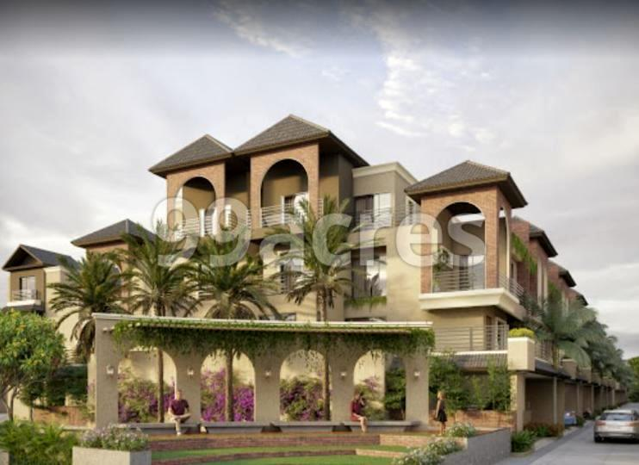
PURPOSE BACKGROUND
The purpose of the Society Management System (SMS) is member pay online Maintenance This project is to provide a paper-less Society up to 90% because it is directly connected to the Society.
The proposed system aims to improve efficiency, accountability, and communication in managing residential societies. The study assesses the technical, operational, and financial feasibility of the project and concludes that the project is feasible.
Residential societies have complex operations, including maintenance, billing, accounting, communication, and document management. These operations are currently managed manually, which can be time-consuming and error-prone.

Slide 6
PRODUCT FUNCTION
Member Management:
Accounting and Financial Management:
Maintain and manage member details such as contact information, occupancy status, and membership fees.
Handle member registrations and track membership status.
Facilitate communication between members and management.
Generate invoices and manage billing for maintenance fees or dues.
Track and record financial transactions.
Prepare financial reports and statements.
Handle online payment integration for fee collection.

Slide 7
PRODUCT FUNCTION
Communication and Notice Board:
Maintenance and Complaint Management:
Receive and record maintenance requests and complaints from residents.
Assign tasks to staff or vendors for resolution.
Track the status and progress of maintenance activities.
Maintain a history of maintenance records.
Provide a platform for communication between residents and management.
Send notifications, circulars, and announcements to residents.
Facilitate community discussions and interactions through forums or messaging systems.
Share important updates and notices on a centralized notice board.

Slide 8
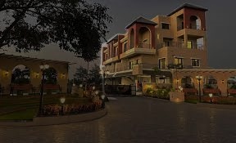
MEMBER AND SECRETORY FACILITIES
Member facilities:-
Secretory facilities:-
Members can Complain to the secretary.
Members can see notice on the notice board.
Members see complain status.
Members see all event.
Members pay maintenance on monthly or yearly.
Members can see all members, events, complains, notices on dashboard.
The Secretary can see all details of maintenance.
The Secretary send notice.
The Secretary can solve complain.
Secretory push event.

