Slide 1

COMFY
Unlocking Customer Loyalty: Data-Driven Strategies for Growth
Reporting on Assignment 1.2
Vishal Sehgal
2109374

Slide 2
Points of Discussion
These are the topics this presentation will cover.
01
Introduction
02
What Do they Buy?
03
Where and How they shop?
04
Whats not working?
05
Action Plan

Slide 3
Introduction
01
411,000 clients in total
02
Loyalty members = top revenue contributors
03
Median receipts per member: 4
Who Are Our Loyalty Members?
04
Top 8% generate over 115,000 in total revenue
Objective
Use data to refine our loyalty tiers, personalize rewards, and boost retention.

Slide 4
Top Categories:
Paid Delivery
Smartphones
Accessories (Headphones , Covers, Glass Protectors) .
What
Do they Buy?
Business units they spend most:
Accessories (29%)
Small Household Appliances (17%)
COMFY HOME (12.5%)
Loyalty members shop for utility and convenience, not just tech

Slide 5
Where and How do they Shop?
33% occur online, but platform data is missing in 68% of those
Loyalty spend concentrated in Kyivska and Dnipropetrovska
67% of all loyalty transactions occur in retail stores:
Brands with most loyalty traction: Comfy, Samsung, Xiaomi
Our loyal customers are hybrid in-store and online but our digital data isn't keeping up

Slide 6



62K duplicate receipts
Reporting inconsistencies
24.5K missing revenue
What’s Not Working
Breaks loyalty calculations
51K negative revenues
Impacts ROI accuracy
Blank platform fields
Missed digital behavior insights
Poor demographic data
Limited segmentation and targeting

Slide 7
Action Plan
Make Loyalty Work Harder
01
Clean demographic fields - start with new loyalty registrations
02
Enrich online platform data to track behavior
03
Build return pattern reports by loyalty tier
04
Run A/B tests on loyalty offers by region + product bundle

Slide 8
COMFY
Strategic Insights for Sales Optimization
Reporting on Assignment 1.3
Vishal Sehgal
2109374

Slide 9
Points of Discussion
These are the topics this presentation will cover.
01
Time Series Decomposition
02
Multidimensional Relationships
03
Category Prioritization
04
Action Plan

Slide 10
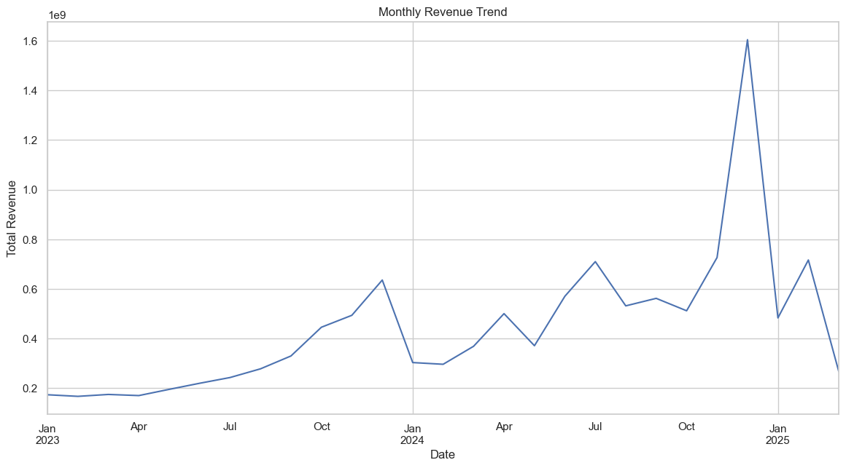
Time Series Decomposition
Uncovering Hidden Patterns in Growth

Slide 11
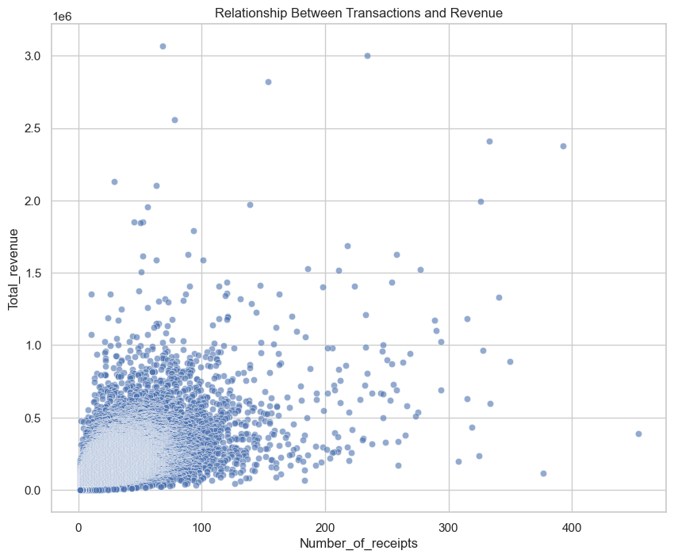
Multidimensional Relationships
Transactions vs. Revenue: Where Are the Gaps?

Slide 12
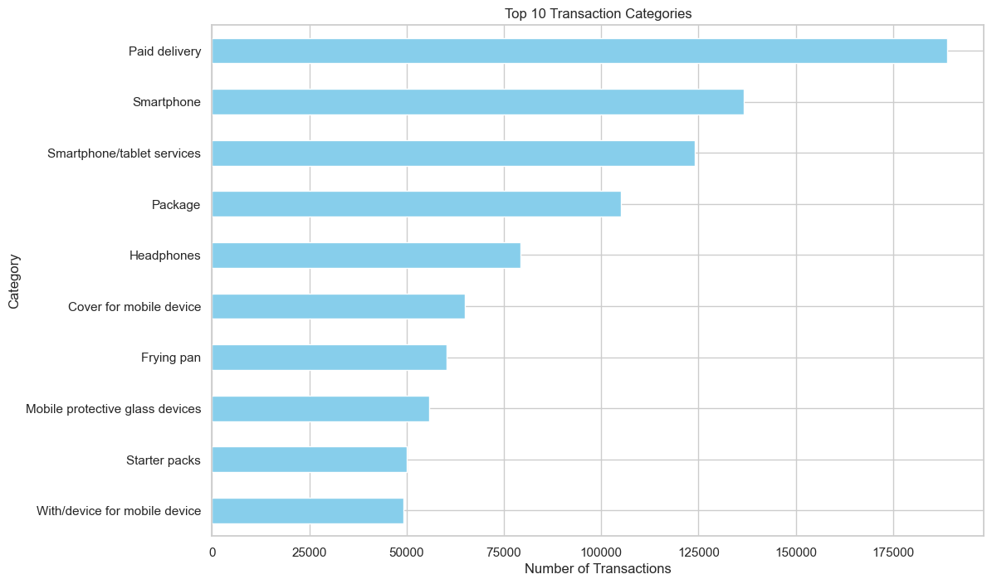
Category Prioritization
Focus on High-Impact Categories

Slide 13
Action Plan
From Insights to Action
01
Optimize resource allocation during seasonal dips.
02
Address inefficiencies in high-volume/low-margin regions.
03
Prioritize mid-tier margin categories (e.g., Smartphones).

Slide 14

Thank you!
COMFY
Vishal Sehgal
2109374

