Slide 1

Pattern Recognition and Machine Learning (CSL 418)
Department of Computer Science and Engineering
National Institute of Technology, Uttarakhand
Submitted by Submitted to
Vishnu Priy Agnihotri Dr . Nitin Kumar
Assistant Professor
Department of CSE
BT18CSE018

Slide 2
Overview:
Introduction
Theory
Experimental Results
Conclusion
Bibliography

Slide 3
Introduction
Topic assigned: CANCELLABLE MULTIMODAL BIOMETRIC USER AUTHENTICATION SYSTEM WITH FUZZY VAULT
Research Paper chosen: “CANCELLABLE MULTIMODAL BIOMETRIC USER AUTHENTICATION SYSTEM WITH FUZZY VAULT” by S.R. Soruba Sree and Dr . N. Radha
Link of the publication and the original pdf of the paper(in the chat)
Purpose of this presentation(elaborate)

Slide 4
Theory
What is user authentication?
What are biometrics?
Why use biometric authentication?
What is biometric fusion?
What is fuzzy vault?

Slide 5
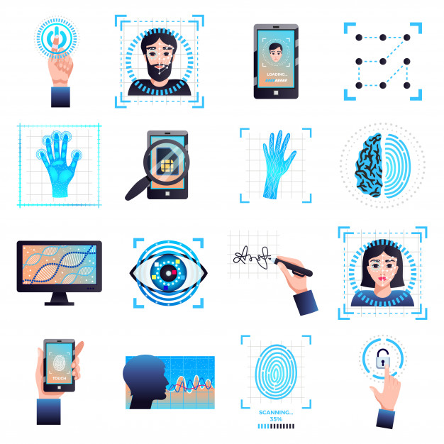
What is user authentication?
It is a process that allows a device to verify the identity of someone trying to access something.
It consists of three tasks:
Identification
Authentication
Authorization
Various authentication methods include usernames, IDs , passwords , PINs , facial recognition , retina scans, voice authentication etc.

Slide 6
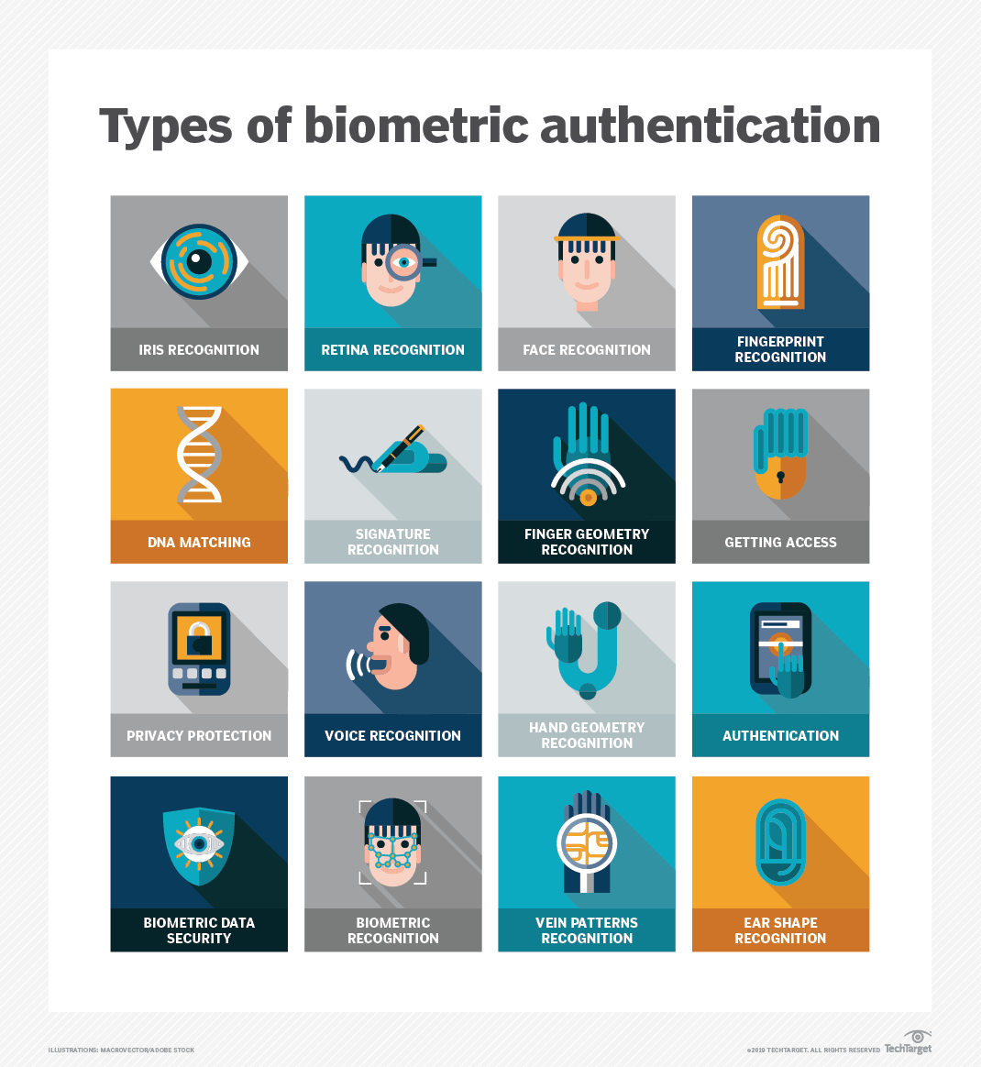
What are biometrics?
Biometrics are body measurements and calculations related to human characteristics.
These characteristics can be physiological which are related to the shape of the body or behavioral which are related to the behavior of the person.
Physiological characteritics include fingerprint , palm veins, face recognition, DNA ,palm print, iris recognition.
Behavioral characteristics include keystroke, signature, voice etc.

Slide 7
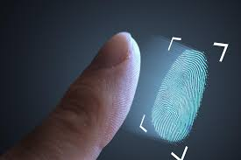
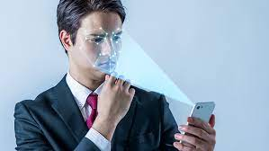
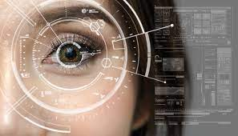
Why use biometric authentication?
Traditional methods such as username/password systems are too vulnerable to security breaches and simply do not provide sufficient security. These can be stolen by variety of techniques.
One of the major advantage of this system is that it cannot be guessed, forgotten , misplaced or easily forged .
Two types of biometric identification systems are unimodal systems and multimodal systems.

Slide 8
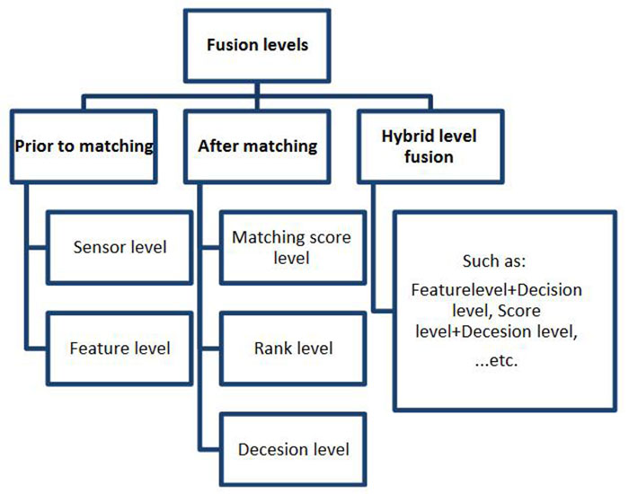
What is biometric fusion?
The design process that can combine the classified results from every biometric channel .
Multimodal biometric fusion is done in order to combine the different biometric samples in a better way in order to enhance the strength and also to reduce the error rates which occur during the verification process.

Slide 9
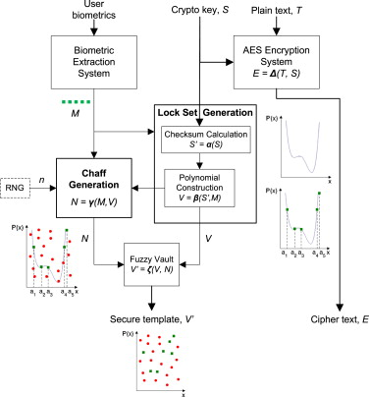
What is fuzzy vault?
Fuzzy vault is a scheme that complements traditional cryptographic security systems by combining it with biometric authentication to overcome the security vulnerability inherent in cryptographic key storage.
Biometric encryption systems based on fuzzy vault scheme are suitable for stand-alone security and authentication devices in the form of system-on-chip (SoC).

Slide 10
Methodology
Distortion Transformation
Binarization
Thinning
Crossing-Number concept
Local Binary pattern
Feature level fusion
Fuzzy Vault

Slide 11
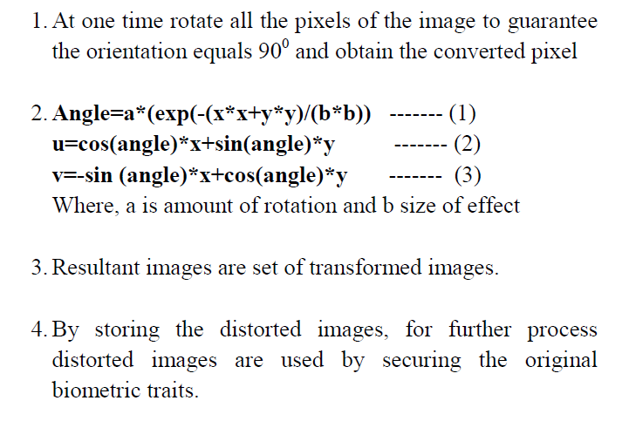
Distortion Transformation
Transformation is the process of changing the angle of image from one angle to other angle so that, the transformed image is used for evaluation and original image is stored for further purpose.
In proposed work, authors have rotated the images with 90⸰

Slide 12
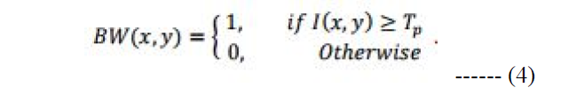
Binarization
Binarization is the process of converting original images into binary images.
Intensity value of enhanced image is represented as I(x,y) at pixel position (x,y). Threshold value is represented as Tp.
BW(x,y) represents the binary image obtained.

Slide 13
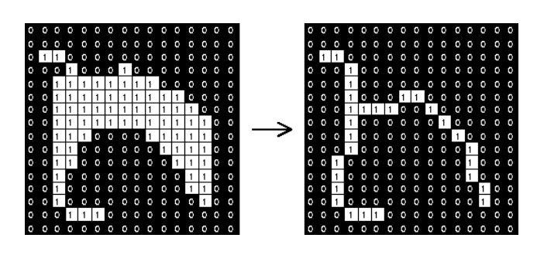
Thinning
Involves removing the foreground pixels in the binary image.
Generally , all lines are reduced to single pixel thickness.
Also known as skeletonization , the picture shown alongside depicts the output after the process.

Slide 14
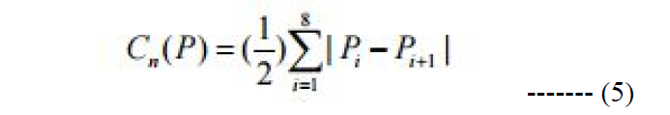
Crossing-Number Concept
Used for extracting the minutiae features from the fingerprint.
Rutovitz’s definition of crossing number for a Pixel P is given alongside.
The pixels are then classified according to their CN value : bifurcation and termination.

Slide 15
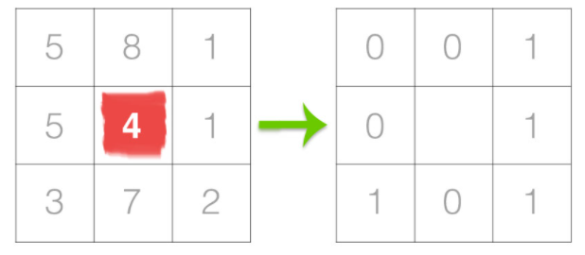
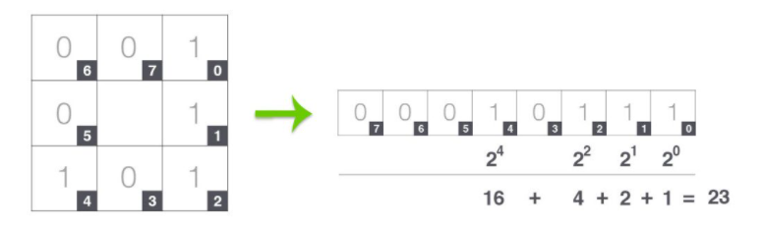
Local Binary Pattern
Local Binary Patterns, or LBPs for short, are a texture descriptor made popular by the work of Ojala et al. in their 2002 paper, Multiresolution Grayscale and Rotation Invariant Texture Classification with Local Binary Patterns.

Slide 16
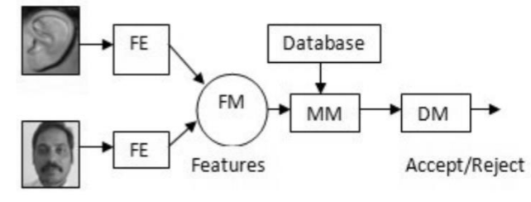
Feature level fusion
The feature level fusion is the extraction of correlated feature from the different modalities and in course identifies a prominent set of feature that can Improve recognition accuracy.

Slide 17
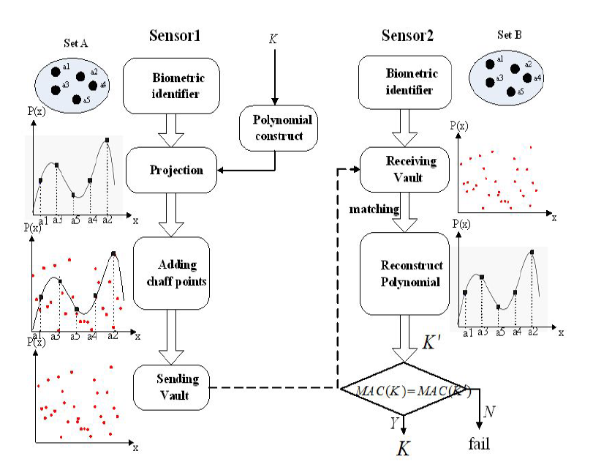
Fuzzy Vault
Consists of projecting a polynomial, adding chaff points and verifying with received vault.

Slide 18
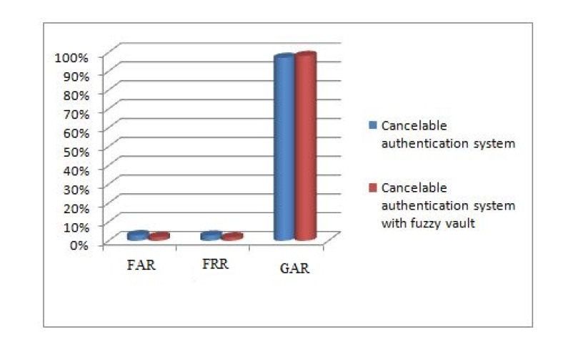
Experimental Result
Evaluation of the proposed system was done by measuring False Acceptance Rate [FAR], false rejection rate [FRR] , genuine acceptance rate [GRR] and accuracy.

Slide 19
Conclusion
In proposed work, authors designed an effective human recognition system with distorted image, the biometric images follows pre-processing, feature extraction, fusion and fuzzy vault.
Proposed technique aimed at improving the template security by the use of fuzzy vault.
Use of fuzzy vault also improved the accuracy and decreased the FAR and FRR .

Slide 20
Bibliography
https://ieeexplore.ieee.org/document/7479931
https://github.com/iamvpa/prmlPaper
https://www.ijert.org/research/a-review-on-various-fusion-techniques-in-multimodal-biometrics-IJERTCONV4IS21018.pdf
https://www.bayometric.com/unimodal-vs-multimodal/
http://www.scholarpedia.org/article/Cancelable_biometrics
https://searchsecurity.techtarget.com/definition/user-authentication

