Slide 1
Project: Database design and query language
Members:
Nguyễn Hoàng Vũ – 18IT1 Team leader
Phan Thành Đạt – 18IT1 Team member
Quách Trọng Thái – 18IT1 Team member
Content: Design a database for a electronic webshop (selling laptop,phone,….) and write query sentence for features DBMS: PostgreSQL

Slide 2
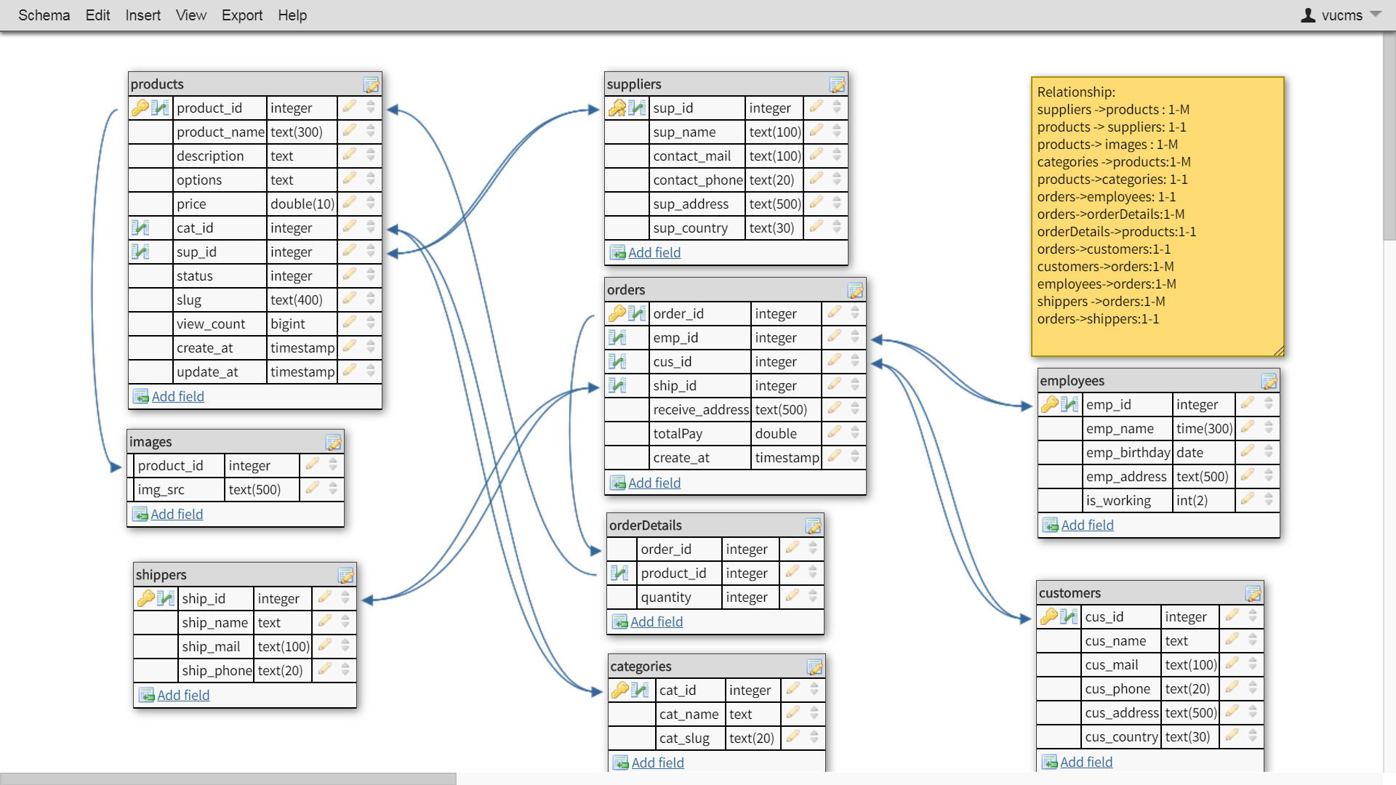
Database structure

Slide 3
Relationships
suppliers -> products : 1-M
products -> suppliers: 1-1
Products -> images : 1-M
categories -> products:1-M
Products -> categories: 1-1
Orders -> employees: 1-1
Orders -> orderDetails: 1-M
orderDetails -> products: 1-1
Orders -> customers: 1-1
Customers -> orders: 1-M
Employees -> orders: 1-M
shippers -> orders: 1-M
Orders -> shippers: 1-1

Slide 4
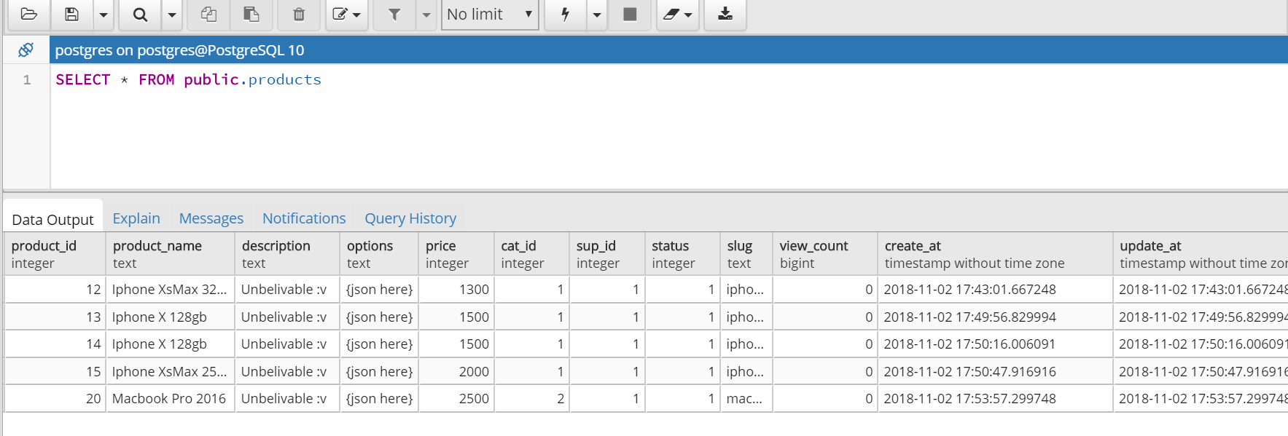
Query Select
Select all informations of all products in table products

Slide 5
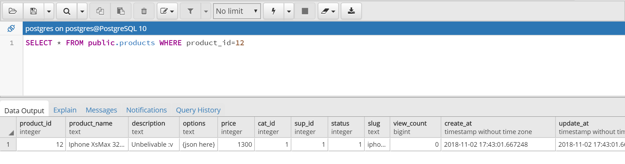
Query Select
Select informations of a product in table products by product_id (Primary Key)

Slide 6
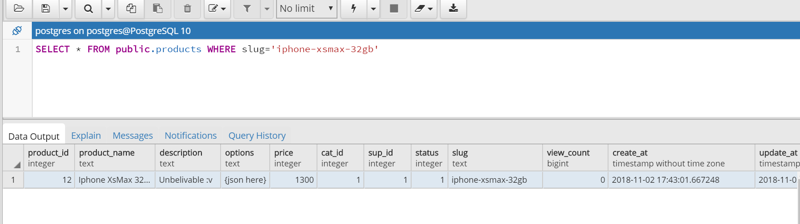
Query Select
Select informations of a product in table products by slug (unique)

Slide 7
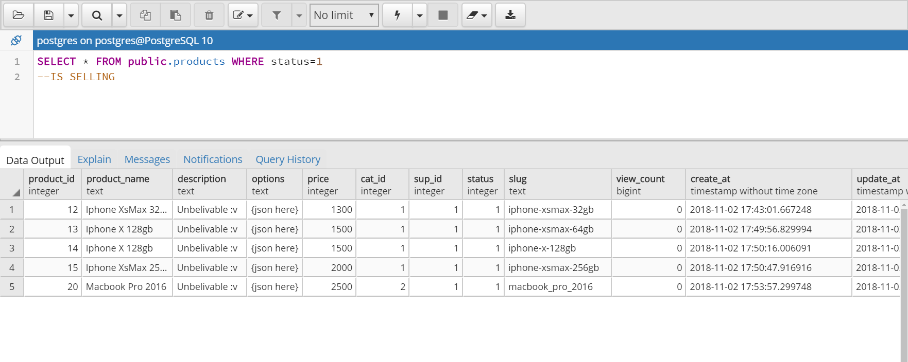
Query Selector
Select all products which are selling status==1 => selling status==0 => stop selling

Slide 8
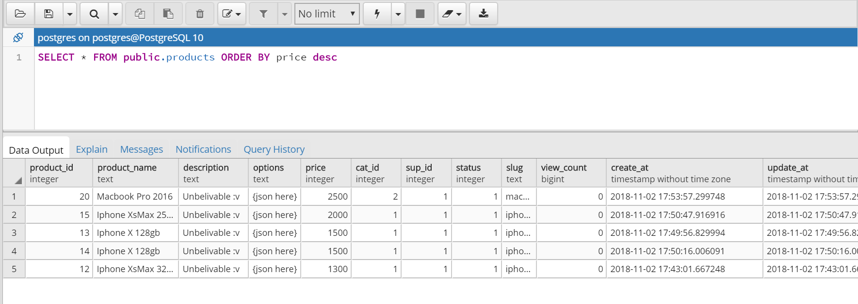
Query Select
Select all informations of products and sort it by Price (Example : high to low)

Slide 9
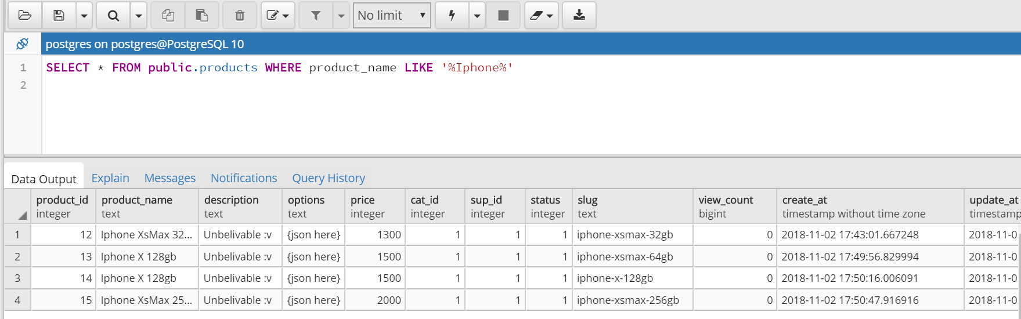
Query Select
Search informations of products by keyword

Slide 10
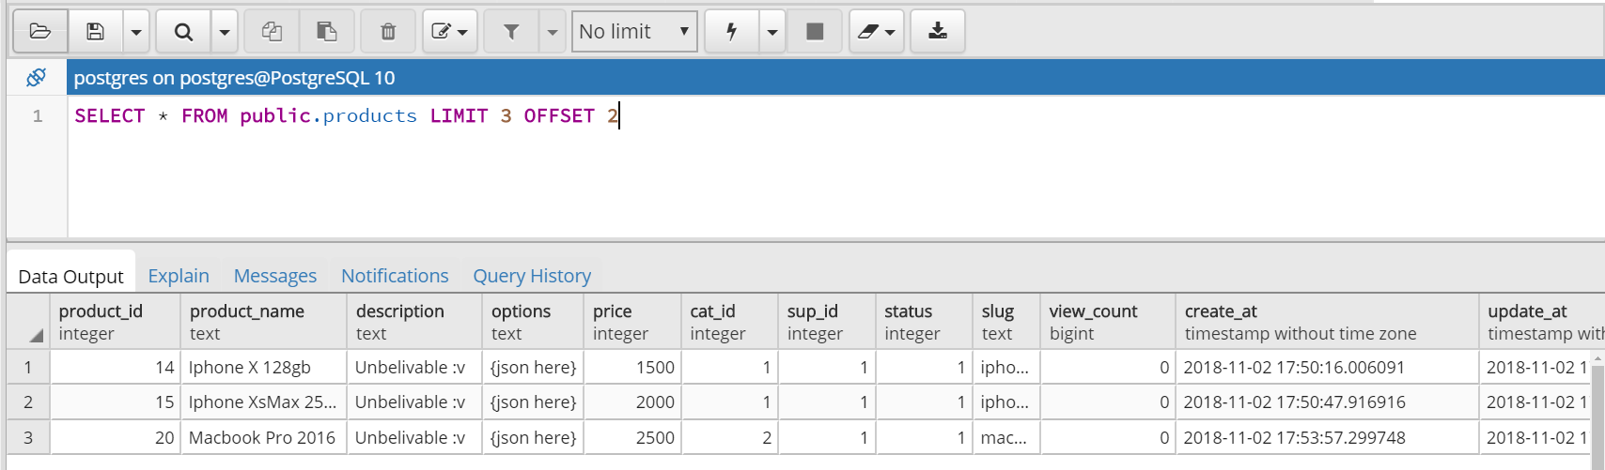
Query Select
Search informations of products with limit and offset (for pagination)

Slide 11
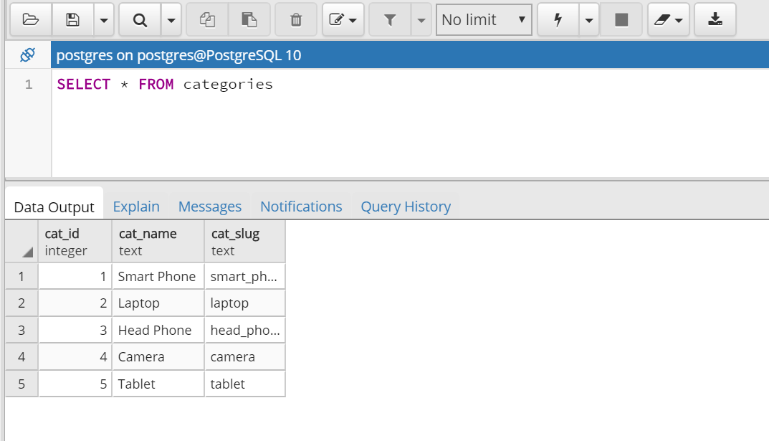
Query Select
Select all categories in categories list

Slide 12
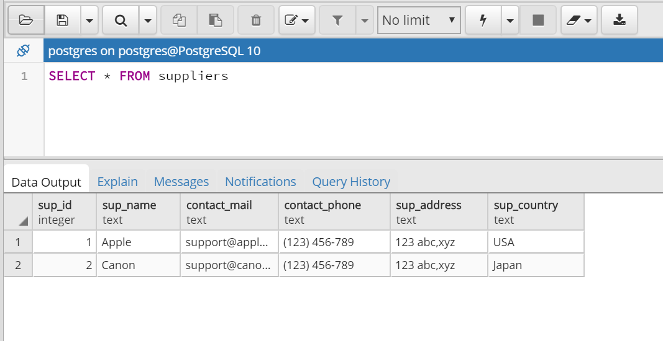
Query Select
Select all information of supplier in suppliers list

Slide 13
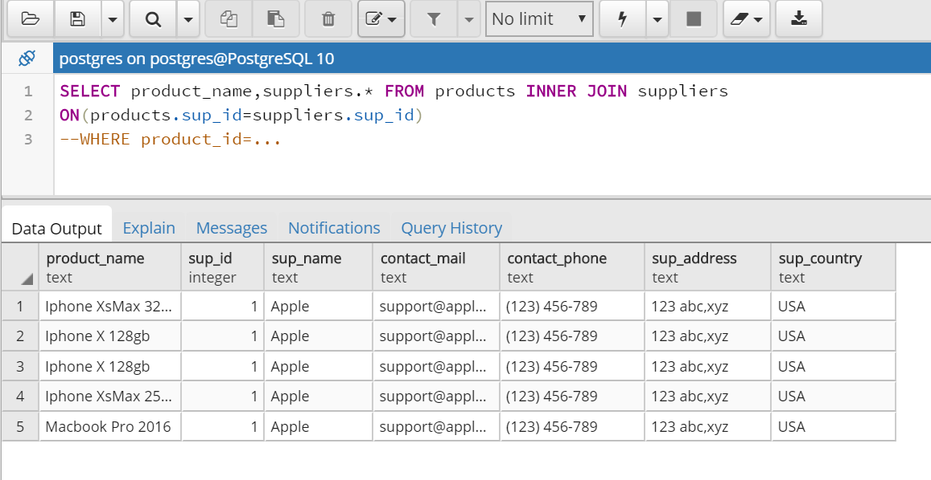
Query Select
Select supplier informations of any products

Slide 14
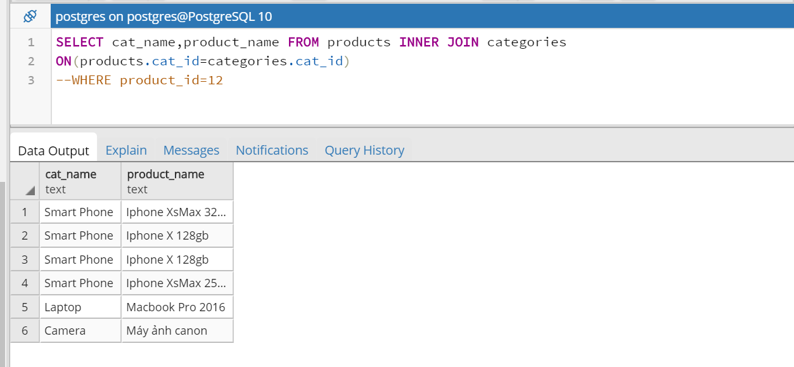
Query Select
Select category name of any products

Slide 15
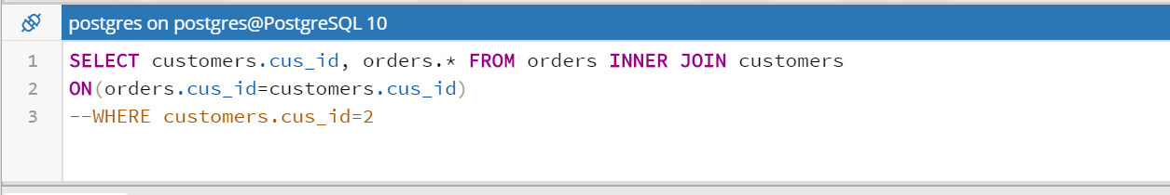
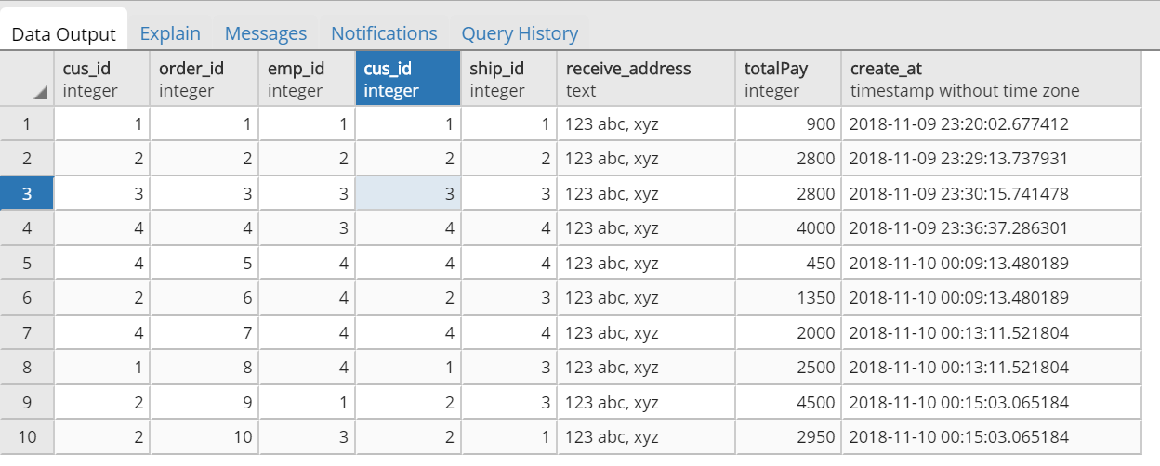
Query Select
Select information orders are bought by any customers

Slide 16
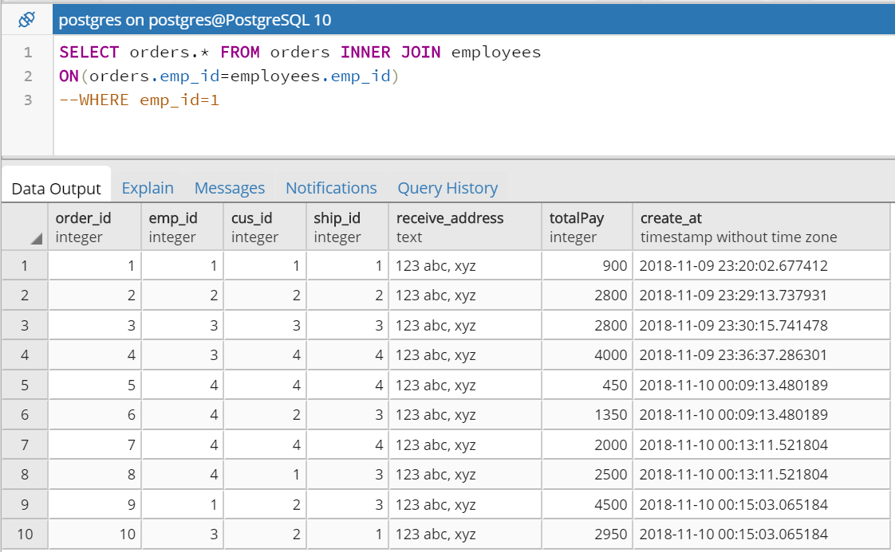
Query Select
Select information orders are sold by any employees

Slide 17
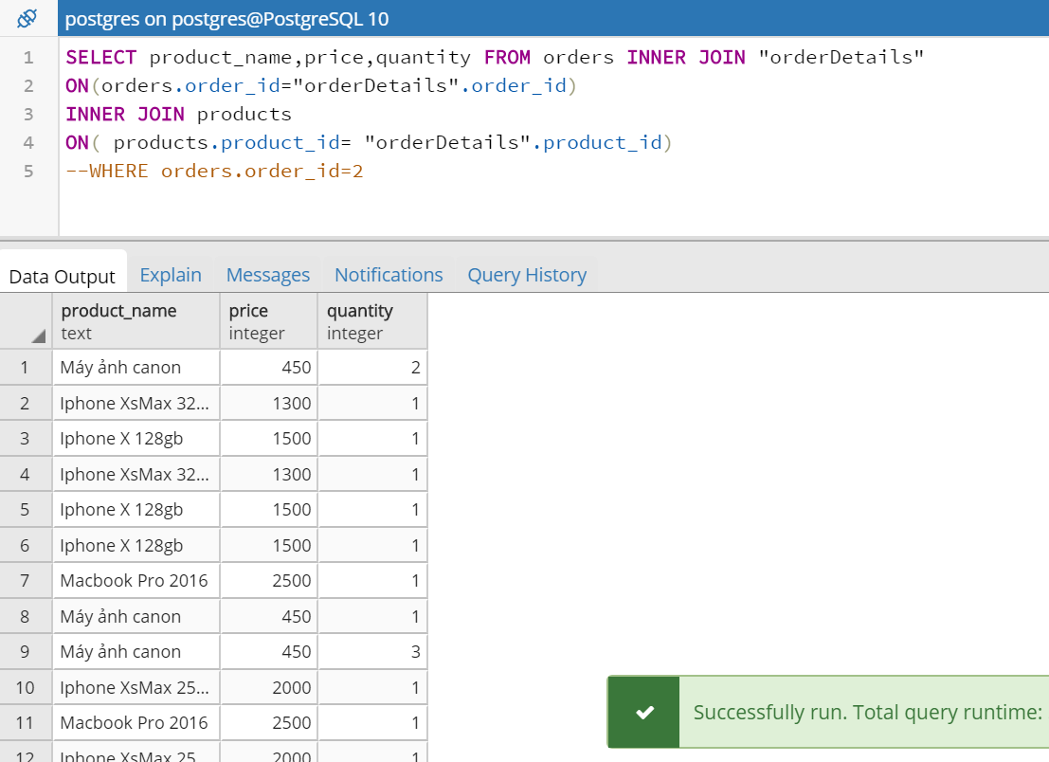
Query Select
Select information of products in a orders

Slide 18
Query Select
Select all suppliers in suppliers li

Slide 19
Query Select
Select all suppliers in suppliers li

Slide 20
Query Select
Select all suppliers in suppliers li

Slide 21
Query Select
Select all suppliers in suppliers li

Slide 22
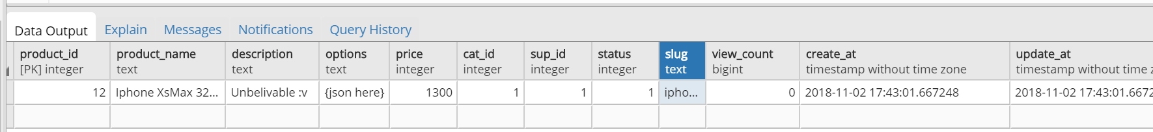
Query Insert
Insert new products into table products INSERT INTO public.products(
product_id, product_name, description, options, price,
cat_id, sup_id, status, slug, view_count, create_at, update_at)
VALUES (12, 'Iphone XsMax 32gb', 'Unbelivable :v ', '{json here}', 1300, 1, 1, 1,'iphone-xsmax-32gb', 0, 'now()', 'now()');
Result:

Slide 23
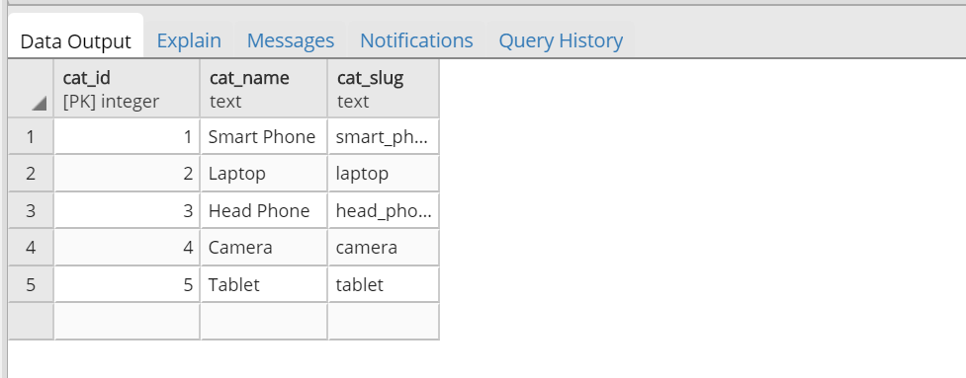
Query Insert
Insert a new category into categories list
INSERT INTO public.categories(
cat_id, cat_name, cat_slug)
VALUES (5, 'Tablet', 'tablet');

Slide 24
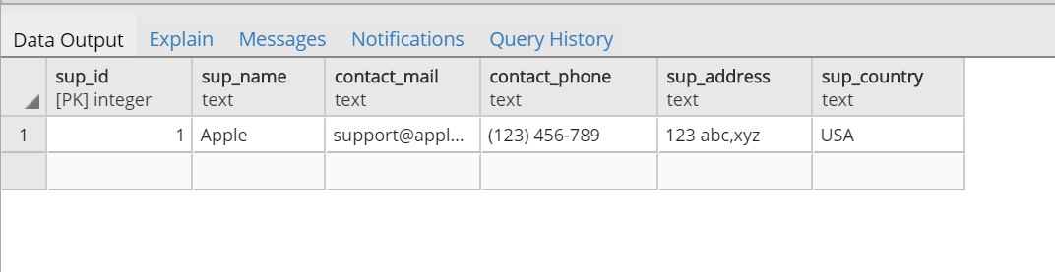
Query Insert
Insert new supplier into suppliers list
INSERT INTO public.suppliers(
sup_id, sup_name, contact_mail, contact_phone, sup_address, sup_country)
VALUES (1, 'Apple', 'support@apple.com', '(123) 456-789', '123 abc,xyz', 'USA');

Slide 25
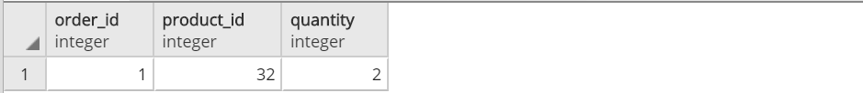
Query Insert
Insert new order into orders list
INSERT INTO public.orders(
order_id, emp_id, cus_id, ship_id, receive_address,”totalPay”, create_at)
VALUES (1, 1, 1, 1, '123 abc, xyz', 900, 'now()');
INSERT INTO public.”orderDetails”(
order_id, product_id, quantity)
VALUES (1, 32, 2);

Slide 26
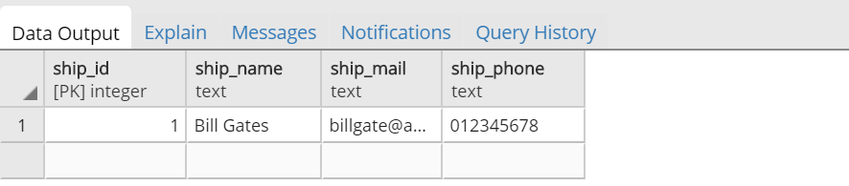
Query Insert
Insert new shipper into shippers list
INSERT INTO public.shippers(
ship_id, ship_name, ship_mail, ship_phone)
VALUES (1, 'Bill Gates', 'billgate@abc.com', '012345678');

Slide 27
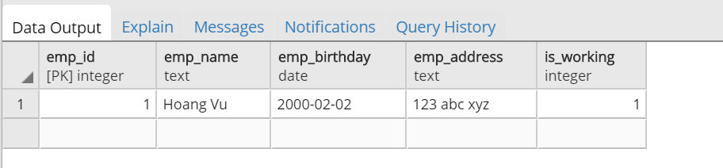
Query Insert
Insert new employee into employees list
INSERT INTO public.employees(
emp_id, emp_name, emp_birthday, emp_address, is_working)
VALUES (1, 'Hoang Vu', '02-02-2000', '123 abc xyz', 1);

Slide 28
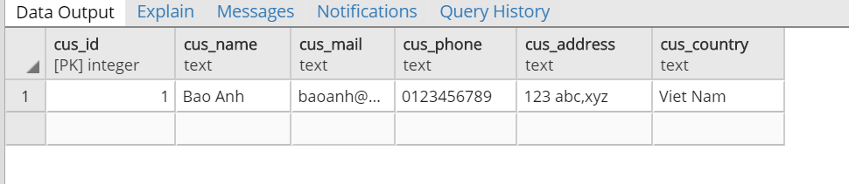
Query Insert
Insert new customer into customers list
INSERT INTO public.customers(
cus_id, cus_name, cus_mail, cus_phone, cus_address, cus_country)
VALUES (1, 'Bao Anh', 'baoanh@abc.com', '0123456789', '123 abc,xyz', 'Viet Nam');

Slide 29
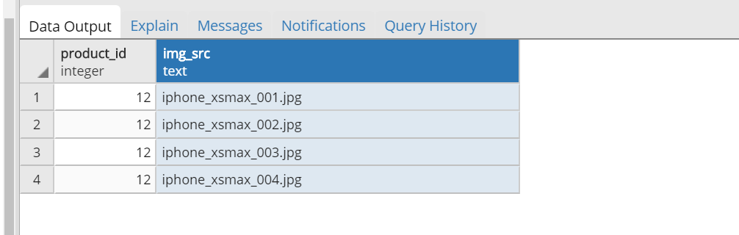
Query Insert
Insert images for products
INSERT INTO public.images(
product_id, img_src)
VALUES (12, 'iphone_xsmax_001.jpg'),(12, 'iphone_xsmax_002.jpg'),(12, 'iphone_xsmax_003.jpg') ,(12, 'iphone_xsmax_004.jpg');

Slide 30
Query Insert

Slide 31
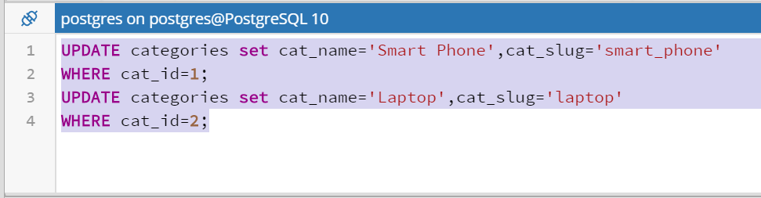
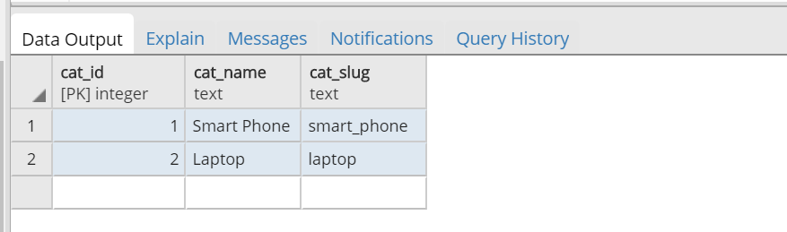
Query Update
Edit a category in category list

Slide 32
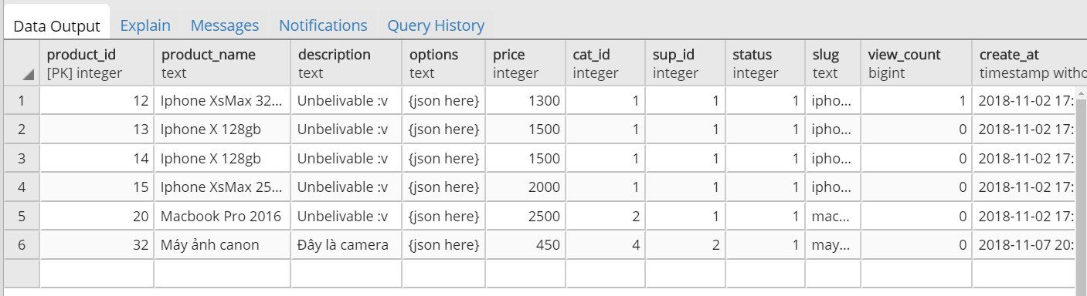
Query Update
Increment a viewer on a product
Update products set view_count = view_count+1,update_at=‘now()’ WHERE product_id=12

Slide 33
Query Update

Slide 34
Query Insert

Slide 35
Query Insert

Slide 36
Query Insert

Slide 37
Query Insert

