Slide 1
Project: Database design and query language
Members:
Nguyễn Hoàng Vũ – 18IT1 Team leader
Phan Thành Đạt – 18IT1 Team member
Quách Trọng Thái – 18IT1 Team member
Content: Design a database for a electronic webshop (selling laptop,phone,….) and write query sentence for features DBMS: PostgreSQL

Slide 2
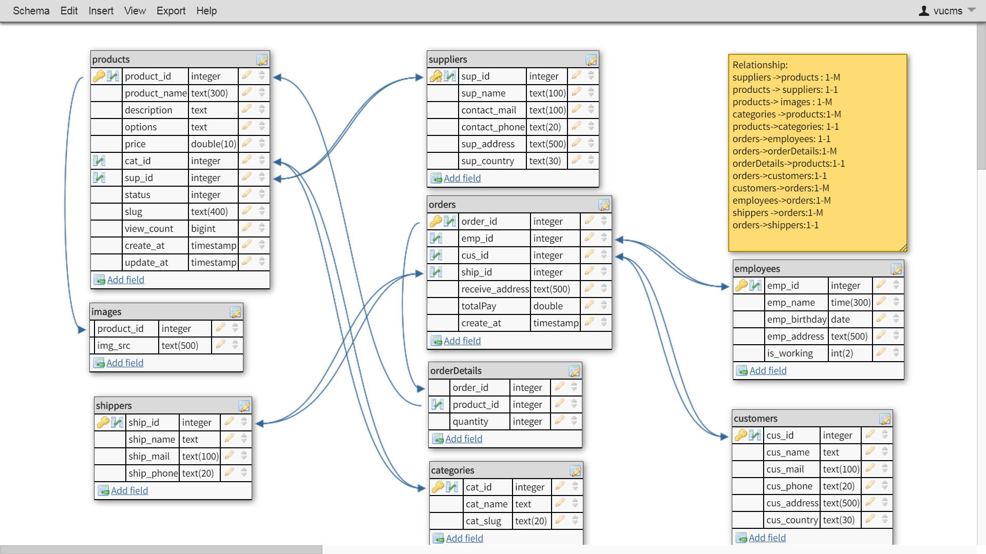
Database structure

Slide 3
Relationships
suppliers -> products : 1-M
products -> suppliers: 1-1
Products -> images : 1-M
categories -> products:1-M
Products -> categories: 1-1
Orders -> employees: 1-1
Orders -> orderDetails: 1-M
orderDetails -> products: 1-1
Orders -> customers: 1-1
Customers -> orders: 1-M
Employees -> orders: 1-M
shippers -> orders: 1-M
Orders -> shippers: 1-1

Slide 4
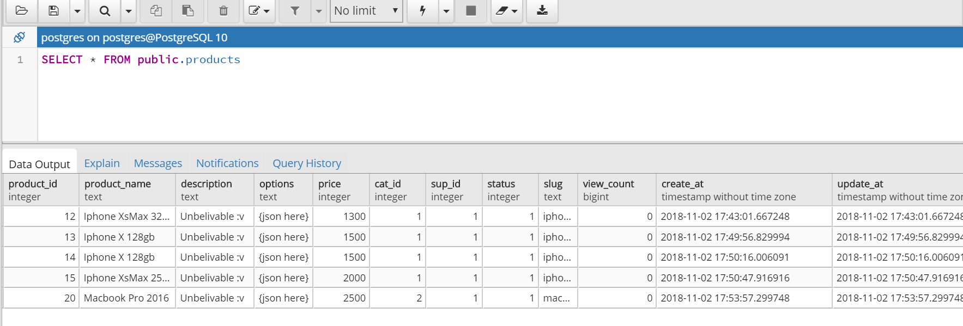
Query Selector
Select all informations of all products in table products

Slide 5
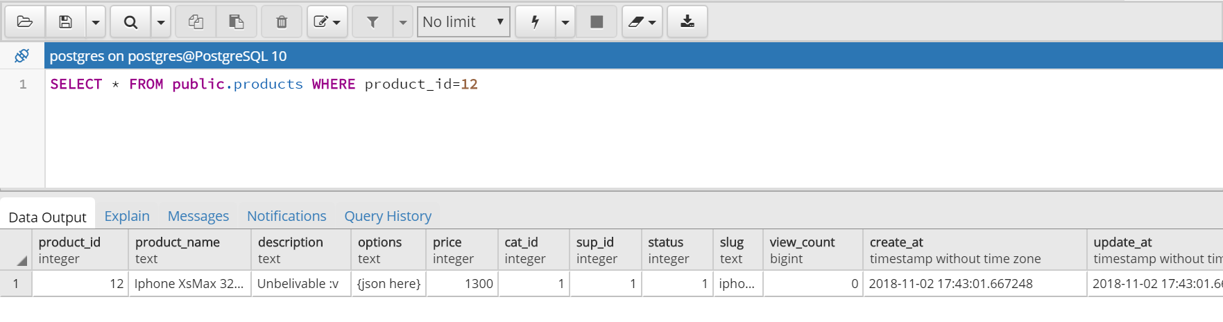
Query Selector
Select informations of a product in table products by product_id (Primary Key)

Slide 6
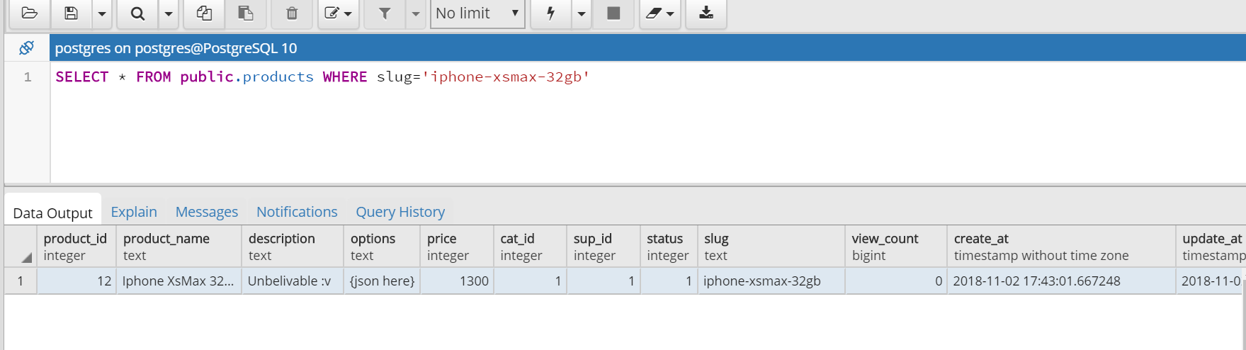
Query Selector
Select informations of a product in table products by slug (unique)

Slide 7
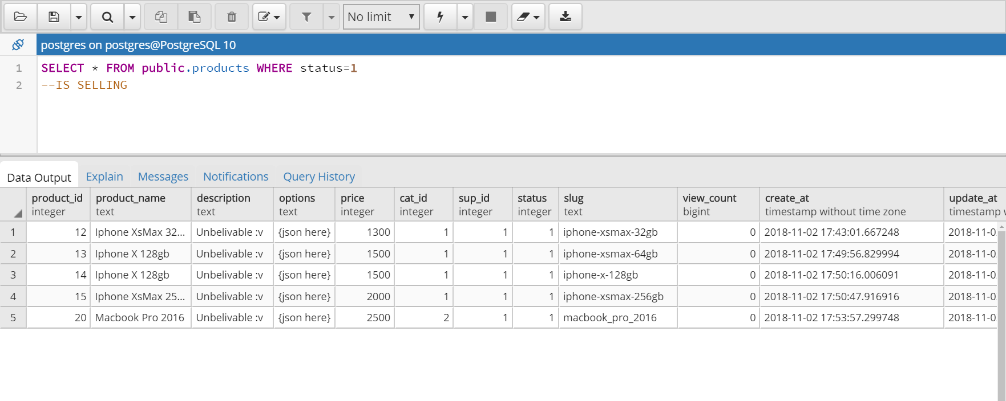
Query Selector
Select all products which are selling status==1 => selling status==0 => stop selling

Slide 8
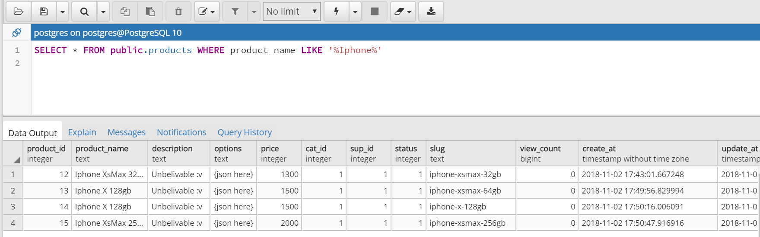
Query Selector
Search products by english keyword

Slide 9
Query Selector
Search products by vietnamese keyword

Slide 10
Query Selector
Select informations of all products in table products

Slide 11
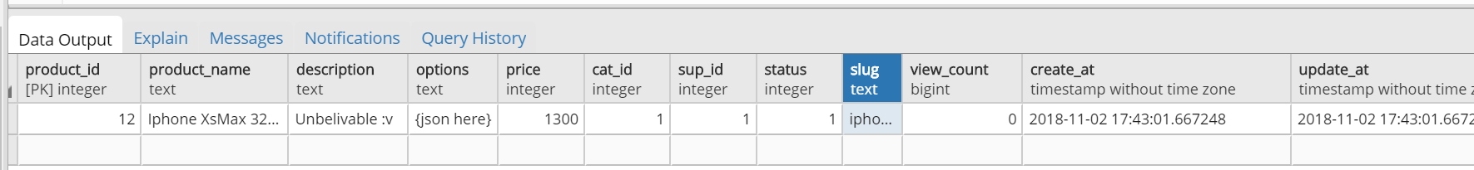
Query Insert
Insert new products into table products INSERT INTO public.products(
product_id, product_name, description, options, price,
cat_id, sup_id, status, slug, view_count, create_at, update_at)
VALUES (12, 'Iphone XsMax 32gb', 'Unbelivable :v ', '{json here}', 1300, 1, 1, 1,'iphone-xsmax-32gb', 0, 'now()', 'now()');
Result:

Slide 12
Query Insert

Slide 13
Query Insert

Slide 14
Query Insert

Slide 15
Query Insert

