Slide 1




SMART INDIA HACKATHON 2026
  Problem Statement Title - StatSkill AI: AI-Assisted Skill Assessment & Competency Calibration Platform
  Problem Statement / Idea ID - 21121
  Theme - Smart Education | PS Category - Software
  Team ID - 176704
  Team Name - AIZENIX

Slide 2
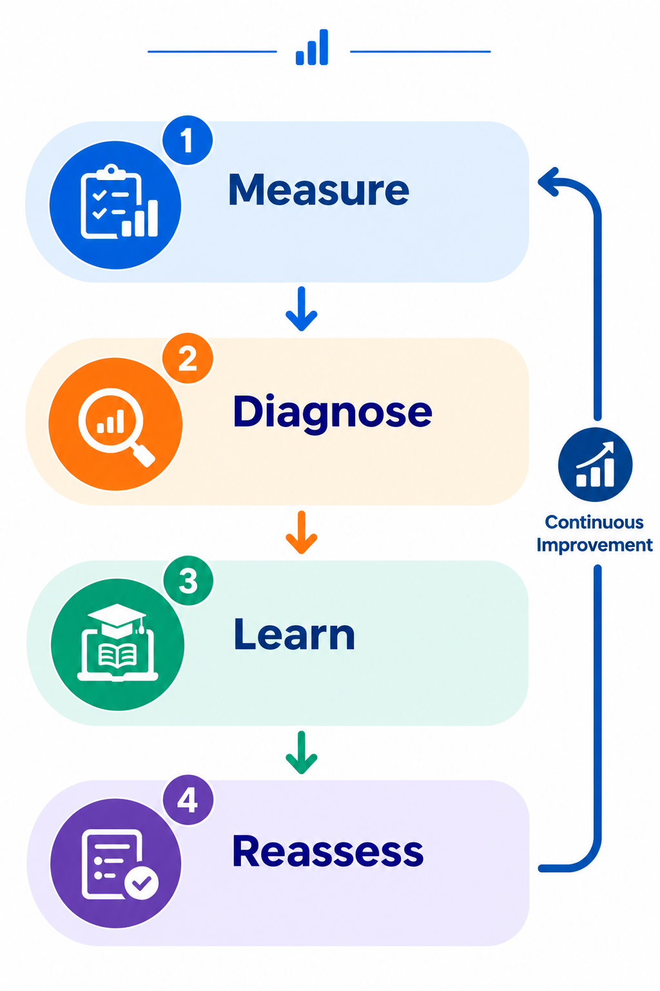
StatSkill AI — Competency Layer for iGOT Karmayogi
AIZENIX
  Proposed Solution
  Profiles each candidate/officer (role, experience, past training) & scores competency across 4 core domains to isolate exact skill gaps using deterministic zero-hallucination logic.
  Recommends personalized iGOT Karmayogi / NSSTA-TPAC courses, tracks completion via iGOT APIs & re-scores after learning — a continuous
  Measure → Diagnose → Learn → Reassess loop
  Flagship: trainer uploads a PDF/PPT/DOCX → AI extracts key concepts and generates trainer-reviewed MCQs with rationales; sits ON TOP of iGOT as an intelligence layer, not a replacement.
2
Notes:
1.7.2013
2

Slide 3
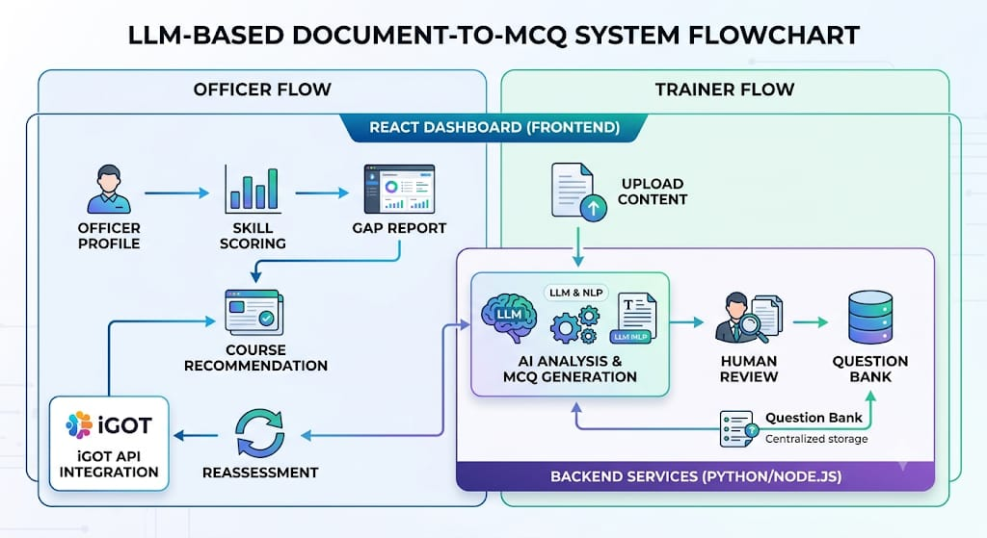
TECHNICAL APPROACH
AIZENIX
Frontend: React.js 18, Interactive Dashboards, Recharts (Radar & Bar comparison)
Backend: Node.js / Express REST APIs, Deterministic Competency-Scoring Engine
AI / NLP: Google Gemini Multimodal APIs, Document Parsing (PDF/DOCX), MCQ Generation
RBAC: Role-Based Access Control, Server-Side Trainer Passcode Validation
SSO & Security: Single Sign-On, Secure Firebase Authentication, DPDP Act 2023 Compliance
API: iGOT REST API Federation Ready, Zero-Infrastructure Serverless Cloud
3
Notes:
1.7.2013
3

Slide 4

FEASIBILITY AND VIABILITY
AIZENIX
MCQ Generation: Can be built using Google Gemini LLM and document parsing technology.
Competency Scoring: Developed with pure algorithmic logic ensuring 100% mathematical consistency.
Recommendations: Suggests relevant iGOT micro-courses mapped directly to competency gaps.
Challenges:
  • No direct access to iGOT production APIs.
  • Candidate and officer data privacy and security concerns.
  • Need for an accurate, standardized competency framework.
Solution:
  • Start with standardized mock/sandbox iGOT schemas; transition to live gateway via institutional MoU.
  • Get official API access gradually through institutional partnership.
  • Implement strict DPDP Act 2023 anonymization, server-side auth, and government cloud standards.
  • Co-develop the competency framework with NSSTA / MoSPI experts, scaling to RPL frameworks.
4
Notes:
1.7.2013
4

Slide 5

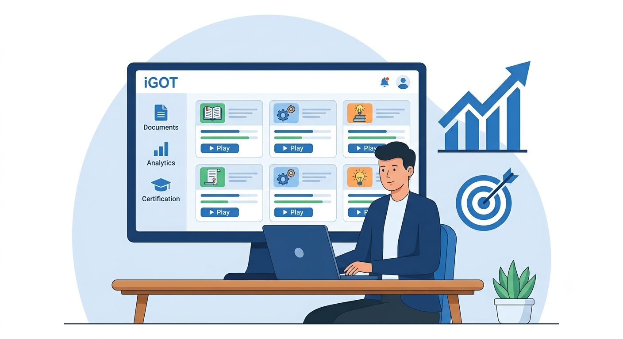




IMPACT AND BENEFITS
AIZENIX
Faster, targeted upskilling for
candidates & statistical officers in 15-min micro-learning sprints
Better utilization of existing iGOT content instead of hunting through an unsorted course catalogue.
Cuts manual course-curation and quiz-writing load on trainers by 80% via automated document ingestion.
Gives measurable training-effectiveness data and real-time national competency heatmaps.
Competency model is extensible to other government cadres and nationwide RPL certification.
5
Notes:
1.7.2013
5

Slide 6

RESEARCH AND REFERENCES
AIZENIX
  iGOT Karmayogi / Mission Karmayogi FRAC framework — igotkarmayogi.gov.in
  NSSTA / TPAC training resources — nssta.gov.in
  MoSPI official statistics resources — mospi.gov.in | DPDP Act 2023 Microdata Standards
  Live Prototype: https://statskill-ai-five.vercel.app
  GitHub Repository: https://github.com/iamwarriorofmyuniverse-coder/statskill-ai
6
Notes:
1.7.2013
6

